Slide 1
Trees, People and the Built Environment 1st April 2014
Dr William Bird MBE
CEO Intelligent Health and GP

Slide 2
Mankind has evolved well
If we take an hour to equal 1000 years then four days is 100,000 years; the time from the origin of mankind to today.
80 seconds ago
10 hours ago
4 hours ago
9 minutes ago
4 Days ago
100,000 yrs ago
Hunter gatherers
10,000 yrs ago
Agriculture
Technology
4000 yrs civilisation
industrialisation
Notes:
If you had developed a computer programme solidly for 4 days and 4 nights and was given 9 minutes to change the entire system you would have a laugh.

Slide 3
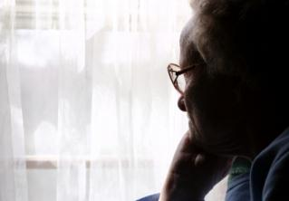
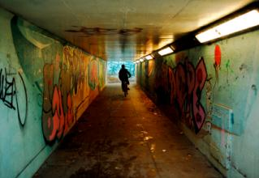
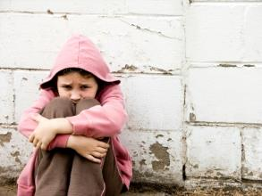
Causes of Stress and Free Radicals
People
Place
Purpose
Chronic Stress

Slide 4
Causes of Stress and Free Radicals
People
Place
Purpose
Chronic Stress

Slide 5
Place
“Better health and wellbeing can be achieved by promoting recreation, access, understanding and enjoyment of the natural environment. All form part of our purpose.”
Natural England (UK Government)
Notes:
Its where we started and where we will end up. The bit in the middle is where we are now.

Slide 6
Causes of Stress and Free Radicals
People
Place
Purpose
Chronic Stress

Slide 7
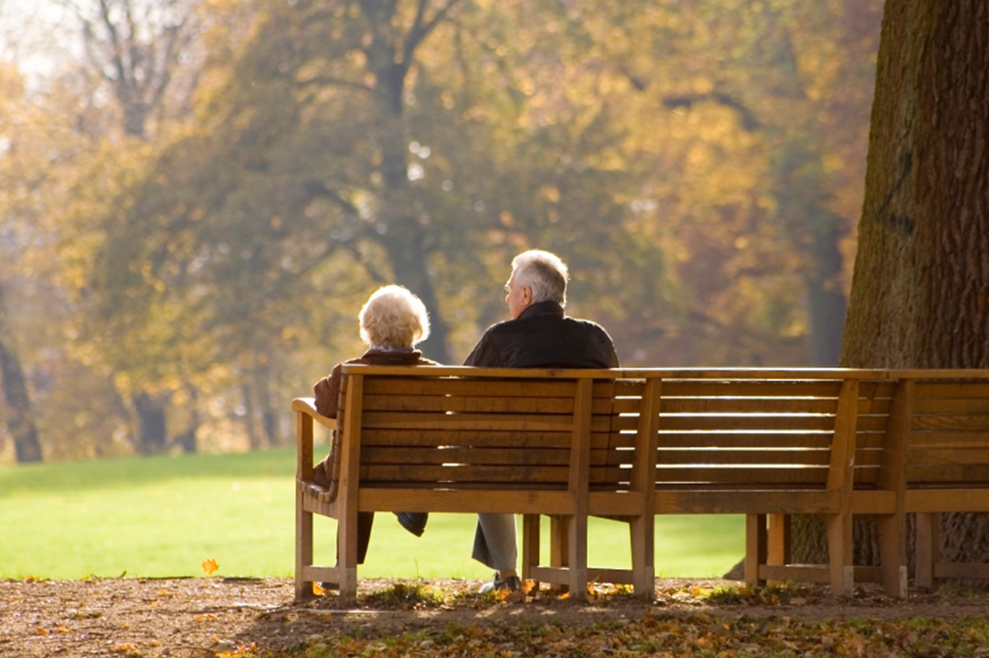
Green Space increases social contact and the sense of “belonging” within a community
Maas, J.; van Dillen, S.M.E.; Verheij, R.A.; Groenewegen, P.P. Social contacts as a possible mechanism behind the relation between green space and health. Health Place 2009, 15, 586–595.

Slide 8
Chronic Stress
Physical Inactivity
Smoking, Alcohol, Diet

Slide 9
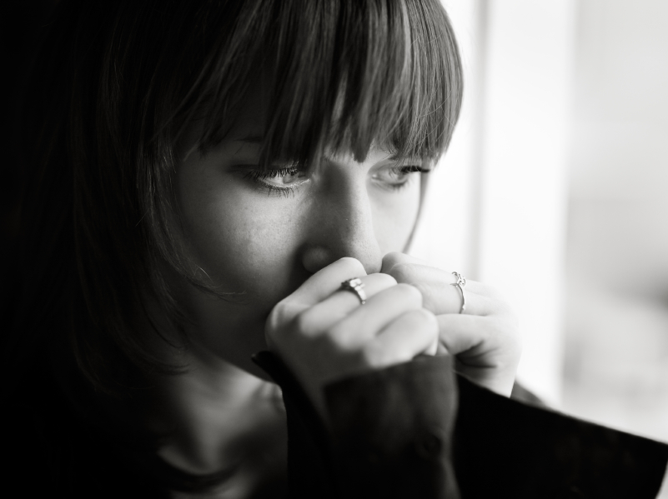
Physical Activity & Stress
Physical activity improves the body’s response to stress¹
Chronic stress reduces levels of physical activity².
1 Rimmele et al (2009)
2 Vitaliano P et al (2002)
Notes:
Positive feedback takes place

Slide 10
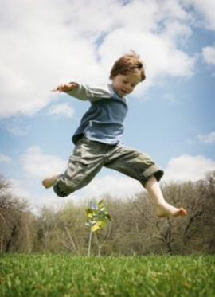
Why does Nature Make us Less Stressed?
Biophilia
The direct effects of nature on the brain
Less bad things
Noise, pollution, excess heat,
poor aesthetics
More Enjoyment
Physical activity, social interaction

Slide 12
Sedentary
Oxidative Phosphorylation
Reactive Oxidative
Species
Anti-Oxidants
Mitochondrial DNA
Mitochondria

Slide 13
Physically Active
Reactive Oxidative Species
Oxidative Phosphorylation
Anti-oxidants
Mitochondrial DNA
Mitochondria

Slide 14
e
People Purpose Place
Chronic Stress
Stress Hormones
Mitochondrial damage / Inflammation
Physical Inactivity
And other poor health behaviours
Mitochondria as a key component of the stress response.
Manoli et al. Trends in Endocrinology and Metabolism Vol 18 No 5 2007
Anxiety
Cancers
Cardiovascular
Diabetes
Dementia
Notes:
Most people setting up PA schemes forget the Chronic Stress lies between the problem and PA.

Slide 15
Place: Green space reduces Health Inequalities
Mitchell, R. and Popham, F. (2008) Effect of exposure to natural environment on health inequalities: an observational population study. The Lancet 372(9650):pp. 1655-1660.
Notes:
Individuals who are exposed to the greenest environments also have lowest levels of health inequality related to income.
Physical environments that promote good health might be important to reduce socioeconomic health inequalities.

Slide 16
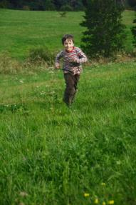
Key attributes to increased use of green space
Perceived quality and safety of local green space.
Good access to green space and lack of antisocial behaviour on the way.
Ward Thompson C, Aspinall P; Natural Environments and their Impact on Activity, Health, and Quality of Life. Applied Psychology: Health and Wellbeing, 2011, 3 (3), 230–260

Slide 17
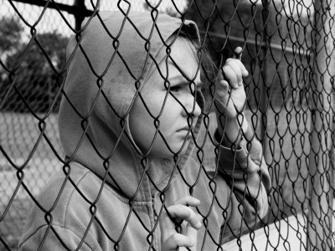
Foster distinctive, attractive communities with a strong sense of place

Slide 18
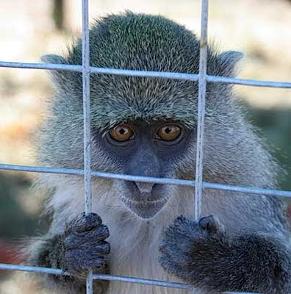

Slide 19
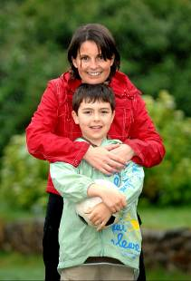
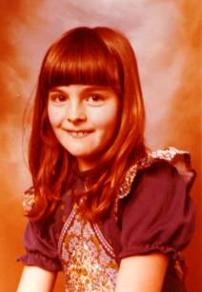
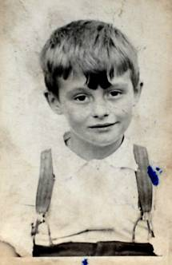
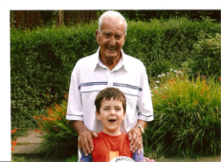

Slide 20
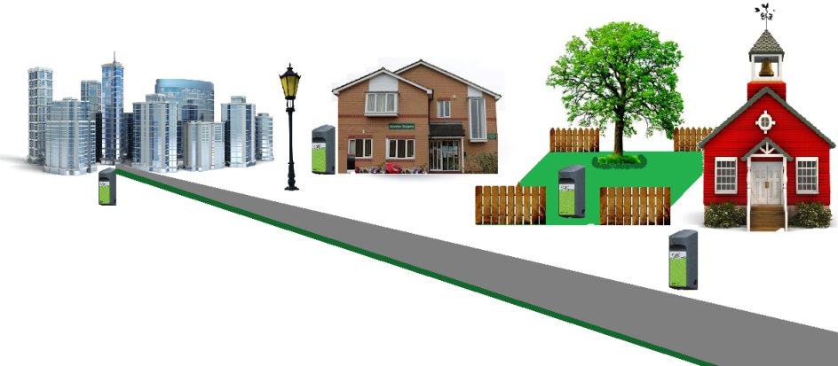
Getting People Outdoors
Park
Work
GP
Street
School
Sport

Slide 21
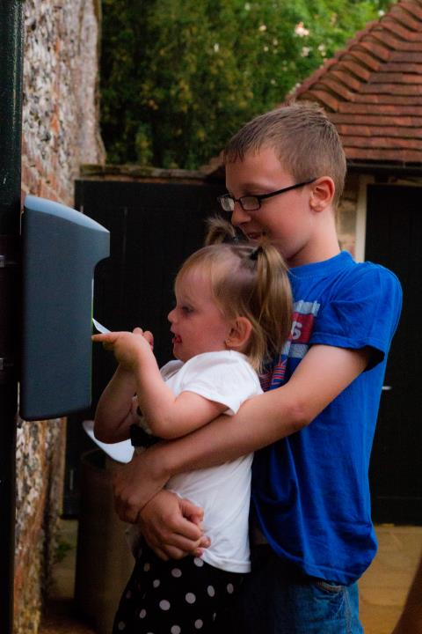
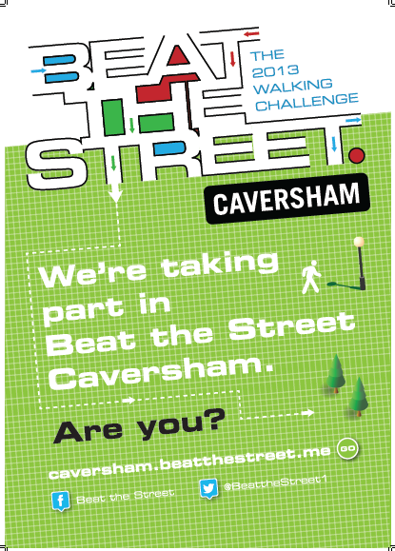

Slide 22
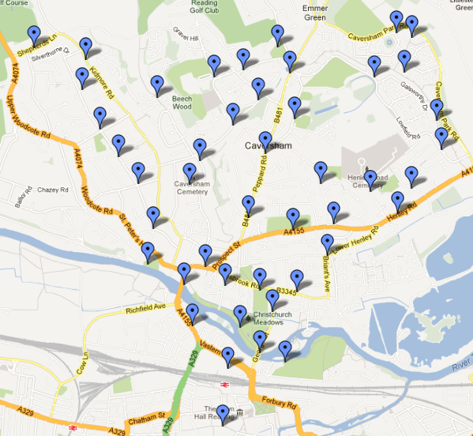
Beat the Street (Local)
Sensors placed at bus stops, shops, schools and surgeries in Caversham (population 30,000).
10,000 cards distributed by: Schools, GPs, Work.
Aim to walk or cycle around the world (twice)over 3 months
More walking the more books donated to schools
Spot prize every week
School leaderboard

Slide 23
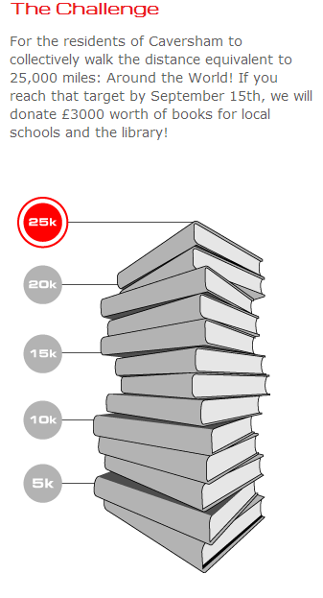
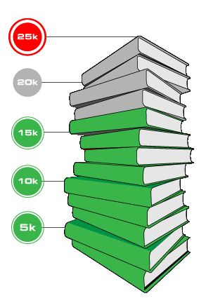
Beat the Street (Local)
250,0000 swipes
50,000 miles walked / cycled
£6000 raised for books
20% of whole population participating
All schools, all GPs, most businesses participated

Slide 24
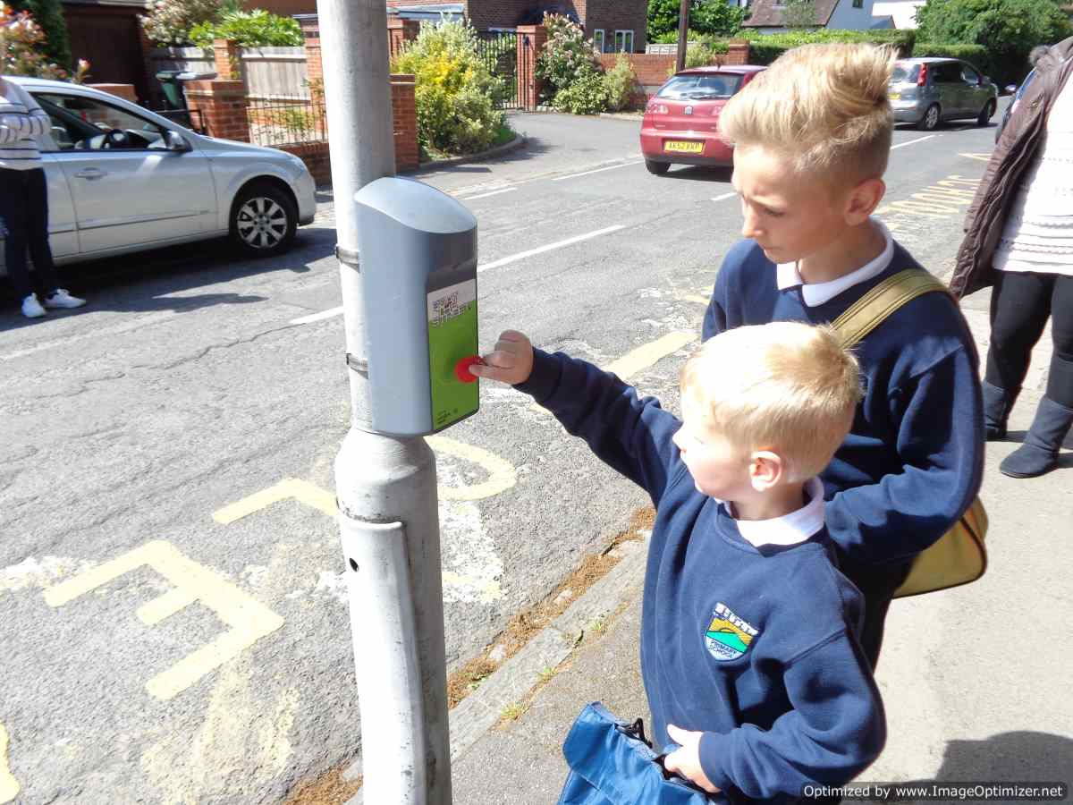

Slide 25
Reasons to take part in Beat the Street

Slide 26
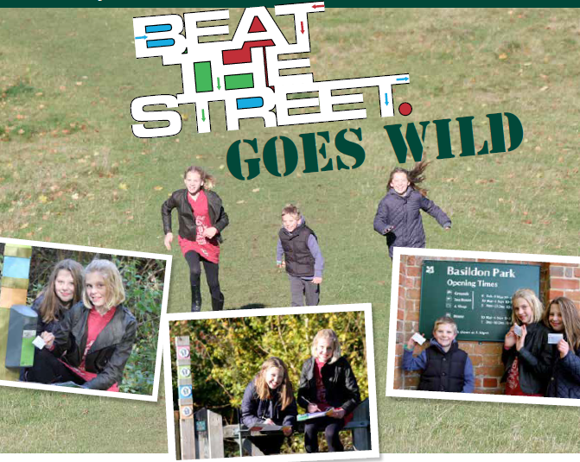

Slide 27
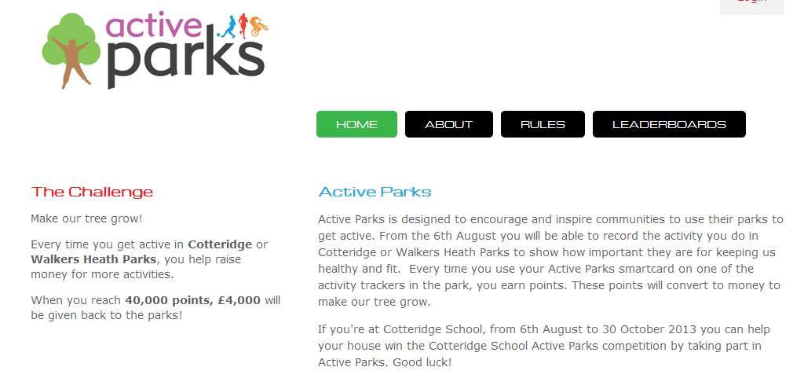
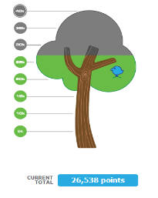

Slide 28
The Health principles of Green Space
Natural Green Space is fundamental to health and the prevention of disease.
Place influences social connections and activity levels that in turn influence resilience.
Make Green Space accessible safe and cared for. It all counts.
Providing a positive outdoor experience is an essential first step.

Slide 29
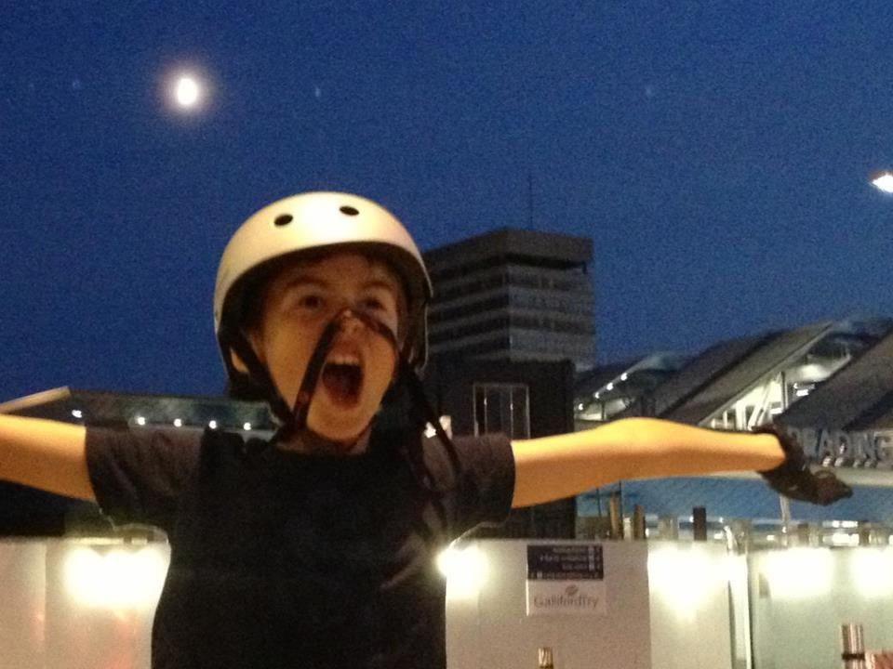
(No) Sweat!
Thank You
william.bird@intelligenthealth.co.uk

