Slide 1
Post-Brexit Britain in A World of Preferential Trade Agreements (PTAs)
University of Birmingham, School of Law
24 February 2017
A Legal Framework Analysis of Britain in A Post-Brexit World of Regional Trade Agreements (RTAs)
Rafael Lima Sakr

Slide 2
Outline
Overview of Brexit/Trump Phenomenon
Overview of Research Project on WTO Law of South-North RTAs
Legal Framework Analysis of Post-Brexit Britain

Slide 3
Overview
of
Brexit and Trump

Slide 4
Brexit and Trump
How did we get here?
[Or, why do we have to think about Britain in a Post-Brexit world of preferential trade agreements?]

Slide 5
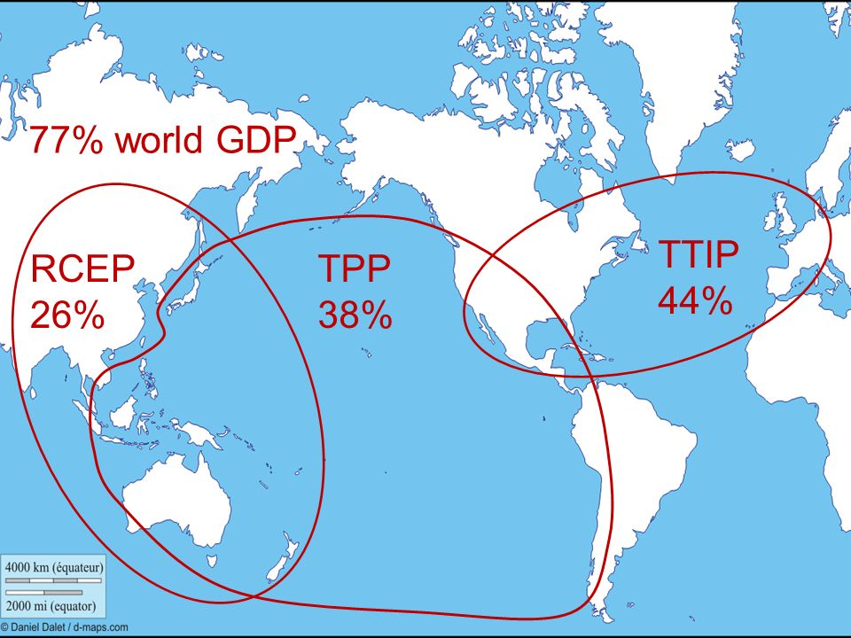
Brexit and Trump
The World Before Brexit/Trump…
Trauma: 2008 Global Financial Crisis
Existing Problem: The Great Recession
Expert Solution: Trade Liberalization
Policy Strategy: Mega-Blocs Regionalism (TTP, TTIP, RCEP)
Legal Technique: WTO law and RTAs

Slide 6
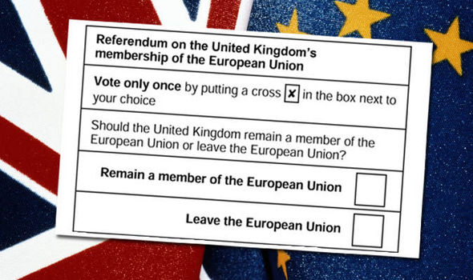
Brexit and Trump
The First Shock: the Brexit
Trauma: the Brexit referendum
Existing Problem: British Future Relationship with EU
Expert Solutions: Light versus Hard Brexit
Policy Strategy: Plan for a Global Britain
Expert Challenge: European-style economic integration was assumed to be a unidirectional and progressive process

Slide 7
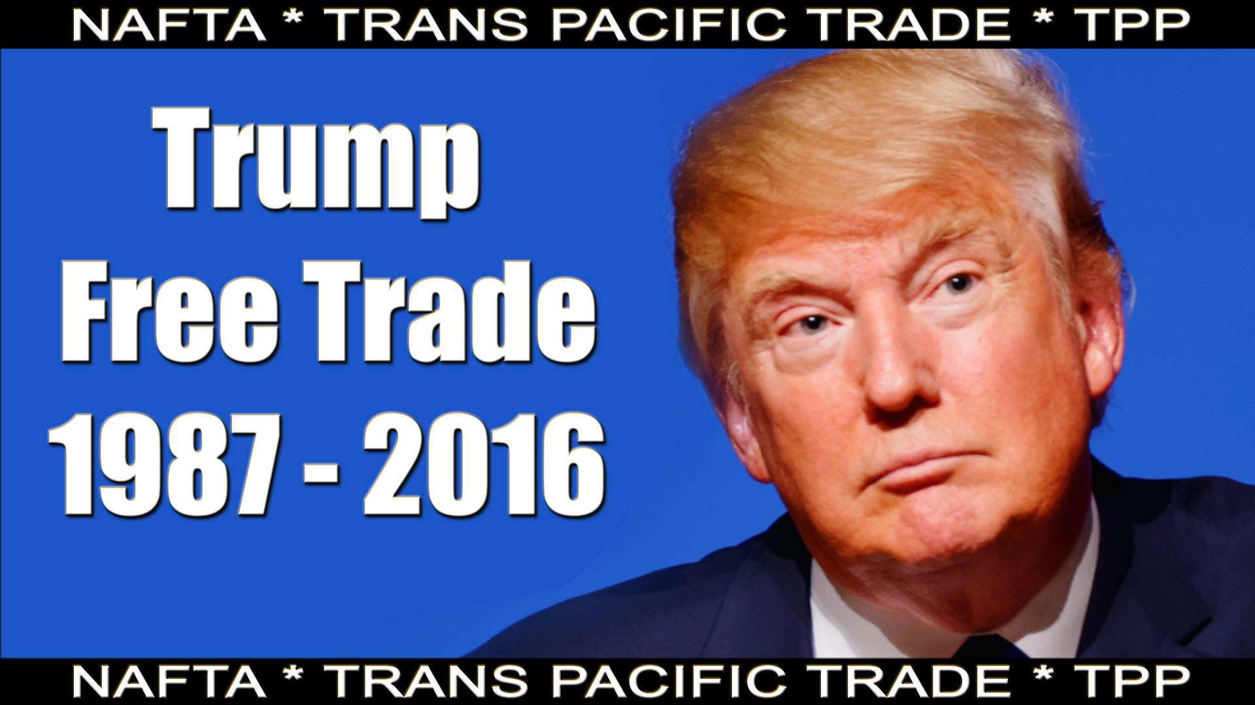
Brexit and Trump
The Second Shock: Trumpnomics
Trauma: U.S. election
Existing Problem: Demise of U.S. economy and the impoverishment of white working class due to economic globalisation and trade agreements
Expert Solution: Trade protectionism
Policy Strategy: Withdraw from TTP and Renegotiate NAFTA
Expert Challenge: trade liberalization through regional arrangements was regarded as the most adequate strategy to promote economic growth

Slide 8
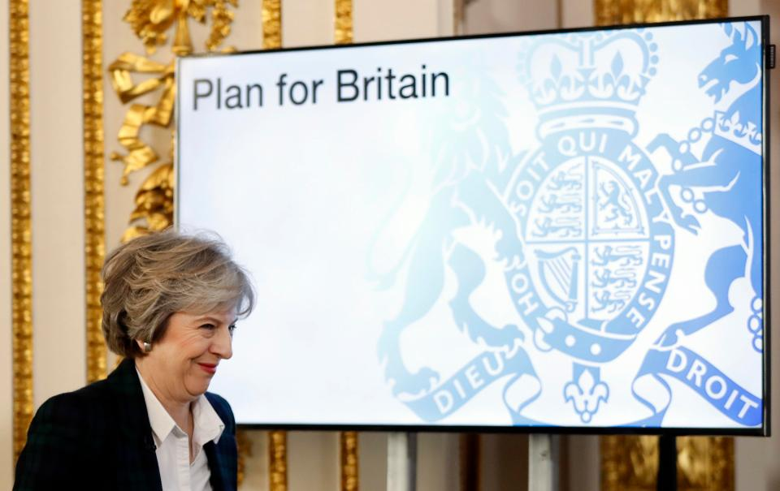
Brexit and Trump
Challenges
to
the WTO Law of Regional Trade Agreements

Slide 9
Trade Regionalism
Economic Development
South-North Regional Trade Regimes
WTO Law

Slide 10
Trade Regionalism
Why is trade regionalism important?

Slide 11
Trade Regionalism
GATT/WTO
Bilateral Commercial Treaties
Colonial Regimes
Regional Trade Agreements (RTAs)

Slide 12
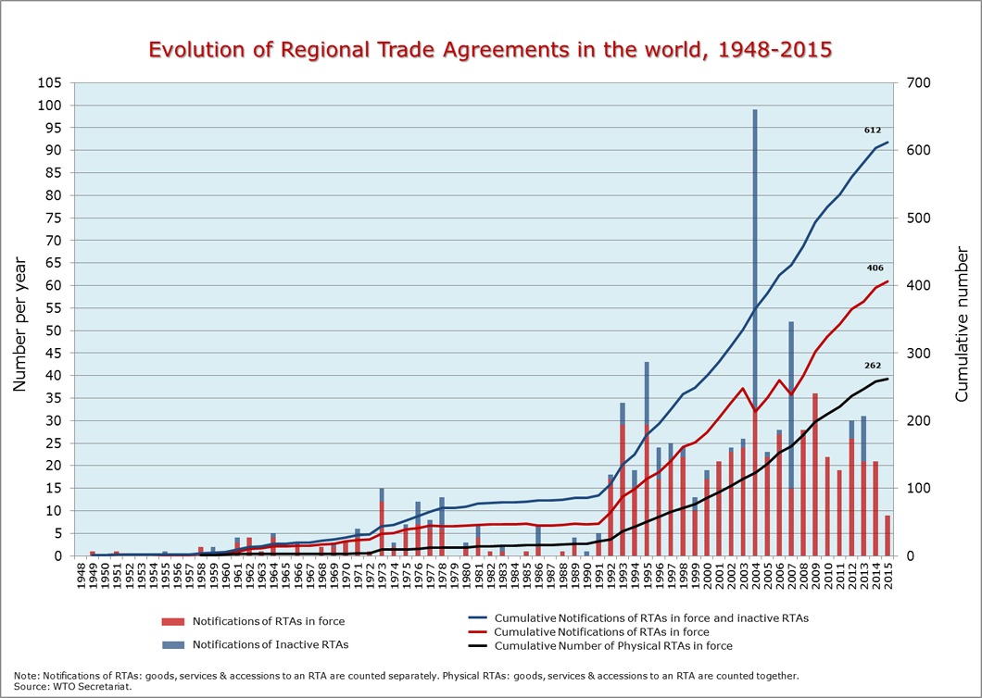
Trade Regionalism

Slide 13
Economic Development
How does Regionalism relate to Economic Development?

Slide 14
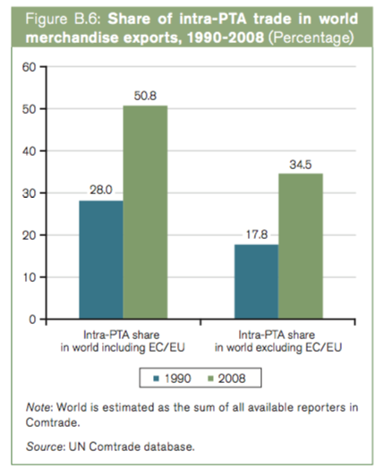
Economic Development

Slide 15
Economic Development
Neoclassical Economics of Trade Liberalization
Trade Creation
Occurs when the formation of a RTA leads to a shifting in the pattern of trade from a high-cost producers to a low-cost producer
Tends to improve welfare
Trade Diversion
Occurs when imports shift in the pattern of trade from a low-cost producer to a high-cost producer
Tends to worsen welfare

Slide 16
Economic Development
Bhagwati’s Arguments Against Regionalism
The formation of regional trade arrangements (RTAs) undermines the WTO
Regional Trade Agreements cause the erosion of non-discrimination principle
Regionalism is harmful because it encourages trade diversion

Slide 17
Economic Development
Krugman’s Arguments Favoring Regionalism
Trade diversion from RTAs is low because trading blocs are “natural” trading areas
Due to proximity and similarity of cultures and standards of living, regional trade agreements stimulate trade that would have occurred even in the absence of an agreement

Slide 18
WTO Law
How does WTO law relate to regionalism and economic development?

Slide 19
WTO Law
 | Provisions | Rules | Functions
General Rule | GATT Article I:1 | Most-Favored-Nation Clause | Non-Discrimination
Exceptions | GATT Article XXIV | Free Trade Agreements Customs Unions | Mutual Discriminatory Regional Regimes for Trade in Goods
 | GATT Article XXIV | Enabling Clause | Unilateral Discriminatory Regional Regimes for Trade in Goods
 | Other Exceptions

Slide 20
WTO Law
Article XXIV
Internal View
Too Flexible
External View
Cause Erosion
Too Rigid
Constrain Negotiators
Contradiction /
Tension

Slide 21
Overview
of
Research Project on WTO Law of South-North RTAs

Slide 22
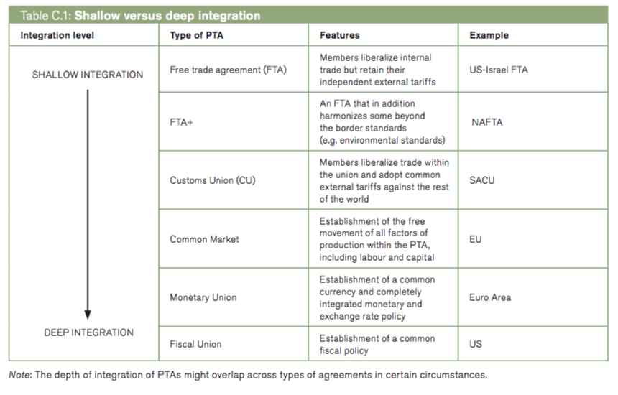
Research Project
RTAs Archetypes
Source: WTO World Trade Report 2011

Slide 23
Research Project
WTO Law of Regional Trade Agreements
Trade-Centrism
Source: WTO World Trade Report 2011

Slide 24
Research Project
Preliminary Hypothesis
Over the last 20 years countries everywhere, either developed or developing, have been engaged in negotiating the same dominant model of trade-centric RTAs without conceiving any other option. The underlying hypothesis is that the lack of alternatives is caused by the fact that experts in international trade law have thought and debated only through a singular pair of lens how to design South-North RTAs. Consequently, new ideas and practices have been marginalized in WTO governance.

Slide 25
Legal Framework Analysis
of
Britain in a Post-Brexit World of RTAs

Slide 26
Britain in a Post-Brexit World
Questions for Future Research
Is the South-North RTA vision also dominant in the U.K. trade interactions with their developed trading partners?
Has Brexit challenged in any way this orthodox view?

Slide 27
Britain in a Post-Brexit World
Legal Theory of Argumentation Frameworks
Definition
Legal Frameworks do NOT refer to a System of Rules and Institutions.
Legal Frameworks are defined as intermediary discursive structures that perform two main functions.

Slide 28
Britain in a Post-Brexit World
Legal Theory of Argumentation Frameworks
Two Functions
Legal Doctrine: Inside international economic law expertise, legal frameworks are used to assign meaning to legal texts by mediating the complexity of socioeconomic relations and the contradictions of trade law.
Legal Mode of Governance: Outside international economic law expertise, legal frameworks are employed to control lawmaking and legal interpretations in global economic governance.

Slide 29
Britain in a Post-Brexit World
A Legal Framework Analysis of 1947-1980 South-North RTAs
Argument: The South-North RTAs were constructed and operated by 3 legal frameworks
Law and Integration Framework
EU-Turkey RTA (1963)
EU-Malta (1970)
EU-Cyprus (1973)
Law and Trade Cooperation Framework
Law and Economic Development Framework
EU-Tunisia RTA (1969)
EU-Morocco RTA (1969)
EU-Israel RTA (1970)
EU-Egypt RTA (1972)
EU-Lebanon RTA (1972)
EU-Israel RTA (1975)
EU-Algeria RTA (1976)
EU-Tunisia RTA (1976)
EU-Morocco RTA (1976)
EU-Jordan RTA (1977)
EU-Egypt RTA (1978)
EU-Lebanon (1978)
EU-Syria (1978)
EU-Yugoslavia (1980)
Yaoundé I (1963)
Lomé I (1975)
Yaoundé II (1969)
Lomé II (1979)
Finland-Bulgaria (1974)
Finland-Czechoslovakia (1974)
Finland-Hungary (1974)
Finland-Poland (1974)
Australia-Papua New Guinea (1976)

Slide 30
Britain in a Post-Brexit World
A Legal Framework Analysis of 1980-2010 South-North RTAs
Argument: The South-North RTAs were constructed and operated by 1 legal framework (so-called Law and Trade Framework)
Political Economy
Legal System
Global Governance Institutions
Legal Framework

Slide 31
Britain in a Post-Brexit World
Law and Trade Framework for South-North RTAs
Political Economy
Legal System
Global Governance Institutions
Global Project for Trade Liberalization
WTO as Legal Authority
WTO as Institutional Model
WTO law as international law treaty
WTO law as legal vocabulary of concepts and practices
Trade-Centric Regionalism

Slide 32
Britain in a Post-Brexit World
A Legal Framework Analysis of Britain in a Post-Brexit World of RTAS
Does Brexit threat the Law and Development Framework?

Slide 33
Britain in a Post-Brexit World
Brexit Strategies
WTO Member
EU-UK RTA
EU-UK RTA+
EU-Turkey Model
EU-Switzerland Model
EU-Norway Model
Trade-Centrism

Slide 34
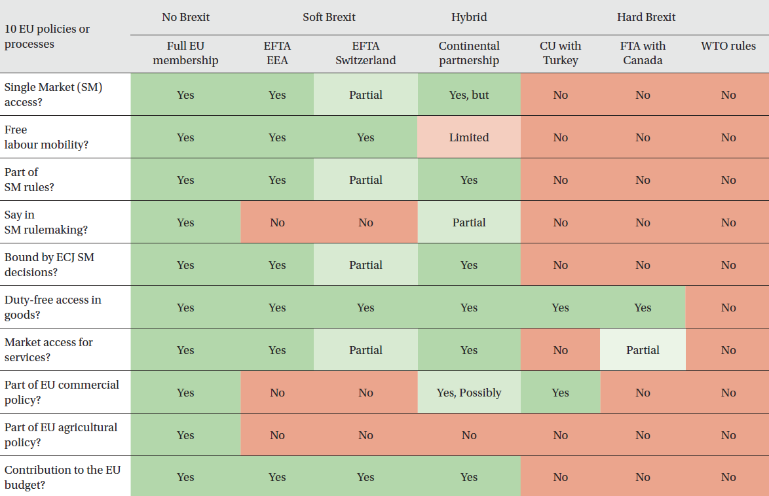
Britain in a Post-Brexit World
Trade-Centrism

Slide 35
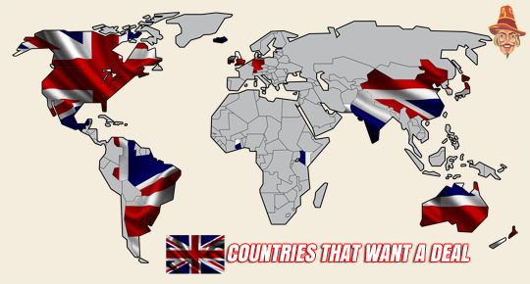
Britain in a Post-Brexit World

Slide 36
Thank You
Rafael Sakr
r.lima-sakr@lse.ac.uk

