Slide 1
Intra-Democratic Variations in Trade Policies: A Comparative Case Study of the Preferential Trade Agreements of Korea and Japan with ASEAN
Zoe Sohyun Lee
Phd candidate in international relations
University of Birmingham
24 feb 2017

Slide 2
Contents
1. Introduction
2. Analytical Framework
3. Korea
4. Japan
5. Korea and Japan in Comparison
6. Conclusion

Slide 3
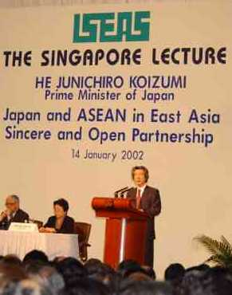
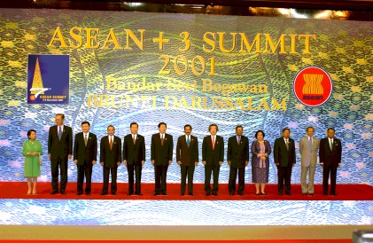
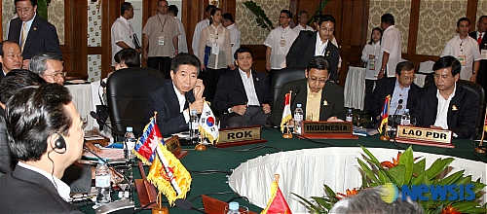
I. Introduction
Nov. 2001 – CAFTA Framework
Jan. 2002 – AJCEP announced
Nov. 2002 – KAFTA announced
(Source: http://japan.kantei.go.jp/koizumiphoto/)

Slide 4
Japan and Korea’s Negotiation preferences toward ASEAN
JAPAN
KOREA

Slide 5
The Supply-Side Explanation
Korea: a few individuals
Japan: numerous key players.
The argument: institutional variations, distributing varying degrees of power to the decision-makers.

Slide 6
Dynamic Systems Model
Atypical principal-agent model (Krause 1996)
Intra-democracy variations
Several assumptions:
Strong executive – centralization, liberalizing, flexible
Strong legislative – decentralization, protectionist, delays
Bureaucracy discretion.

Slide 8
Korea’s Institutionalization of FTAs
Treaty negotiation authority to President (Article 73), National Assembly only in ratification process (Article 60)
Administrative jurisdiction over trade under MOFAT.
Executive-Bureaucracy relations unaffected by the party.

Slide 9
The FTA Roadmap 2003 Partner Selection Criteria: Economic benefit Political and diplomatic implications Counterparty’s will Whether the FTA with the partner will help promote FTAs with big and advanced economies Strategies simultaneous multitrack strategy with advanced and big economies Short term goals: Japan, Singapore, ASEAN, Canada, EFTA, Mexico, Chile Medium & long-term goals: China, India, the US, the EU, Korea-China-Japan, EAFTA, MERCOSUR

Slide 10
Korea-ASEAN FTA
Short-term goal, considering 5 year single-term presidency
Negotiation approaches, scope, and degree of liberalization: discretion to bureaucrats.
Trade Minister Kim Hyun Chong’s push for efficiency and high liberalization.

Slide 11
Japan’s Institutionalization of FTAs
The Cabinet has trade negotiation authority, but approval from Diet is needed ‘depending on circumstances.’ (Article 73)
LDP factionalism, division along sectoral interests, strong bureaucracy discretion
Koizumi Cabinet as an exception? No substantial institutionalization.

Slide 12
Competition of Strategies for ASEAN
Koizumi’s announcement of AJCEP in January 2002
Negotiation Approach: MOFA vs METI
Trade Scope & degree of liberalization: METI vs MAFF
Final product:
Bilateral EPAs similar to JSEPA.
Japan will not pick and choose ASEAN counterpart.
Integration under AJCEP and further EA Community.

Slide 13
Korea & Japan in Comparison
Korea: Strong Executive + Bureaucracy (Case #3)
De jure institutionalization. Strategies shaped prior to the negotiation.
Centralization, liberalization
Japan: Strong Legislative + Bureaucracy (Case #4)
De facto institutionalization. Strategies shaped along with the negotiation.
Decentralization, slow progress, limited liberalization

Slide 14
Conclusion
Strong executive → centralization in FTA policies
‘How much is too much?’

