Slide 1
Complementary Food Hygiene Programme Activities in The Gambia
Photos from the campaign

Slide 2
Day 1
Introducing the project to the village
Performing the drama
Village volunteers

Slide 3
Breakdown of Day 1
Meeting the village head
Entry point into the village
Household visits
Involves the whole community
Announcing the team’s presence to the village
Using drumming and a campaign song
Afternoon event
Drumming, songs, prayers, drama, Q&A, animation video, competition announced, photos of pledged mothers taken and displayed
Training community volunteers
Training by community volunteers

Slide 4
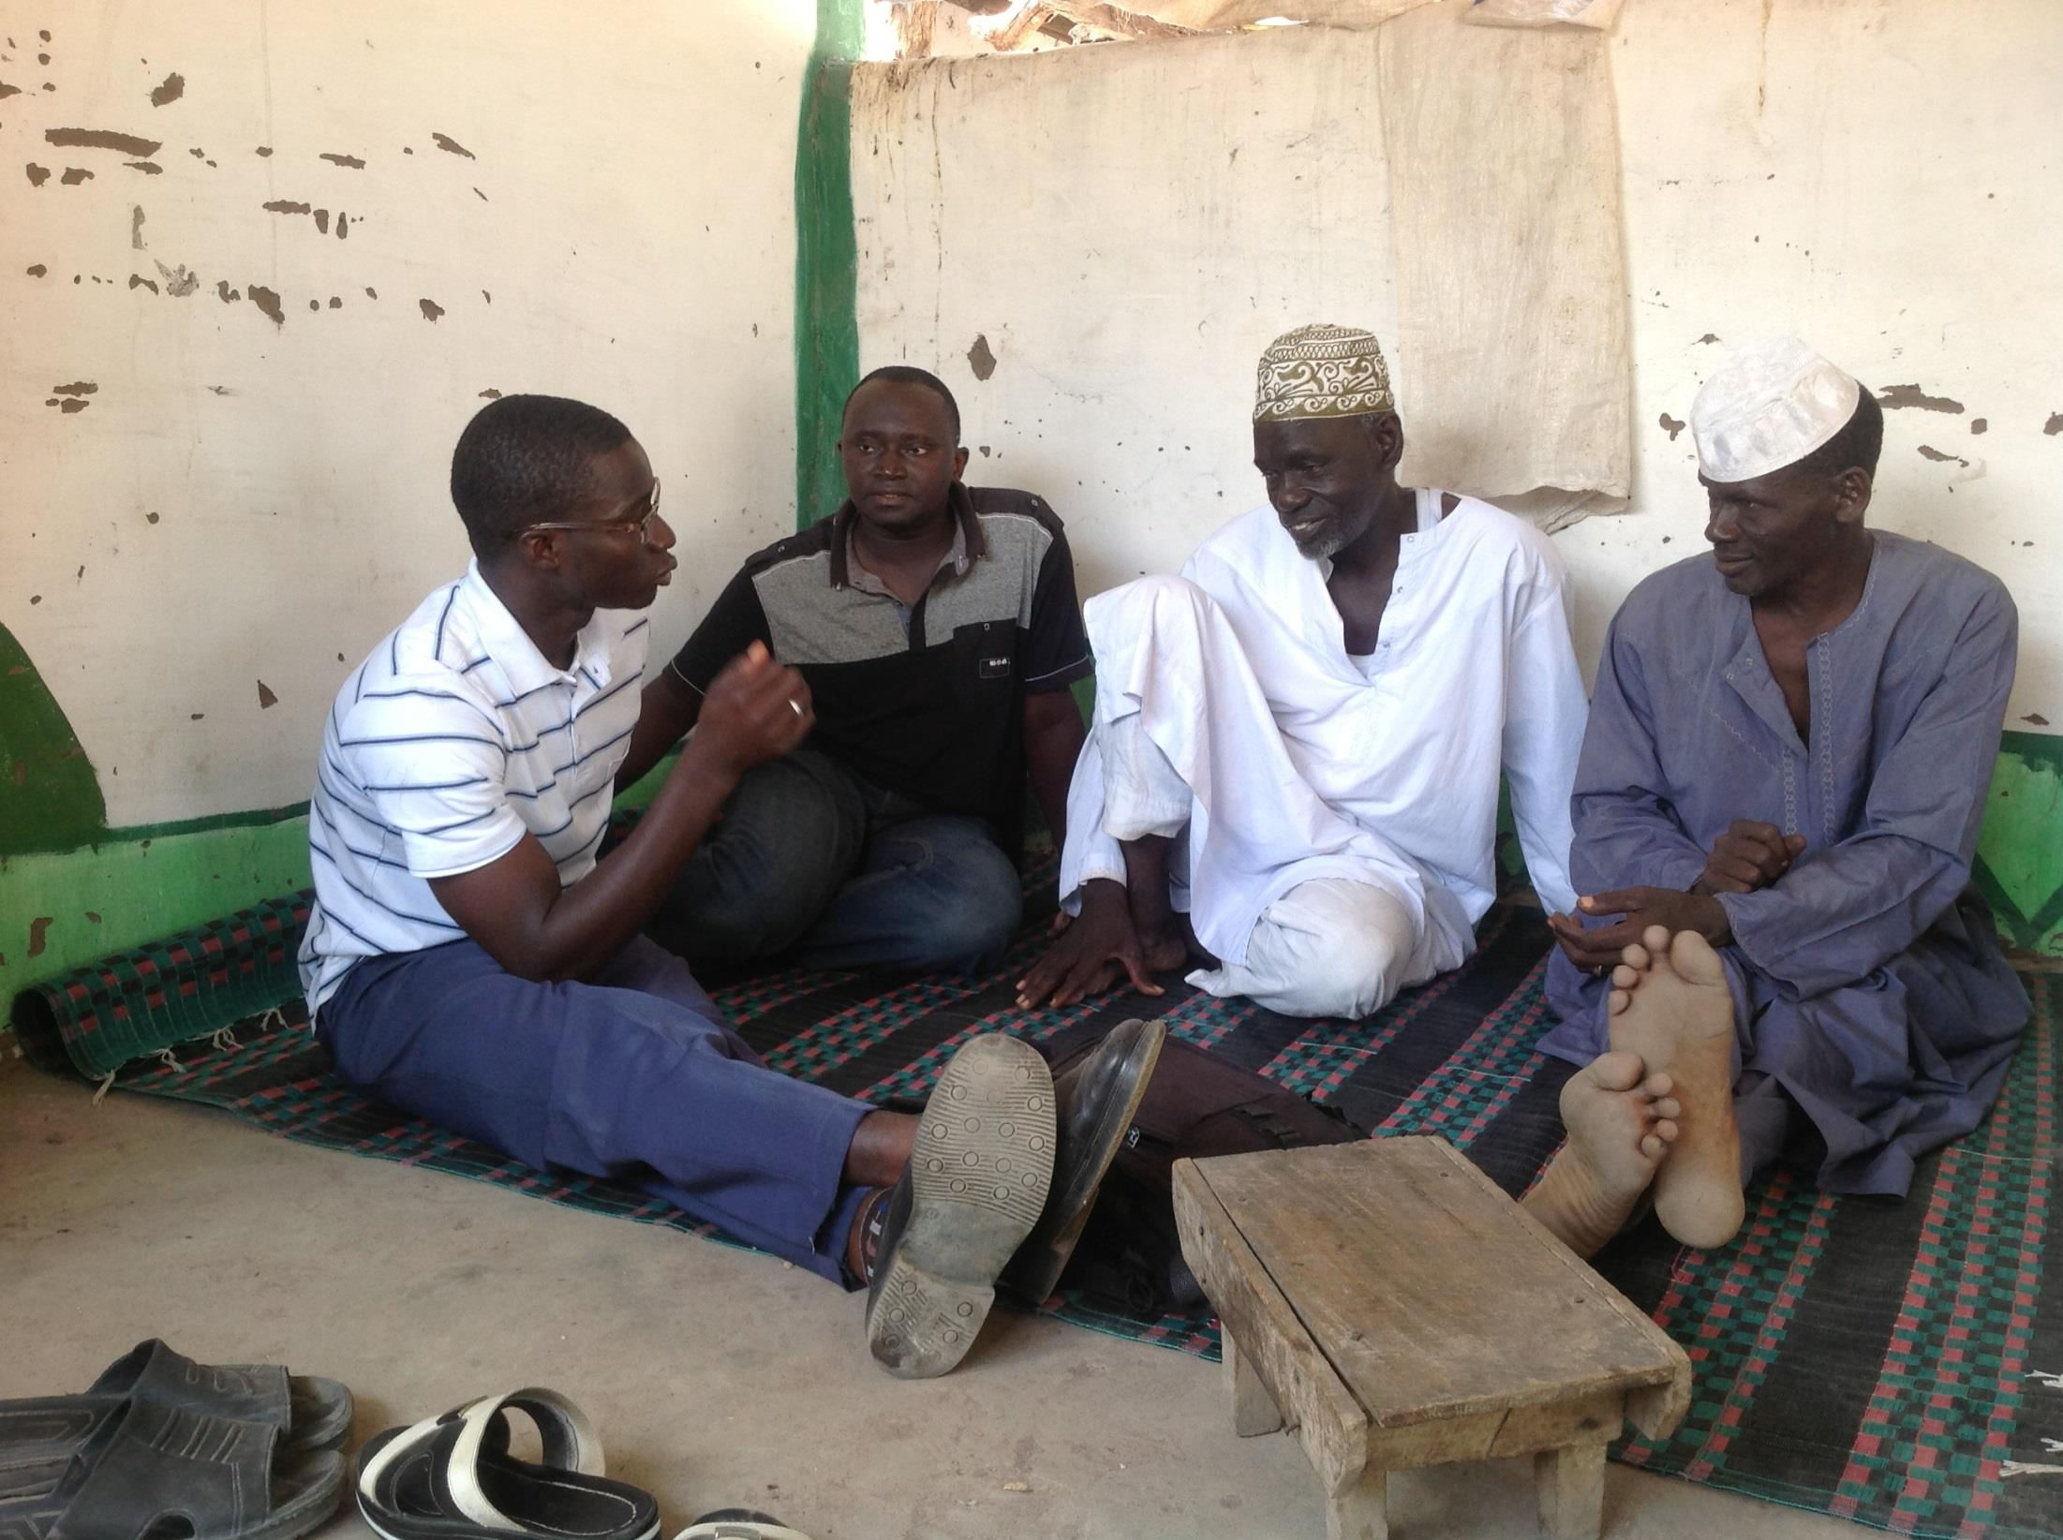
Presentation of the project activities to the village head (Alkalo)
Notes:
Presentation of the project activities to the village head (ALKALO).

Slide 5
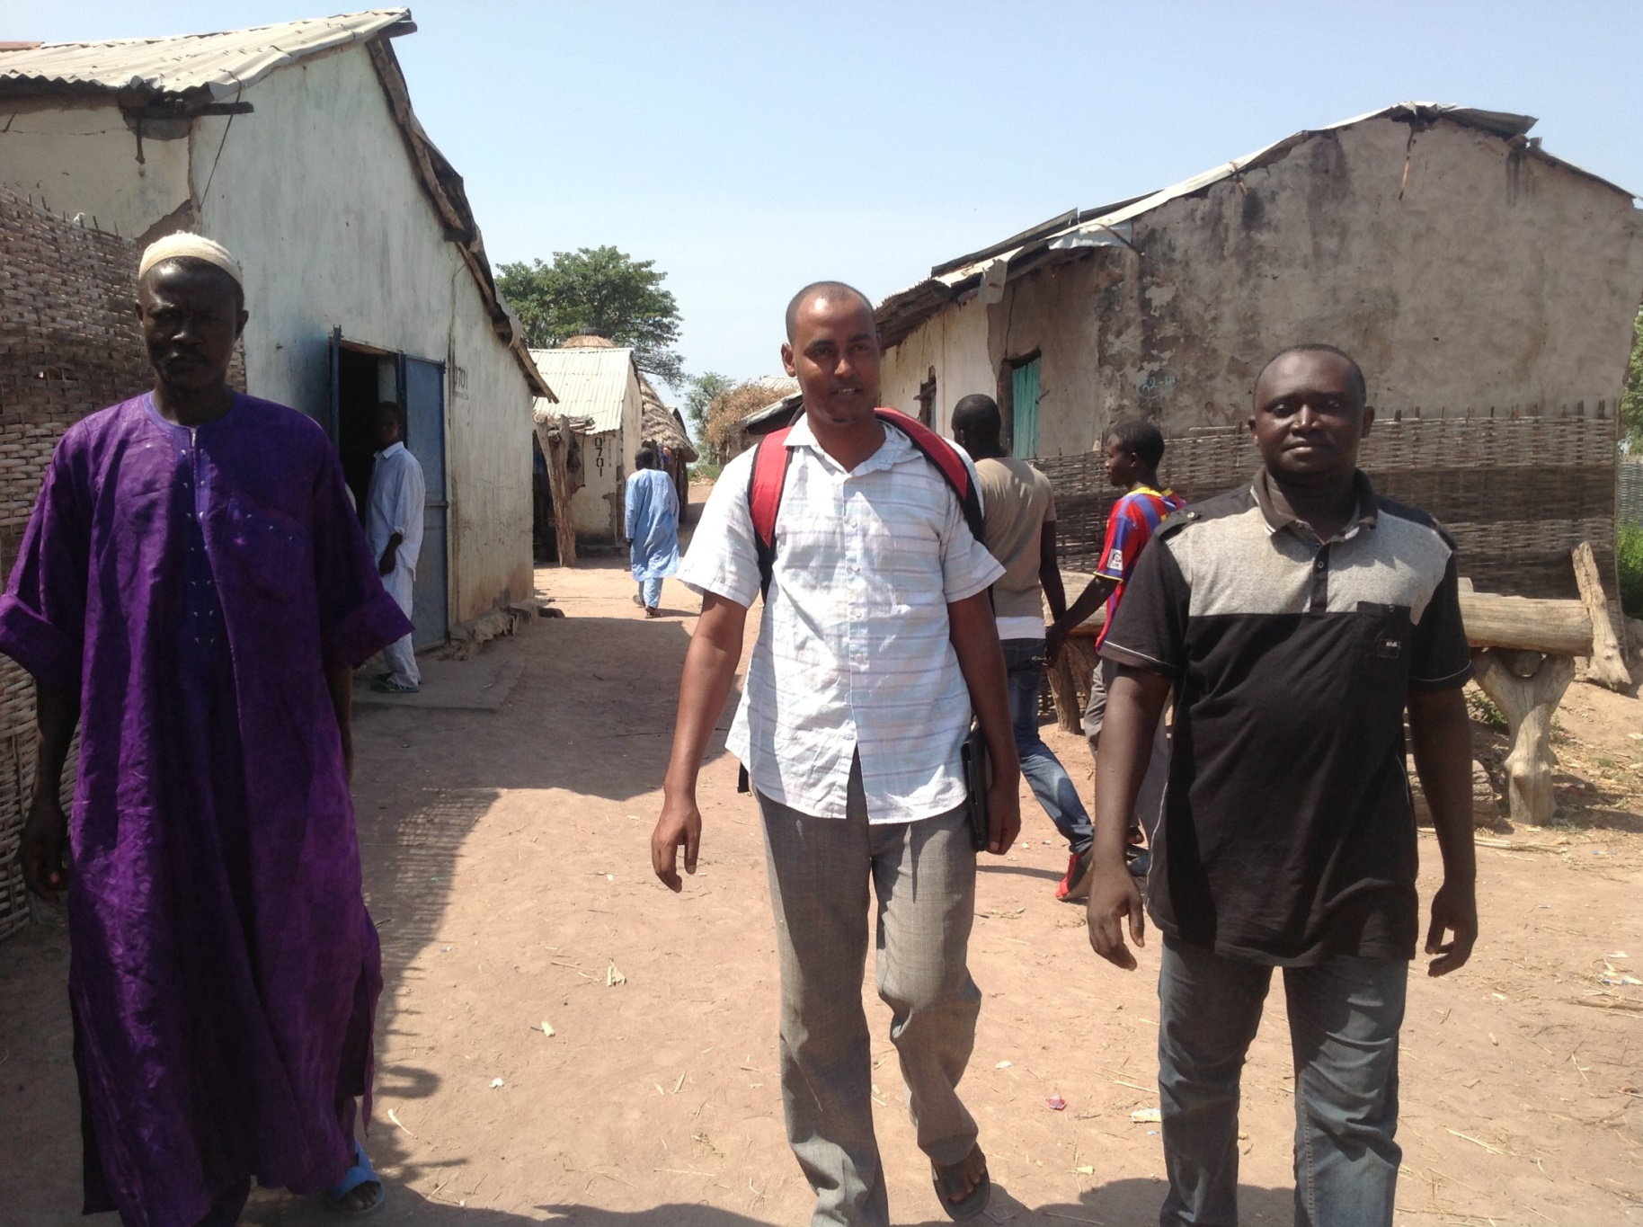
Household visit inviting all household members to the afternoon meeting
Notes:
Household visit inviting all household members to the afternoon meeting

Slide 6
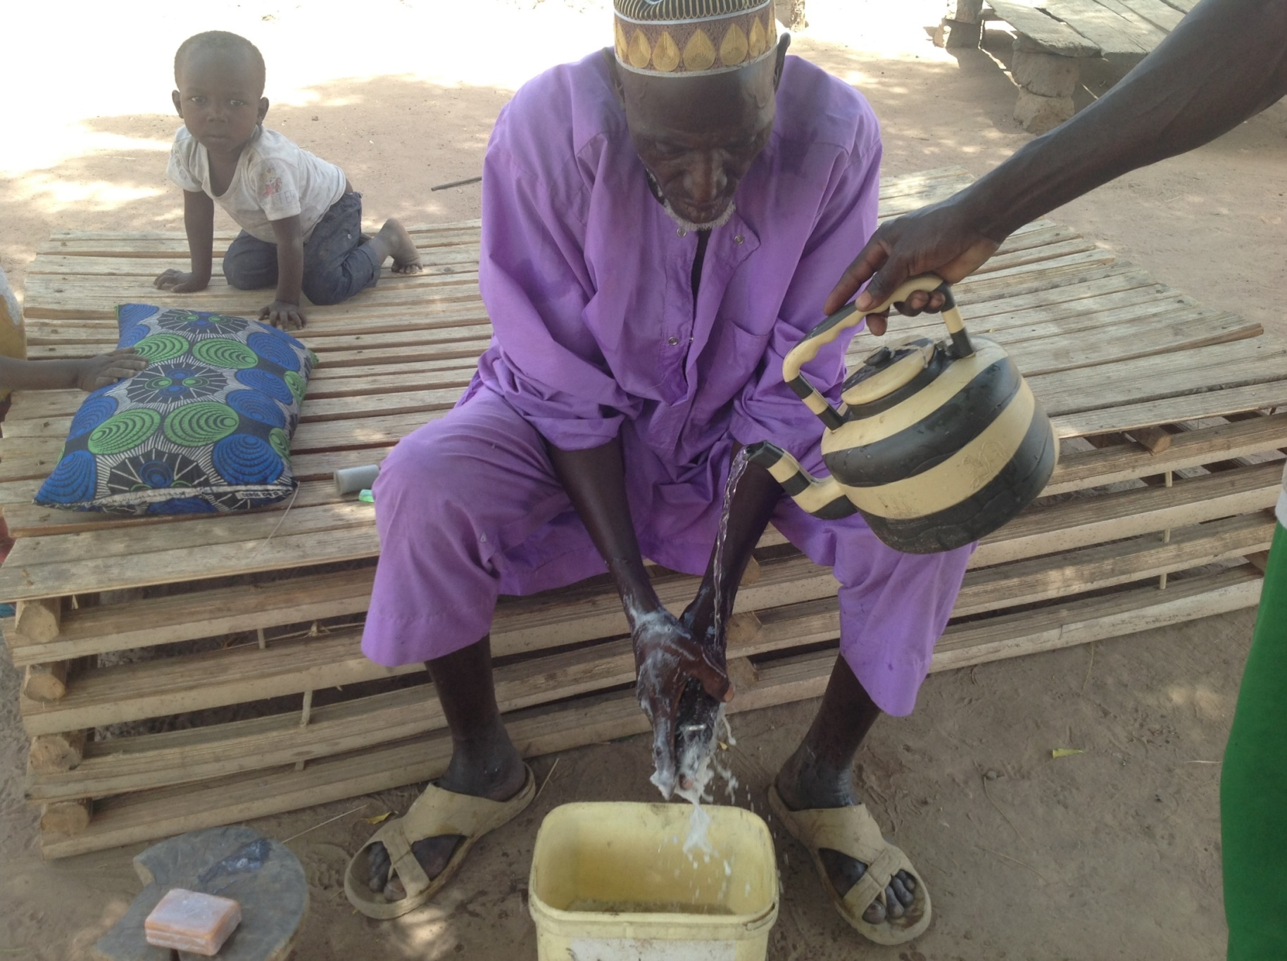
Village Head (Alkal0) practicing hand washing with soap and water
Notes:
Village Head (Alkalo) practicing hand washing with soap and water

Slide 7
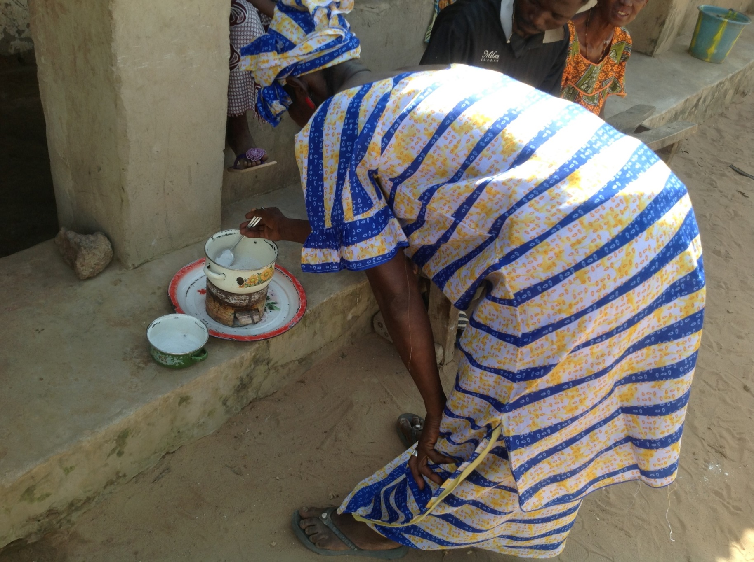
Wife of village head practice reheating stored weaning food
Notes:
Wife of village head practice reheating stored weaning food

Slide 8
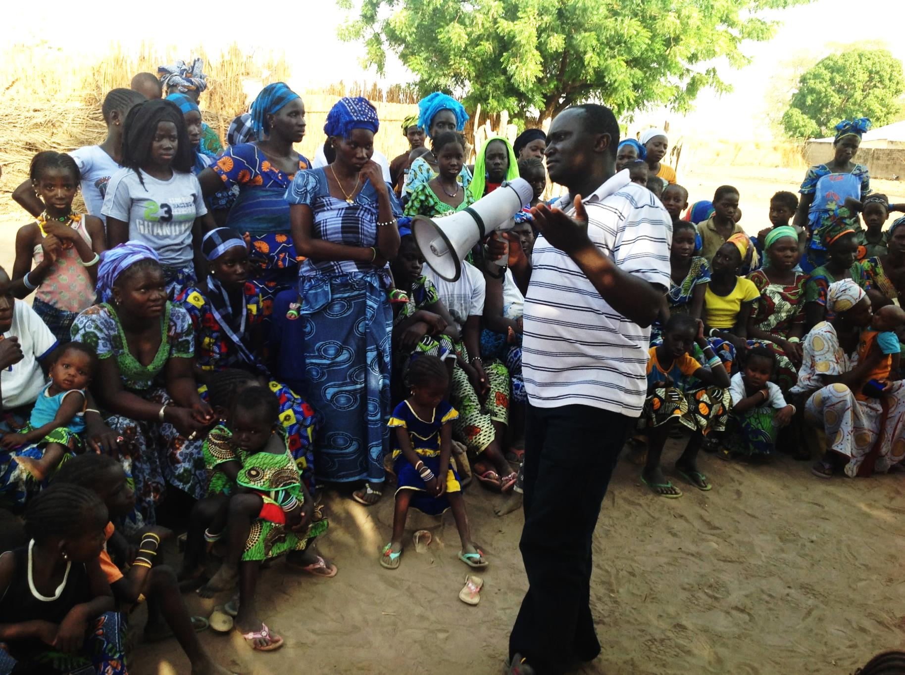
Afternoon meeting attended by community members
Notes:
Afternoon meeting attended by community members

Slide 9
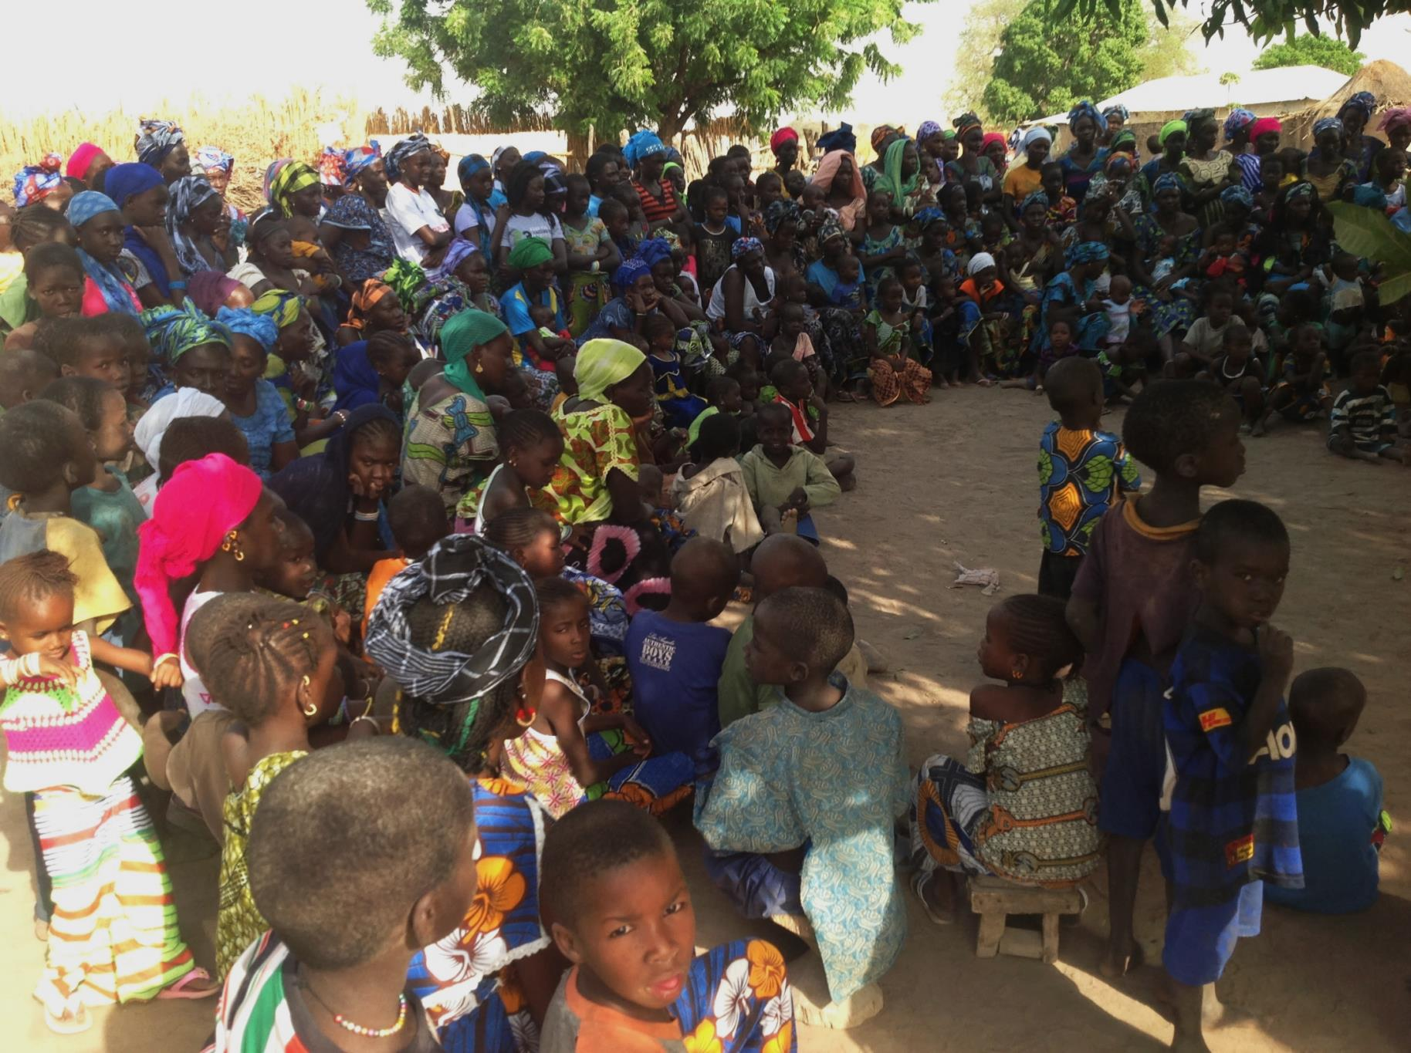
Afternoon meeting attended by community members
Notes:
Afternoon meeting attended by community members

Slide 10
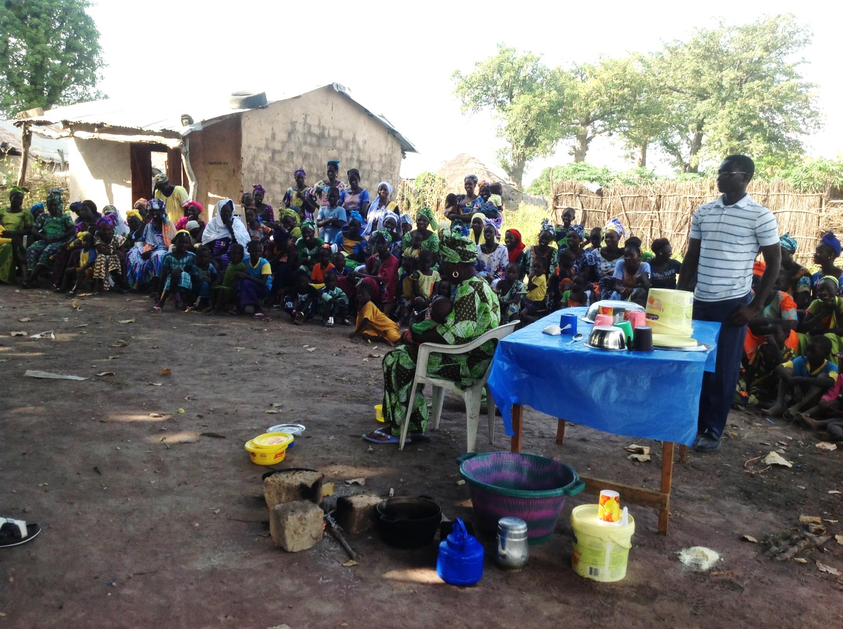
Drama showing traditional communicator acting as MaaChampion, demonstrating hygienic cooking of weaning food
Notes:
Drama showing Traditional Communicator acting as MaaChampion, demonstrating hygienic cooking of weaning food

Slide 11
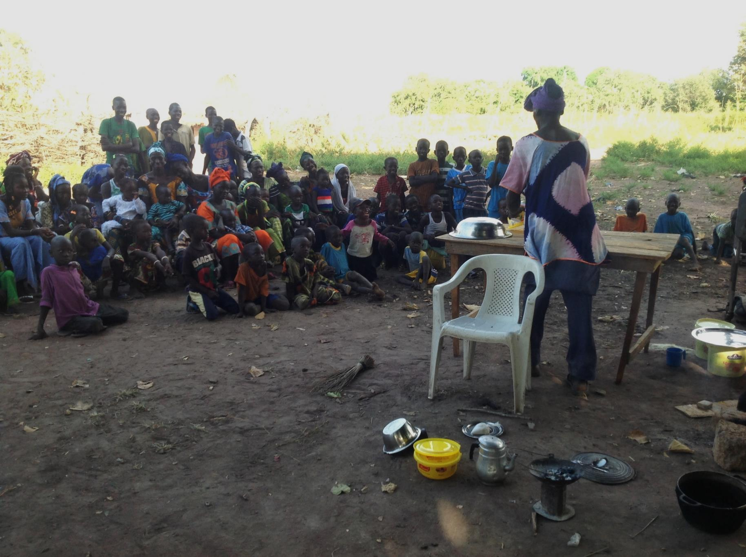
Drama showing traditional communicator acting as Funtu, demonstrating unhygienic cooking of weaning food
Notes:
Drama showing Traditional Communicator acting as Funtu, demonstrating unhygienic cooking of weaning food

Slide 12
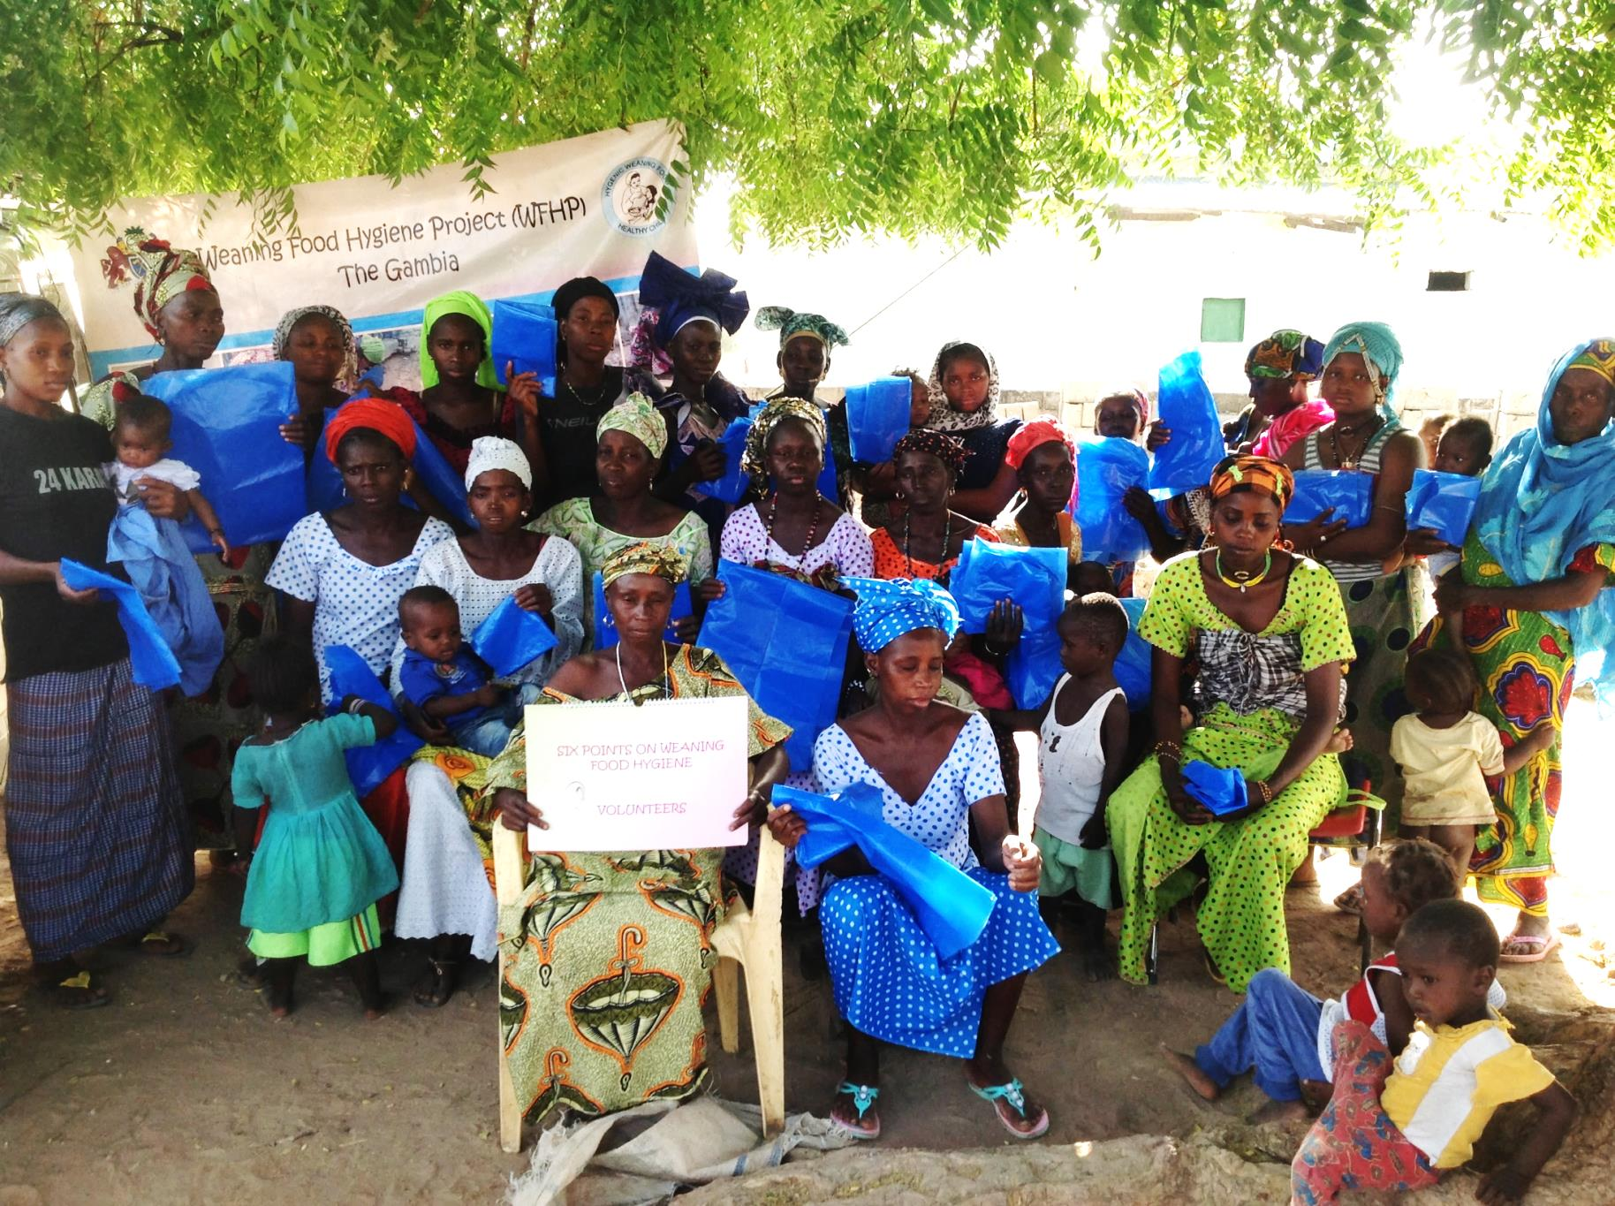
Pledged mothers (MaaFamboos) with plastic and village volunteers (MaaSupervisors) holding posters
Notes:
Pledged mothers (MaaFamboos) with plastic and village volunteers (MaaSupervisors) holding posters

Slide 13
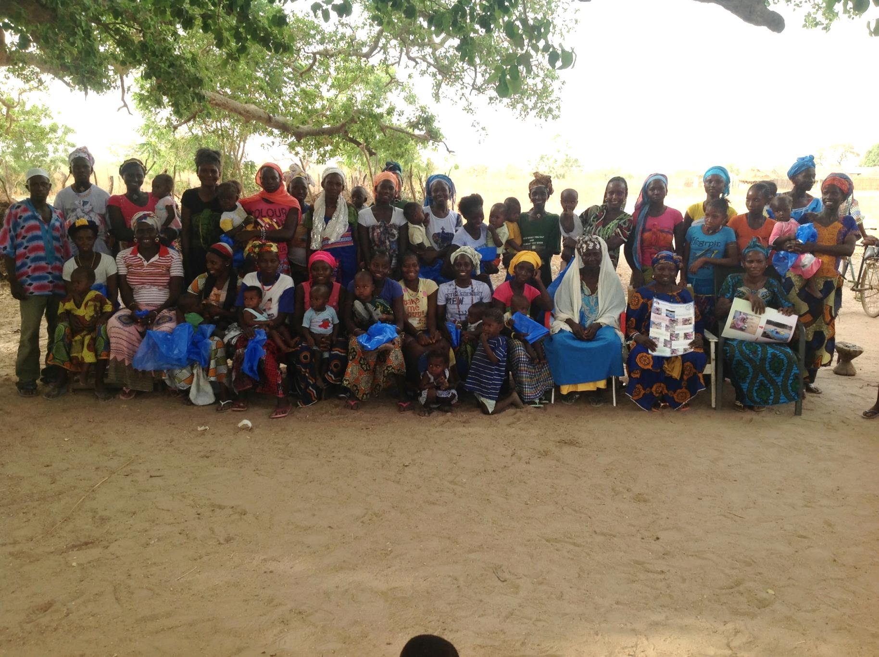
Pledged mothers (MaaFamboos) with plastic and village volunteers (MaaSupervisors) holding posters
Notes:
Pledged mothers (MaaFamboos) with plastic and village volunteers (MaaSupervisors) holding posters

Slide 14
Day 2
Assessing pledged mothers
Narrating a story
Handwashing technique

Slide 15
Breakdown of Day 2
Meeting Alkalo again
Sign of respect to gain his support
House-to-house visits with village volunteers
Train and boost confidence of volunteers
Assess pledged women for next stage
Adhoc meeting with women and men
Narration of story
Demonstration of handwashing

Slide 16
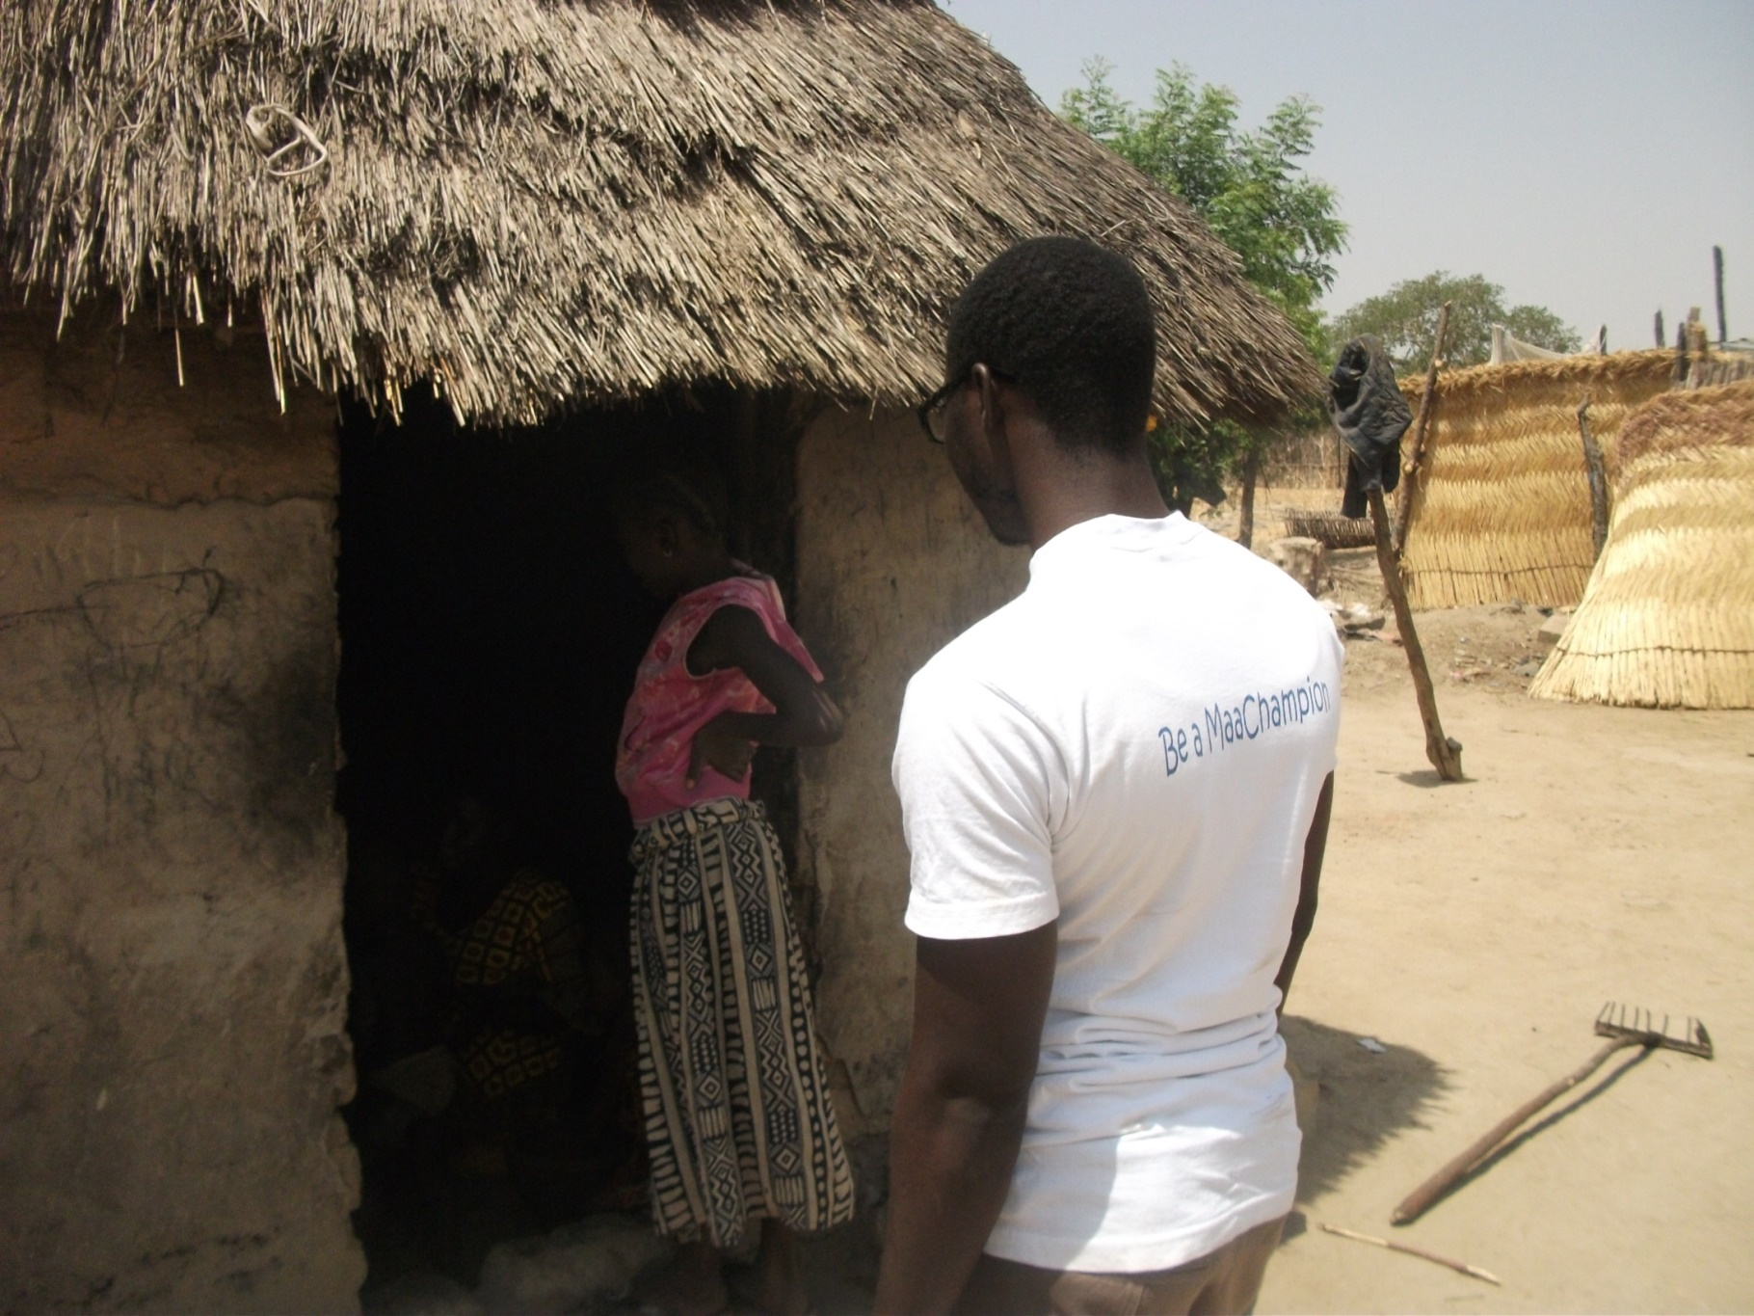
Assessment of pledged mothers (MaaFamboos) on six points to become achieved mothers (MaaSawars)
Notes:
Assessment of pledged mothers (MaaFamboos) on six points to become achieved mothers (MaaSawars)

Slide 17
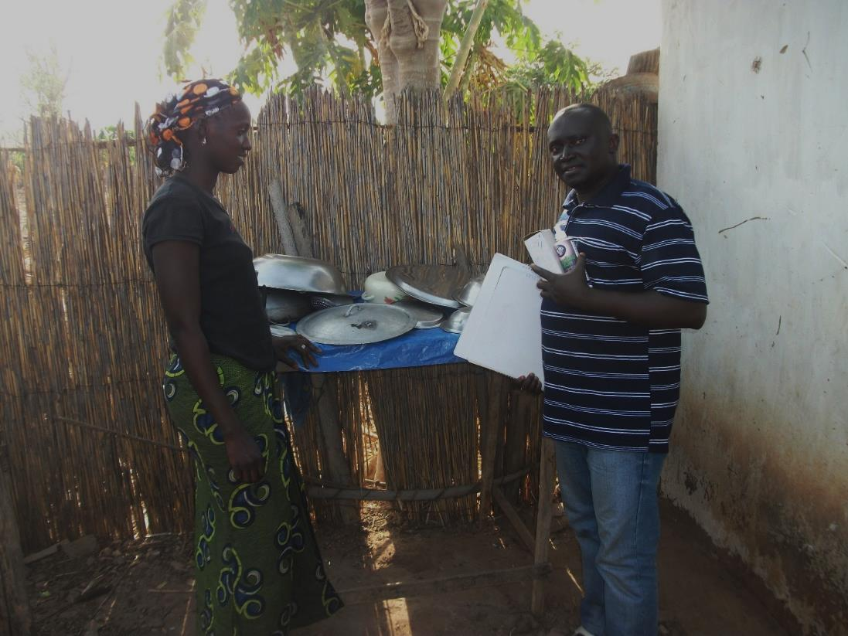
Assessment of pledged mothers (MaaFamboos) on six points to become achieved mothers (MaaSawars)
Notes:
Assessment of pledged mothers (MaaFamboos) on six points to become achieved mothers (MaaSawars)

Slide 18
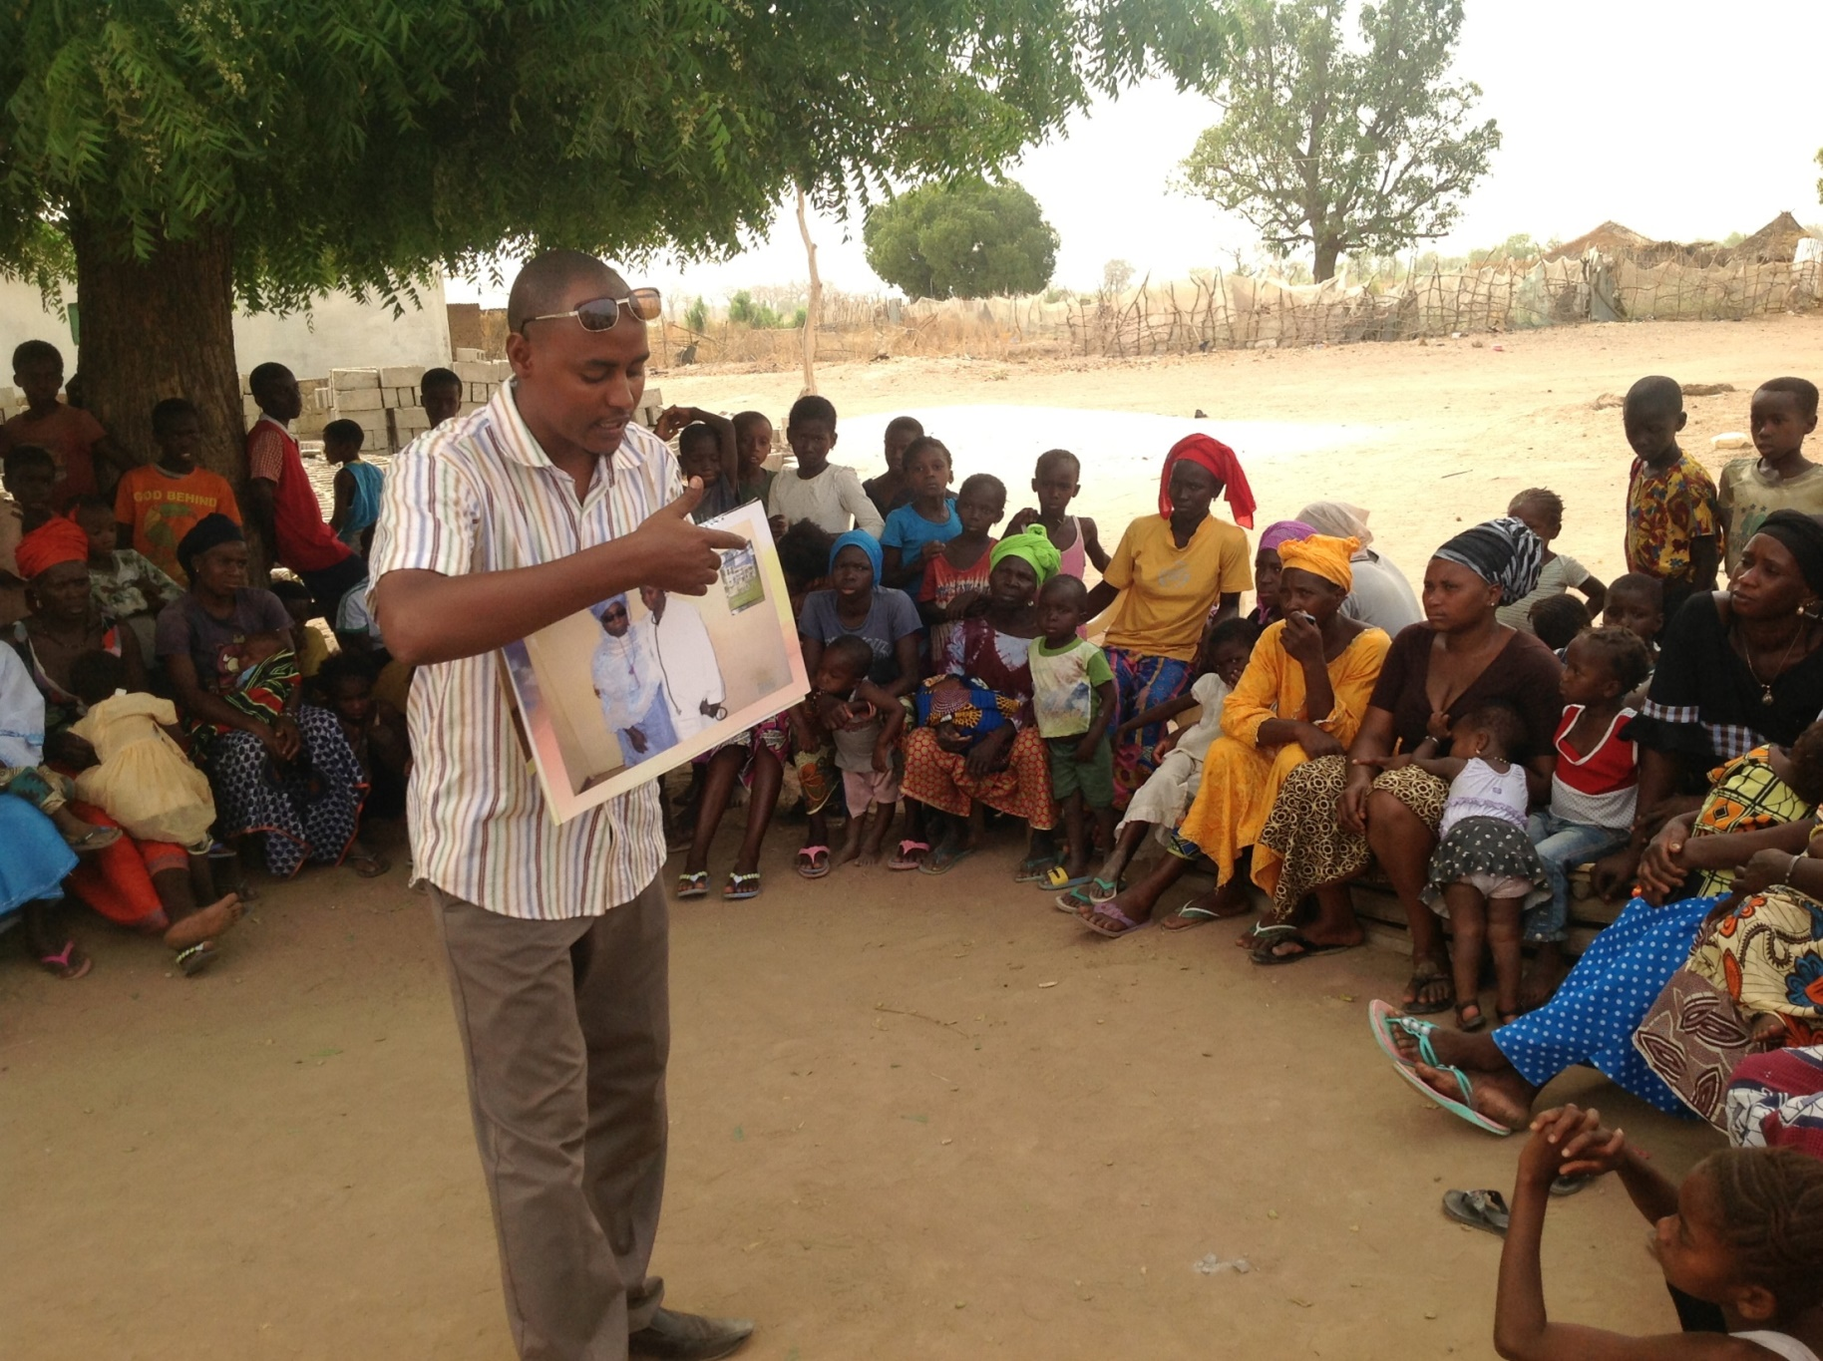
Ad hoc meeting with women and men, narrating the story ‘Disgust and Nurture’
Notes:
Adhoc women and men meeting, narrating story disgust and nurture

Slide 19
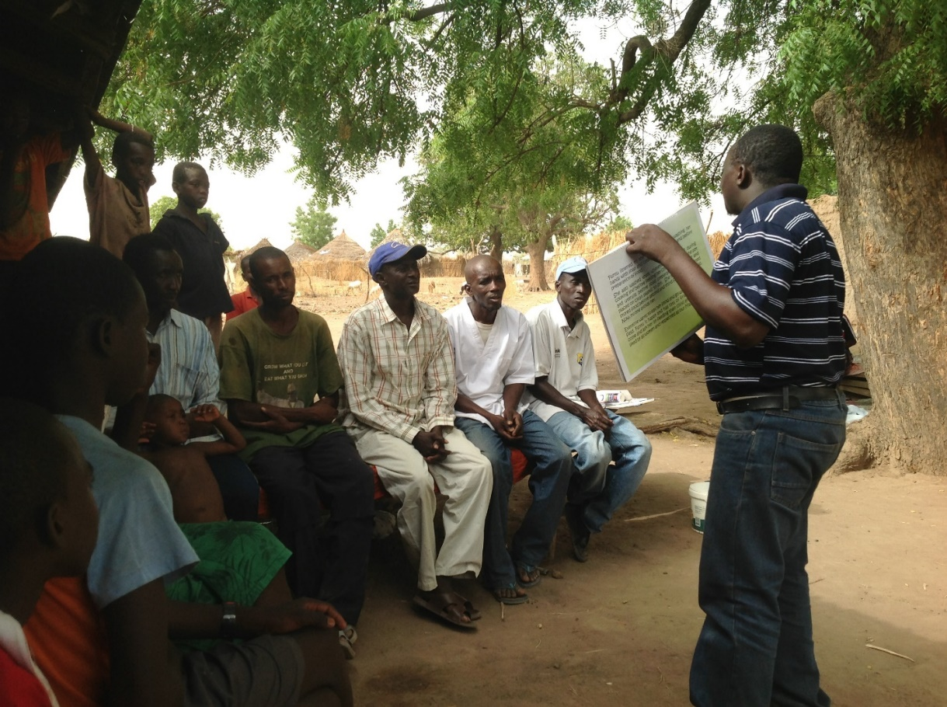
Ad hoc meeting with women and men, narrating the story ‘Disgust and Nurture’
Notes:
Adhoc women and men meeting, narrating story disgust and nurture
[Original photo missing from folder]

Slide 20
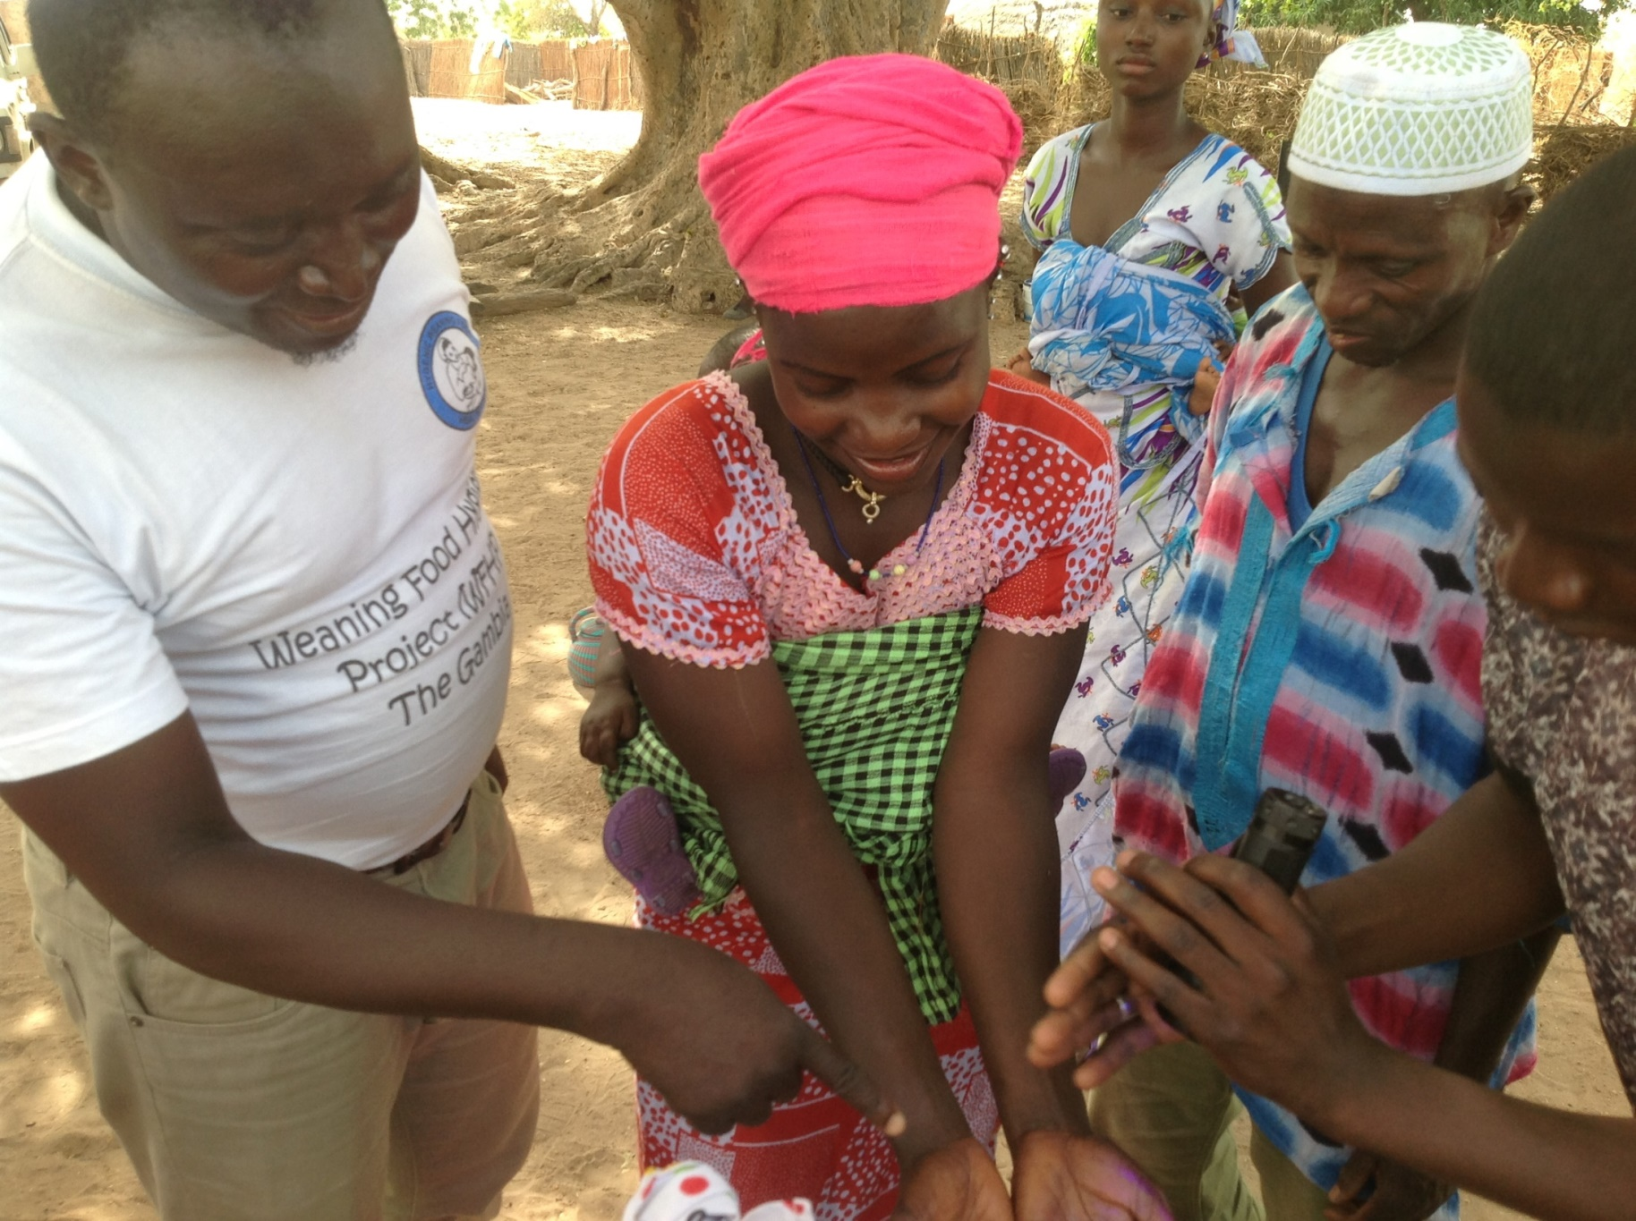
Practice of proper handwashing with soap and water, using glow-germ to show effectiveness
Notes:
Practice of proper hand washing with soap and water using glow-germ

Slide 21
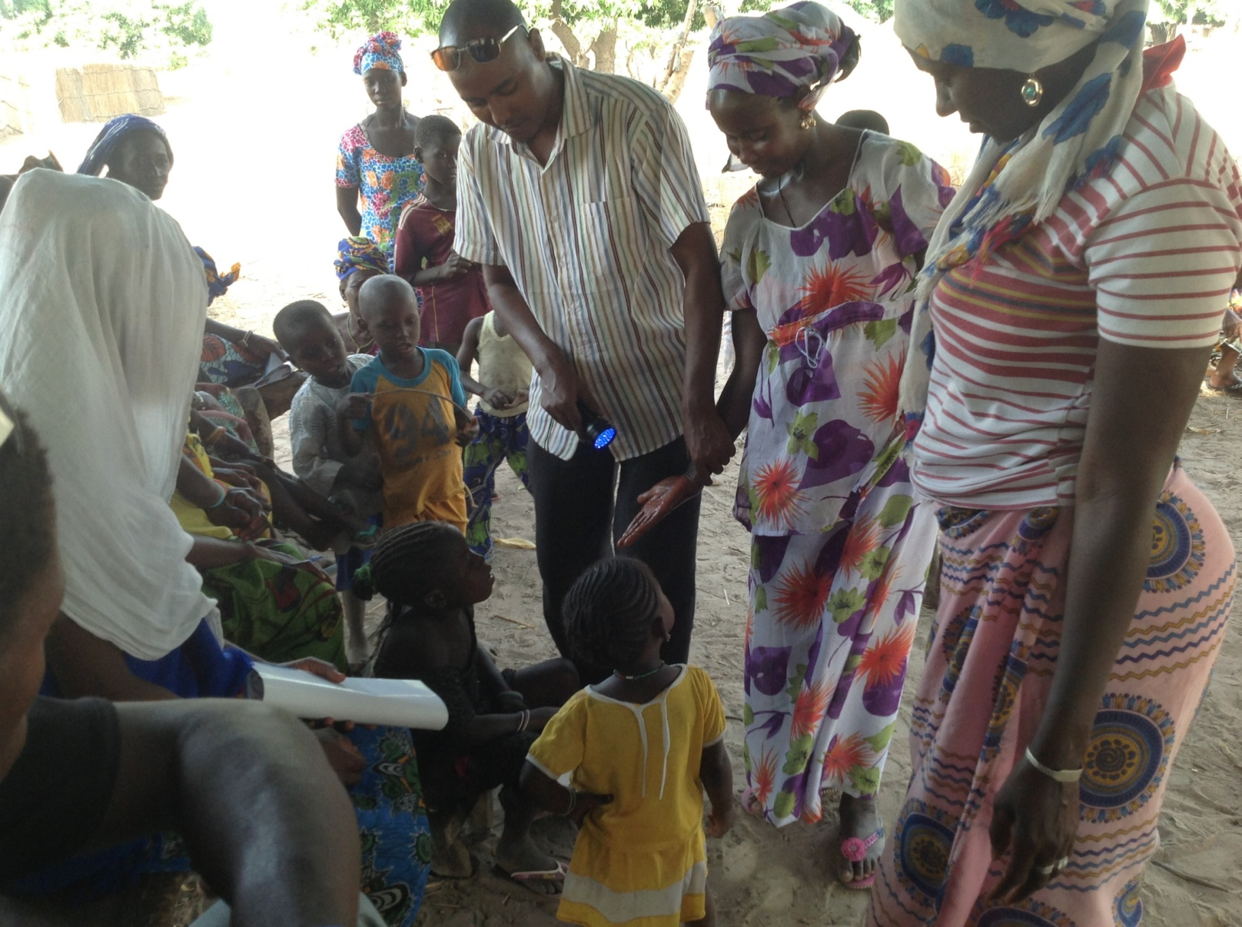
Practice of proper handwashing technique with soap and water, using glow-germ
Notes:
Practice of proper hand washing with soap and water using glow-germ

Slide 22
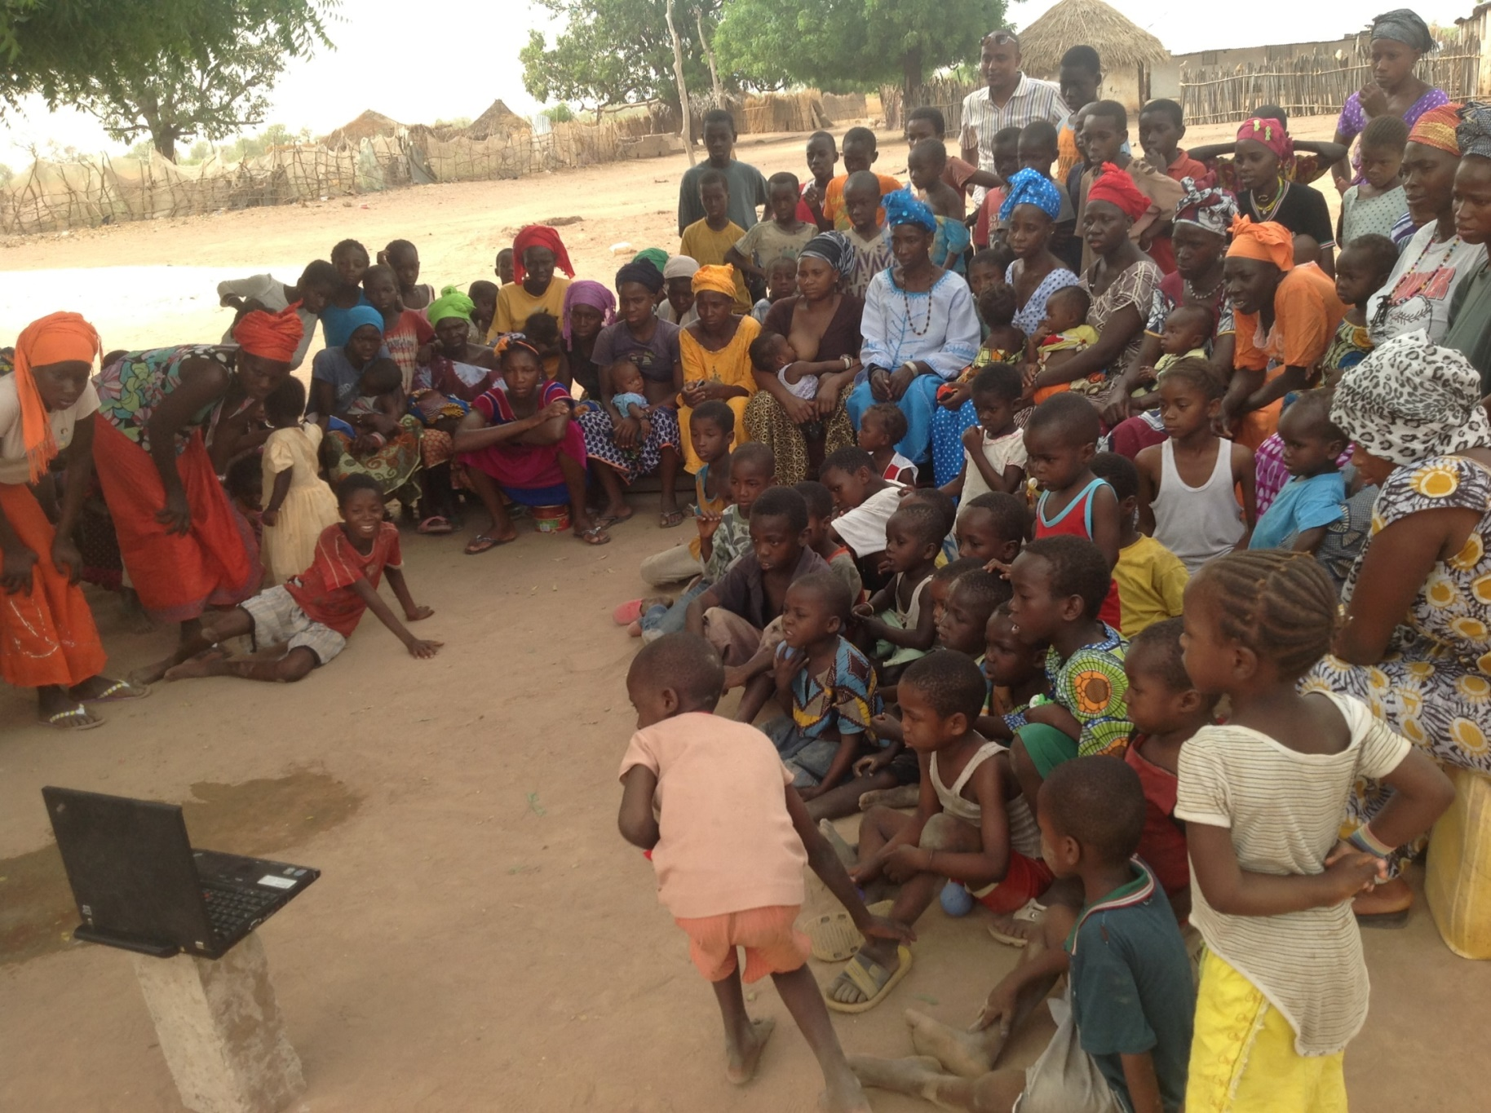
Mothers watching soap choice on handwashing
Notes:
Mothers watching choose-soap on hand washing

Slide 23
Day 3
Assessing and observing mothers
Giving corrective measures

Slide 24
Breakdown of Day 3
Meeting Alkalo
House-to-house visits with village volunteers
Video mothers reciting key points
Promote practice
Announce presence of team to village again
Second afternoon event
Show videos of successful mothers
Display successful mothers’ photos on honour board
Sign up new pledged mothers

Slide 25
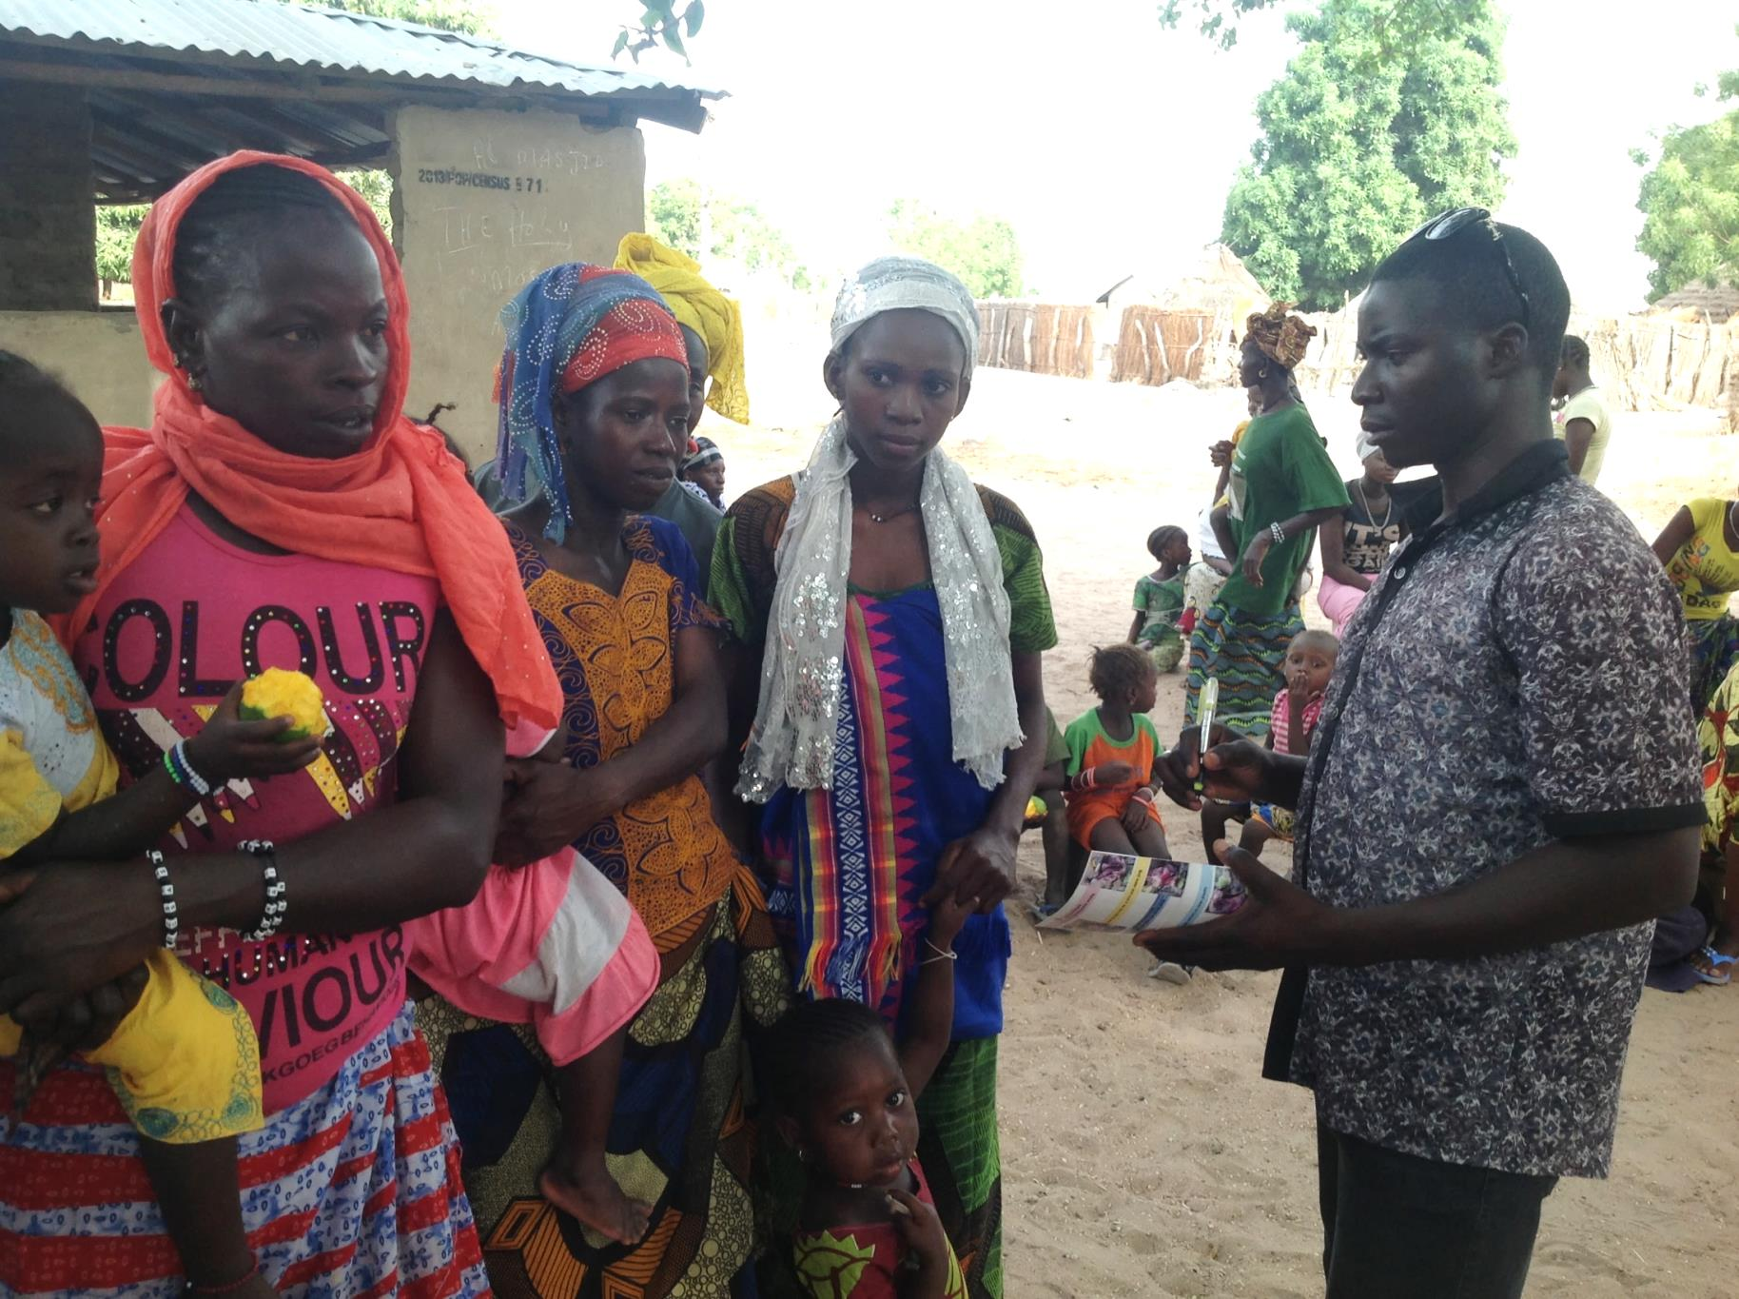
Assessment and observation of pledged (MaaFamboos) and achieved (MaaSawars) mothers on the six key messages
Notes:
Assessment and observation of pledged (MaaFamboos) and achieved (MaaSawars) mothers on the six key messages

Slide 26
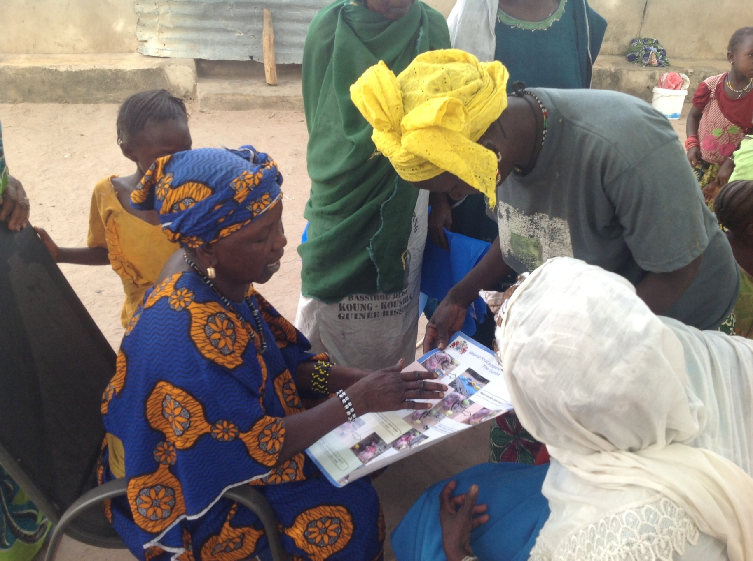
Village volunteer (MaaSupervisor) giving corrective measures to the mothers
Notes:
Village volunteer (MaaSupervisor) giving corrective measures to the mothers

Slide 27
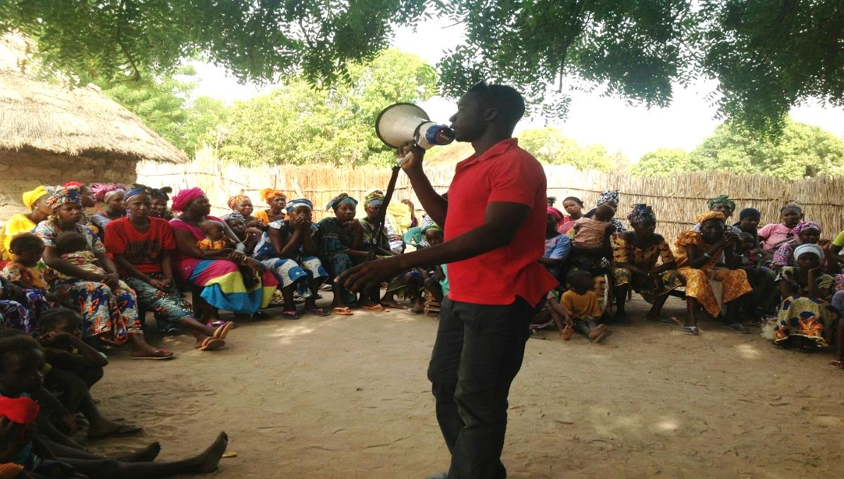
Afternoon meeting when corrective measures are given to mothers
Notes:
Afternoon meeting when corrective measures are given to mothers

Slide 28
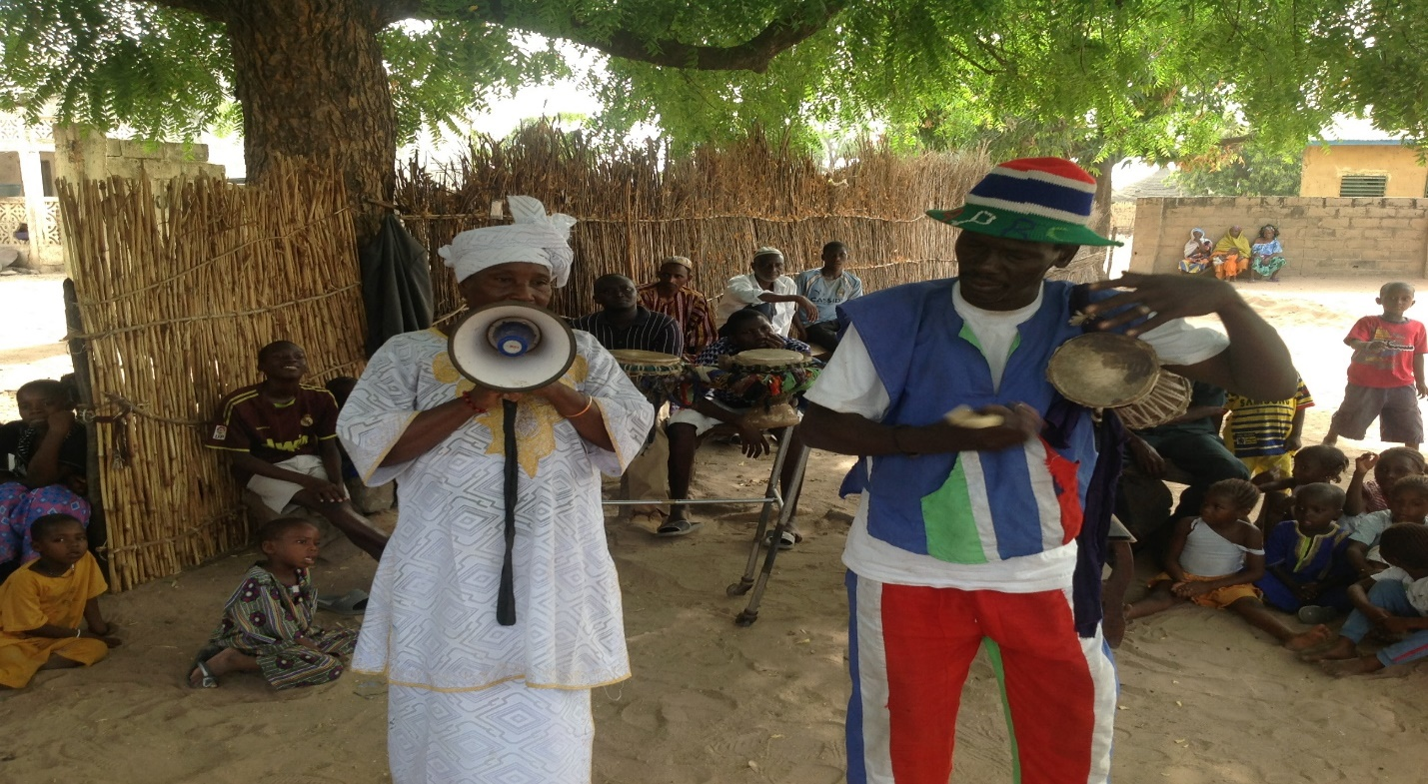
Traditional communicators giving corrective measures to mother and encouraging with campaign songs
Notes:
Traditional Communicators giving corrective measures to mother and encouraging with campaign songs

Slide 29
Day 4
Medal presentations
Village procession
Unveiling the signpost

Slide 30
Breakdown of Day 4
Meeting Alkalo
House-to-house visits with village volunteers
Announce presence of team to village
Third afternoon event
Medal presentation
Erect weaning food hygiene signpost
Present certificate to village
Give motivational advice on sustainability

Slide 31
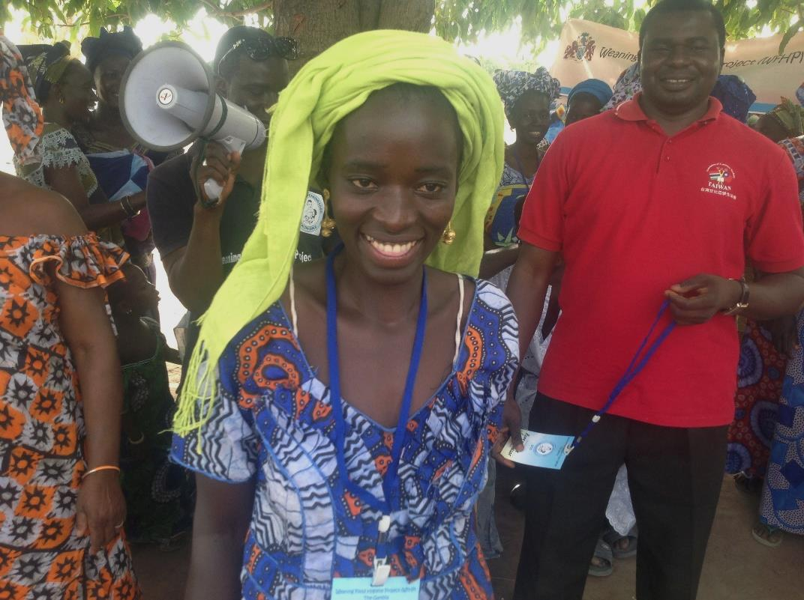
Presentation of medal to role models (MaaChampions) as reward
Notes:
Presentation of medal to Role models (MaaChampions) as reward

Slide 32
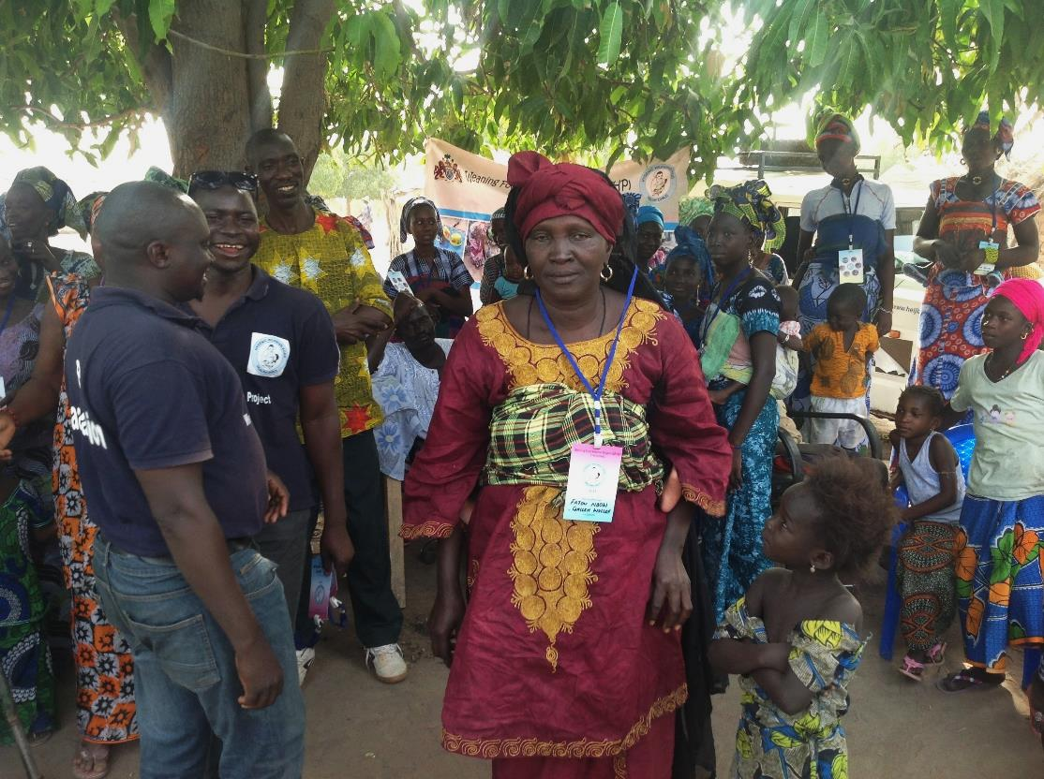
Presentation of medal to village volunteers
Notes:
Presentation of medal to village volunteers (MaaSupervisors) as reward

Slide 33
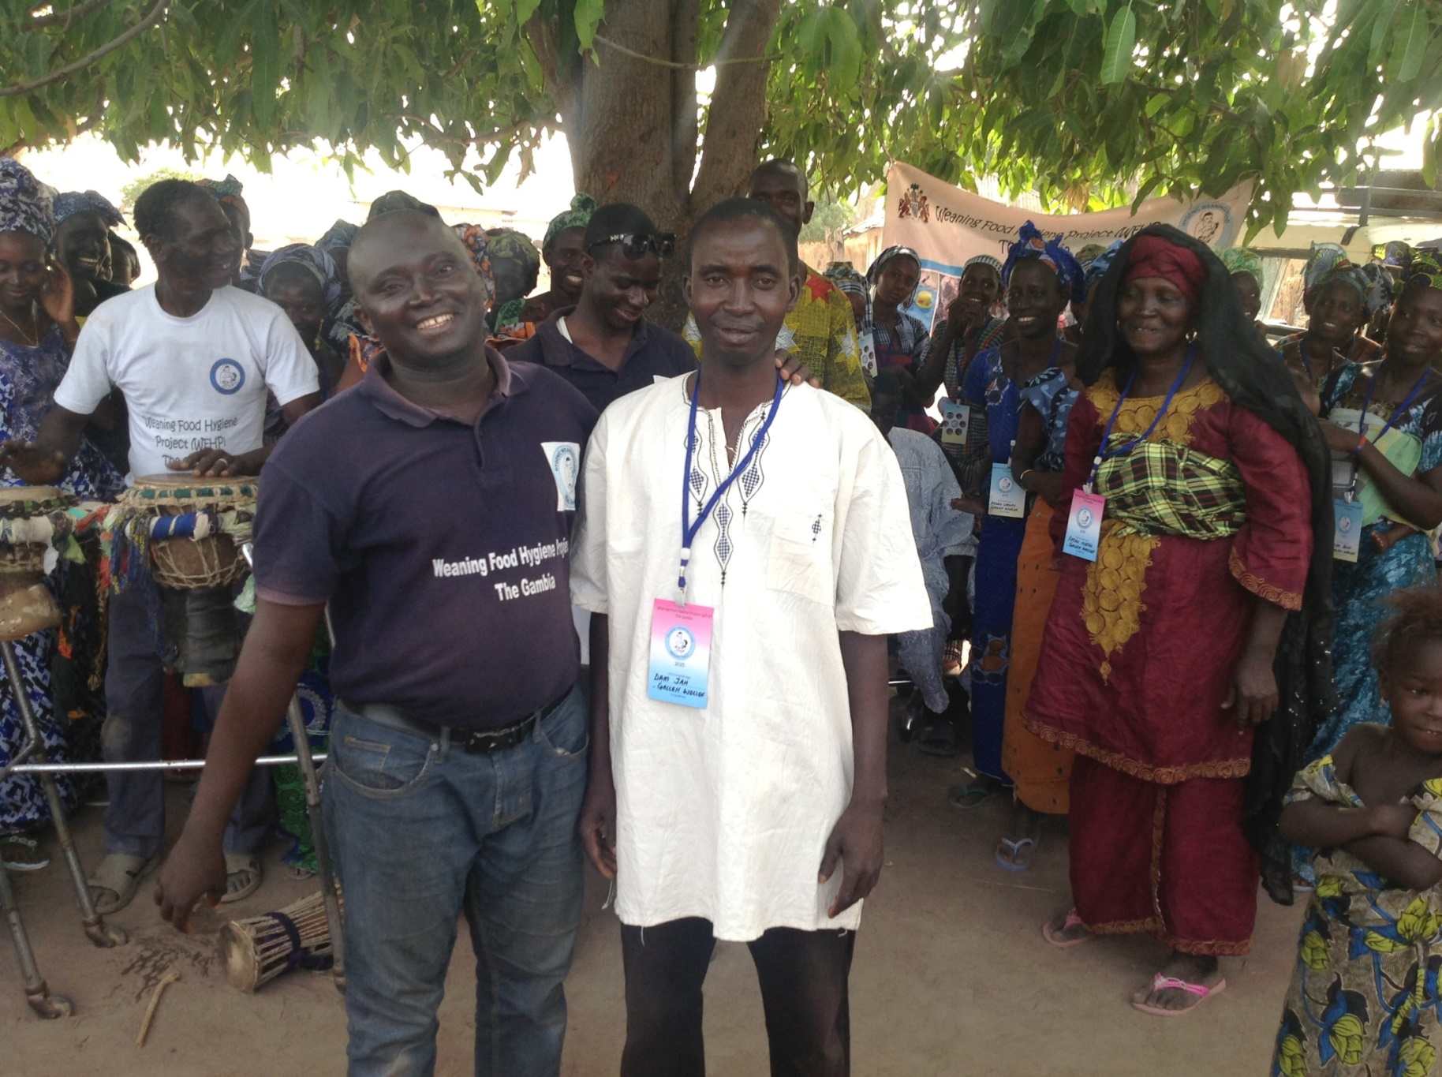
Presentation of medal to well-performing male whole support mothers
Notes:
Presentation of medal to well-performing male whole support mothers

Slide 34
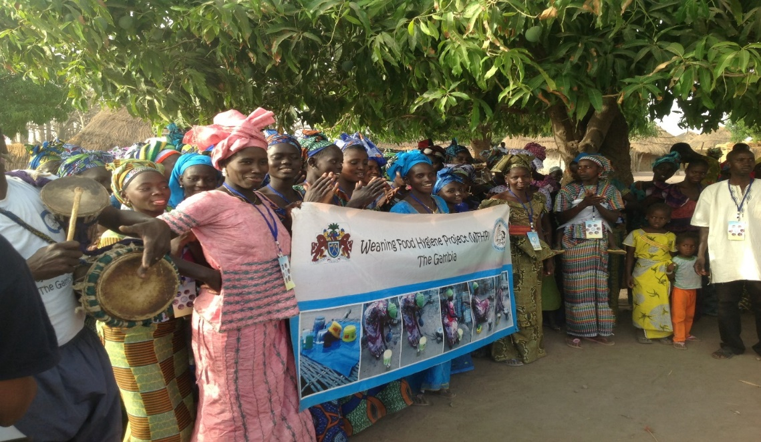
MaaChampions ready to head to the signpost at the village entrance

Slide 35
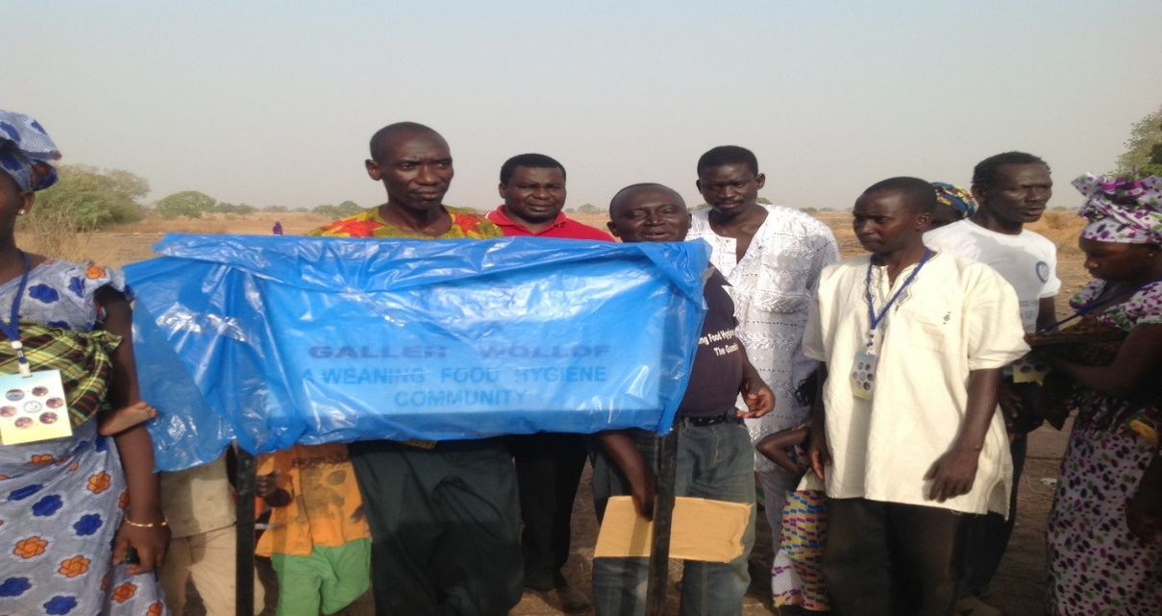
Unveiling of the signpost at the village entrance in the presence of the whole community
Notes:
Unveiling of the sign-post at village entrance in the presence of the whole community

Slide 36
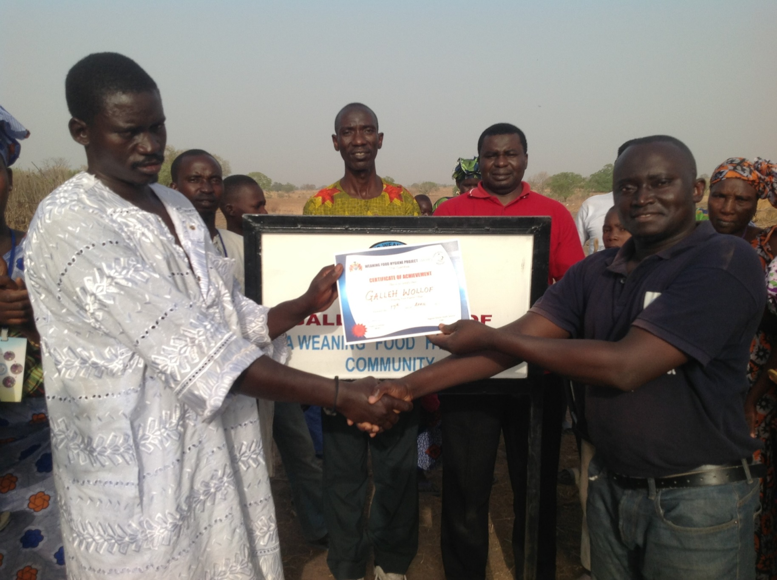
Presentation of certificate to village head for his village becoming a Weaning Food Hygiene Community
Notes:
Presentation of certificate to village head for his village becoming a Weaning Food Hygiene Community

Slide 37
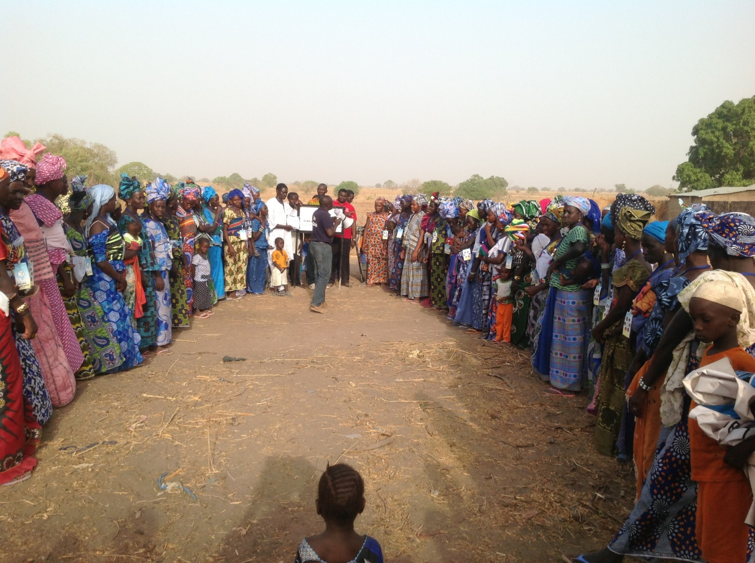
Community members celebrating becoming a weaning food hygiene village at the village entrance
Notes:
Community members celebrating becoming a weaning food hygiene village at the village entrance

Slide 38
Performance
The weaning food hygiene drama, performed by Traditional Communicators

Slide 39
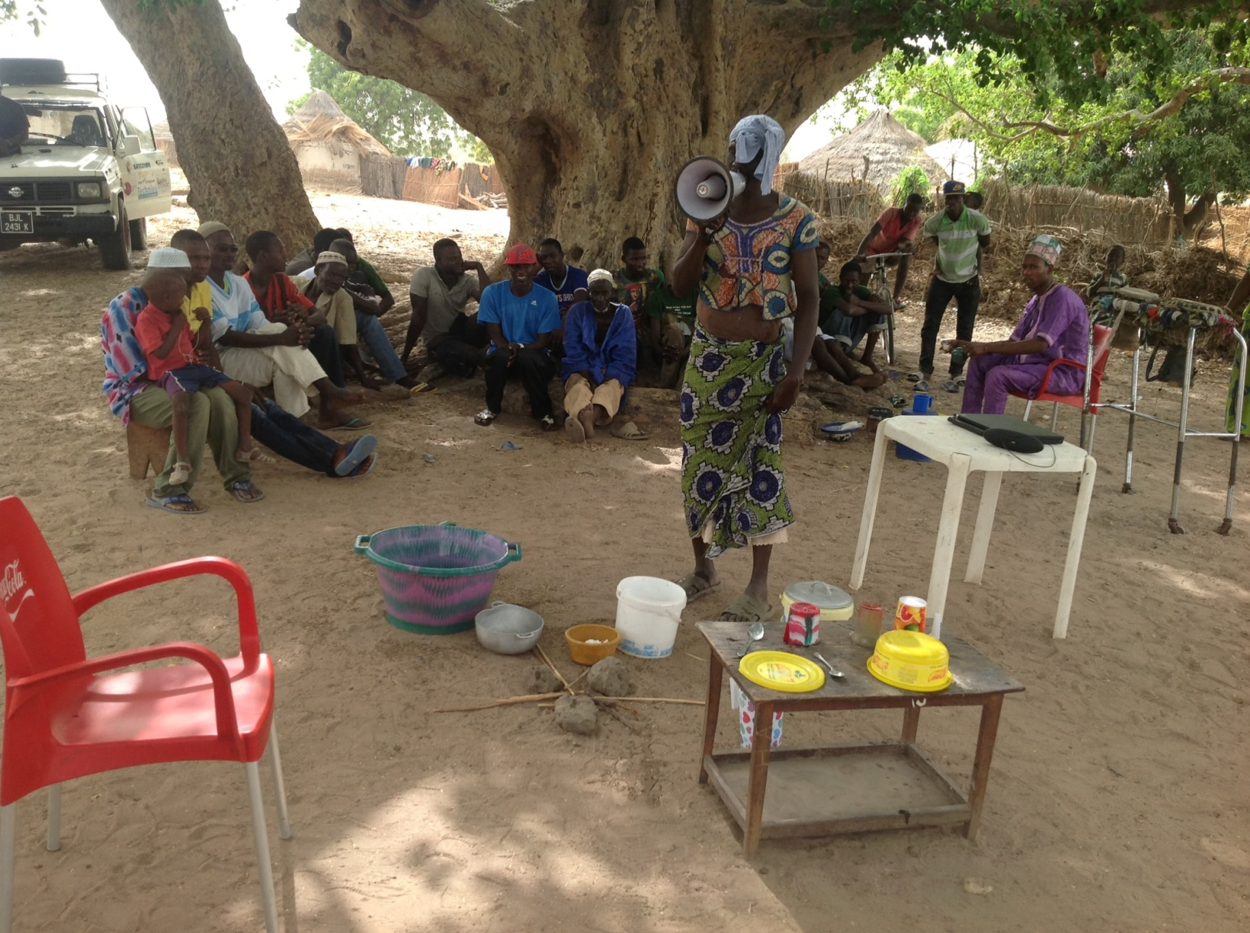
Drama Funtu drying clean dishes on a dirty surface
Notes:
Drama Funtu drying clean dishes on dirty surface

Slide 40
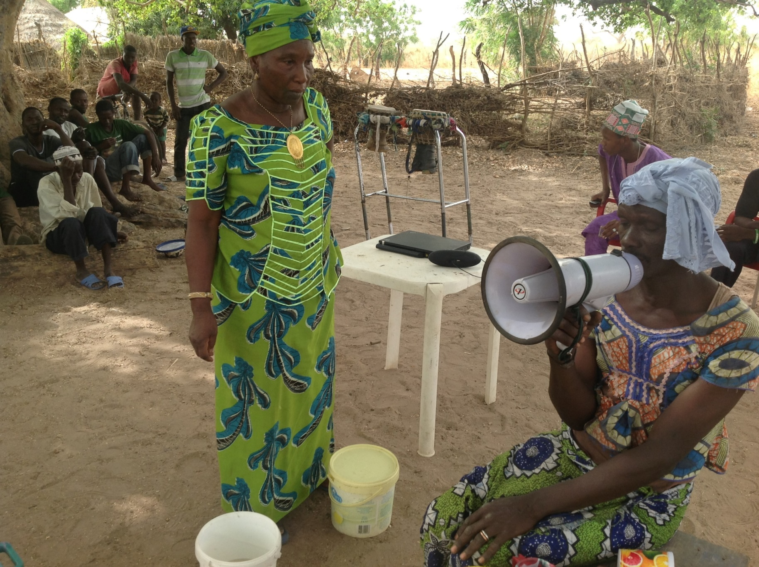
Drama Funtu seeking help from MaaChampion
Notes:
Drama Funtu seeking help from MaaChampion

Slide 41
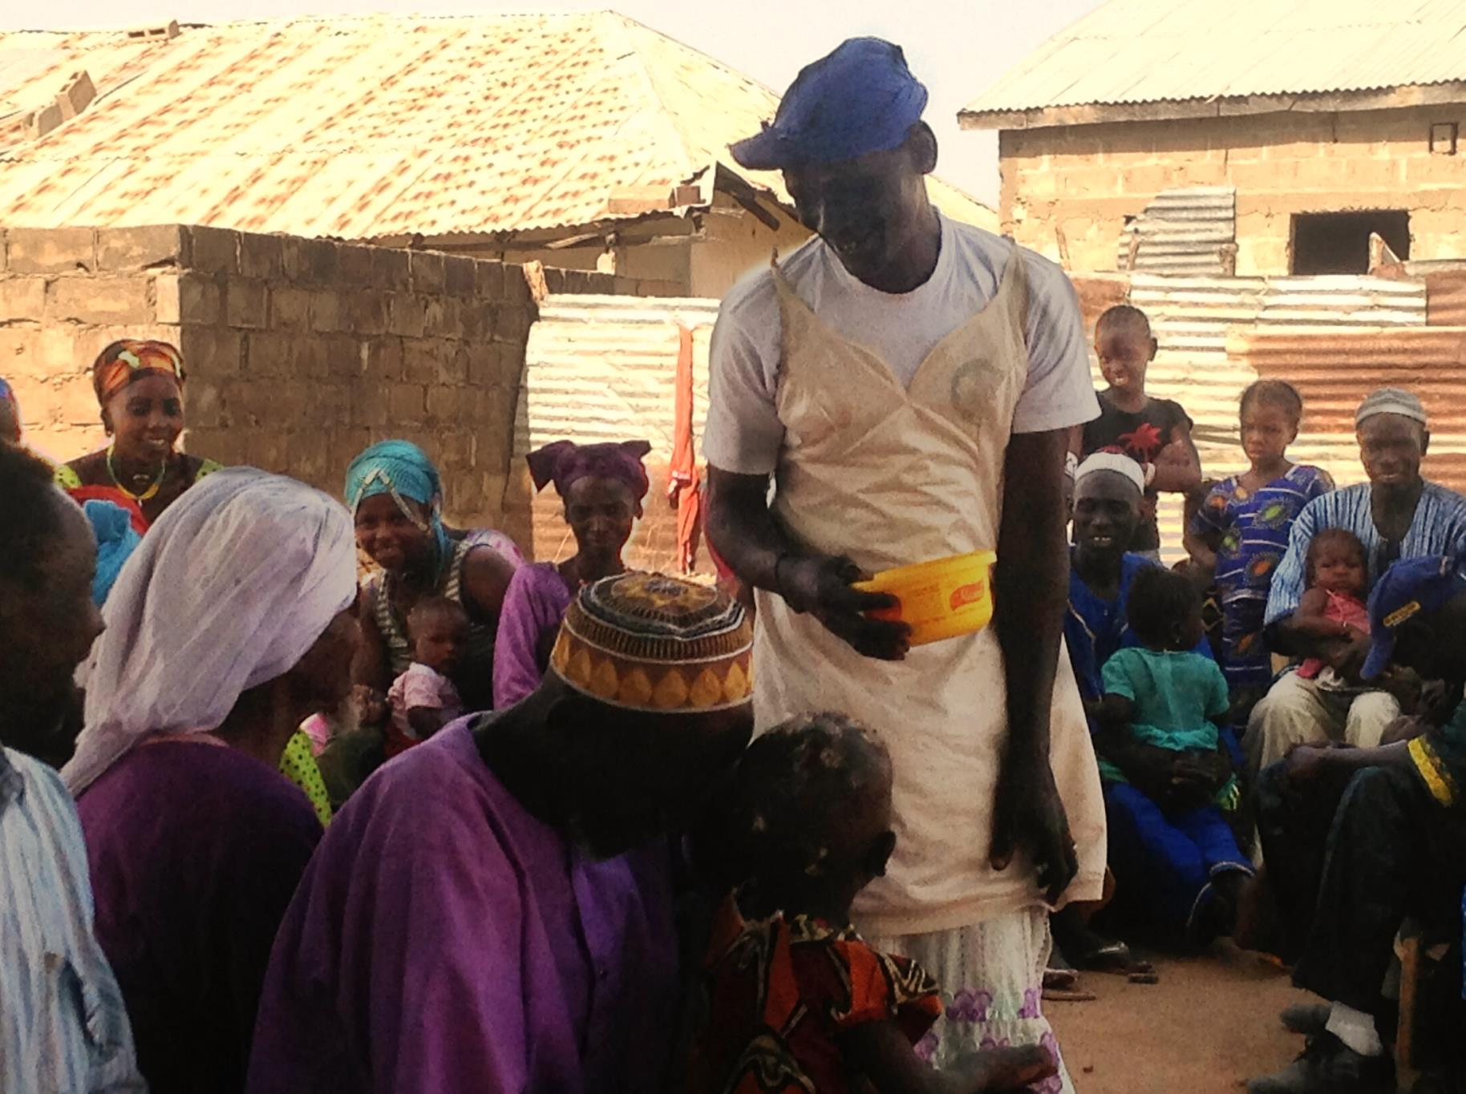
Drama Funtu trying to get villagers to eat unclean food
Notes:
Drama Funtu trying to get villagers to eat unclean food

Slide 42
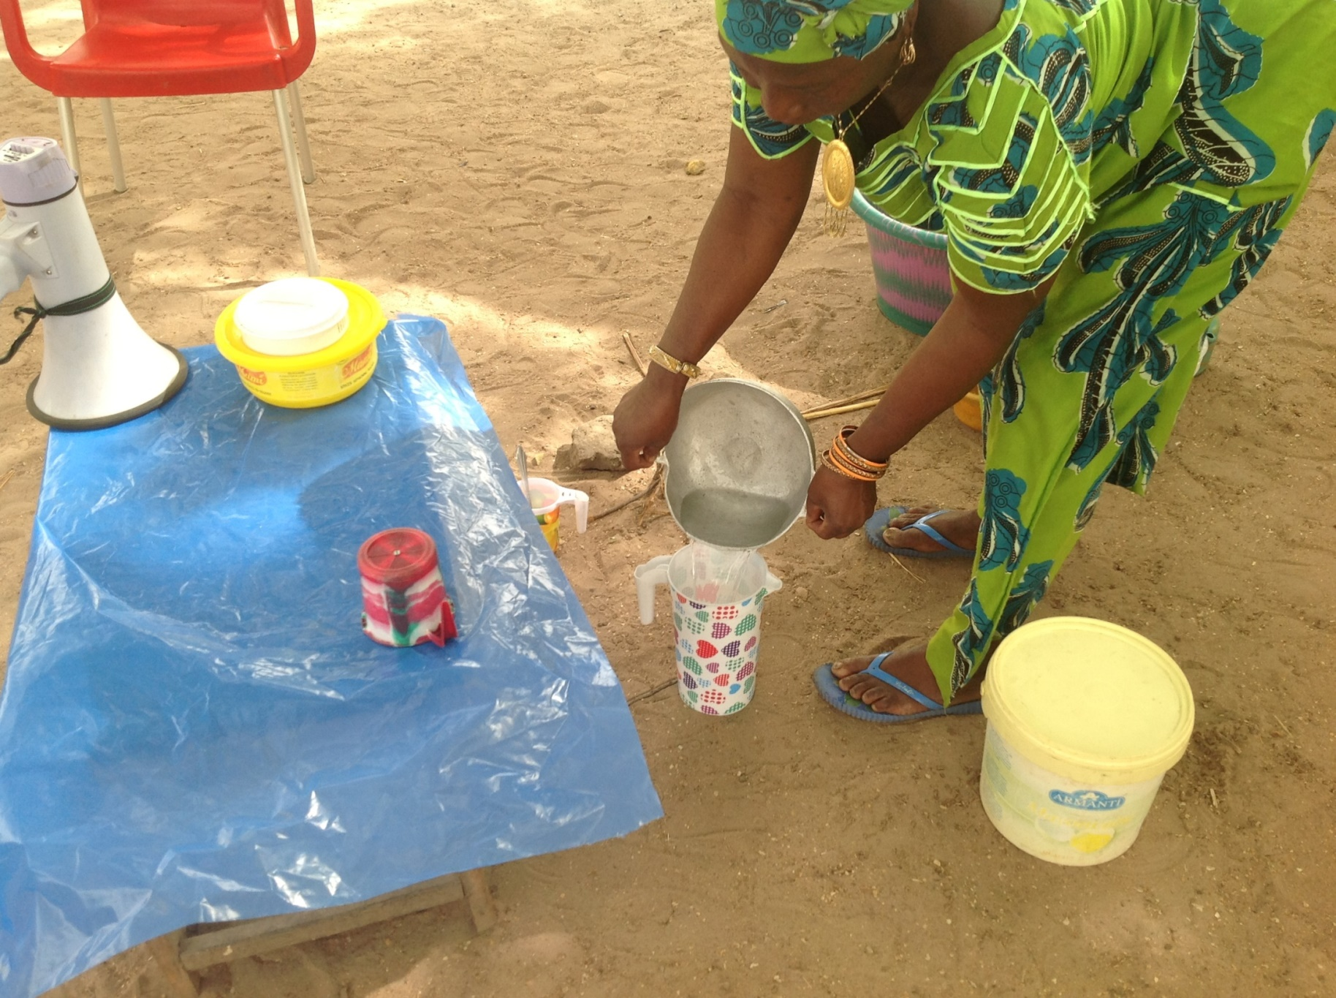
Drama MaaChampion boiling water for a child
Notes:
Drama MaaChampion boiling water for a child

Slide 43
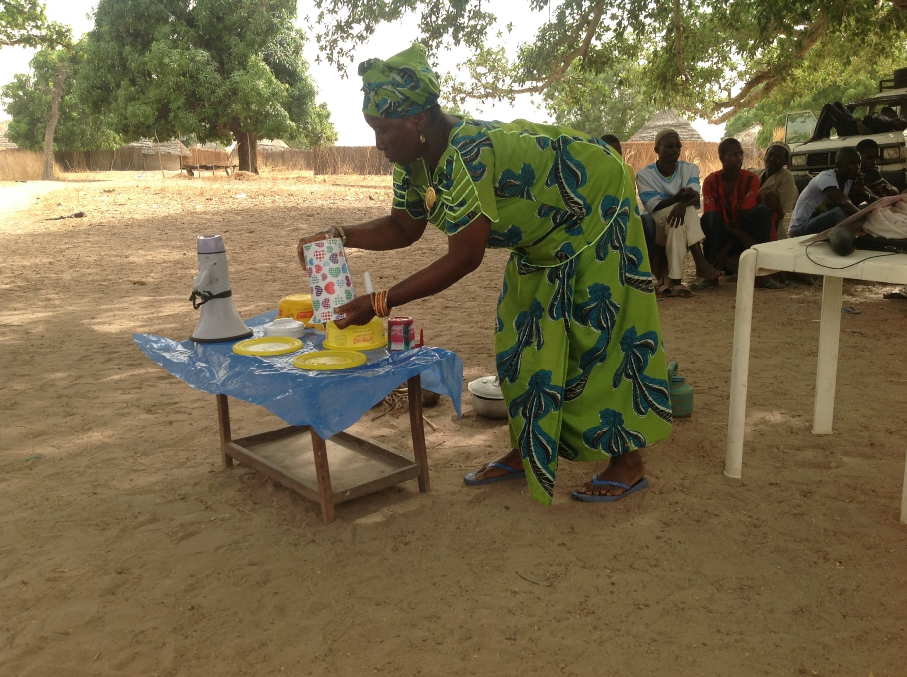
Drama MaaChampion drying dishes on a plastic mat
Notes:
Drama MaaChampion drying dishes on a plastic mat

Slide 44
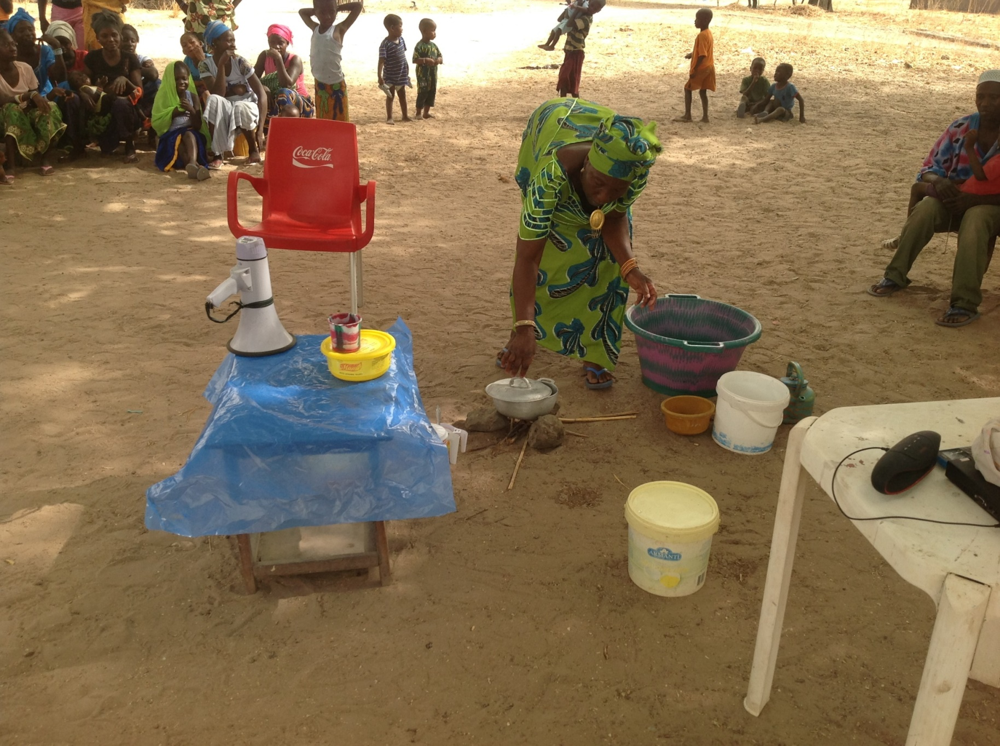
Drama MaaChampion reheating stored food
Notes:
Drama MaaChampion reheating stored food

Slide 45
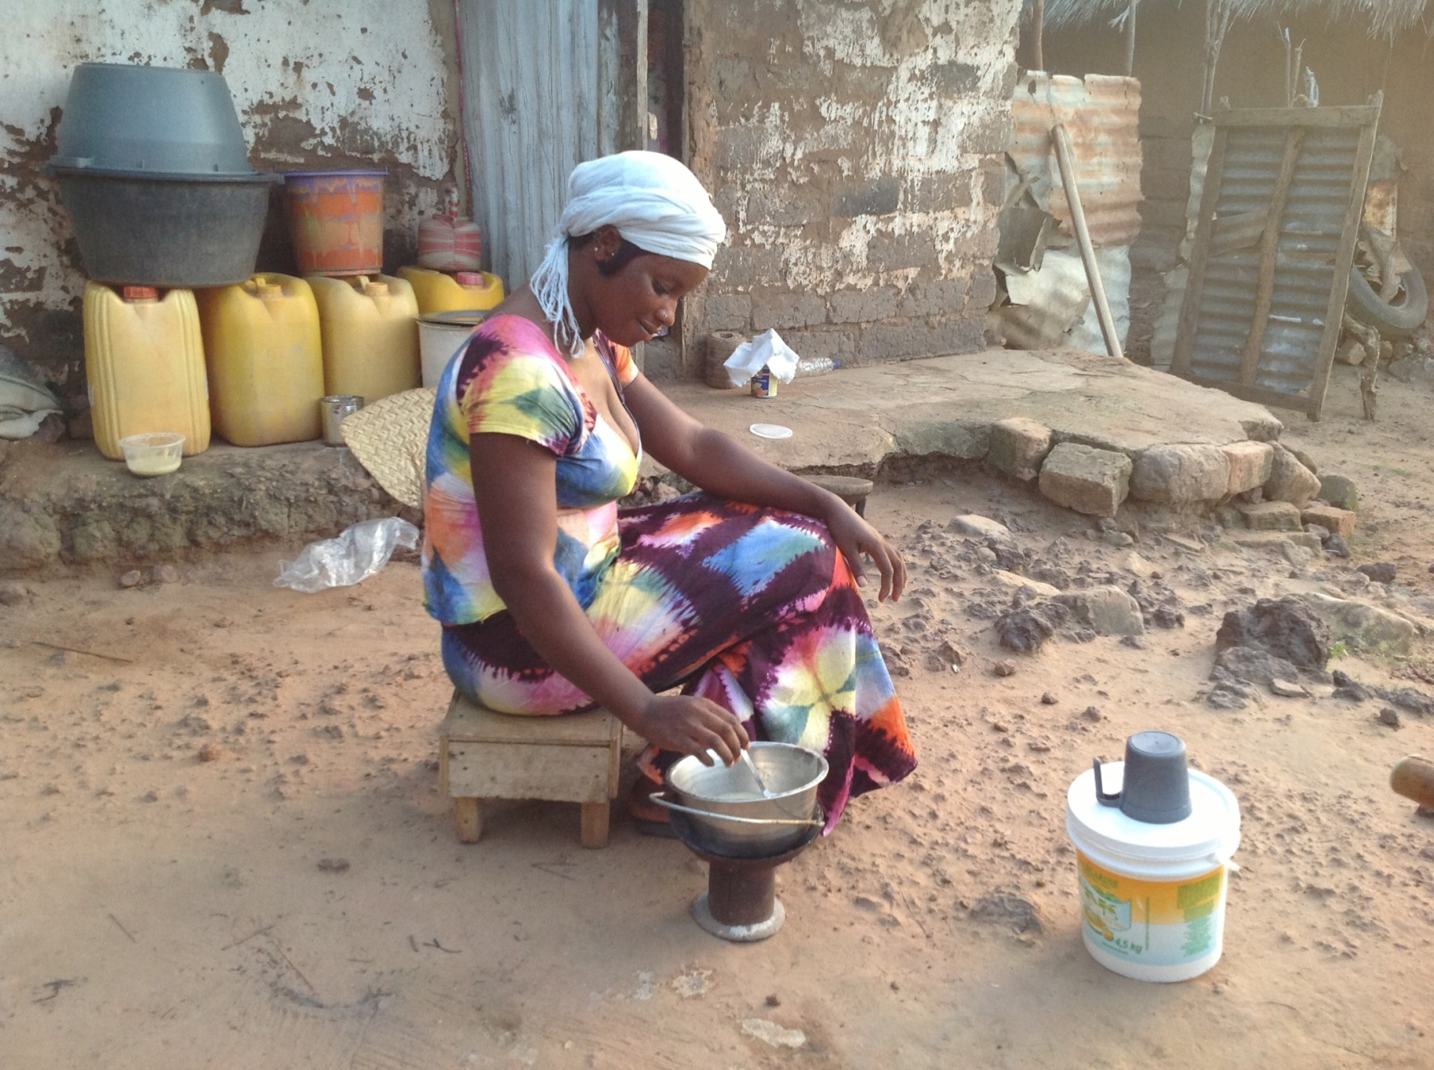
MaaChampion reheating stored weaning food
Notes:
MaaChampion reheating stored weaning food

