Slide 1
Complementary Food Hygiene in the Gambia
Formative Research Stages

Slide 2
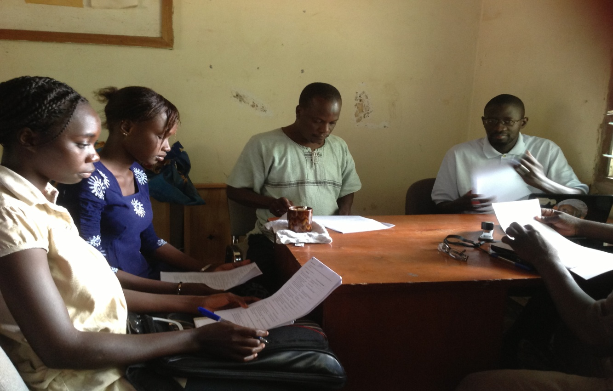
Training session: field workers and assistants
Notes:
Training session: Lady Field workers and Assistants for formative research

Slide 3
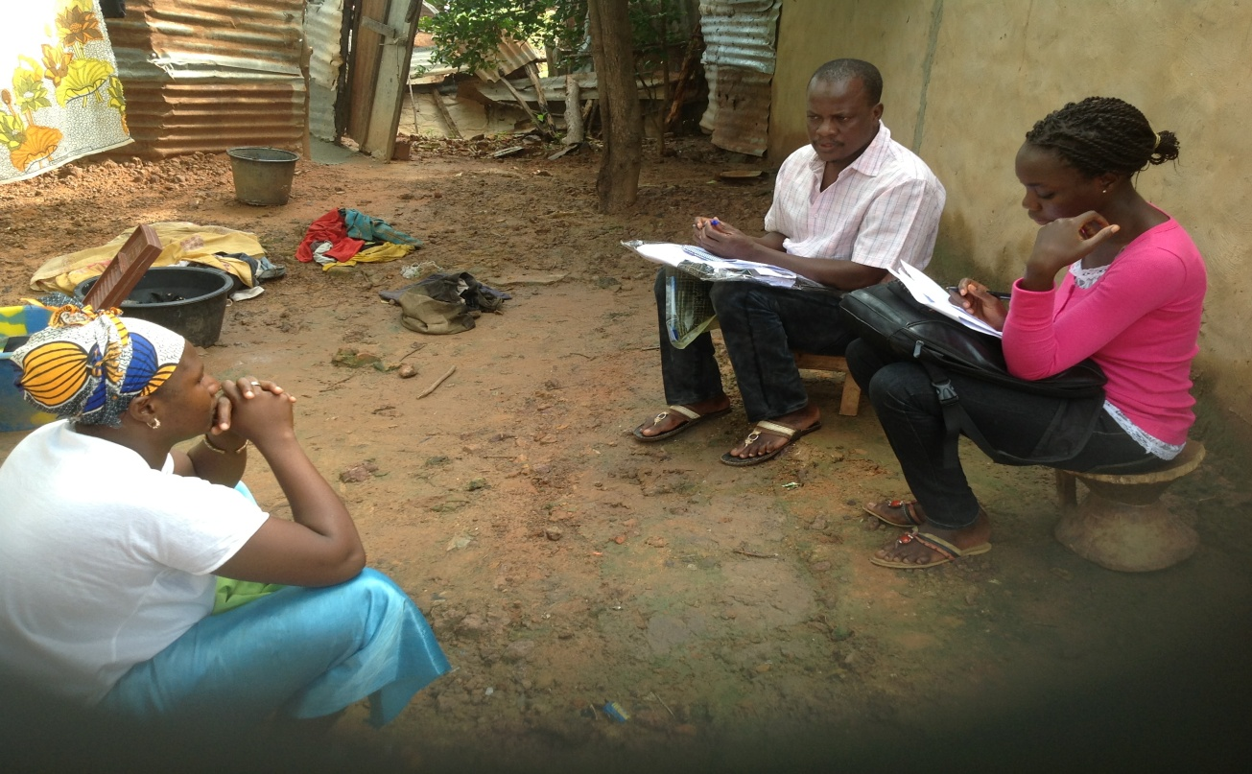
Pre-testing the tools
Notes:
Pre-testing the tools for formative research

Slide 4
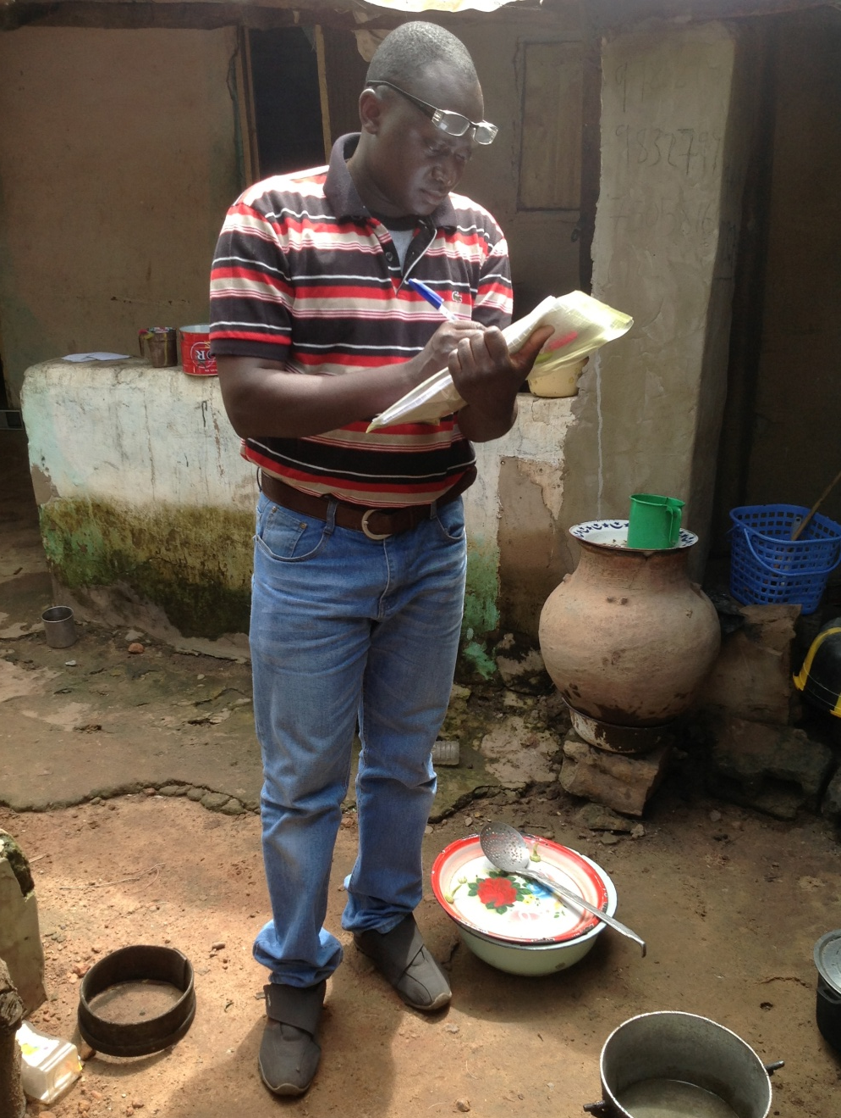
Pilot testing tools
Notes:
Pilot-testing tools for formative research

Slide 5
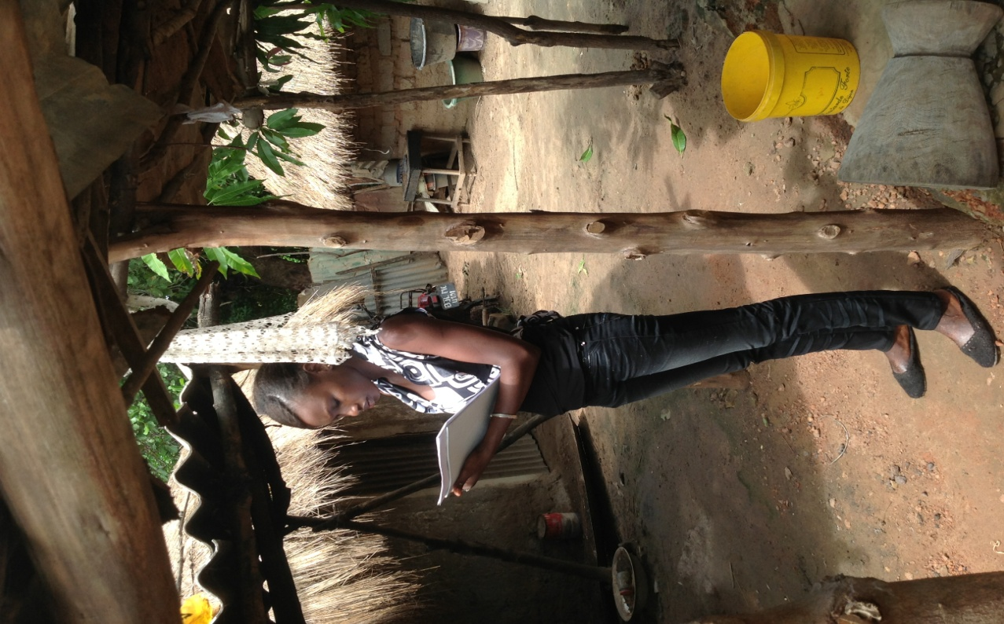
Field work exercise
Notes:
Field work exercise for formative research

Slide 6
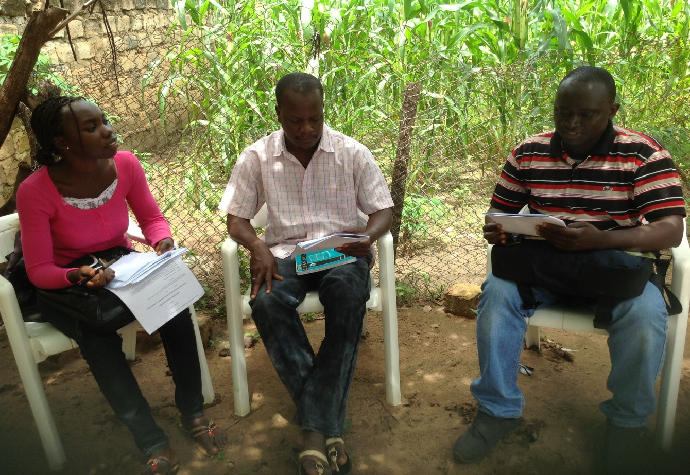
Discussion and adaptation of tools
Notes:
Discussion and adaptation of tools for formative research

Slide 7
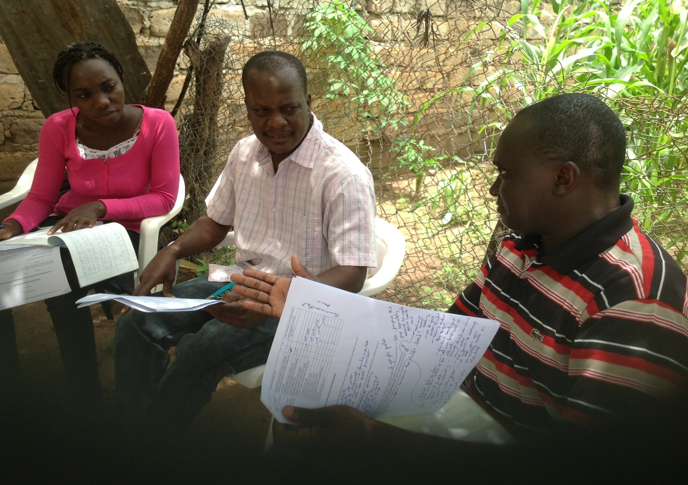
Discussion and adaptation of tools
Notes:
Discussion and adaptation of tools for formative research

Slide 8
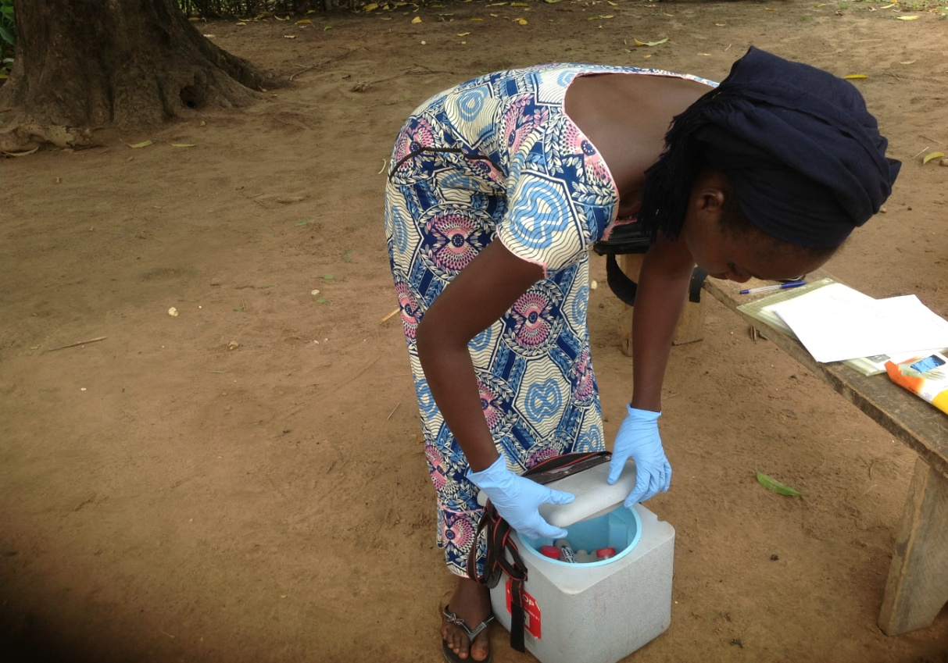
Daily collection of samples
Notes:
Daily collection of samples for formative research

Slide 9
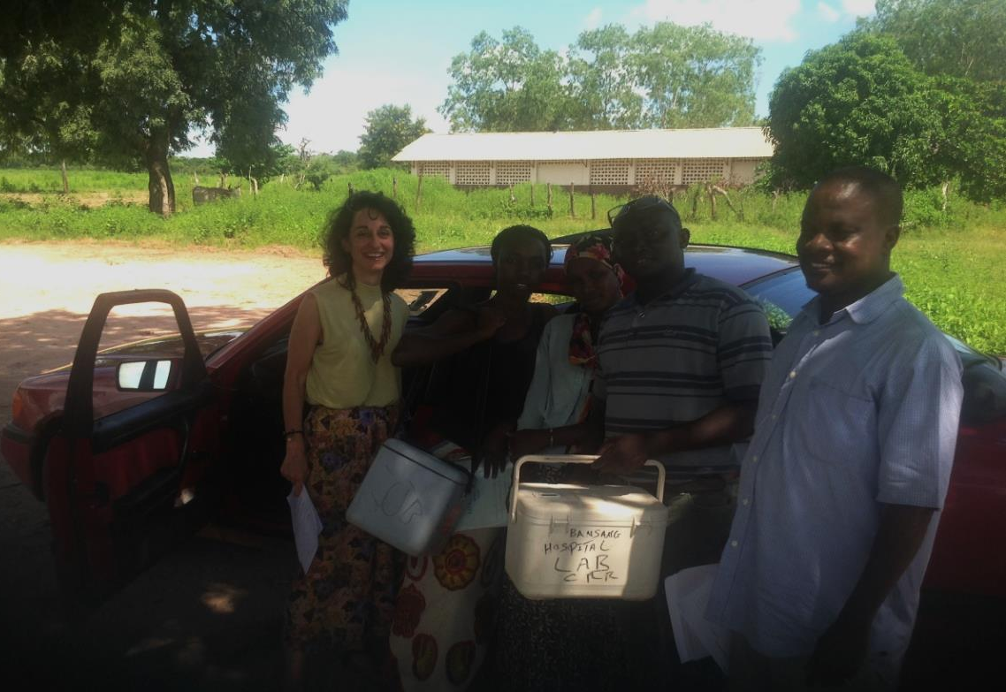
Daily collection of samples
Notes:
Daily collection of samples for formative research

Slide 10
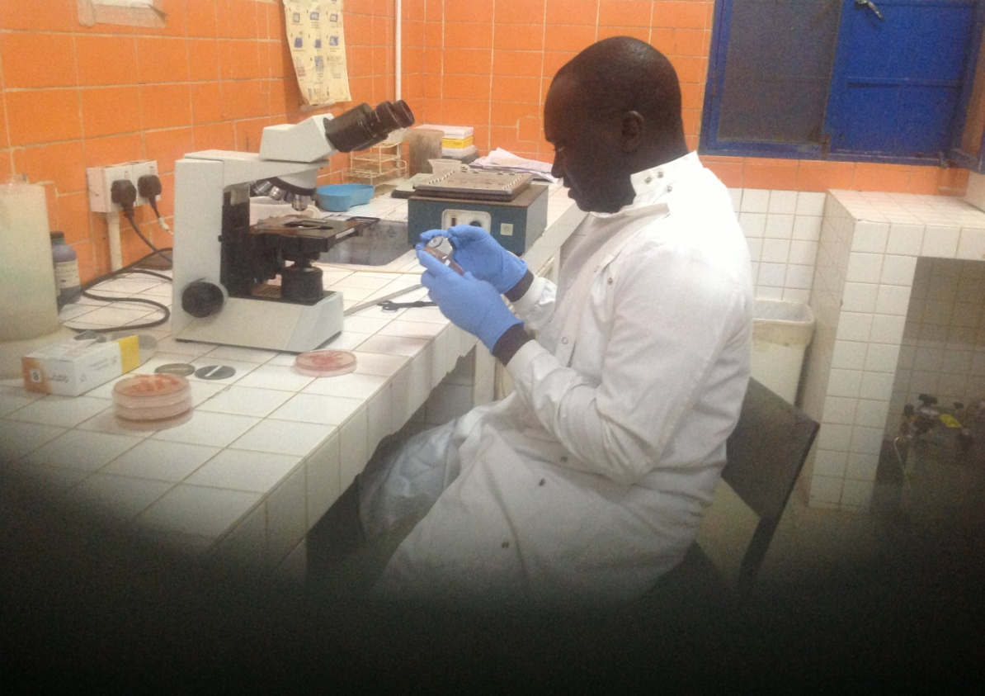
Sample analysis at the lab
Notes:
Sample analysis at the lab for formative research

Slide 11
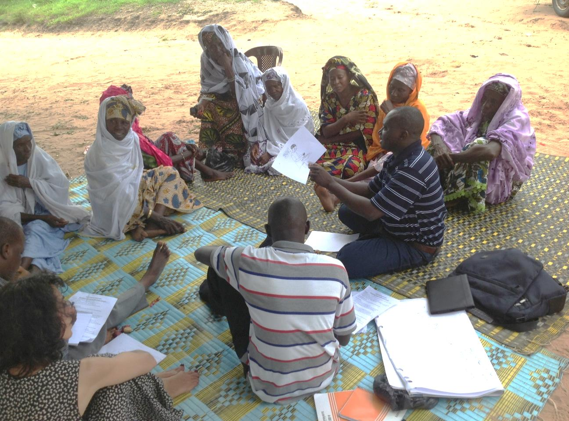
Focus group discussion with grandmothers
Notes:
Focus Group Discussion for Grandmothers for formative research

Slide 12
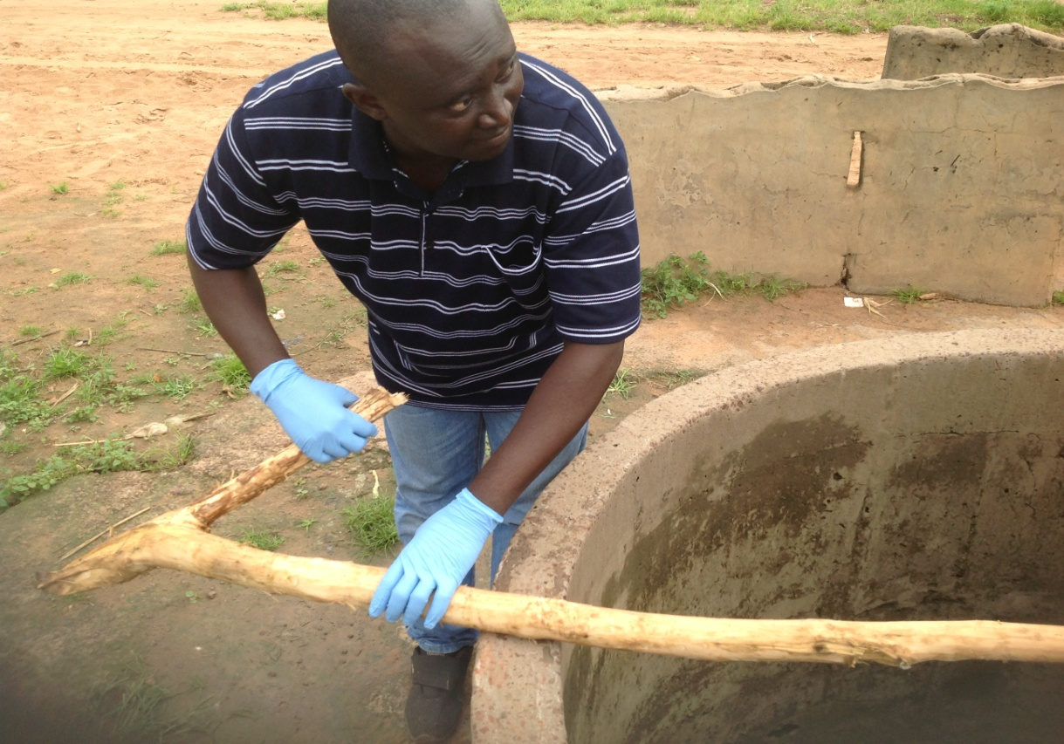
Water sample collection
Notes:
Water sample collection for formative research

Slide 13
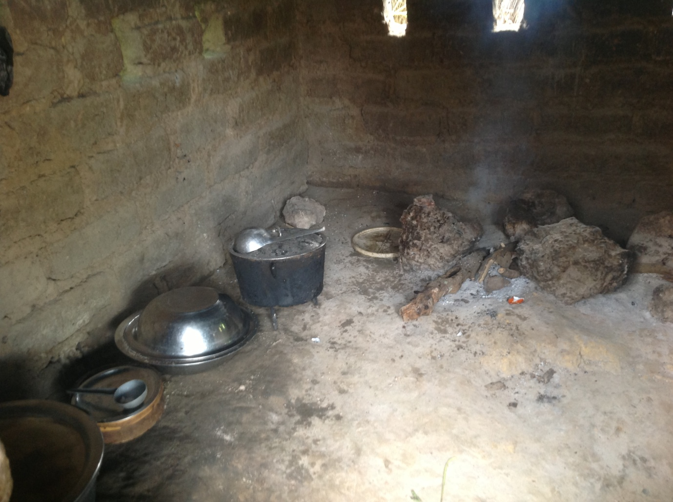
Kitchen as seen during observation of mother in formative research stages
Notes:
Kitchen as seen during observation of mother for formative research

