Slide 1

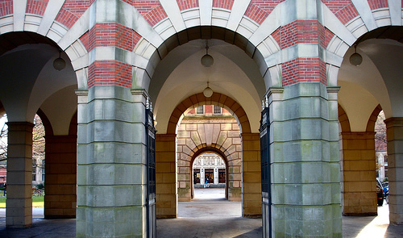

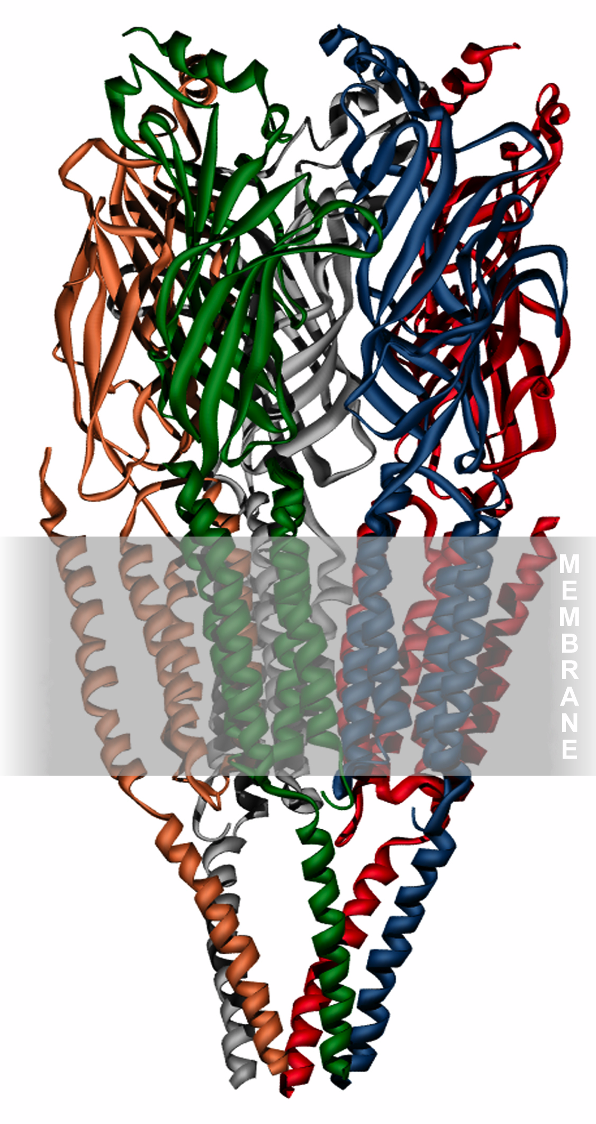
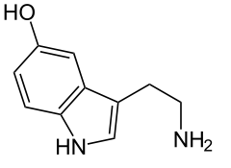
Generation of human monocyte-derived microglia from human peripheral blood monocytes; phenotypic and functional characterisation
Professor Nicholas M. Barnes PhD, FBPhS
Neuropharmacology Research Group, College of Medical and Dental Sciences, University of Birmingham B15 2TT UK

Slide 2
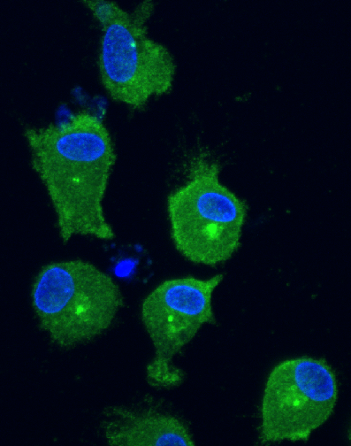
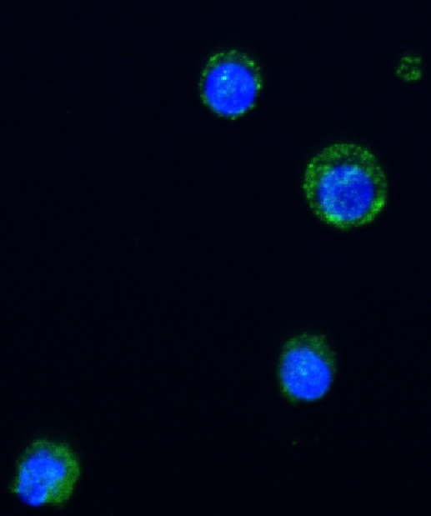
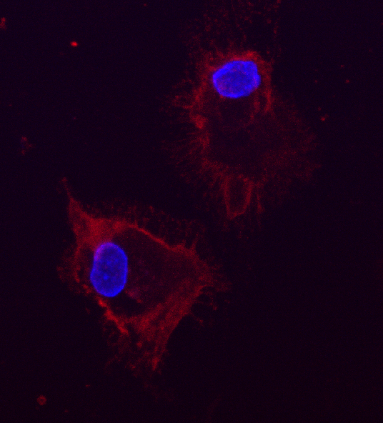
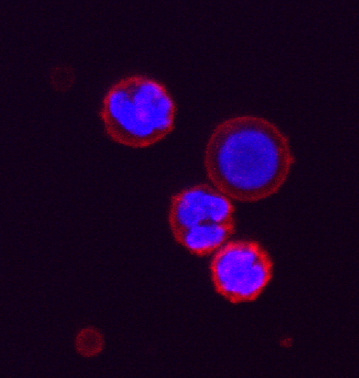
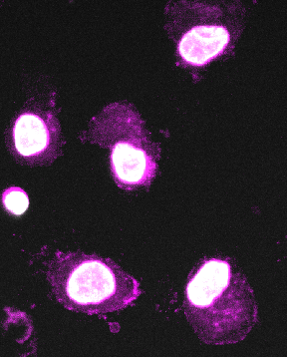
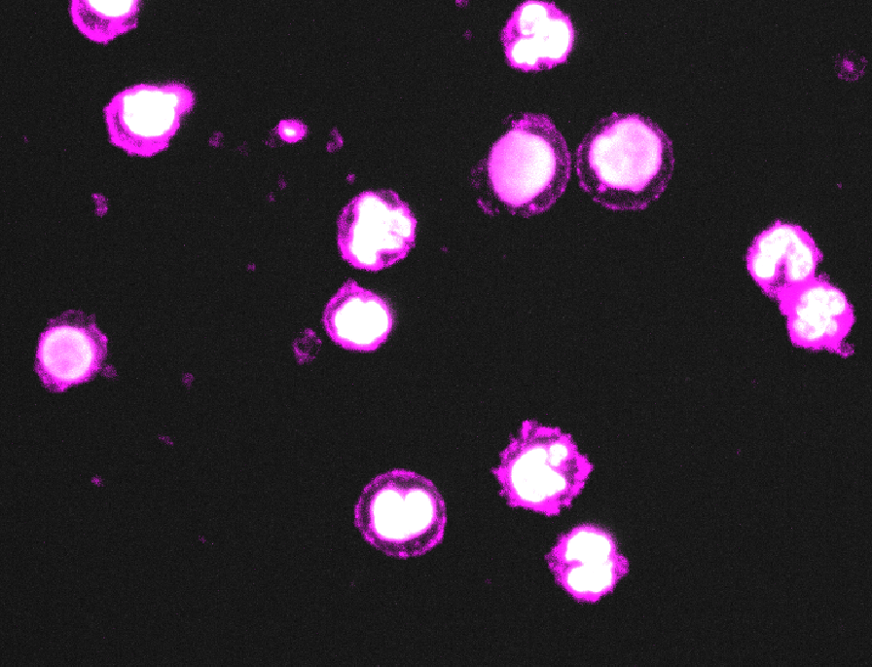
Monocyte-derived Microglia (MDMi cells)
MDMi
Monocyte
Human peripheral blood monocytes differentiated to microglia (MDMI cells) using a method adapted from Ryan et al. (Science Translational Medicine 9, eaai7635, 2017)
MDMi cells express markers and morphology consistent with a microglial phenotype (right panels)
MDMi cells phagocytose various cellular components including human pHrodo-labelled myelin-basic protein membrane (next slide)
DAPI TMEM-119
DAPI CD45
DAPI CD11b

Slide 3
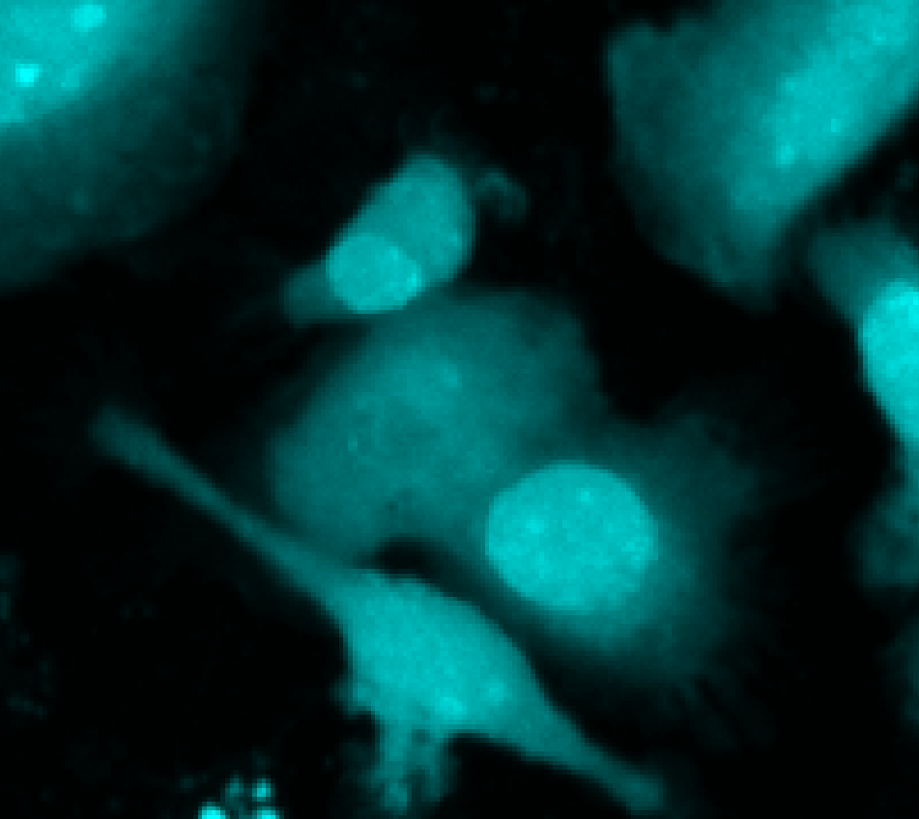
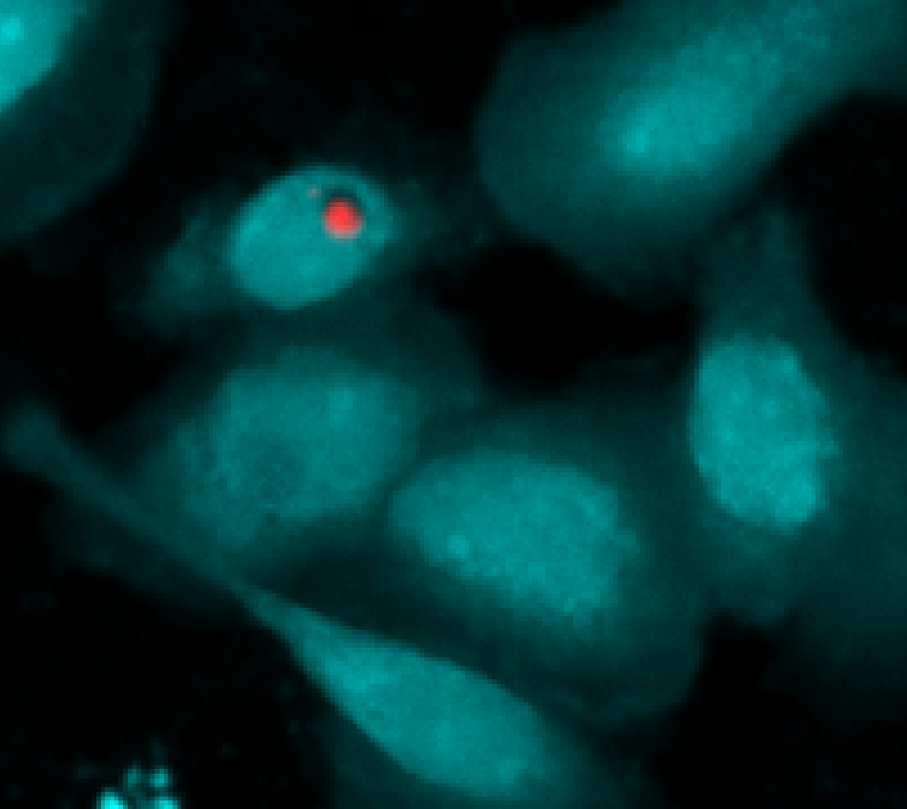
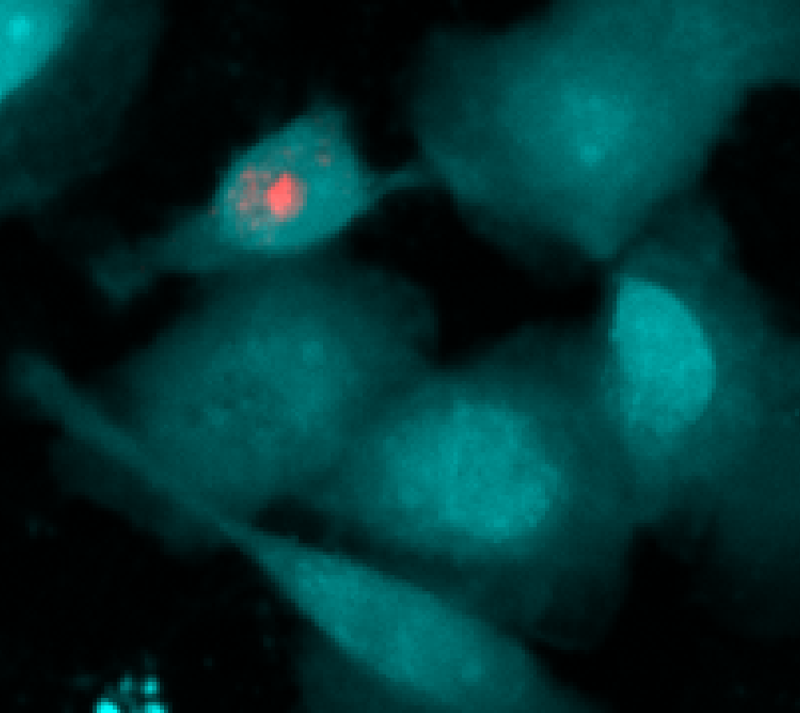
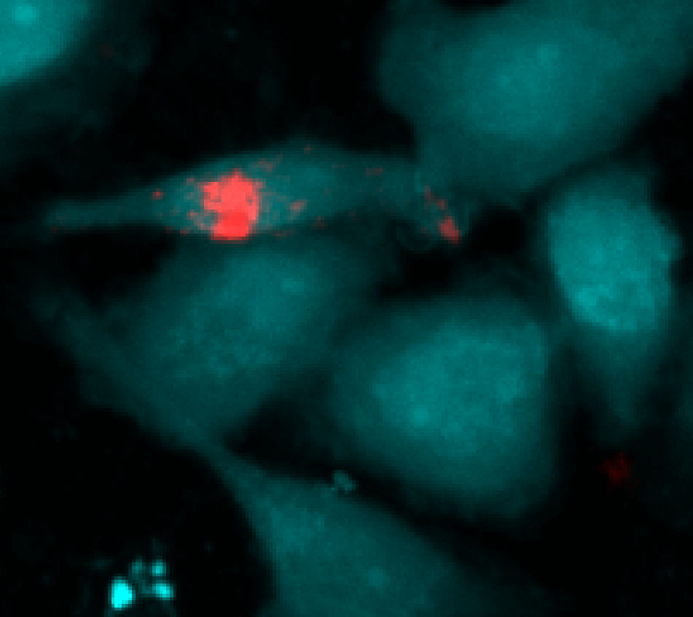
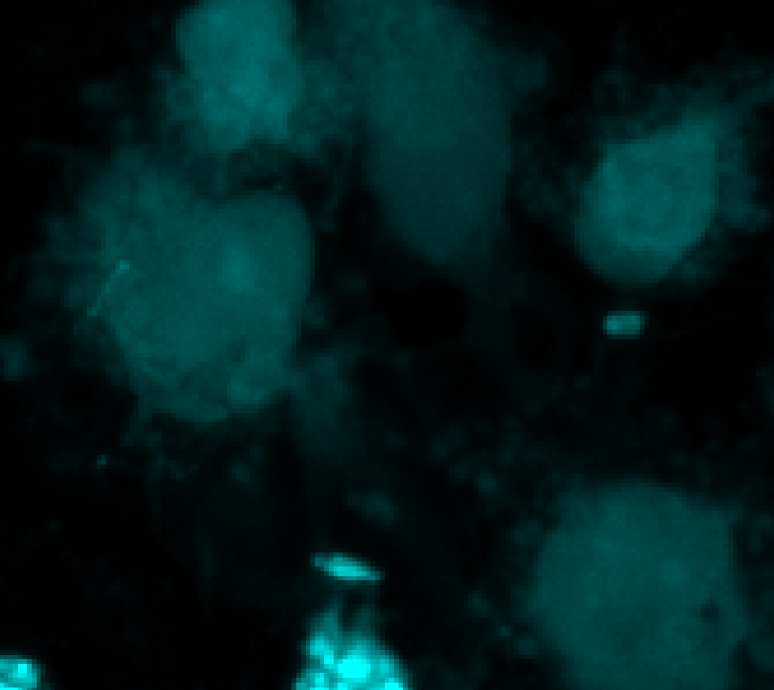
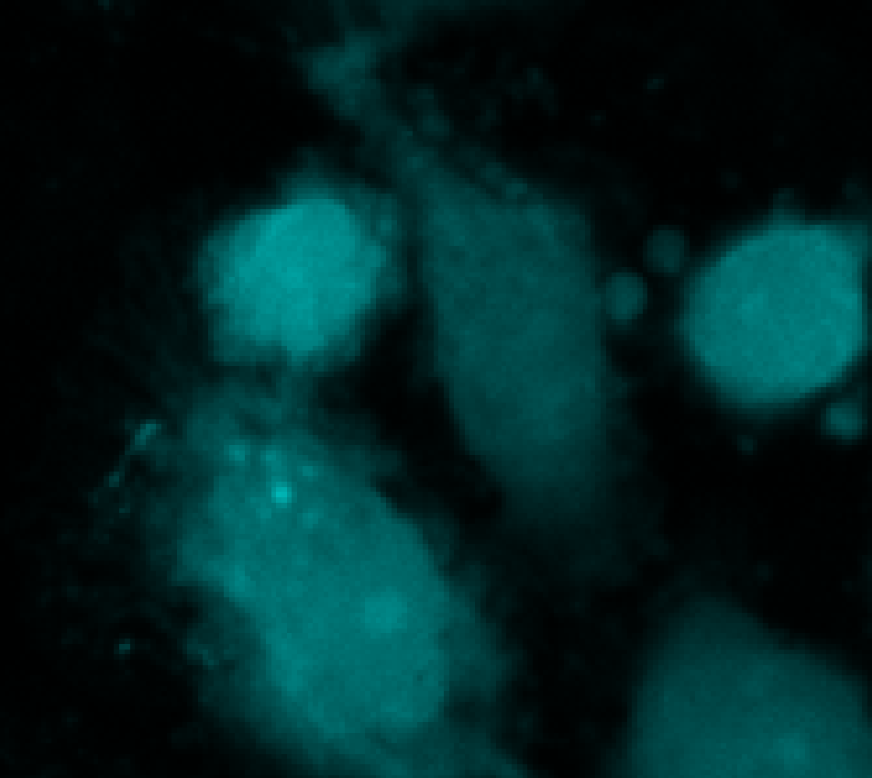
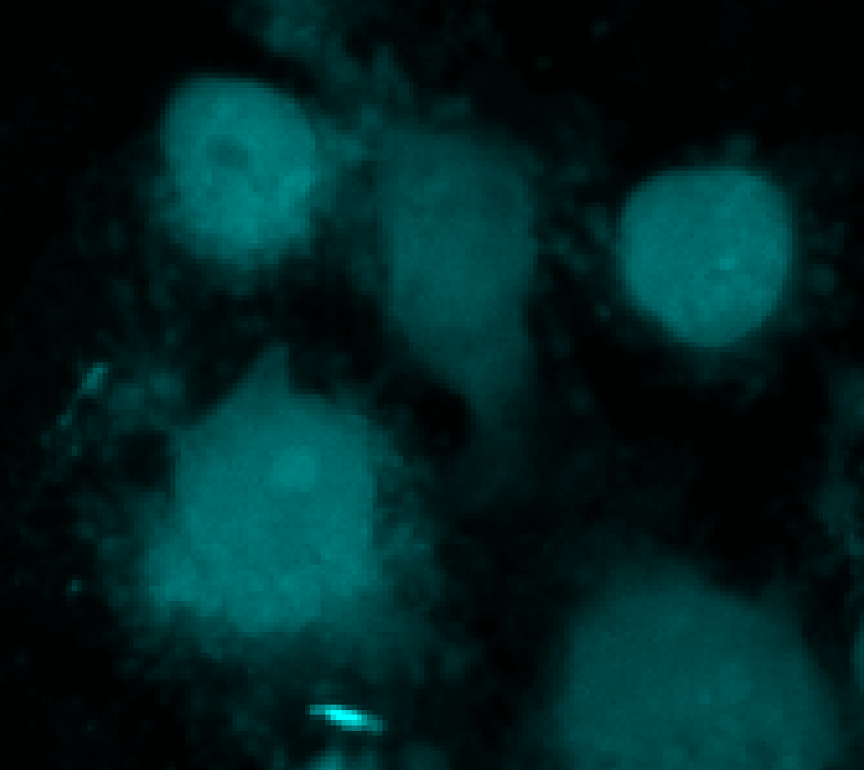
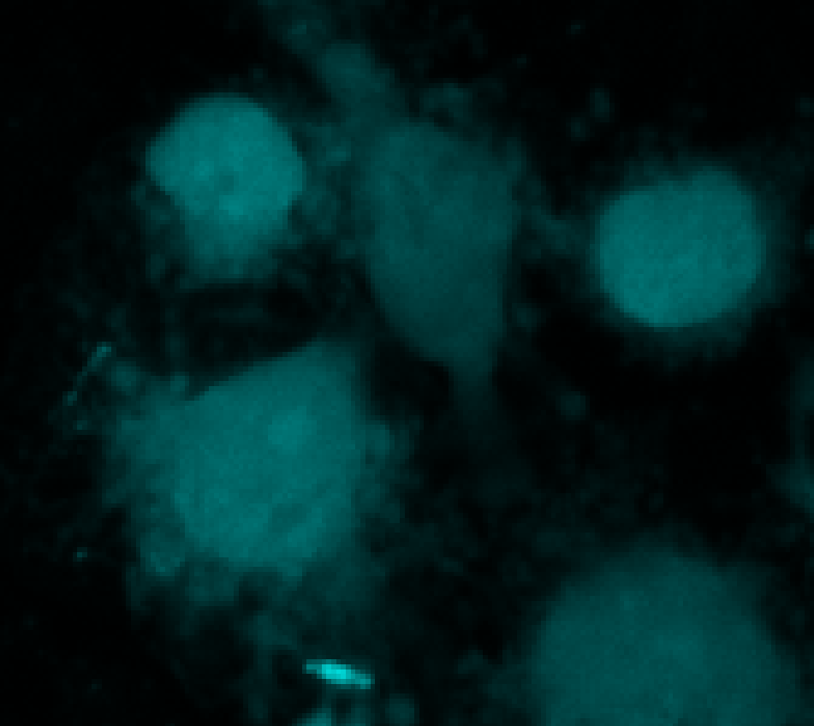
Monocyte-Derived Microglia (MDMi cells): Phagocytosis
Phagocytosis of human pHrodo-labelled myelin-basic protein membrane by human microglia (MDMi cells labelled with eFluor450; red fluorescence associated with phagocytosed protein) and inhibition of phagocytosis by cytochalasin D (see next slide for videos of the phagocytosis).
T=0h
T=1h
T=2h
T=6h
Control
T=0h
T=1h
T=2h
T=6h
Cytochalasin

Slide 4
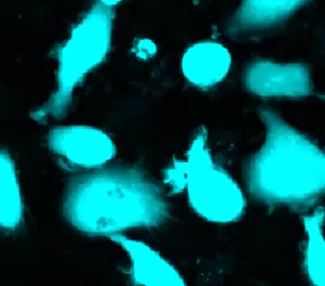
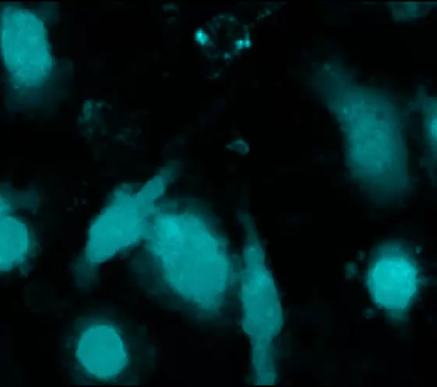
Monocyte-Derived Microglia (MDMi cells): Phagocytosis
Videos of phagocytosis of a human pHrodo-labelled myelin-basic protein membrane preparation by human microglia (MDMi cells labelled with eFluor450; red fluorescence associated with phagocytosed protein). MDMi cells treated with vehicle (left) or cytochalasin D (right). Each second of video is one hour of recording.
Vehicle
Cytochalasin D
Please click on the picture to start the video

