Slide 1
Women’s Health Hubs Evaluation Lessons in implementation Dr Beck Taylor, Clinical Associate Professor in Public Health, University of Warwick Research team: Dr Jennifer Bousfield, Senior Analyst, RAND Europe Kelly Daniel, Evaluation Fellow, Health Services Management Centre, University of Birmingham Lucy Hocking, Senior Analyst, RAND Europe Dr Louise Jackson, Associate Professor in Health Economics, Institute of Applied Health Research, University of Birmingham

Slide 2
The BRACE programme
This rapid evaluation was carried out by the Birmingham, RAND and Cambridge Evaluation Centre (BRACE).
This project was funded by the National Institute for Health and Care Research, Health Services and Delivery Research programme (HSDR 16/138/31 – Birmingham, RAND and Cambridge Evaluation Centre).
The views expressed are those of the authors and not necessarily those of the NIHR or the Department of Health and Social Care.
Please note that our final report is currently under final review with NIHR and may be subject to change. This summary was developed to provide findings rapidly to policy and practice.

Slide 3
Evaluation plan
May-July 2022
July 2022-January 2023
October 2022-March 2023
Map and describe hubs
Develop database of WHH
In depth work in 4 sites
Selection of 4 exemplar hub sites
Consolidation of findings and recommendations
Interviews with national stakeholders (n=4-5)
Analysis of 10 scoping interviews
Interviews with regional stakeholders (n=7)
Development of typology if possible
Online survey with lead from every WHH
In-depth interviews with staff (n=7) and service users (n=8) at each site
Focus groups with women in local communities (via community groups)
Documentary analysis
Rich description and map of UK Women’s Health Hubs
Identification of outcomes which are/could be used to assess impact
Development of a theory of change
Recommendations for policy, practice and research.
WP1
WP2
WP3

Slide 4
Defining Women’s Health Hubs
There was no agreed definition, so we developed a new working definition.
Challenges and considerations
Hubs are not ‘one-size-fits-all’
Context dependent (variation by geography, existing services/resources, standpoint of leaders, aims and needs of local populations)
At the time of evaluation, models were bottom-up/organic rather than standardised/driven by policy
Important that concept is meaningful to women and wider stakeholders
Agreed definition could support identification of hubs, engagement with relevant individuals, and implementation of the women’s health strategy
Broad definition – we removed ‘joint commissioning’ to be inclusive in the evaluation.
Our working definition
Women’s health hubs:
WHHs are based in the community and work at the interface between primary and secondary care and/or voluntary sector and wider.
WHHs offer more than a single service (and include the provision of both gynaecological services and contraception) or demonstrate plans to.
WHHs have more than one organisation involved in the process of service delivery; including in design, commissioning and/or provision of care, beyond simply referring-in.

Slide 5
Mapping Women’s Health Hubs:
results of online mapping survey
We identified 17 services across the UK that meet our definition of a WHH and are active (i.e. currently seeing women).
Most were located in England (N=13), with four in Northern Ireland.
No hubs were identified in Wales or Scotland.
Most women in the UK did not have access to a hub.
Small scale and rare
Varied with no optimum model (model, leadership, commissioning, footprint/scale, etc)
Services mostly clinically led by GPs
Multiple venues and formats of appointments
GP referral pathways
Range of appointment formats
Map created using MapChart.net

Slide 6
Services offered

Slide 7
Implementation processes
Not all hubs had a clear organised or pre-defined implementation process. This was created through pooling examples of implementation processes across hubs.

Slide 8
Step 1: Mapping existing services and gaps
Mapping informed design and scope (e.g. identifying local needs, inequalities, reviewing referral numbers), and good practice involves collaboration across organisations (enhancing shared vision and strategy) and the involvement of women and communities.

Slide 9
Step 2: Scoping and designing the hub
Tools such as the non-adoption, abandonment, scale-up, spread and sustainability (NASSS) framework can be used at both the mapping, scoping and design phases to ensure hubs are fit for purpose, suitable for local women and complementary to existing local services and resources. It can be helpful to pre-emptively think though potential barriers and facilitators.

Slide 10
Step 3: Securing funding & buy-in
A business case could be used to secure funding and to support buy-in from commissioners and potential providers. This could support a pilot hub. When building a team and securing buy-in (and at other stages of this process), leaders/implementers could utilise frameworks for managerial behaviours to empower colleagues.

Slide 11
Step 4: Implementation activities
IT barriers that could be pre-empted and solutions put in place include interoperable systems where primary and secondary care systems cannot connect with each other, hindering joint-working across organisations and sectors.

Slide 12
Step 5: Set-up steering strategy/group
Strategy/steering groups oversee the implementation and delivery of a hub. These groups (e.g. primary care staff, secondary care staff, commissioners, public/patients) could undertake varied activities, including reviewing hub activity, discussing plans for hub growth, inputting into patient pathway design and risk management.

Slide 13
Step 6: Shift from pilot to core funded service
All exemplar hubs were initially implemented as a pilot and most were created out of existing services, expanding over time. Expansion included: offering additional services, seeing a greater number of women, hiring more staff, involving more organisations, and covering a wider geographical area. Most hubs were not core funded services and challenges for sustainability and scale-up may need to be considered as hubs are implemented more widely.

Slide 14
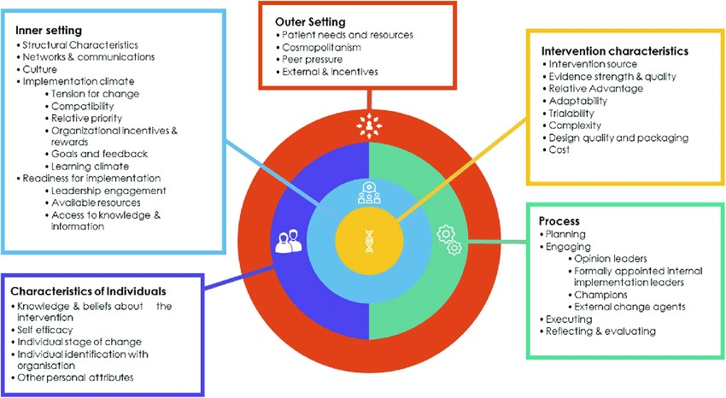
Consolidated Framework for Implementation Research (CFIR)
The CFIR provides a menu of constructs that have been associated with effective implementation.
It draws on 19 frameworks or related theories and user feedback.
It provides a guide to assess enablers and barriers to implementation.

Slide 15
CFIR: Example of women’s health hubs
Intervention characteristics:
Source (bottom – top-down)
Evidence/relative advantage (base, early evaluation, learning from others/resources)
Trialability/pilots
Costs (business cases)
Inner Setting (local services and settings/ local context & variation):
Change/implementation readiness
Relative priority
Resources
Funding/commissioning
Outer setting: WHS,
backlogs & resources challenges
Process
Planning & engaging (business cases, steering groups)
Internal implementation leaders (assigning responsibility at every level)
Reflecting & evaluating (data)
Characteristics of individuals/teams:
Existing knowledge & attitudes to women’s health & integration
Leadership & team/workforce (capacity, readiness, skills)

Slide 16
Advice for implementers
Identify a lead for an area and give time to hub leads
Start small/familiar, where possible utilise existing resources and grow/expand
Pilot/proof of concept (e.g. financial viability, consider/test infrastructure, e.g. IT, physical space, equipment)
Collect data (cost, outcomes, impact, sustainability) and prioritise based on local population needs
Build/utilise existing relationships & work with all stakeholders/sectors (including women – use, risk of exclusion)
Learn from others further along/community of practice
Wider resources (e.g. Primary Care Women’s Health Forum)

Slide 17
Thank you for viewing this presentation
For further information about the study please contact:
Beck.Taylor@warwick.ac.uk
For more information:
Women’s Health Hub Evaluation
BRACE is funded by the NIHR Health Services and Delivery Research (HS&DR) programme (HSDR16/138/31).
The views expressed are those of the authors and not necessarily those of the NIHR or the Department of Health and Social Care.

