Slide 1
Women’s Health Hubs Evaluation: Summary of findings
Dr Beck Taylor, Clinical Associate Professor in Public Health, University of Warwick
Research team:
Dr Jennifer Bousfield, Senior Analyst, RAND Europe
Kelly Daniel, Evaluation Fellow, Health Services Management Centre, University of Birmingham
Lucy Hocking, Senior Analyst, RAND Europe
Dr Louise Jackson, Associate Professor in Health Economics, Institute of Applied Health Research, University of Birmingham

Slide 2
The BRACE programme
This rapid evaluation was carried out by the Birmingham, RAND and Cambridge Evaluation Centre (BRACE).
This project was funded by the National Institute for Health and Care Research, Health Services and Delivery Research programme (HSDR 16/138/31 – Birmingham, RAND and Cambridge Evaluation Centre).
BRACE, including this evaluation, is funded by the NIHR Health Services and Delivery Research (HSDR) programme (HSDR16/138/31). The views expressed are those of the authors and not necessarily those of the NIHR or the Department of Health and Social Care.

Slide 3
Women’s Health Hubs
…improving access, quality and experience of care for services for menstrual problems, contraception, pelvic pain, menopause care and more…
…tailored to meet local women’s needs… delivering services in the community that better fit around women’s lives and streamline access…
…address fragmentation in provision, for example by providing management of contraception and heavy bleeding in one visit, or integrating cervical screening with other aspects of women’s health care…
…create longer-term savings…improving access to preventative care and reducing pressure on secondary care services.”
…£25 million investment over the next 2 years…
…government released guidance documents in 2023 (definitions, services and care pathways, logic model)
…Women’s Health champions appointed in every ICB
https://www.gov.uk/government/publications/womens-health-hubs-information-and-guidance/womens-health-hubs-core-specification
UK Gov. Press release £25 million for women's health hub expansion 2023: https://doi.org/https://www.gov.uk/government/news/25-million-for-womens-health-hub-expansion

Slide 4
The evaluation

Slide 5
Update on final report – under peer review and subject to change
Please note that our final report is currently under final review with NIHR and may be subject to change. This summary has been developed to provide findings rapidly to policy and practice.
The findings presented here are accurate to the best of our knowledge. However, this is a complex context and hubs are evolving continuously.

Slide 6
Evaluation aims and design

Slide 7
Evaluation aims
Project initiation:
  Prior to the release of the Women’s Health Strategy (September 2021)
  NIHR asked the BRACE Rapid Evaluation Centre to undertake a rapid evaluation following a request by DHSC.
Study period: 12 months from April 2022 to March 2023.
Overall aim to explore the ‘current state of the art’ to inform policy and practice:
  map the landscape
  study experiences of delivering and using hub services
  define key features and early markers of success.

Slide 8
Evaluation questions
What are Women’s Health Hubs, and is there variation in how stakeholders name and define them?
How many Women’s Health Hubs have been established/are in development across the UK, where are they, and what are their characteristics, including models of structure, commissioning and delivery?
Why have Women’s Health Hubs been implemented, and how are they intended to address health inequalities?
What have Women’s Health Hubs achieved to date? How do Women’s Health Hubs achieve this?
What are the experiences and perspectives of staff regarding Women’s Health Hub setup, commissioning, funding, implementation and delivery?
What are the experiences and perspectives of women?
How are Women’s Health Hub performance, outcomes and costs measured, and how might they be measured in future?

Slide 9
Design:
Mixed-methods evaluation, comprising:
Mapping of the current landscape and context for WHHs
  10 scoping interviews with key informants
  Online survey of UK WHH leaders
  Desk research
In-depth evaluation in four purposively selected hub sites
  Interviews with staff (n=40) and women (n=32), four focus groups with diverse women in local communities (n=48), and documentary analysis.
Interviews with regional* (n=7) and national (n=6) stakeholders
*Regional stakeholder interviews were postponed to enable discussion of hubs in the context of the Women’s Health Strategy, as publication was delayed until 20th July.

Slide 10
Current status:
Final report submitted to NIHR March 2023
Currently under final review
Academic papers and dissemination materials in preparation
DHSC have had sight of the draft report

Slide 11
Findings

Slide 12
RQ1:
What are Women’s Health Hubs, and is there variation in how stakeholders name and define them?

Slide 13
Defining Women’s Health Hubs
There was no agreed definition, so we developed a new working definition.
Challenges and considerations
Hubs are not ‘one-size-fits-all’
Context dependent (variation by geography, existing services/resources, standpoint of leaders, aims and needs of local populations)
At the time of evaluation, models were bottom-up/organic rather than standardised/driven by policy
Important that concept is meaningful to women and wider stakeholders
Agreed definition could support identification of hubs, engagement with relevant individuals, and implementation of the women’s health strategy
Broad definition – we removed ‘joint commissioning’ to be inclusive in the evaluation.
Our working definition
Women’s health hubs:
WHHs are based in the community and work at the interface between primary and secondary care and/or voluntary sector and wider.
WHHs offer more than a single service (and include the provision of both gynaecological services and contraception) or demonstrate plans to.
WHHs have more than one organisation involved in the process of service delivery; including in design, commissioning and/or provision of care, beyond simply referring-in.

Slide 14
RQ2:
How many have been established, where are they, and what are their characteristics?

Slide 15
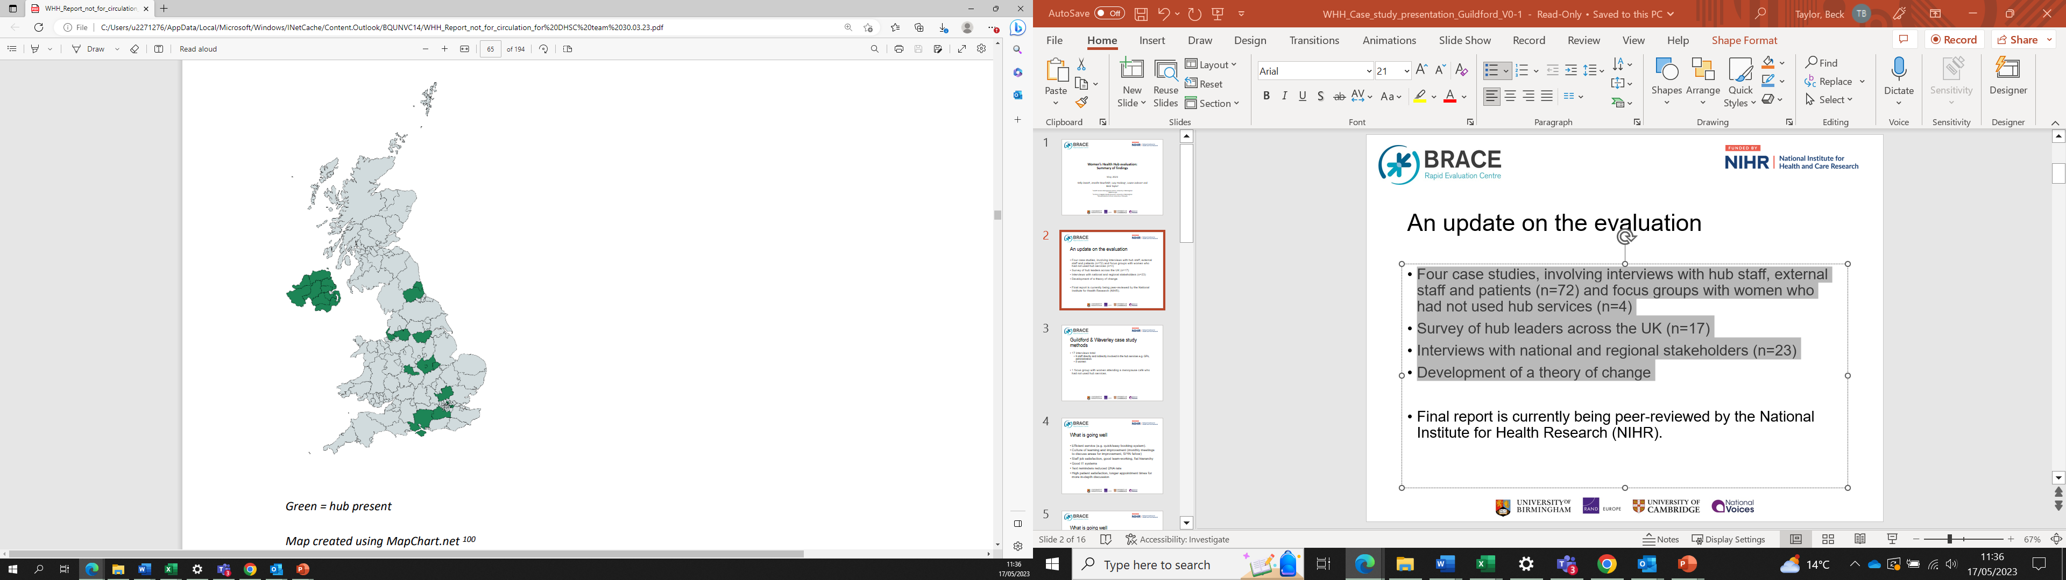
Mapping Women’s Health Hubs:
results of online mapping survey
We identified 17 services across the UK that meet our definition of a WHH and are active (i.e. currently seeing women).
Most were located in England (N=13), with four in Northern Ireland.
No hubs were identified in Wales or Scotland.
Most women in the UK did not have access to a hub.
Map created using MapChart.net

Slide 16
Women’s Health Hub characteristics
Most were evolving, no standard or ‘typical’ model.
Footprints, size and scale varied widely and no optimum footprint identified (PCN, ‘citywide’, multiple PCNs, CCG, GP Federation/s, ICS).
Intermediary space between standard primary care and specialist secondary care, although this boundary varied.
Majority clinically led by GPs with special interest in women’s health, although some were led by SRH consultant/gynaecologist-led.
Model descriptors and interpretation varied: e.g. one-stop-shop, hub-and-spoke.
Commissioning arrangements were diverse. Many examples of formal and informal creative approaches to identify and access resources, and in some cases share costs across different parts of the health and social care system. No clear optimum commissioning model identified.
Most hubs operated from multiple venues, often primary care or community venues.
Most had GP referral pathways.
Most did not offer out of hours/weekend services.
Most offered telephone appointments.

Slide 17
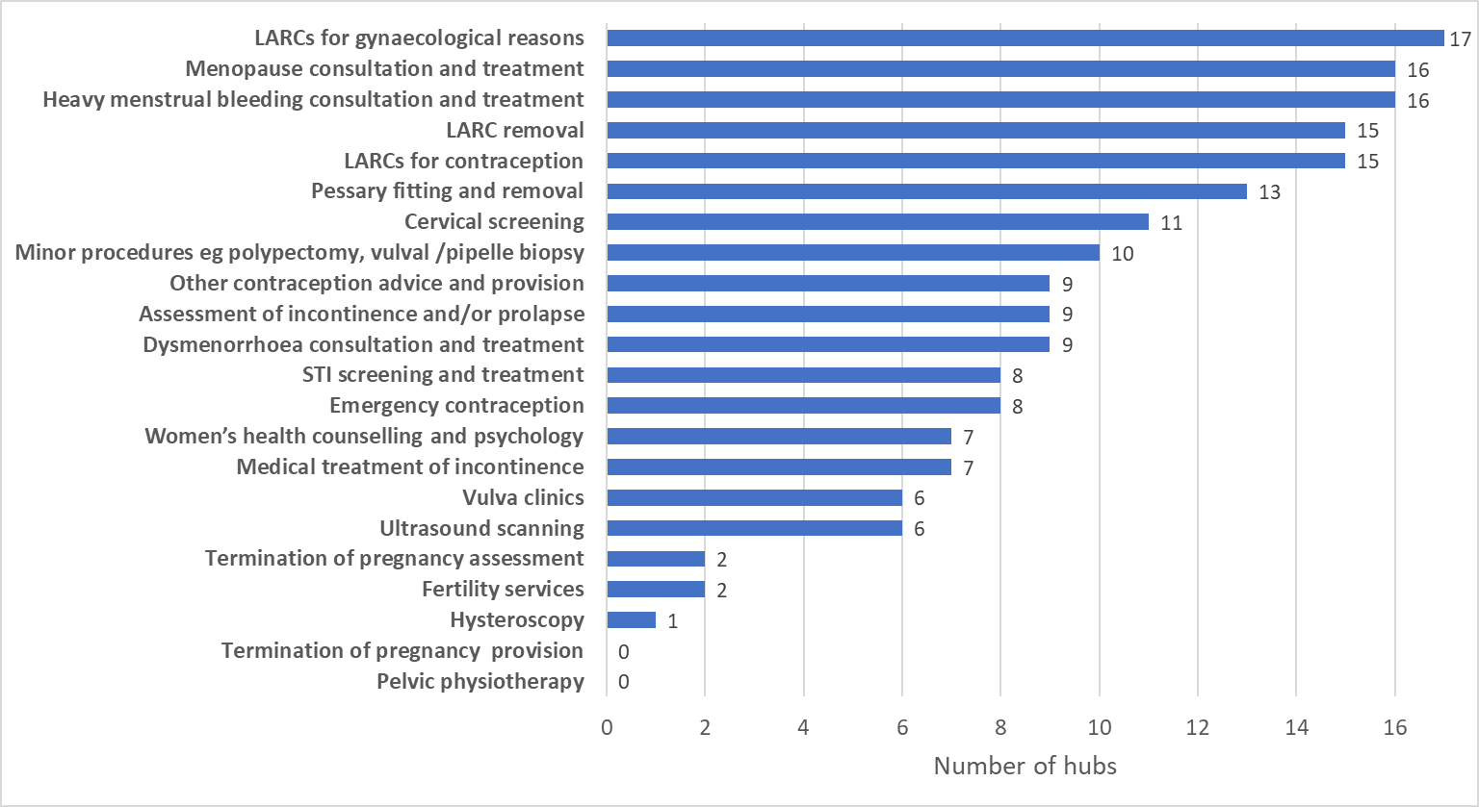
Services offered

Slide 18
Workforce and training
Diverse range of professionals reported to work in hubs:
  Most common staff groups: GPwSI and administrators
  Others (in order of frequency): healthcare assistants, hospital gynae associate specialist/consultants, community SRH consultants/specialists, GPs, practice nurses, specialist nurses, community SRH trainees, GP trainees, counsellors, GUM associate specialists, advanced nurse practitioners, nursing assistants, ultrasonographers, data analysts, physician assistants/associates.
  None of the hubs reported include hospital gynaecology trainees; physiotherapists; or pharmacists.
Almost all hubs reported that they offer training to healthcare professionals working in the hub.
  Some hubs also offered training opportunities to healthcare professionals from elsewhere, e.g. LARC training for local GPs, pessary fitting training for nurses, menopause training.

Slide 19
RQ3:
What have Women’s Health Hubs achieved to date? How do Women’s Health Hubs achieve this?

Slide 20
Key achievements/outcomes
WHHs have been successfully implemented, often with limited or no additional funding, and alongside service pressures, and COVID-19.
WHHs are providing access and care for hundreds of women in some local health systems.
Variation in measures and limited data prevents meaningful comparison of models, but available figures include:
  Low onward referral rates to secondary care gynaecology (5 to 14%, 3 hubs)
  Triage times and waiting times varied but were short (3 hubs), with triage within days and appointments within a few weeks
  14% reduction in secondary care gynaecology referrals by local GPs (1 hub)
  8.5% increase in local LARC fitting rates (1 hub)

Slide 21
Inequalities
WHH leaders committed to address socioeconomic and demographic inequalities
Often key issues were described as geographical (i.e. a ‘postcode lottery’)
No clear data on inequalities impact – further work is needed
Concerns were raised about access for some women, and risk of widening inequalities
“We cannot create the capacity to meet the demand and it is always, when things like that happen, it’s the ones who aren’t articulate or intelligent or – not intelligent, that’s the wrong word, but who lead, some people lead a chaotic lifestyle. Some people have young kids. Some people who aren’t able to, they can’t speak the language, they aren’t able to navigate the system are the ones who get left out and that’s a big, big concern for us. And it isn’t because we are not trying, because we are.”
(EH4, internal interview)

Slide 22
RQ4:
What are the experiences and perspectives of staff regarding Women’s Health Hub setup, commissioning, funding, implementation and delivery?

Slide 23
Facilitators and barriers to implementation and delivery
FACILITATORS
Collaborations/relationships across services and organisations (e.g. hub and CCG, acute trust, SRH)
Committed and experienced GPs (committed, enthusiastic, experienced, determined, engaged)
Supportive, passionate leadership (mostly GP-led, but includes commissioners and secondary care consultants)
Wider contextual factors making hubs a priority
Funding/commissioning aspects (additional funding/resource, commissioners involved from the start/design stage)
BARRIERS
Funding and commissioning issues (insufficient resource, siloed commissioning)
Challenges with IT systems (functionality, incompatibility across organisations, ordering tests electronically)
Staff recruitment and/or capacity (time to develop business case, covering out of hours, not enough adequately trained staff, lead’s personal time)
Physical space and logistics
Challenges with collaborating/buy-in (support from local stakeholders/providers)
Wider contextual challenges (many priorities for PCNs and ICB/S, local political landscape)

Slide 24
What helps/hinders implementation: illustrative quotes (1)
Strong leadership and motivated team
“…And I guess the critical thing is the enthusiasm of my colleagues! Because without that it would have floundered, no question. But we are all extremely enthusiastic and committed to the service and [Name]’s a brilliant lead, so [they’re] extremely able and a complete delight to work with. So that’s made a big difference.” GP working in a hub
Support from commissioners
“…it was very encouraging when the CCG came to us [GP team setting up the hub] because they were very enabling and we had carte blanche to provide a service that we felt would benefit the patients but also played to our strengths as well.” GP working in a hub
Strength and functionality of a service that is being expanded
“If you try and deliver that service on a faulty or on a fragile infrastructure, you know what’s going to happen. It is going to fail. Now with the best will in the world, even if you’ve got the most committed people, if you don’t give them the tools to do the job, they will do their best but that will not be good enough.” Practice Manager

Slide 25
What helps/hinders implementation: illustrative quotes (2)
Logistical challenges
“It took a long time to set up [the hub service] because of logistical bits, you know, things completely outside of our control and also the space availability, working around the times, who’s funding what, who needs to be there… you know, just those little logistical things. The medicine is fine!” PCN leader
No specific allocation of funds for hub
“I think that’s the biggest challenge that I have at the moment, that there isn’t a separate pot of money somewhere, we are trying to pull it from, you know, where it’s already in a particular system and that system is already fairly stretched, but it’s looking at better ways of working and looking at what we can pull out.” Local service manager

Slide 26
RQ5:
What are the experiences and perspectives of women who have used hub services?

Slide 27
Women’s perspectives
Most women were unaware of the term ‘Women’s Health Hubs’, and there was some lack of awareness about what they were or offered.
Experiences were largely positive, including when care at a WHH was compared to other services.
Though there were a few examples where things had gone less well, e.g. communication about what would be involved.
In focus groups with women not using the hub, some women raised concerns about whether hub services would be easily accessible to all.
Facilitators and barriers to uptake included awareness, waiting times and accessibility.
The Women’s Advisory Group also provided insights regarding hubs, including how the concept may be perceived by women in the community.

Slide 28
Women’s experiences: illustrative quotes (1)
Feeling heard and content with treatment plan
“…And I’ve always come out feeling really reassured and that I’ve got an action plan to sort of move forward with, like it felt like people were actually understanding, listening and explaining things to me, which was really good because sometimes I feel like that’s all you need!”
Flexibility and spread of venues for appointments
“Like I say, it’s quite good that I’ve actually been seen today via another doctor in another surgery, that’s not even my own, do you know what I mean? I think it’s important that that does expand, to be fair, because like if people are suffering and got to wait weeks, months to get the help, if your GP can’t give you that help then I think it’s a really positive thing, that it does spread worldwide, or in these different places.”

Slide 29
Women’s experiences: illustrative quotes (2)
Concerns about follow-up of care received at a hub
“…probably really just a consideration is about the aftercare really of patients which is a little bit of a shame really because they [hub staff] may give some great advice and whatever but can the GP maintain it safely? I don’t know.”
Other limitations/barriers to uptake:
Availability of parking
Co-ordination between hub staff and a woman’s GP
More than one appointment often required (e.g. for scans)
Lack of clarity about the hub (issues around advertisement, communication)

Slide 30
RQ6:
How are Women’s Health Hub performance, outcomes and costs measured, and how might they be measured in future?

Slide 31
Measurement of hub performance
Variation in measures and approaches, including activity, outcomes, costs, denominators and comparators.
Challenges in data collection/access/interpretation across the whole system.
Some standardisation will be of benefit to enable evaluation/monitoring/comparison.
We do not know if/how care is moving from/to other parts of the NHS.
Participants highlighted that longer term measurement is required to measure things in a meaningful way.
We have summarised current and suggested measures in our report (under review).
“We need to have a look at that when it’s been running for a much longer time and look at the impact it’s had on the existing [services].” (EH1, internal interview)

Slide 32
Implications

Slide 33
Implications for implementing at pace and scale nationally:
Hubs are currently small scale and rare, and the evidence is still emerging, requiring further monitoring and evaluation.
Scale up will take time and resources, and capacity is limited, with different stages of local readiness.
Local autonomy to develop context-specific solutions needs to be balanced with standardisation.
Many areas lack local champions and leadership is key, including local clinical champions and designated responsibility in ICBs.
Needs assessment necessary to identify gaps, opportunities, avoid duplicating existing provision that is working well.
Some areas may have significant barriers to WHH establishment, some may deem that a WHH is not the best approach.
Engagement and collaboration, including involving women, is crucial – there is scope for more involvement of women.
The commissioning challenges are a major barrier. Current ‘workarounds’ are not long-term solutions, and the underlying challenges remain. Collaborative local integrated commissioning and delivery of hub models is needed.
Ensuring pathways and systems align is crucial, including maintaining established routes to care, data systems/sharing, connections to other ‘hub’ models.
Inequalities should be considered throughout. Hub design and implementation approaches need to explicitly identify and measure the inequalities being addressed. Leaders may wish to consider focusing hub implementation in or for specific underserved communities to tackle inequalities head-on.
Assumptions and unintended consequences require further exploration and mitigation where necessary e.g. what women want, what works/works best, different model benefits, cost effectiveness, impact on other services, workforce challenges and inequalities.
Integrated care practice and evidence beyond women’s health can inform approaches.

Slide 34
Questions/comments

Slide 35
Study details
For further information about the study please contact:
Beck.Taylor@warwick.ac.uk
For more information:
Women’s Health Hub Evaluation
BRACE is funded by the NIHR Health Services and Delivery Research (HS&DR) programme (HSDR16/138/31).
The views expressed are those of the authors and not necessarily those of the NIHR or the Department of Health and Social Care.

