Slide 1
What are other tax academics up to that social policy academics might be interested in?
SPA Tax and Social Policy Group
University of Birmingham
12 February 2019
Professor Andy Lymer
Professor of Tax, Birmingham Business School
Director of CHASM Research Centre

Slide 2
Overview
Credentials
Is/should tax be a discipline?
What academic disciplines ‘do’ tax research?
Accounting/Business & Law
British Tax Review – Revenue law based journal
Economics
IFS and Fiscal Studies – economics based journal
Tax Research Network
Tax Centres
Tax Degrees

Slide 3
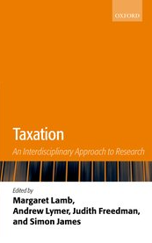
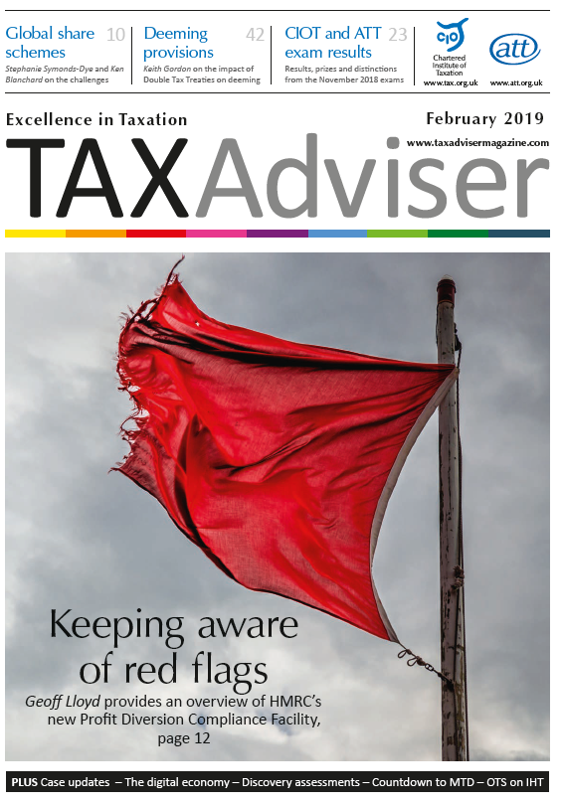
Credentials
Professor of Tax, Birmingham Business School
Director of CHASM
Co-editor & co-author of Interdisciplinary Research in Taxation – Oxford University Press
Author of academic research ‘series’ in Tax Adviser Magazine
President of the Tax Research Network (www.trn.org.uk)

Slide 4
Taxation = Discipline

Slide 5
Scientific study of the human mind and its functions/behaviour related to taxation
Tax management, calculation, reporting and collection operations in public and private sectors
Psychology*
Impact of taxation on the potentialities and realities of social welfare and services
Accounting/ Business
Social Policy
Law
Political Science
Interpretation and application of revenue law
Impact of taxation on the aims and practices of government
Economics
Revenue, expenditure and distributional impacts of tax policy and practice

Slide 6
Accounting/Business/Law
Tax Administration Research Centre – Exeter University
London – LSE (all angles!) & Kings (Law)
British Tax Review
Founded in 1956 by Ash Wheatcroft (revenue lawyer at LSE)
Current editor – Professor Judith Freedman (Oxford - lawyer)
Primary focus = revenue law and accounting/some economics & social policy
Recent articles sample:
Taxing the digitised economy: targeted or system wide reform
Home care workers – challenges of the minimum wage, tax and benefits system
The new Budget process and its implications for tax policy making
Public law in the tax tribunals and the case for reform

Slide 7
Economics
Oxford Centre for Business Taxation
Institute for Fiscal Studies
Exemplar of academic ‘economic’ analysis producers providing respected evidence/expert based content

Slide 8
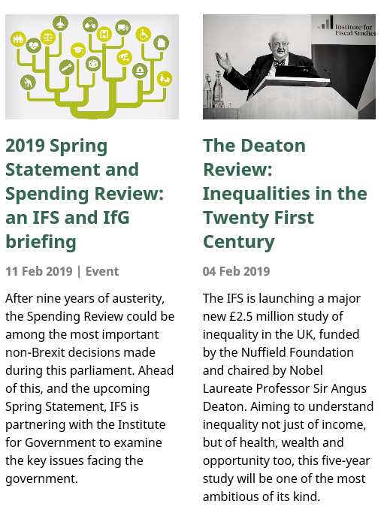

Slide 9
Economics
Oxford University Centre for Business Taxation
Institute for Fiscal Studies
Exemplar of academic ‘economic’ analysis producers providing respected evidence/expert based content
Fiscal Studies journal
‘presenting economic analyses of taxation in terms that are accessible to the well –informed non-specialist’
Recent tax articles sample:
Fiscal rules and Government financing costs
Multi-factor effective corporate taxation, firms’ mark-ups and tax incidence
Zero rating versus cash transfers under the VAT
Housing and the tax system: How large are the distortions in the euro-area?
How taxes and welfare benefits affect work incentives
Optimal environmental taxation with capital mobility
Income shifting in the Spanish Dual income tax

Slide 10
Tax Research Network
Connected group of tax researcher (accountants/lawyers + few economists… needs more social policy folk!)
2018 Conference – Birmingham – sample presentations
Social contract theory as applied to taxation
The fair amount of taxes – relative tax planning
Elite schools and tax privilege in England
Tax law and state-building in twenty-first century UK
Tax morale – framing and fairness
The position of married women and unmarried couples in Dutch income tax law 1893 – 2018
A comparative political analysis of South African tax policy: VAT and Sugar tax
Impact of financial and tax literacy on the development of tax morale in young people before they enter the job market (Tax Education Day)

Slide 11
Tax related Research Centres
CHASM(!) - Birmingham
IFS
Oxford University Centre for Business Taxation
Tax Administration Research Centre (TARC) – Exeter – Lynne Oats
International
Australian Tax School (ATax) – UNSW. Australia – Michael Walpole/Chris Evans
Research Institute for International Taxation - WU, Austria - Michael Lang

Slide 12
Tax degrees
UG – Bournemouth
PG
MSc Taxation**/CIOT Fellowship – University of Birmingham
LLM Tax Law* – Queen Mary
LLM International Tax Law* - Kings College London
MSc Taxation* – Oxford University
MSc Taxation* – Exeter University
LLM International Tax Law* (& Doctoral programme**) – WU, Austria
Various in the Netherlands – Leiden, Tilburg, Maastricht, Amsterdam
Master of Tax* & Law (Tax)* – UNSW School of Taxation & Business Law + others
USA …lots!
* Taught ** Research

Slide 13
Current trends in tax research
Evidence rich – policy makers demand it
Behavioural – older models of rationality don’t explain enough of reality to satisfy complexity of reality
Economic psychology – Eric Kirchler
Nudge
International – what can we learn from each other and how do your decisions affect me in a globalised world?
Key for UK in a post Brexit world?
Equity issues – what do we mean by ‘fair-share’?
Future role for wealth taxation?
BEPS and corporate taxation

Slide 14
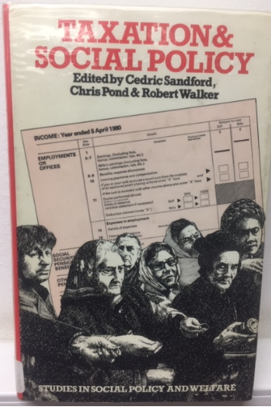
Contributors wanted…….

Slide 15
If taxation is a complex subject doesn’t it need an interdisciplinary* approach?
- discuss…..!
* interdisciplinary - adopting the perspectives and research approaches of more than one academic discipline

