Slide 1
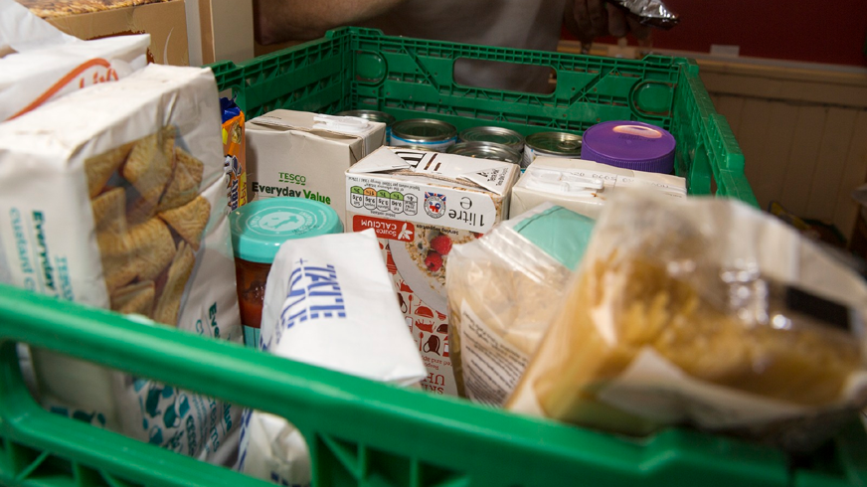
Charitable food provision as an 'emergency' response: where do we go from here?
Kayleigh Garthwaite
University of Birmingham
@KA_Garthwaite

Slide 2
Outline of today’s talk
Context to rising foodbank use – political and media rhetoric
My own ethnographic work
Where next for foodbanks?
New British Academy project

Slide 3
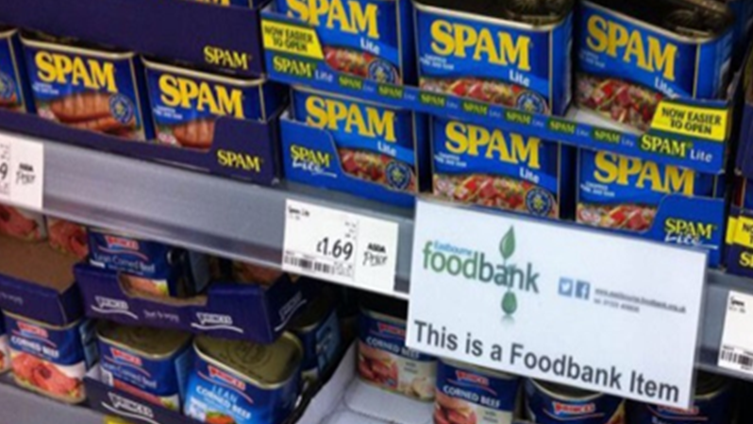
Context: Foodbank Britain
Between 1st April 2017 and 31st March 2018, the Trussell Trust’s foodbank network distributed 1,332,952 three day emergency food supplies to people in crisis, a 13% increase on the previous year. 484,026 of these went to children.
As foodbank use has risen in the UK, ministers’ responses have shifted towards blaming individuals for their food bank use, with a focus on poor financial management and ‘faulty’ behavioural practices, resulting in many ‘hidden costs’ (Purdam et al. 2015) of using a foodbank

Slide 4

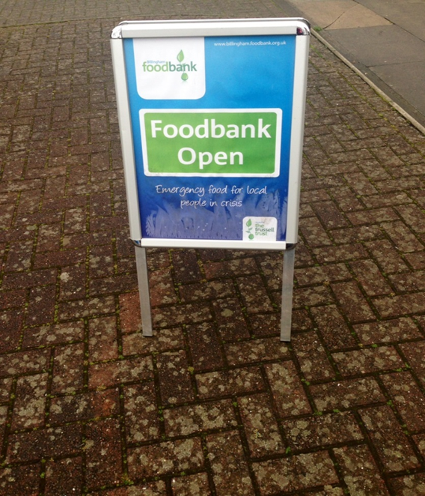
Who runs them?
In the UK, the Trussell Trust are the largest foodbank franchise, with 423 foodbanks (and 1,500 foodbank centres)
40,000 people volunteered with Trussell Trust last year
53,883 frontline professionals such as doctors and social workers gave foodbank vouchers to people in crisis
IFAN indicates at least 700 more food banks and food aid providers across the country

Slide 5
Context: Foodbank Britain
Then education secretary Michael Gove suggested that foodbank users were themselves to blame, guilty of making decisions that showed they were "not best able to manage their finances”.
Dominic Raab MP said the typical foodbank user is ‘someone who has a cashflow problem episodically’
Using social media as a platform, West Oxfordshire Conservative Future chairman Liam Walker said on Twitter: “I have seen some ‘food bank users’ in the pubs of Witney...#priorities.”
Conservative councillor Julia Lepoidevin labelled some foodbank users as "selfish", suggesting they “make a conscious decision not to pay their rent, their utilities or to provide food for their children because they choose alcohol, drugs and their own selfish needs?"
Jacob Rees-Mogg MP described foodbanks as being “rather uplifting”.

Slide 6
Continued government denial of research evidence on foodbank use
“Reasons for food bank use are complex, so it's misleading to link them to any one issue”
“one sided view” “just 25 interviews” “small self-selecting sample”
““Well, foodbanks are an interesting phenomenon that we are having a look at, the Department… We find, even in areas of very high employment, there are foodbanks. Now, there’s never been any serious work to try and understand what the drivers of that are, and why people would feel they need to go to foodbanks”… at the Department we’re going to be doing some thinking over the next few months and some research into why that is“
Kit Malthouse MP, Conservative MP for North West Hampshire, on BBC North West Tonight
http://www.ekklesia.co.uk/node/25452

Slide 7
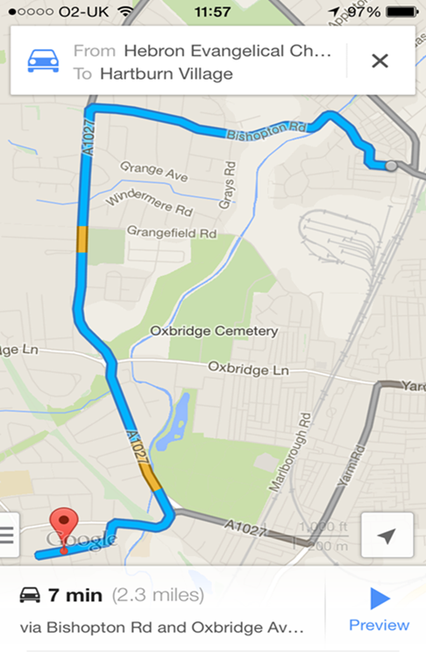

Work Package 3:
Urban Ethnography of Health Inequalities
5 year multi-disciplinary research project led by Prof Clare Bambra at Durham University
An investigation into the health, lives, place and community in two contrasting areas, as well as an extensive and detailed examination of the physical, social and cultural context
Repeated participant observation in the case study areas, qualitative interviews with residents in the two areas, interviews with key local informants, and documentary research
What is it like living in an area where there is such a huge gap in life expectancy? Lived experience of health inequalities in both areas

Slide 8
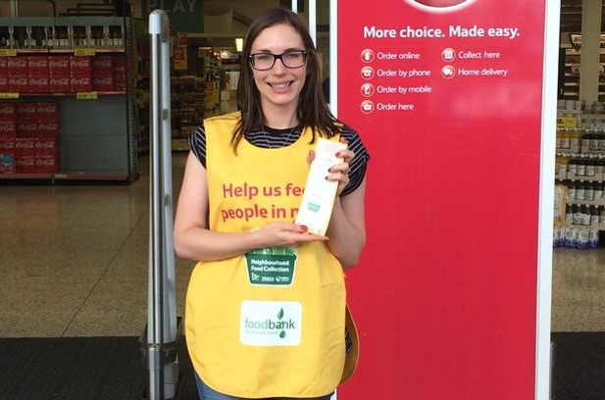
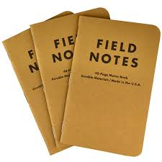
My research
Trained as a Trussell Trust volunteer
Now spent four years with the foodbank in Stockton Town Centre
Took part in all activities that other volunteers did – administration of red voucher, collections at Tesco supermarkets, preparing food parcels, making tea and toast
Everyone at the foodbank knew who I was and why I was there
I took detailed fieldnotes (40,000 words!) and also interviewed people in their homes, staff at referral agencies, and volunteers

Slide 9
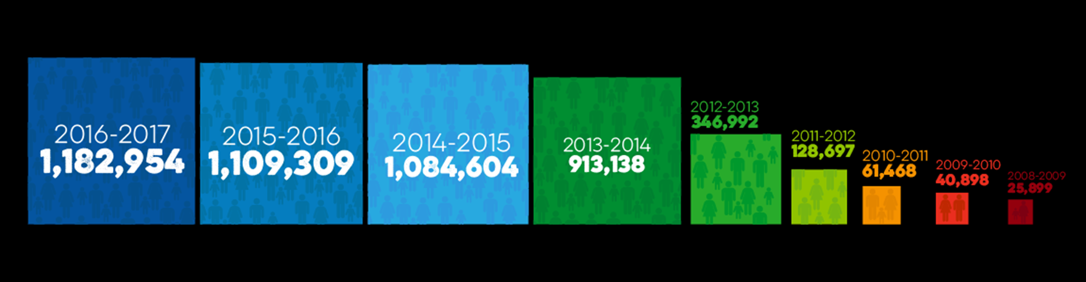
Foodbank use in the UK, 2008-2017

Slide 10
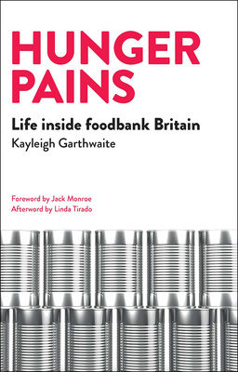

We’ve heard that one million food parcels are being given out. But where are the voices of the people who are using foodbanks?
Focuses on the real stories behind the foodbank statistics
People using foodbanks have been blamed and shamed for their own situation – the book shows this is not true

Slide 11
Why did people use a foodbank?
Immediate income crises - problems with benefit sanctions and delays
Longer term income insecurity – people on a consistently low income are more susceptible to a seemingly small crisis – new school uniform boiler breaking down
‘Tipping points’ – life changing events such as bereavement, job loss, ill health, or relationship breakdown

Slide 12
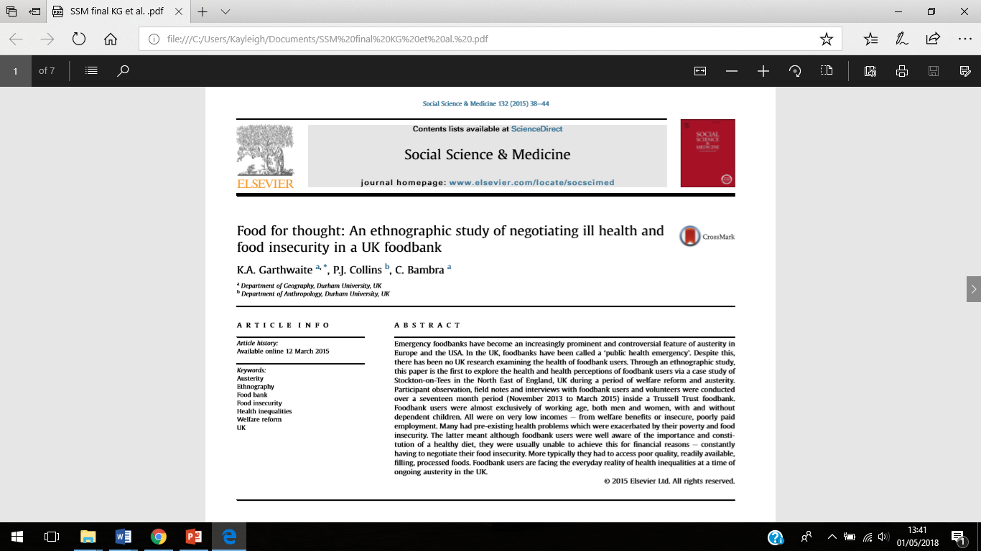
Poor health, especially mental health
People accessing the foodbank were often suffering from chronic health problems, with mental health problems being particularly prevalent.
Although the food assistance from the foodbank was viewed as a ‘lifeline’, the food provided could have negative consequences upon people’s health, especially for those with food intolerances.
People accessing the foodbank were aware of how to eat healthily but were unable to so due to affordability.

Slide 13
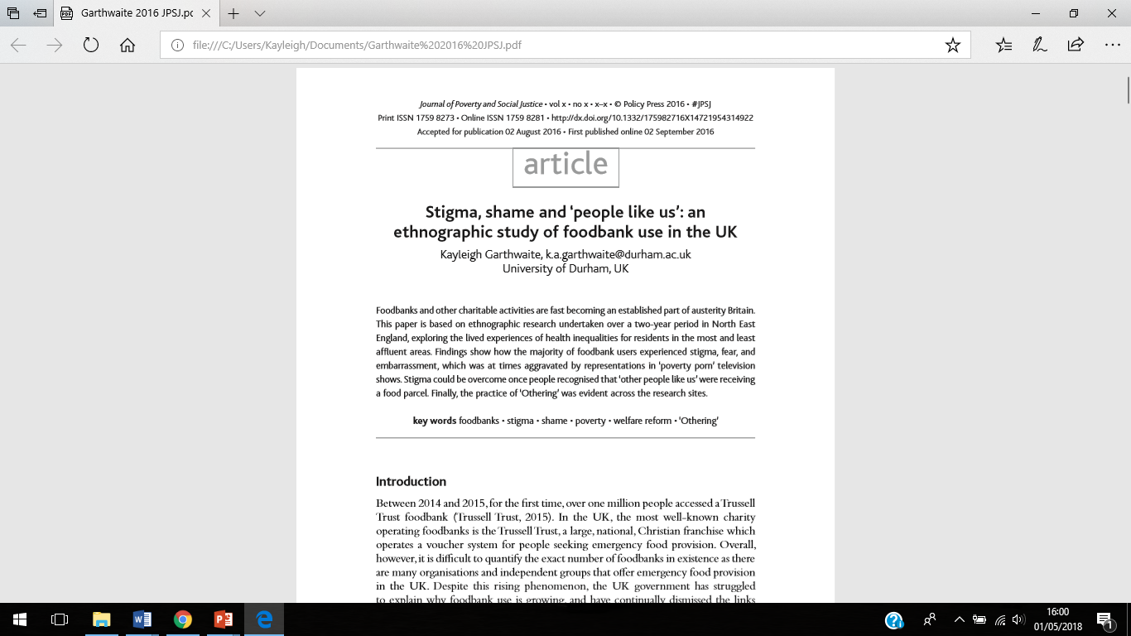
Stigma and shame
Findings show how the majority of foodbank users experienced stigma, fear, and embarrassment, which was at times aggravated by representations in ‘poverty porn’ television shows
At times, stigma can stop people accessing foodbanks
However, stigma could be overcome once people recognised that ‘other people like us’ were receiving a food parcel.

Slide 14
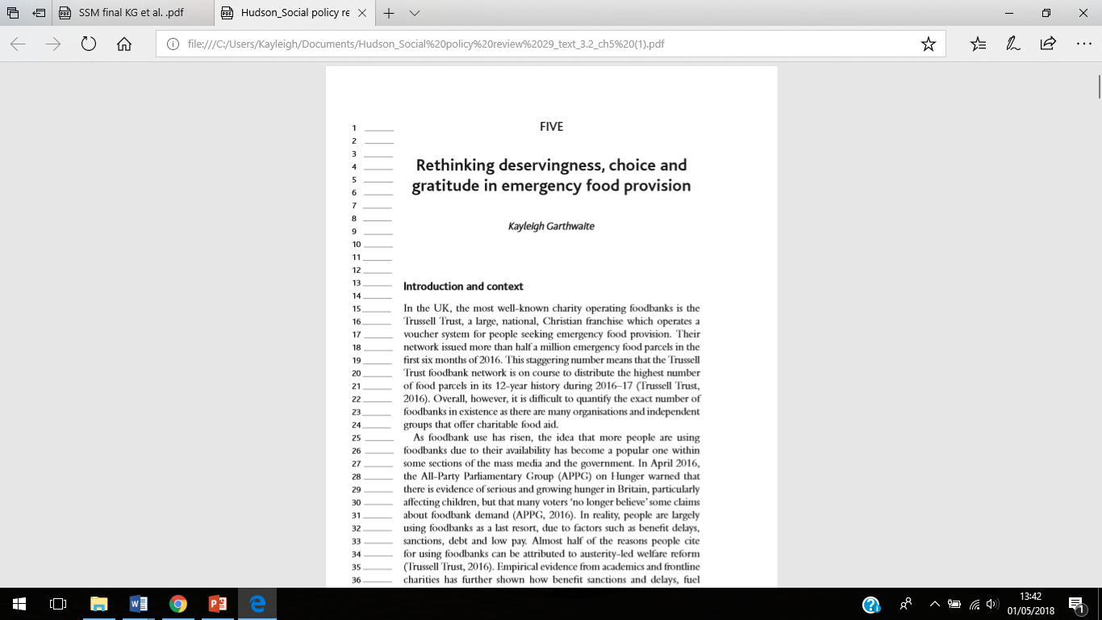
Deservingness and ‘choice’
Volunteers, staff at referral agencies, and food donors and people who used the foodbank regularly discussed ideas of who is (or who should be) considered ‘deserving’ or ‘undeserving’.
This is closely linked to choice and the anticipation of gratitude, and, more specifically, the expected behaviours of people accessing emergency food.
Deservingness is arguably inbuilt into the foodbank referral scenario, which requires staff at referral agencies to decide whether to issue a red voucher required to access a food parcel.

Slide 15
Where next for foodbanks?
CHELTENHAM FOODBANK SAYS IT HAS TO DOUBLE OPENING HOURS IN RESPONSE TO UNIVERSAL CREDIT ROLL OUT (1/11/17)
Food banks are running out because of Universal Credit failures, MPs hear as Labour push for pause in roll-out of benefits system (24/10/17)
Foodbank opens in Theresa May's leafy hometown (7/11/17)
Volunteers at food banks perform ‘staggering’ 4.1m hours annually, says report (17/10/17)

Slide 16
Where next for foodbanks?
emergency (noun)
a serious, unexpected, and often dangerous situation requiring immediate action
(English Oxford Dictionary)
Is emergency food provision really ‘emergency’?
Field Notes
7th February 2014
We’re starting to run out of food now despite the glut we received at Christmas time after the Tesco’s collection. There was no sugar at all today, very little pasta or rice, no meat, and only two tins of tuna left. There is supposed to be a collection at Asda over the weekend, so hopefully that will get us stocked up. Ron and I stacked some of the shelves with what remaining food we did have – we found some jars of pasta sauce, rice pudding, veg, chopped tomatoes and biscuits hiding in the cupboard. Thankfully someone donated a large bag of food, and Ron and Belinda brought 10 bottles of juice as they knew we had none left. They all went today.
Nature of the provision and public support - will it continue?

Slide 17
Where next for foodbanks?
‘Fight Hunger Create Change’ £20 million partnership between Asda, Trussell Trust and FareShare…
A Citizens UK analysis which found Asda to be employing 120,000 ‘low paid workers’, and a glassdoor.co.uk report which suggests many of their employees are actually paid less than the national minimum wage.
Yet the Trussell Trust have spoken about a ‘foodbank exit strategy’…

Slide 18

Foodbanks in Germany recently ‘celebrated’ 25 years of being open…
In January, food aid charity Essener Tafel it said that only German passport holders would be allowed to apply for new membership cards.
The restriction, the charity said, was necessary because 75% of those receiving food were foreigners, and that many elderly women and single mothers had stopped coming to the food bank.

Slide 19
Where next for foodbanks?
Three important steps are needed to begin to effectively address rising foodbank use in the UK:
1/ Government intervention;
2/ Avoid / challenge the stigmatisation of people living in poverty;
3/ Start listening to people who are living in poverty

Slide 20
Where next for foodbanks?
Foodbanks cannot become the new normal. They should be seen as unusual, shocking and outrageous. Emergency food provision cannot replace an accountable system of social protection, as experience in the USA and Canada shows us
The long-term consequences of increasingly relying on charity to address poverty cannot be ignored. Where provision is adequate and tailored to the needs of people using it, foodbanks can relieve some symptoms of their insecurity – temporarily – but there are many structural ‘solutions’ outstanding

Slide 21

New project…
Recently received funding from the British Academy for the project ‘Charitable food provision as an emergency response: sharing evidence from Canada, the USA and the UK’
This will involve an interactive two day workshop which will bring together international early career (ECR) and senior researchers, charities, front-line workers, media, those experiencing food poverty and insecurity, and grassroots organisations
5th and 6th November 2018, Impact Hub Birmingham

Slide 22

Thank you!
Any questions?

