Slide 1


Slide 2

Conference Exhibitors

Slide 3
Do you want to communicate with others on campus about teaching and learning? Subscribe to ‘HEFi-OPEN’, a JiscMail mailing list service:
https://tinyurl.com/y3wczmyh
Use it to:
share teaching ideas and resources, look for collaborators
find out about development opportunities related to teaching and learning
ask questions about how others teach and support learning
build and strengthen links within the teaching community

Slide 4
Parallel session 2A: Digitised Futures
2.1 Do business simulation games enhance students’ employability skills? Lesley Strachan, Southampton Business School, University of Southampton
2.2 The Smart Car Park Tim Jackson, College of Engineering and Physical Science, University of Birmingham
2.3 Digitising learning – the learning bots are coming, the application of a classic change model to their introduction Stephen Ellis, Business and Management, Regent’s University London
2.4 Enhancing Lab Work in the CTL with Digital Tools and Resources Joseph Berry, HEFi, Birmingham Digital Education Team, University of Birmingham

Slide 5
Evidence of how to develop student employability skills via a simulation
Lesley Strachan
University of Southampton
Notes:
My background
Programme leader Southampton Solent University now freelance academic “parachute into a number of HEIs” to fill gaps in teaching and/or experience.
Award winning trainer| author| career coach| simulation specialist| employability skills guru| marketing tutor| speaker
Research interests “The awareness of development of in employability skills in learners”.
Today, I represent The University of Southampton where I currently work on contact.
I’m also here as one of the Learning & Development Manager for Venture Simulations who build highly innovative and award-winning learning solutions for the corporate training and education sectors including SimVenture Evolution.

Slide 6
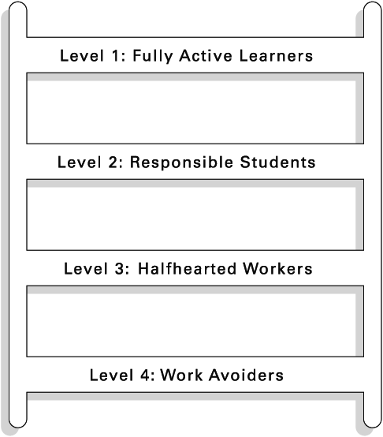
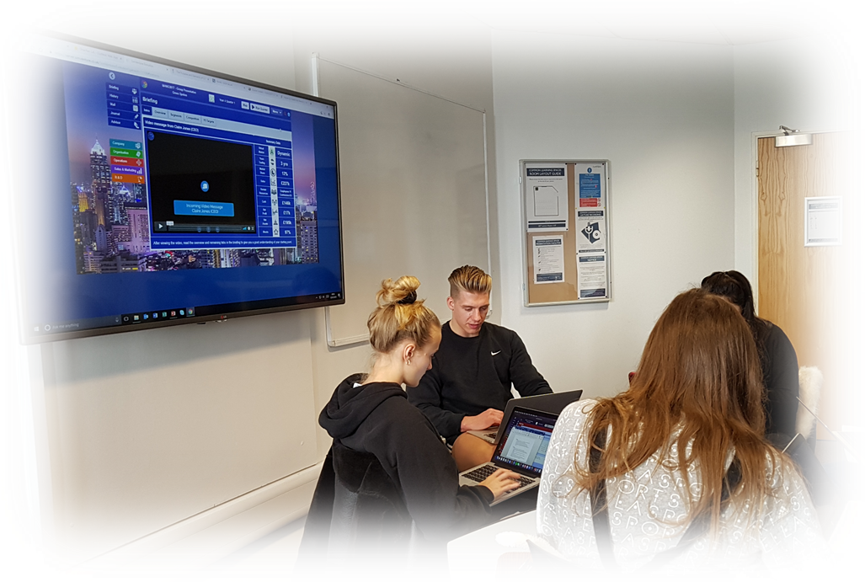
Education Storm
Student expectations
Attendance
Disengaged learners
Tutor v student centred learning
Progression & retention
Students ill-prepared for work
How can we create change?
Notes:
Learning from Great Teachers – in a perfect storm
Some teachers, those we might call our great teachers, have a knack for moving students through those motivation levels. If we visited their classrooms, we would see, week by week, fewer and fewer students working at levels three and four, more and more at levels one and two.
Somehow these teachers are able to inspire students to work harder than they were initially inclined to work. As a result, the students tend to climb what we call the Active Learning Ladder (Figure 1). Merrill Harmon and Melanie Toth present a ladder that describes four levels of student motivation.
How can we create change?
Https://www.edutopia.org/classroom-student-participation-tips

Slide 7

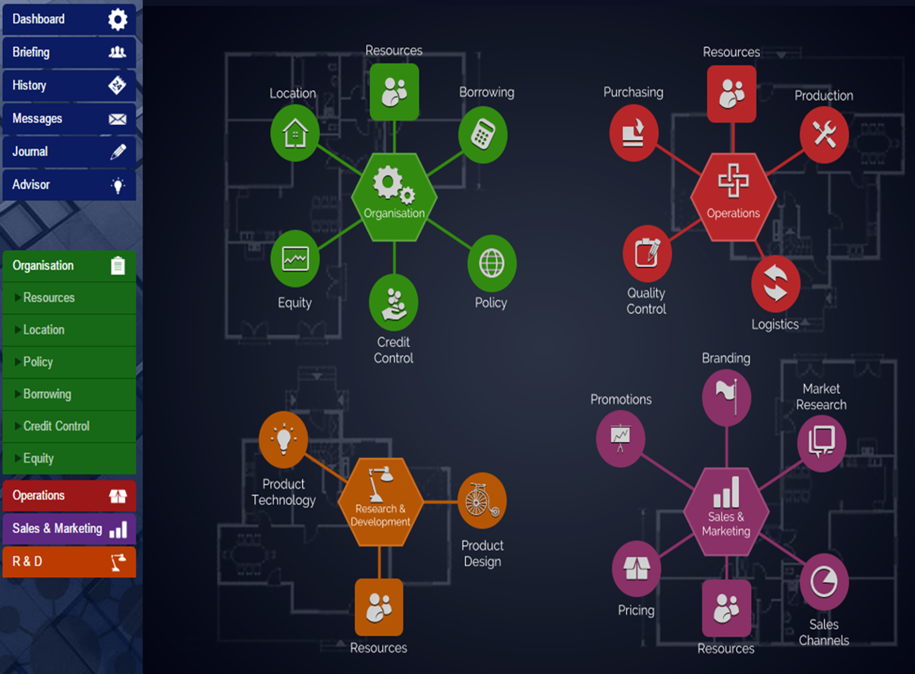
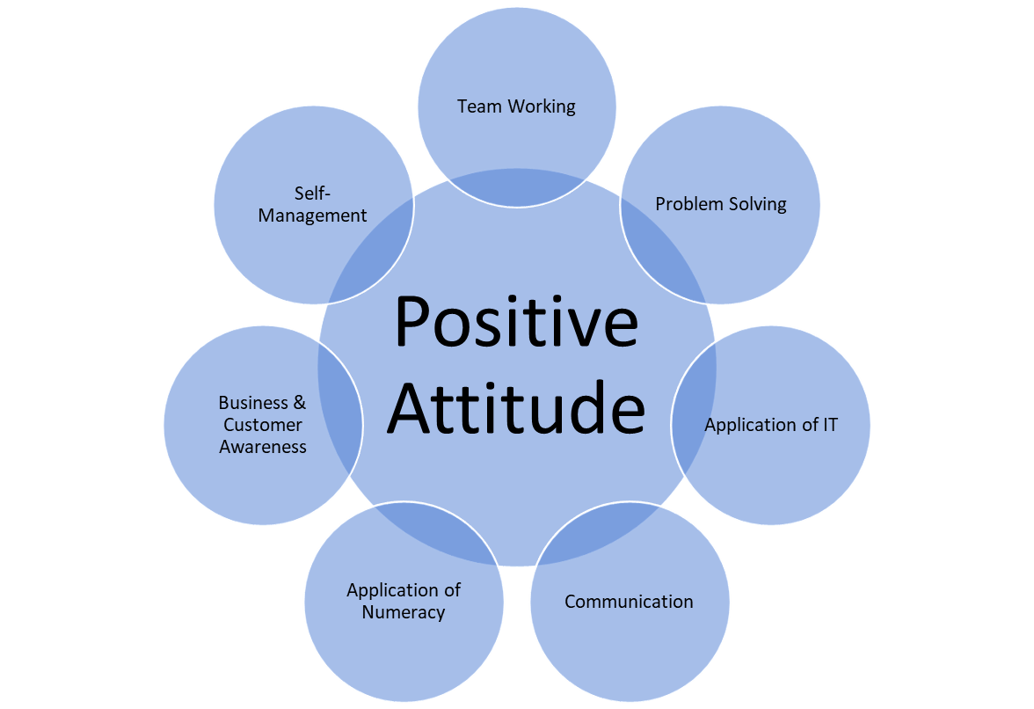
Developing employability skills
Notes:
Aligning the two so that students can make sense of their experience and to develop students employability skills so that they can enhance their CV is important to me and critical for them in such a fast moving working environment.
I looked at various definitions of employability skills and behaviours and settled on the definition by the CBI because it represents nearly 7 million people, about one-third of the private sector-employed workforce into which our students will be employed.

Slide 8
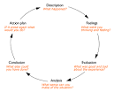
CBI definition
Positive Attitude
Team Working
Problem Solving
Application of IT
Communication
Application of Numeracy
Business & Customer Awareness
Self-Management
Two questionnaires
Before module started
After module finished
Gibbs (1998) model
Notes:
CBI definition of employability skills by Lord Young were the basis for the research studies.
So, as the students working on developing their company they wrote up notes each week showing with evidence how they developed their employability skills ready for their summative assessment. Each week they reflected on:
A positive attitude (readiness to take part, openness to new ideas and activities, desire to achieve)
underpinning
Self-management – readiness to accept responsibility, flexibility, time management, readiness to
improve own performance
Team working – respecting others, co-operating, negotiating/ persuading, contributing to
discussion.
Business and customer awareness- basic understanding of the key drivers for business success and
the need to provide customer satisfaction.
Problem solving- analysing facts and circumstances and applying creative thinking to develop
appropriate solutions.
Communication and literacy-application of literacy, ability to produce clear, structured written work
and oral literacy, including listening and questioning.
Application of numeracy-manipulation of numbers, general mathematical awareness and its
application in practical contexts.
Application of information technology-basic IT skills, including familiarity with word processing,
spread sheets, file management and the use of internet search engines.

Slide 9
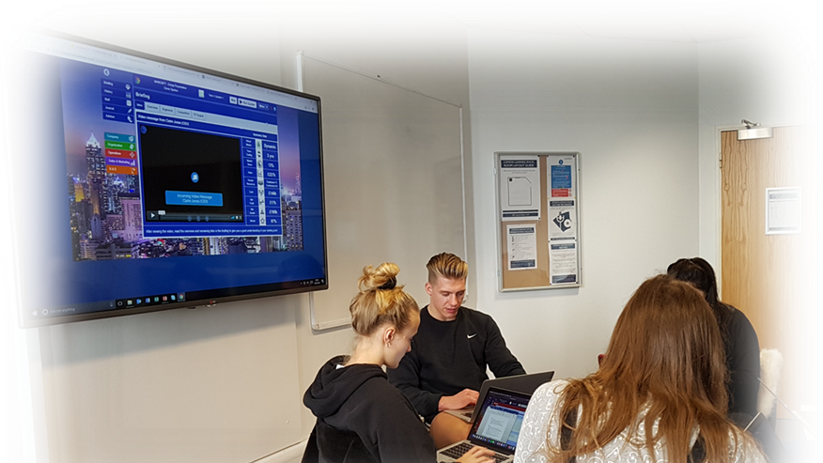
What happened?
Students ran businesses
Unprompted discussions
Formative feedback
CEO led the team - rules of engagement

Slide 10

Rules of Engagement
Mind warm-up
Movement
Collaboration
Quick writes
Run a tight ship
Fairness
All teams feedback
Minimal supervision
Student centred learning
Don’t ask me - be accountable
Notes:
Rules of Engagement for students and academics
Mind warm up (collaboration and competition avoids dead time)
Movement (sitting, standing changes the energy)
Collaboration (project & team-based work)
Quick writes - Journal/reflective writing
Run a tight ship when giving instructions
Fairness – teams to feedback to tutor every week
All teams answer one question
Minimal supervision – team leader takes the lead
Student v teacher centred learning
Don’t ask me be accountable
https://www.edutopia.org/classroom-student-participation-tips

Slide 11

Emerging themes
Rate the degree to which your employability skills have developed
Teamwork
What was the single most valuable employability skill that you learnt?

Slide 12


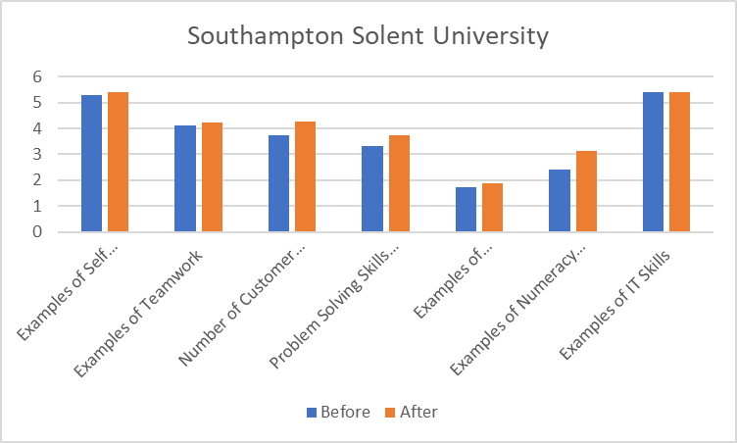
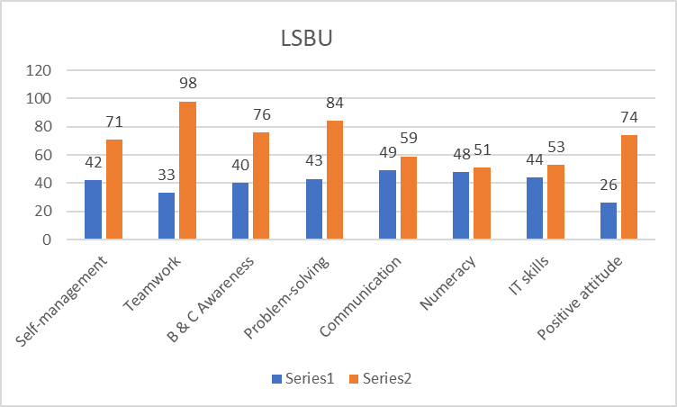

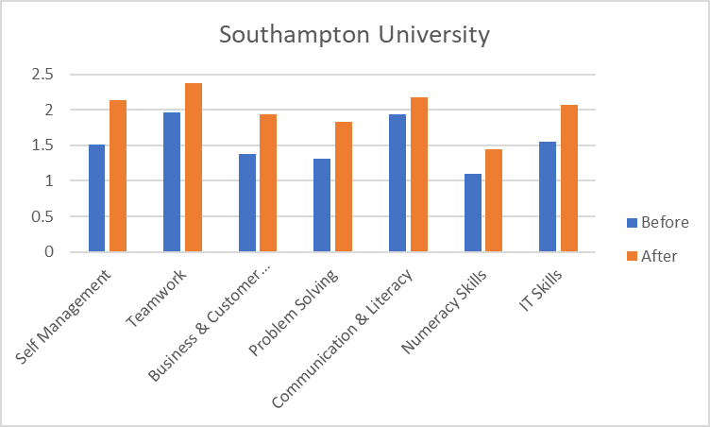
(*based on 54 responses)
(*based on 116 responses)
(*based on 53 responses)
Notes:
LSBU data from Survey Monkey Summary Data.xlsx - LDT folder
BUS136 Summary of REP01REP02 V2

Slide 13
Additional unintended outcomes
94% attendance
77% positive experience
97% submission
Notes:
How would you rate your overall experience of practising your employability skills via SimVenture Evolution? 1 = low, 100 = high 77%

Slide 14
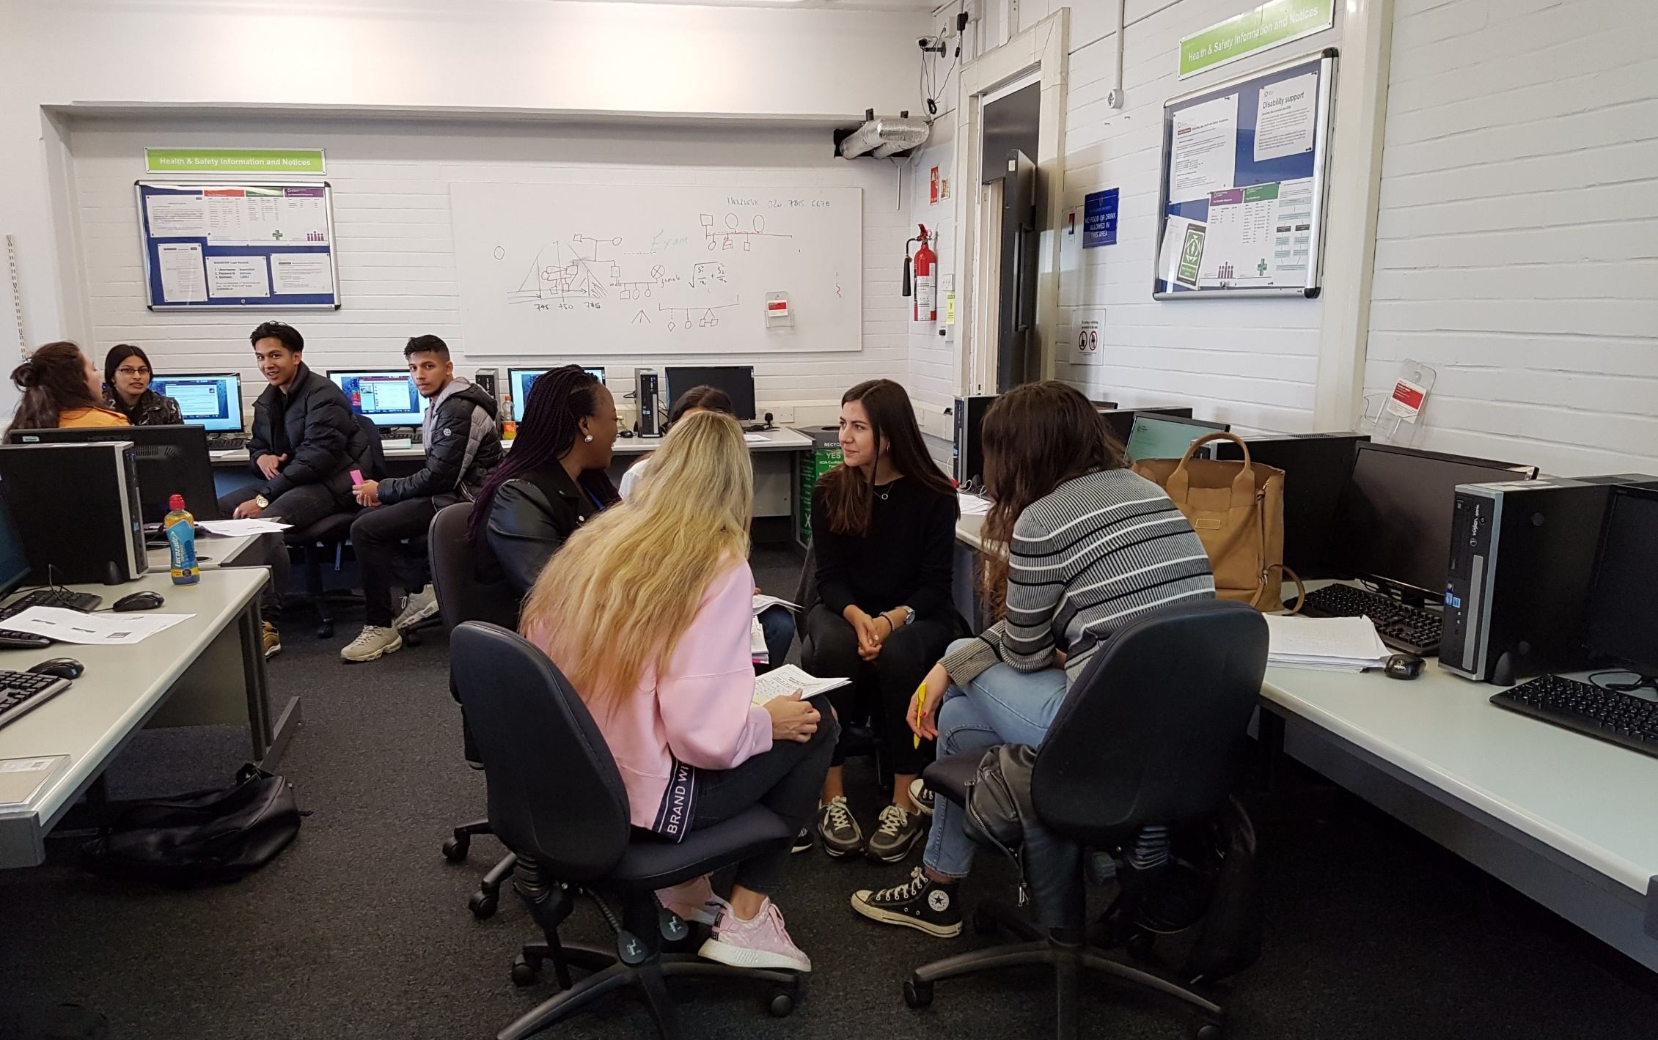

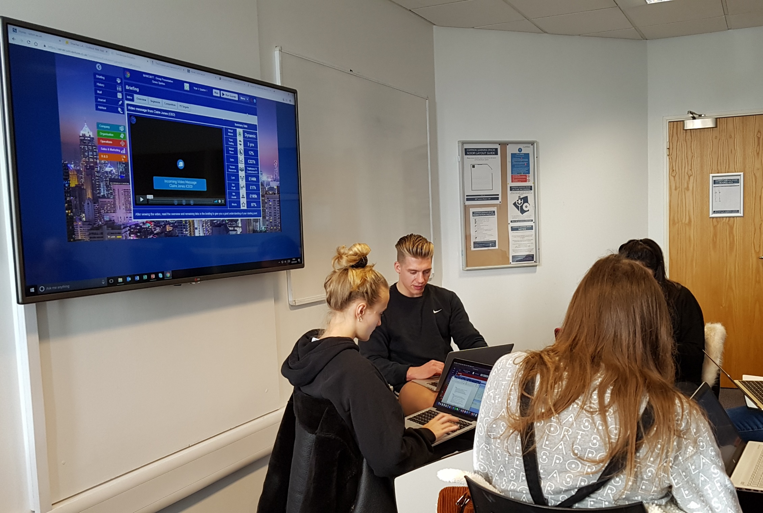
“It is an actual hands on approach different from the usual theory taught in lectures. I felt more involved”

Slide 15

Let’s chat afterwards
I’m around after the presentation
Ask me about what works and what doesn’t
Happy to chat
How can I support you?

Slide 16

The Smart Car Park
Tim Jackson, T S Murphy, R J Mason, N Mussington*, S F Quigley, J S Watkins, N K Wilkin College of Engineering and Physical Sciences, University of Birmingham

Slide 17
Common goals on Feedback
Stimulating
Accessible
Formative
Students
Summative
Course leaders
Convenient
Relevant
Consistent
Clear
Manageable

Slide 18
Format
Quick quizzes (4) Self-assessment test of underlying principles
Articles (3) Mainly textual exploration
Activities (4) Led students through a design problem with feedback for incorrect responses based on expected misconceptions
Three attempts
One single completion date

Slide 19
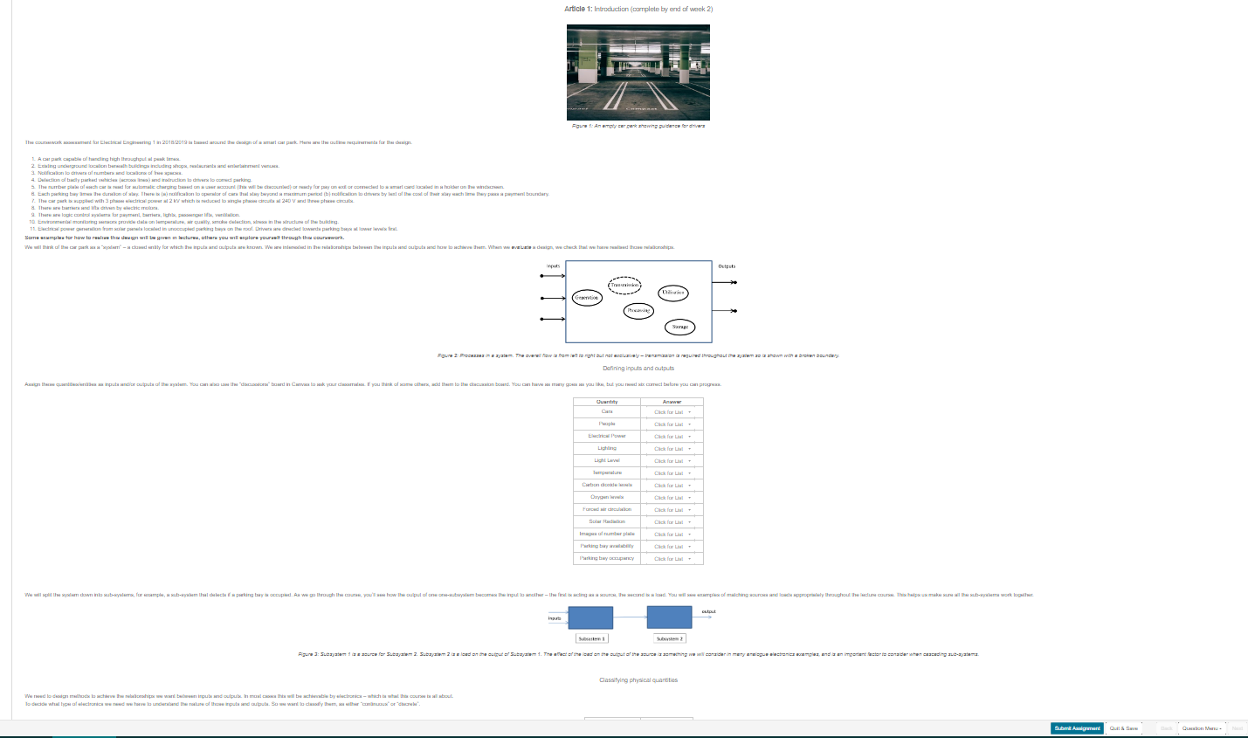

Slide 20
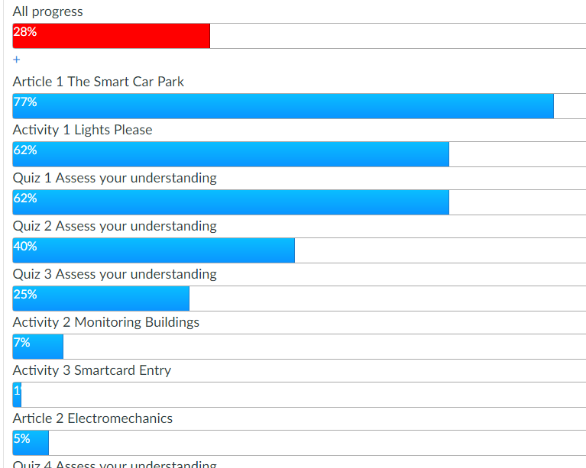
Public weekly monitoring
 | Article 1 | Activity 1 | Quiz 1 | Quiz 2 | Quiz 3 | Activity 2 | Activity 3 | Article 2 | Quiz 4
attempted | 291 | 229 | 232 | 149 | 95 | 28 | 7 | 19 | 2
mean % | 92 | 89 | 86 | 86 | 93 | 78 | 99 | 100 | 100

Slide 21
“Have you found the feedback useful?”
Response | Number
Yes | 19
Slightly generic | 2
We haven’t had any | 2
Helps me solve the problems | 2
Sometimes | 1

Slide 22
“Have you discussed with others?”
Platform | Number
Face to face | 14
Facebook/messenger | 6
Online learning environment | 2
Family | 1
No | 5
“The big time frame makes it so you can actually learn and not only feel the rush to copy”
Didn’t discuss as “most of it is self study”

Slide 23
“Interesting and motivational?”
Platform | Number
Yes | 14
No | 5
Related to daily life | 3
“Different from exams and rest of course” – this was a negative statement
“Hard to know where to start”, “Can’t look it up”

Slide 24
“Your view of quizzes, articles, activities”
Longer activities are harder, more interesting (12)
Longer articles confusing (3)
Push students to self study (1)
Quizzes easier, fun (2)
Quizzes boring (1)
Quizzes good to test understanding of lectures (2)
Variety of ways to learn is good (2)

Slide 25
“How easy to use? Where do you use it”
Response | Number
Easy | 18
Convienent | 2
Response | Number
On campus | 7
Home | 11
Shopping mall/coffee shop | 3
Laptop | 5
Phone | 1

Slide 26
Module outcome
Weighting 70:30 Exam:Coursework Does feedback improve outcomes?

Slide 27


Resource required
Team for coding/hosting including student intern
Writing resources – over several weeks
Experience of misconceptions
Experience in error trapping
Integration of Maplesoft Möbius into Canvas
“Behind the scenes” checking and validation

Slide 28
Further thoughts
Smooth delivery
Student queries are mainly content based, not procedural
Need to automate analytic data collection to assess ongoing outcomes of learning
Need to communicate more effectively as to what feedback is and what it is intended to be used for
Video content to add variety?
Should we try to stimulate visible discussions?

Slide 29
Digitising Learning –the ‘learning bots’ are coming
Applying Lewin’s change management models to their introduction – Dr Steve Ellis PFHEA

Slide 30
The march of digitisation

Slide 31
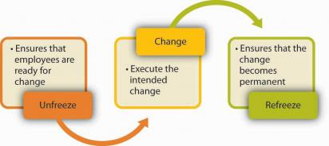
Applying Lewin’s three step model

Slide 32
Do you want to communicate with others on campus about teaching and learning? Subscribe to ‘HEFi-OPEN’, a JiscMail mailing list service:
https://tinyurl.com/y3wczmyh
Use it to:
share teaching ideas and resources, look for collaborators
find out about development opportunities related to teaching and learning
ask questions about how others teach and support learning
build and strengthen links within the teaching community

Slide 33
Parallel session 2B: Digitised Futures
2.5 Translation software: a useful tool for international students? Rina De Vries and Jake Groves, Birmingham International Academy, University of Birmingham
2.6 Preparing Students for a Digitised Future Mehran Eskandari Torbaghan, Manu Sasidharan, Ian Jefferson, Lisa De Propris, Jonathan Watkins, Mohammed Ali, Richard Newman and Jenny Steere, School of Engineering and Business School, University of Birmingham
2.7 ‘Your canvas skills are more advanced than most staff’: reflections on developing canvas as a study space, not a learning material archive Withdrawn
2.8 Crossing Borders: Using technological approaches to ‘live’ teach diverse student cohorts across different countries Ian Jackson and Jodie Silsby, Art and Design, Winchester School of Art, University of Southampton
2.9 Optimising One-to-One Student Support Annette Margolis, Birmingham International Academy, University of Birmingham

Slide 34
Optimizing One to Ones
My teaching context
Solutions for my teaching context
Annette Margolis a.margolis@bham.ac.uk

Slide 35
Translation software: a useful tool for international students? Rina F. de Vries & Jake Groves, Birmingham International Academy, UoB

Slide 36
Outline
Background
Details about our exploratory study
Conclusions and implications of our research

Slide 37
Context
Birmingham International Academy (BIA)
English for Academic Purposes (EAP) for international students
Students have to meet English language requirements before moving on to their degree courses (threshold level)
Students need to develop towards graduate competence (often with in-sessional support)

Slide 38
Why did we become interested in Translation tools?
Increasing use (Jolly & Maimone, 2015; Alhasisoni & Alhaysony, 2017).
Ever greater accuracy, esp. for ‘big’ languages (e.g. English, Chinese).
Often meets language level required for university (Groves and Mundt, 2014).
Implications for teaching and learning / assessment / ethical policy?
Notes:
Consequences for learning & teaching are unclear. Don’t hope they won’t use it: what is the reality?
Some EAP tutors say it is just a tool (but would you use this tool in the classroom?); some say it hinders language learning and might even threaten the profession.

Slide 39
Research aim: explore our own context
Do our international students use translation software for their studies?
How do they use it for reading / writing?
Do they think it helps to develop their English?
Do they think it is appropriate to use it?

Slide 40
Research design
Survey
University of Birmingham
155 international students
80% PG and 20% UG
Almost 90% Asian (76.5% Chinese).
In-depth interviews
3 Chinese, 1 Korean, 1 Greek
Notes:
So these were students who had already met the entry requirement for university study.

Slide 41
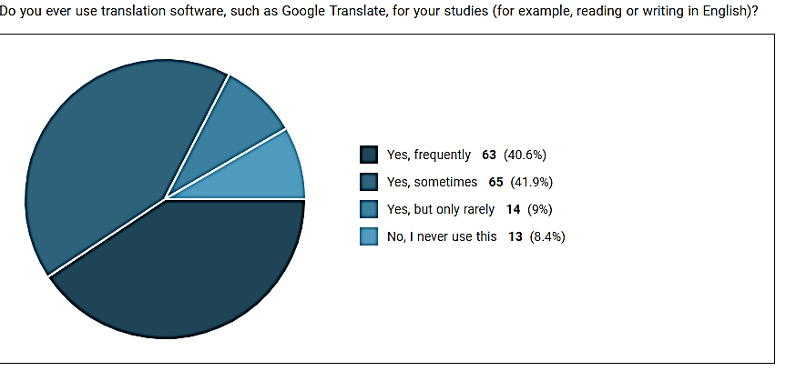
Survey: ‘Do you ever use translation software, such as Google Translate, for your studies?’
Frequently 40.6% (63)
Sometimes 41.9% (65)
Only rarely 9% (14)
No, I don’t 8.4% (13)

Slide 42
‘How do you use translation software for reading?’ (Multiple answers possible.)

Slide 43
‘When reading English texts, do you….?’

Slide 44
‘How do you use translation software for writing?’ (Multiple answers possible.)

Slide 45
‘When writing English texts, do you use translation software to translate…?’

Slide 46
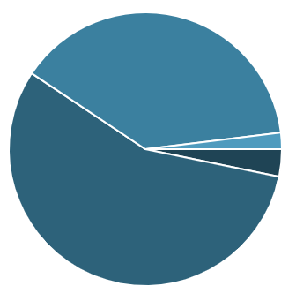
‘How reliable do you think translation software is?’
Very reliable 3.2% (5)
Somewhat reliable 56.1% (87)
Somewhat unreliable 38.7% (60)
Very unreliable 1.9% (3)

Slide 47
‘Do you think it is appropriate to use translation software for…?’ (Multiple answers possible.)

Slide 48
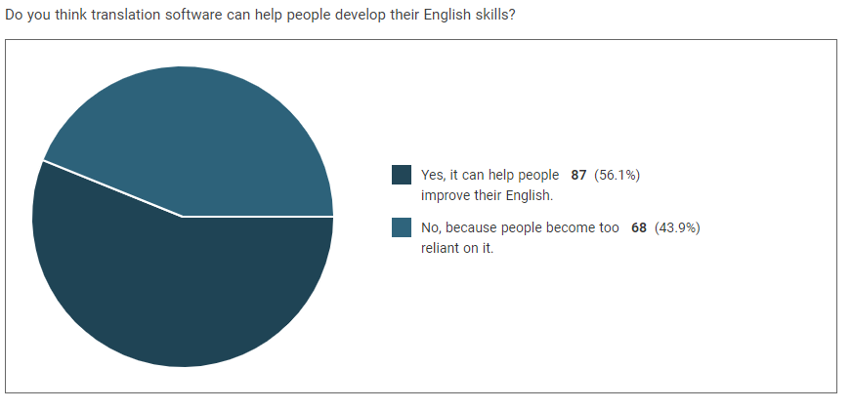
‘Do you think translation software can help people develop their English?’
Yes, it can help 56.1% (87)
No, people become too
reliant on it 43.9% (68)

Slide 49
Conclusions from survey
Our students do use translation software.
Mostly for short pieces of text
Most students: see GT as (reasonably) reliable and use as appropriate – but not for entire texts.
Student opinion divided about whether it helps or hinders English language development.

Slide 50
Quotes from interviews
“Most of my friends… just translate this whole article into Chinese and they will just read the Chinese.”
“Can we say that using the Google Translation is ours? Is it Google writing?”
“Even if I know that something is forbidden and it may help me I will use it.”
“Sometimes I think it’s really unfair if the professor reduces my score due to the English skills.”
“In the future maybe we can compete more fairly with domestic students.”

Slide 51
How are we responding to this?
Development of policy on the use of GT
Revised assessment for entry to degree programmes
GT teaching & learning strategies for English language development throughout academic career

Slide 52
References
Alhaisoni, E. and Alhaysony, M. (2017). An Investigation of Saudi EFL University Students’ Attitudes towards the Use of Google Translate. International Journal of English Language Education. 5. 72-82
Beare, K. (2018). How to Use Google Translate to Teach English. Available online: https://www.thoughtco.com/how-to-use-google-translate-for-teaching-english-1211770. Accessed 27 March 2019.
Clifford, J., Merschel, L., and Munné, J. (2013). Surveying the landscape: What is the role of machine translation in language learning? @tic. revista d’innovació educativa, 10, 108-121.
Groves, M. and Mundt, K. (2015). ‘ Friend or foe? Google Translate in language for academic purpose.’ English for Specific Purpose 37 (2015) 112-121.
Jolley, J. R. and Maimone, L. (2015). Free Online Machine Translation: Use and Perceptions By Spanish Students and Instructors. In Learn Languages, Explore Cultures, Transform Lives: Selected Papers from the 2015 Central States Conference on the Teaching of Foreign Languages, edited by Moeller, A.J. 181–200.
Mundt, K. and Groves, M. (2016). ‘A double-edged sword: the merits and the policy implications of Google Translate in higher education.’ European Journal of Higher Education, 6 (3), pp. 1-15.

Slide 53
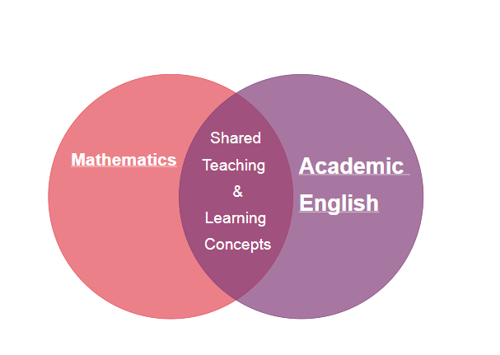
Supporting Foundation Students

Slide 54
‘Connecting before Correcting’
Timetabling Constraints
‘Gradual Release of Responsibility’
‘Recursive Learning’

Slide 55
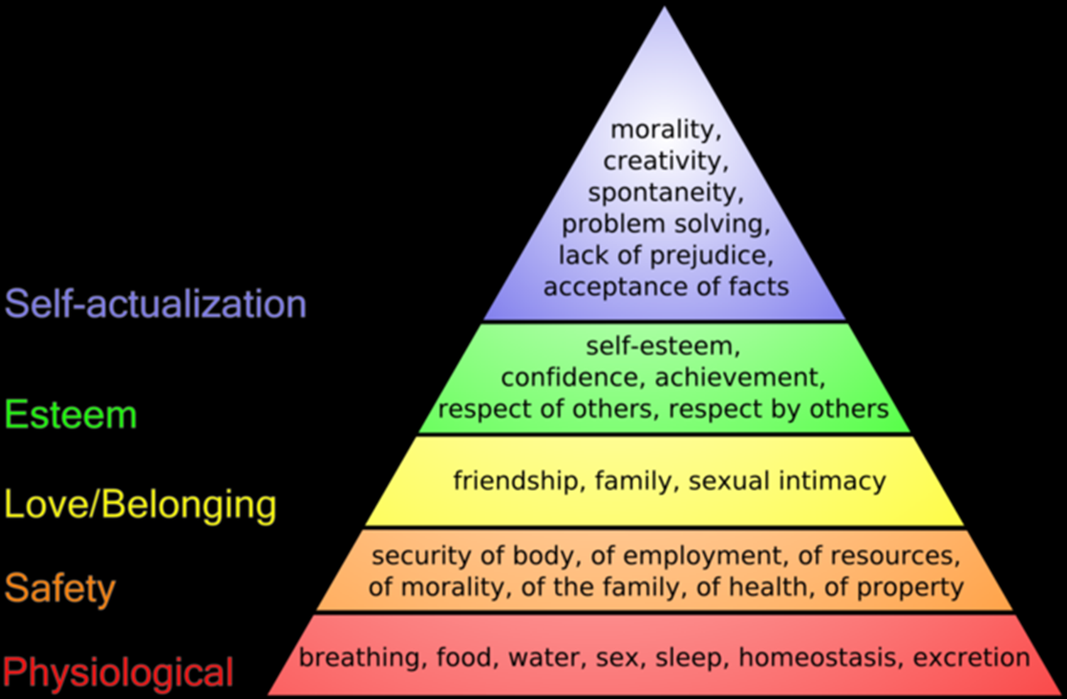
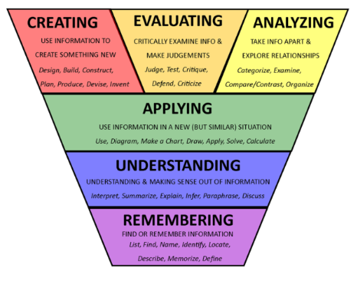
Maslow’s Hierarchy of Needs
A Modified Bloom’s Taxonomy
https://bokcenter.harvard.edu/taxonomies-learning
https://www.simplypsychology.org/maslow.html

Slide 56
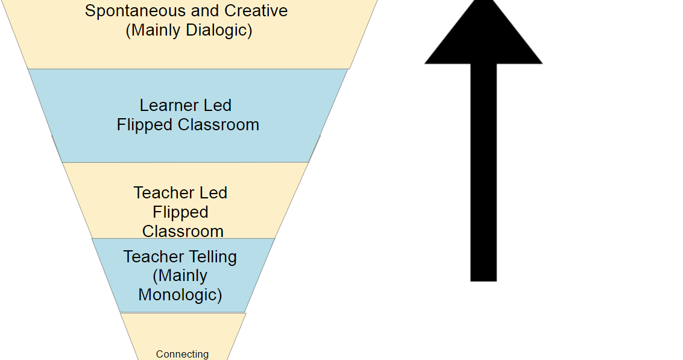
Increased Learner Talking Time

Slide 57

https://www.space.fm/astronomy/planetarysystems/geocentricheliocentric.html

Slide 58
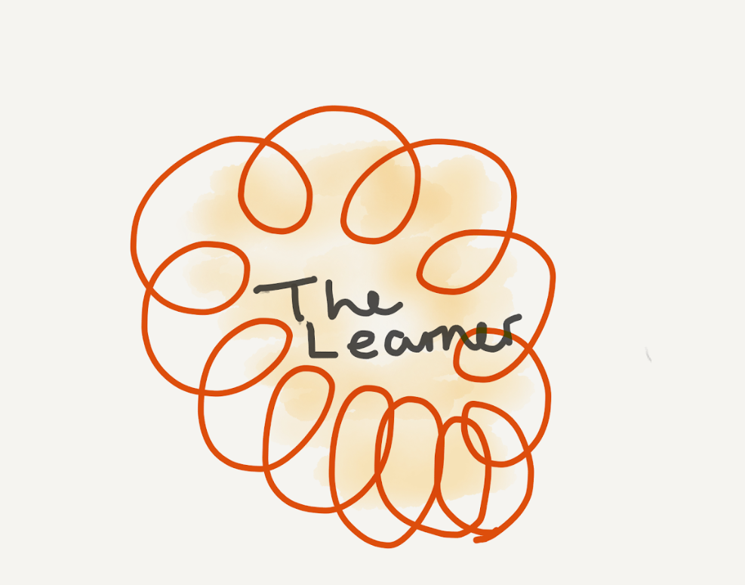

Slide 59
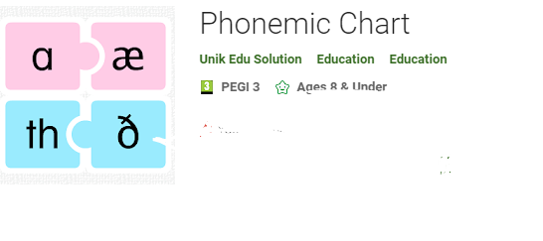
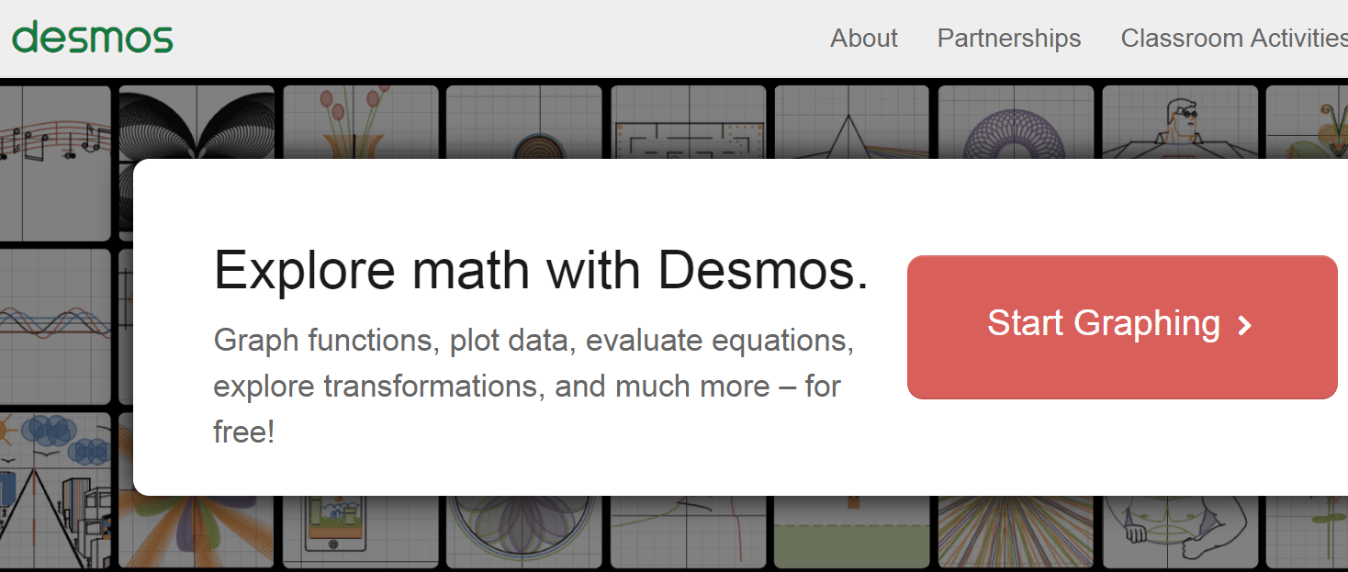

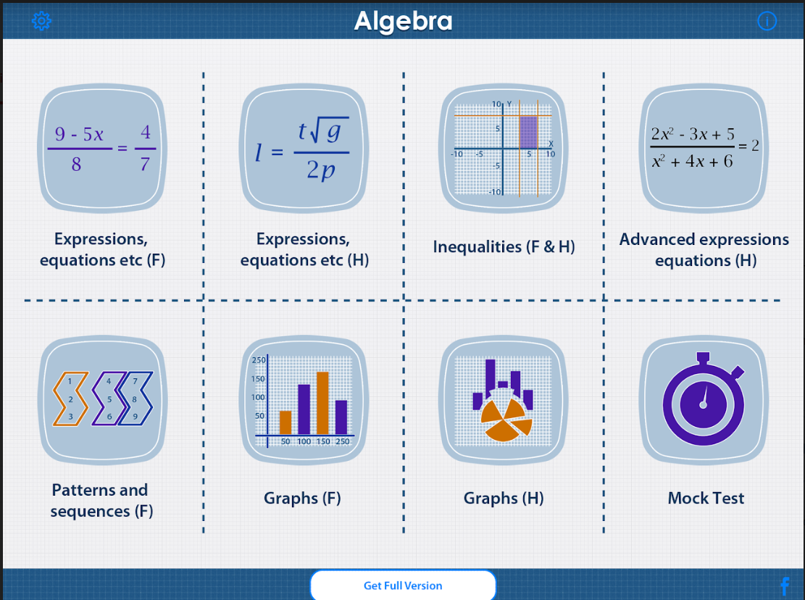
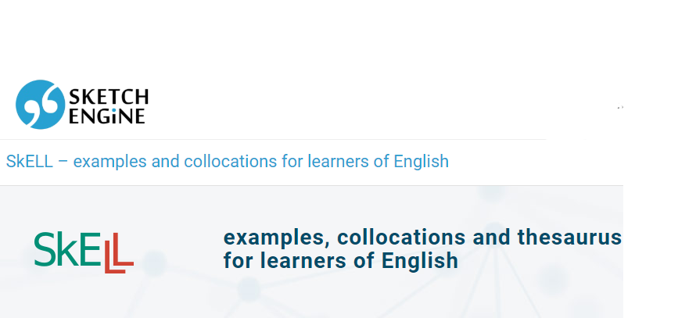
‘Low Hanging Fruit’ Apps

Slide 60
Acedo, M. (2018). 10 Pros And Cons Of A Flipped Classroom. Available Online: https://www.teachthought.com/learning/10-pros-cons-flipped-classroom/ [Accessed 8th January 2019]. Bloom (Krathwohl and Anderson) and Web 2.0. Available Online: http://www.mmiweb.org.uk/web20/bloomweb20.html [Accessed 8th January 2019]. Critchley Charlton, B. (2010). Engaging the DisEngaged. Ontario, Canada. Pembroke Publishers Limited. Lynch, M. (2001). From the Students’ View: One-on-One Learning. Available Online: https://cft.vanderbilt.edu//cft/articles-and-essays/the-teaching-forum/from-the-students-view-one-on-one-learning/ [Accessed 8th January 2019]. Pearman, D. (2017). Evaluating Apps for Learning. Available Online: https://teachtechplay.com/evaluating-apps-learning/ [Accessed 8th January 2019]. Teaching and Learning Toolbox: Technology Tool Resource List. Available Online: http://teachingandlearningtoolbox.com/storage/app/media/resources/CTLA%20-%20Accounting%20Toolbox%20w_Logo_%20Resource%20List_REV_080316.pdf [Accessed 11th June 2019]. Wilson, L.O. (2016). The Second Principle: Anderson and Krathwohl – Bloom’s Taxonomy Revised: Understanding the New Version of Bloom’s Taxonomy. Available Online: https://thesecondprinciple.com/teaching-essentials/beyond-bloom-cognitive-taxonomy-revised/ [Accessed 8th January 2019].

Slide 61
References

Slide 62
Do you want to communicate with others on campus about teaching and learning? Subscribe to ‘HEFi-OPEN’, a JiscMail mailing list service:
https://tinyurl.com/y3wczmyh
Use it to:
share teaching ideas and resources, look for collaborators
find out about development opportunities related to teaching and learning
ask questions about how others teach and support learning
build and strengthen links within the teaching community

