Slide 1
Coins as History
Numismatics and Historical Evidence

Slide 2
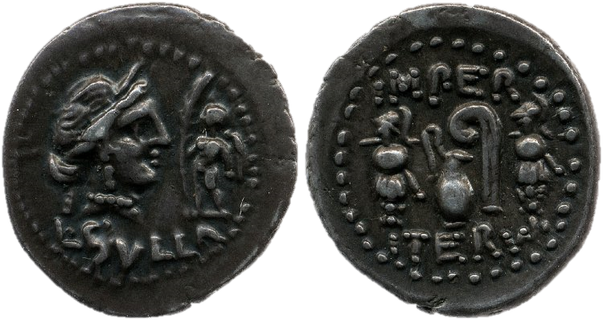
Obverse
Reverse
Legend
Denarius of Sulla (84-83 BC)
Notes:
Teacher Notes:
ALL titles hyperlinked to Coins of the Roman Republic Online
The heads side of the coin = the obverse
The tails side of the coin = the reverse
The writing = the legend
The area of the coin on which the images are depicted is referred to as the field.
On this coin, minted by Sulla in 84-83 BC:
Obverse: The diademed head of the goddess Venus facing right; the figure of Cupid holding a palm branch (symbol of victory)
legend = L(ucius) Sulla
Reverse: Two trophy monuments, in between which is a jug and a lituus (augur’s staff)
Legend = Impera(ator) Iterum = Imperator [victorious general] for the 2nd time
[See video for information on the meanings of this coin]
NEXT SLIDE:Breaking down all the elements on the coin

Slide 3
Cupid with a palm branch
Imper(ator)
Venus
trophies
Jug
Lituus
L(ucius) Sulla
Denarius of Sulla (84-83 BC)
iterum
Notes:
Teacher’s Notes:
NB animation function to click through the different parts of the coin:
Obverse:
1: Venus
2: Cupid with palm branch (i.e. victory)
3: Legend = Lucius Sulla
Reverse:
1: Trophies (monuments made out of the weapons of opponents; anthropomorphic)
2: Lituus (augur’s staff)
3: Jug
4: Legend = Imper(ator) Iterum (Imperator [i.e. victorious general] for the 2nd time)
[NEXT SLIDE: understanding the numismatic use of the trophy monument and the lituus]

Slide 4
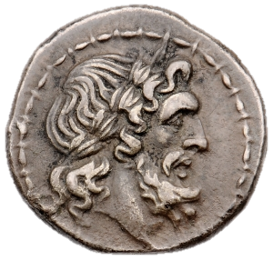
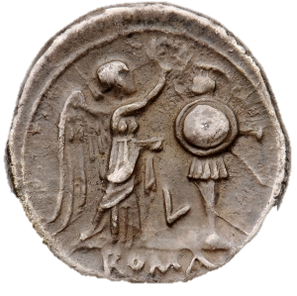
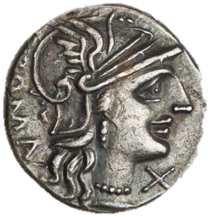
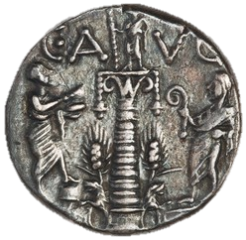
211 BC, Victoriatus (RRC 53)
135 BC, Denarius (RRC 242)
Notes:
Teacher’s notes:
Comparison of the coin of Sulla with two earlier coins, in order to understand the iconography of trophies and the lituus.
211 BC, Victoriatus, depicts on the obverse the laureate Jupiter; reverse: winged Victory crowning a trophy monument with a wreath. The trophy comprises: a helmet; circular shield; long spear; sword (hilt visible); tunic and possibly leg greaves.
135 BC, Denarius minted by C. Minucius Augurinus
Obverse: helmeted head of Roma
Reverse: The column on the reverse represents the bronze Columna Minucia outside the Porta Trigemina in the Servian Wall. The spiral column is decorated with two bells at the top, and two lions at the base; standing on the column is a togate statue holding a staff; behind each lion is a corn-ear; on the left is a togate figure holding loaves (?) and placing foot on a modicus (grain measure); on the right is a togate figure with his hood up (capite velato) i.e. a priest, holding a lituus (augur’s staff).
This scene is, in part, a play on the moneyer’s name: ‘Augurinus’.
[Next slide: revisiting the coin of Sulla]

Slide 5
Denarius of Sulla (84-83 BC)

Slide 6
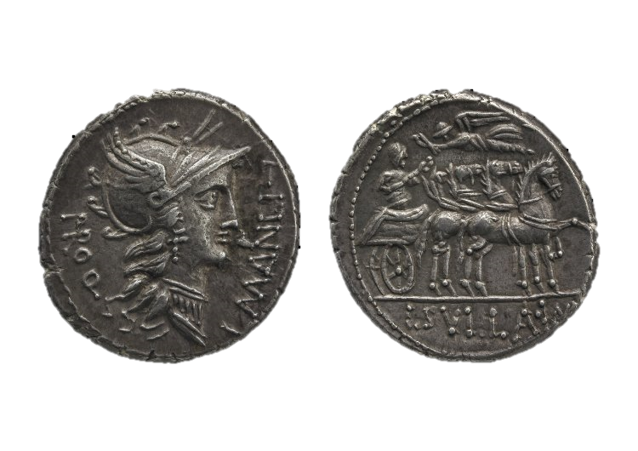
Denarius of Sulla (82 BC)
Notes:
Teacher’s Notes:
Coin of Sulla minted in 81 BC by PRO Q(uaestor) L. MANILI(us), depicting the helmeted head of Roma on the obverse.
Reverse: scene of triumph; Legend: L(ucius) Sulla Imp(erator).
[NEXT SLIDE: detailed examination of reverse image]

Slide 7
Triumphator holding a caduceus
Winged Victory holding a wreath
Quadriga (four-horse chariot)
Denarius of Sulla (82 BC)
L(ucius) Sulla Imp(erator)
Notes:
Teacher’s notes:
Focusing on understandin the reverse image
Reverse side:
1: Quadriga (four-horse chariot)
2: Triumphator (general celebrating the triumph) holding a caduceus (herald’s staff: symbol of negotiation and peace)
3: Winged Victory crowning triumphator with wreath
4: Legend = L(ucius) Sulla Imp(erator) = Lucius Sulla Victorious General [Imperator is a title]
[NEXT SLIDE: history of the Quadriga and the triumph on Roman coinage]

Slide 8
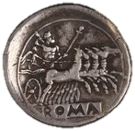
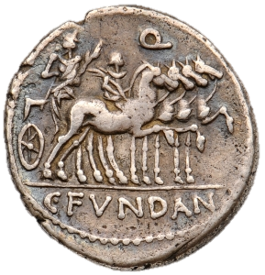
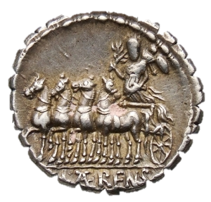
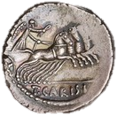
c. 225-212 BC (Quadrigatus)
101 BC
83 BC
82 BC
71 BC
46 BC
Notes:
Teacher’s notes:
Series of coin reverses depicting the quadriga
Quadrigatus of 225 -212 BC: Jupiter in quadriga driven by Victory. Jupiter holds sceptre and hurls thunderbolt; legend [incuse on tablet] = ROMA
In the 3rd and 2nd centuries BC, it was common to see gods in quadriga.
Denarius of 101 BC (RRC 326) minted by the quaetor Gaius Fundanius on behalf of Gaius Marius consul. Marius a triumphator in a chariot; young man on horseback probably his osn. Marius was awarded this triumph for his victory over the Teutones.
First instance of a mortal and contemporary figure depicted in a quadriga on coins.
Denarius of 83 BC (RRC 358): only a single surviving specimen: depicts triumphator holding laurel branch (victory) and a trophy. According to D. Sears (Roman Coins and their Values, vol. 1) it ‘would appear to be another anticipatory type connected with the military confrontation between the Marians and Sulla’ (p. 125).
Denarius of 82 BC (Sulla’s triumph)
Aureus of 71 BC (RRC 402): Pompey the Great as triumphator (with son on trace horse), with winged victory flying over head. The legend PRO COS (proconsul) indicates that this is in relation to Pompey’s proconsular command in Spain against Sertorius.
Denarius of 46 BC (RRC 464/5): Victory in quadriga, holding wreath. Likely alludes to the triumphs of Caesar in 46 BC (issues of victory in Civil War).
[NEXT SLIDE: Revisiting Sulla’s coin]

Slide 9
Denarius of Sulla (82 BC)
Notes:
Teacher’s Notes:
Sulla celebrated two triumphs in 81 BC: one over Mithridates (whom he had defeated at Chaeronea in 86 BC), in the first Mithridatic war 88-84 BC (the 2nd mithridatic war 83-81 BC was ‘indecisive), and one over young Marius and the Samnites in Italy (in 82 BC) cf. Pliny NH 33.16.

Slide 10
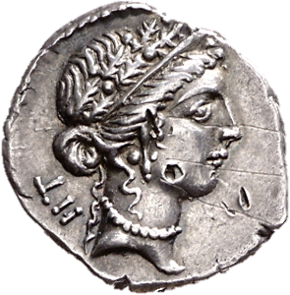
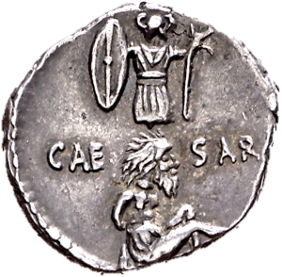
Denarius of Caesar (48-47 BC)
Notes:
Teacher’s notes:
Denarius of Caesar minted 48-47 BC
Obverse: Female head, wearing an oak wreath; Legend: Roman numeral for 52.
Reverse: a gallic trophy (monument) and a Gallic captive; Legend: CAE – SAR
[NEXT SLIDE: decoding obverse of the coin]

Slide 11
Oak Wreath
LII = 52
Reverse of denarius of Augustus, 19-18 BC
‘On account of citizens having been saved’
Obverse of Caesarian Denarius
Notes:
Teacher’s notes:
Obverse:
Female head- note the jewellery (can you spot what she is wearing) – possibly Venus
Oak Wreath
Denarius of Augustus (19/18 BC) to illustrate purpose of oak wreath. See also Aulus Gellius Attic Nights 5.6: “The crown is called "civic" which one citizen gives to another who has saved his life in battle, in recognition of the preservation of his life and safety.”
Legend: 52 – this is thought to refer to Caesar’s age.
[NEXT SLIDE: decoding reverse of coin]

Slide 12
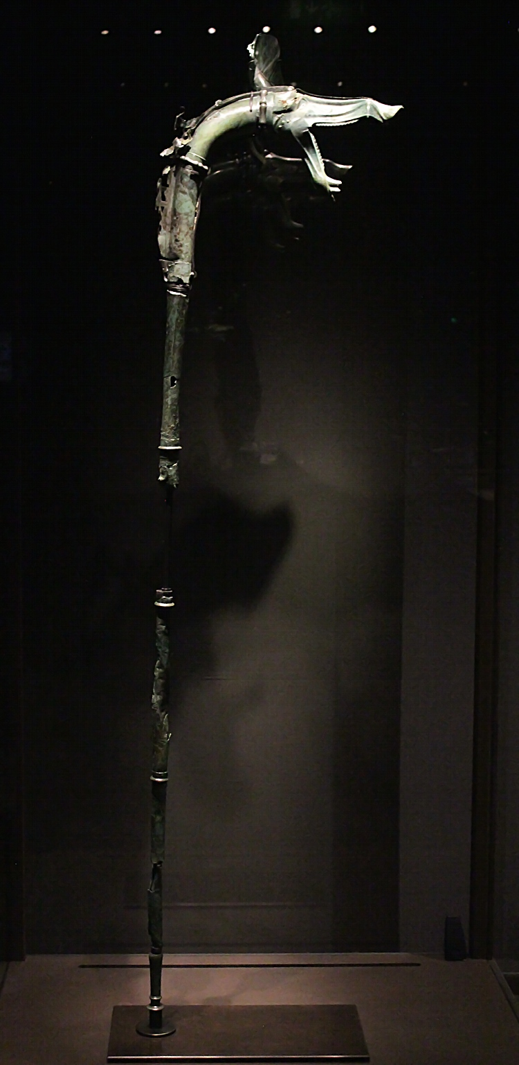
trophy
carnyx
Victoriatus, 211 BC
Gallic prisoner of war
What did a carnyx sound like?
Notes:
Teacher’s notes:
Reverse:
Trophy monument (anthropomorphic displays of enemy weapons – REMEMBER SULLAN COIN)
Victoriatus coin – Compare the style of weapons between the two coins. What are the differences?
Victoriatus coin = round shield; Caesar’s coin = oblong shield
Victoriatus coin = crested helmet; Caesar’s coin = horned (?) helmet
Victoriatus coin = long spear and sword; Caesar’s coin = carnyx (what’s that?)
Carnyx = Celtic/Gallic battle horn/trumphet
Tintigac carnyx (excavated in France) + link to video on carnyces and what they sound like!
5) Gallic prisoner of war [note his arms are tied behind his back; long hair and beard = un-Roman
[NEXT SLIDE: Revisiting Caesar’s coin]

Slide 13
Denarius of Caesar (48-47 BC)
Notes:
Teacher’s notes:
So what does this coin mean?
We have the head of Venus wearing an oak wreath. The wreath symbolises that citizen lives have been saved.
Venus was both the patron deity and divine ancestor (allegedly!) of Caesar.
52 = Caesar’s age at the time; this is possible a coinage that commemorates his birthday, his divine support and his achievements.
Which were what?
Well the reverse seems to be telling us about he Gallic victory!
[NEXT SLIDE: another coin of Caesar]

Slide 14
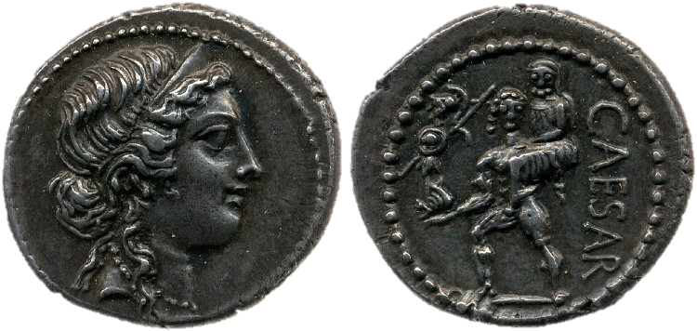
Palladium = statue of Pallas Athena rescued by Aeneas from Troy
Denarius of Caesar (47-46 BC)
Notes:
Teacher’s notes:
Obverse: Head of Venus wearing a diadem
Reverse: Aeneas, Anchises and the Palladium (click to emphasise); legend = Caesar
[NEXT SLIDE – other images of Aeneas and family’s flight from Troy]

Slide 15
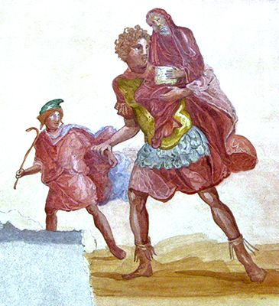
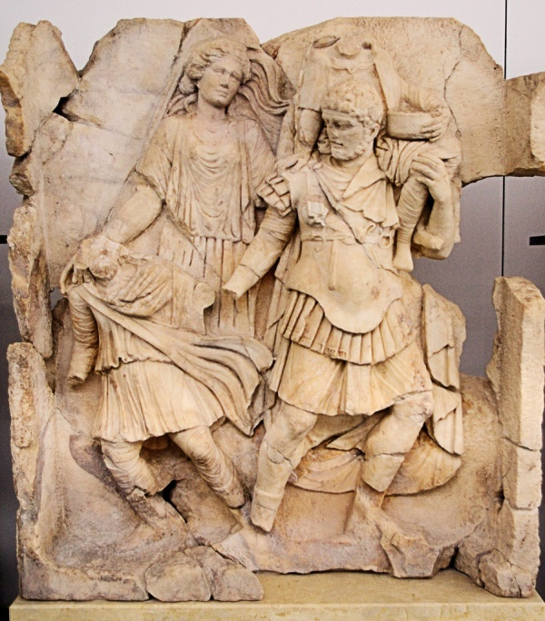
Copy of a Roman fresco from Pompeii, 1st century AD.
Relief panel from Aphrodisias, 1st century AD
Notes:
Teacher’s notes:
Two early Imperial images of the flight of Aeneas, Anchises (his father) and Ascanius (who we do not see on the coin – click to compare).
Aeneas was the son of Anchises and of Venus, his own son Ascanius was also called Iulus, from whom were descended the Iulii family. Gaius Iulius Caesar is thus claiming descent from Venus through Aeneas with this coin.
[NEXT SLIDE: The Ides of March coin]

Slide 16
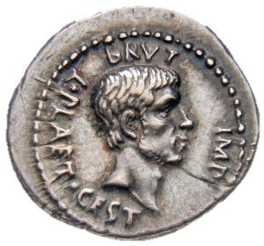
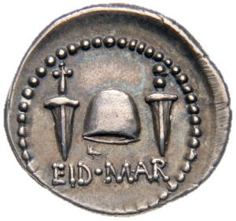
Denarius of Brutus (43-42 BC)
Notes:
Teacher’s notes:
Obverse: Head of Marcus Iunius Brutus; legend: BRVT(us) IMP(erator), L(ucius) PLAET(orius) CEST(ius) - who was responsible for minting the coin on Brutus’ behalf.
Revese: Two daggers, between which is a pilleus = cap of a freedman; Legend: EID(ibus) MAR(tiis) = On the Ides of March i.e. 15th March.

Slide 17
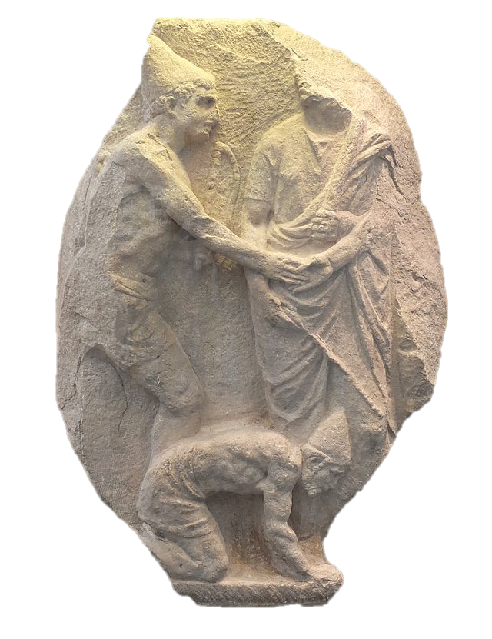
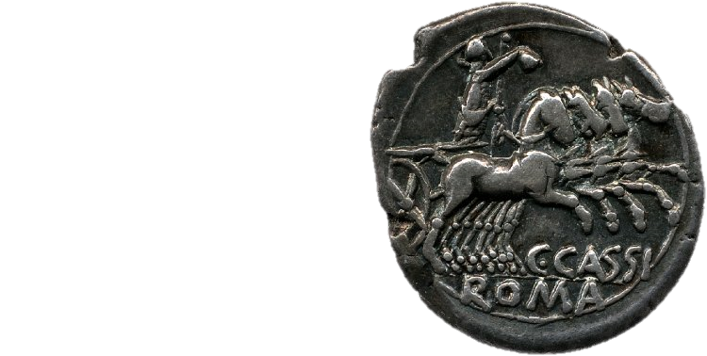
Denarius of 126 BC (RRC 266.1)
Relief depicting Roman manumission
(1st century BCE, Musée de Mariemont)
Notes:
Teacher’s notes:
For the Romans the pileus was the symbol of libertas (freedom). It was given to a slave when he was freed) – here is relief sculpture depicting a scene of manumission – note the hats!
The hat was also the attribute (object associated with) of the goddess Libertas – this 2nd century BC coin is understood to depict Libertas riding in a quadriga (triumphal chariot), identified by the pileus she is holding out!
[NEXT SLIDE: back to Brutus]

Slide 18
Denarius of Brutus (43-42 BC)
Dio Cassius 47.25.3:
In addition to these activities Brutus stamped upon the coins which were being minted his own likeness and a cap and two daggers, indicating by this and by the inscription that he and Cassius had liberated the fatherland.
Notes:
Teacher’s notes:
So what does this coin tell us?
Brutus is commemorating the Ides of March as the date/day on which he liberated the state (the pileus) with the assassination of Caesar (draggers).
In fact, over two centuries later the History, Cassius Dio, would remark upon the message of this coin: Dio Cassius 47.25.3:
In addition to these activities Brutus stamped upon the coins which were being minted his own likeness and a cap and two daggers, indicating by this and by the inscription that he and Cassius had liberated the fatherland.
[NEXT SLIDE: Mark Antony and Caesar]

Slide 19
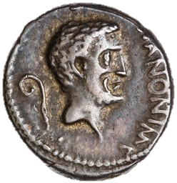
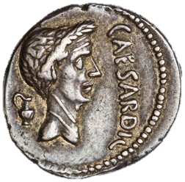
Denarius of Antony (43 BC)
Notes:
Teacher’s notes:
Obverse: bare head of Mark Antony, behind a lituus; legend: M(arcus) ANTON(ius) IMP(erator)
Reverse: laureate head of Caesar, behind a jug; legend CAESAR DIC(tator)
Can you remember what the lituus and the jug symbolised? [Think back to Sullan coinage]
Antony was an augur
Caesar was Pontifex Maximus (chief pontiff)
What do the laurels on Caesar’s head symbolise?
Antony is promoting his association with Caesar and possibly trying to claim a position as the successor (and heir) of Caesar, at a time when Caesar’s great nephew, Gaius Octavius, was also claiming that position.
It is also possible that by recalling Caesar’s dictatorship, Antony is confirming the validity of Caesar’s acts and laws when he was dictator.
[NEXT SLIDE: Mark Antony and Octavian]

Slide 20
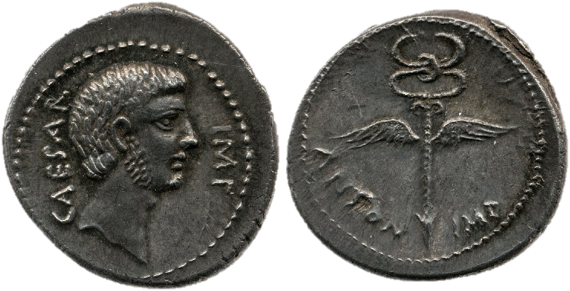
Denarius of Antony and Octavian (39 BC)
Notes:
Teacher’s notes:
Obverse: bearded head of Octavian; Legend: CAESAR IMP(erator)
Reverse: winged Caduceus; legend: ANTON(ius) IMP(erator)
What’s in a name? CAESAR IMP. Does not refer to Julius Caesar, but to his great nephew, whom we offer call Octavian. He was born Gaius Octavius, but when he learnt that he was named as one of Caesar’s heirs in his will, he took Caesar’s name: Gaius Iulius Caesar was a way of confirming his position as such.
NOTE that both Octavian and Antony are named as ‘Imperator’ (or Imperatores in the plural). This means that they have been successful on campaign; in fact both were awarded a ovation (minor triumph) in 40 BC because they had made peace with each other!
This peace is symbolised by the caduceus.
[NEXT SLIDE: What is a caduceus?]

Slide 21
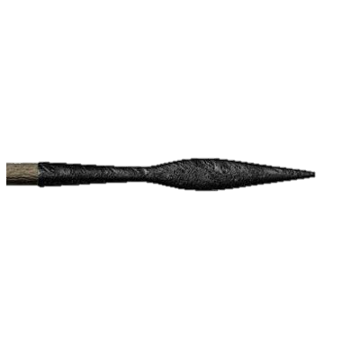
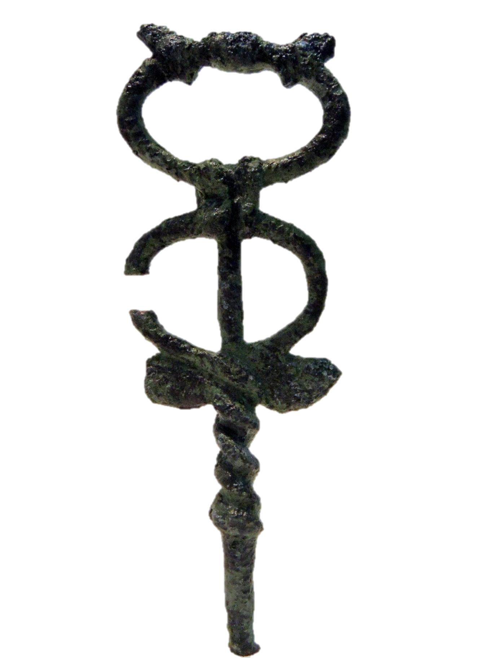
Aulus Gellius, Attic Nights, 10.27
the Roman people had sent them a spear and a herald's staff, signs respectively of war and peace; they might choose whichever they pleased and regard the one which they should choose as sent them by the Roman people.
Notes:
Teacher’s notes:
This passage comes from Aulus Gellius account of a Roman embassy to Carthage before the beginning of the Hannibalic war. This passage indicates that the Romans symbolised war with the spear (hasta) and peace with the caduceus, the messenger’s staff / staff of Mercury (or Hermes in Greek). Mercury was the messenger god, as well as the god of trade and commence. His staff symbolise the possibility of negotiation and therefore peace.
[NEXT SLIDE: More peace between Mark Antony and Octavian]

Slide 22
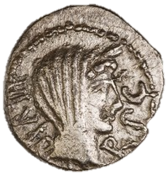
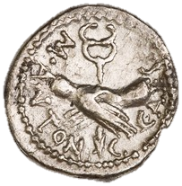
Quinarius of 39 BC (RRC 529.4)
Notes:
Teacher’s notes:
In 40 BC, after the battle of Perusia (where Antony’s brother, Lucius, and Antony’s wife, Fulvia, had fought against Octavian), Antony and Octavian made peace at Brundisium, and celebrated ovations at Rome. They also solidified their alliance through the marriage of Antony to Octavia, Octavian’s sister (Fulvia was now dead).
This coin once again depicts the caduceus, this time with two joined hands (symbolising trust and agreement) and the legend M(arcus) ANTON(ius), C(aius) CAES(ar)
On the reverse is a veiled diadem-wearing female head and the legend: III VIR(i) R(ei) P(ublicae) C(onstituendae) = the triumviri (lit. three men) for the restoration of the Republic.
[NEXT SLIDE: back to the denarius]

Slide 23
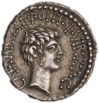
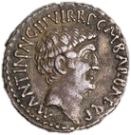
Denarius of Octavian, 39 BC
Denarius of Octavian & Antony, 41 BC
Denarius of Antony and Octavian (39 BC)
Notes:
Teacher’s notes:
The quinarius coin celebrates the peace and agreement between Antony and Octavian in 40 BC. So does our denarius (here), but whilst both Octavian and Antony are named on the coin, only Octavian has a portrait. On earlier coins from 41 BC, both men minted coins with their own portrait and the other’s portrait. This coin, however, was minted by Octavian in the west (the area he controlled), while Antony was away in the east, minting coins of his own.
[NEXT SLIDE: Octavian and his right-hand man]

Slide 24
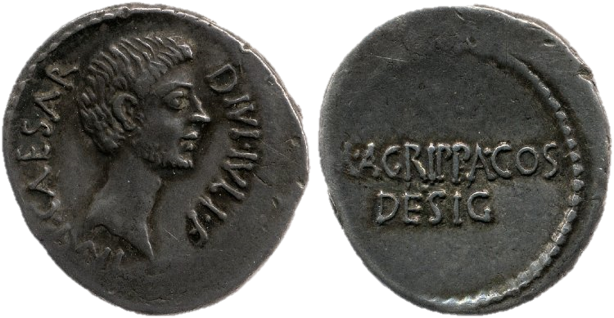
Denarius of Octavian with Agrippa (38 BC)
Notes:
Teacher’s notes:
Obverse: bearded head of Octavian; Legend: IMP(erator) CAESAR DIVI IVLI F(ilius) = Imperator Caesar, son of the Deified Iulius
Reverse: just the legend: M(arcus) AGRIPPA CO(n)S(ul) DESIG(natus) = Marcus Agrippa consul-elect
Note that now Julius Caesar has been deified, so Octavian can claim to be the son of a god!
Agrippa is clearly important enough to share a coin with Octavian, but not enough to get a portrait!!

