Slide 1
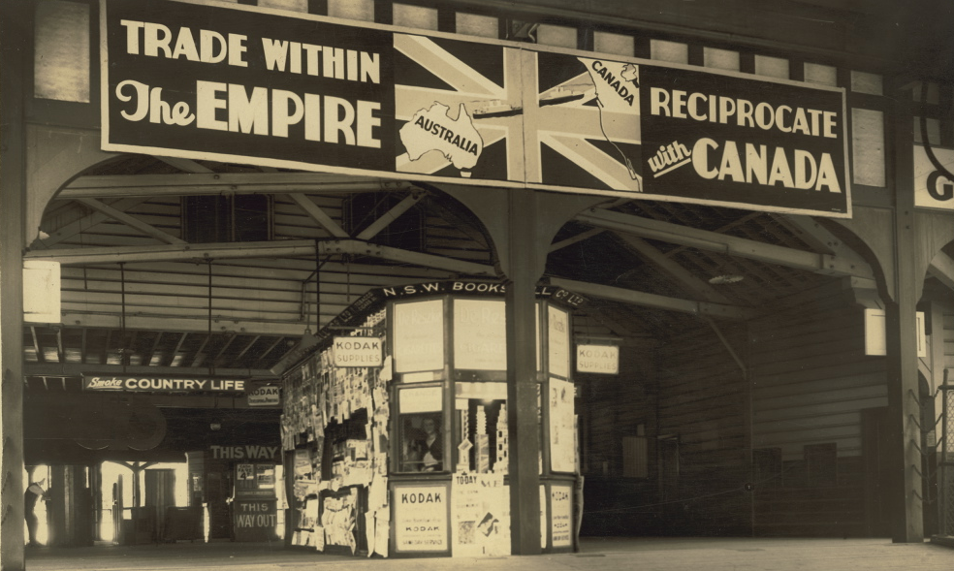
Post-Brexit Britain in A World of Preferential Trade Agreements
University of Birmingham, School of Law, 24 February 2017

Slide 2
Britain, Brexit and Beyond
Lorand Bartels (University of Cambridge)
Lilja Ólafsdóttir (Reykjavik University, former Legal Council at the EFTA Secretariat and negotiator for Iceland on FTAs and the EEA Agreement)
Robert Howse (New York University)
Chair: Luca Rubini (University of Birmingham)

Slide 3
Horizontal issues: Legal Institutions, Disciplines, Political Economy
Rilka Dragneva-Lewers (Birmingham) – ‘The EU and its Association Agreements with Ukraine, Moldova and Georgia’
Sohyun Lee (LSE) - 'Institutions and Variations in the FTA Negotiation Strategies: A Comparative Case Study of Korea and Japan'
Rafael Lima Sakr (LSE) - 'Rethinking Development in WTO: A Law and Development Framework for South-North Regional Trade Regimes’
Chair: Maria Anna Corvaglia (Birmingham)

Slide 4
Subsidies, Investment and Energy
Luca Rubini (Birmingham) – ‘Controlling subsidies in PTAs’
Ira Ryk-Lakhman (UCL) - 'Investment Dispute Settlement Mechanisms in New Generation FTAs: Problems and Opportunities'
Andrea Rocco (Birmingham) and Natasha Georgiou (Reading) - 'A Call for Energy Governance in EU-Russia Energy Relations: The Path Towards the Energy Union'
Chair: Rilka Dragneva-Lewers (Birmingham)

Slide 5
Labour and Environment
Maria-Anna Corvaglia (Birmingham) – ‘Labour Standards: The Swiss-China FTA’
Billy Melo Araujo (Queen's University Belfast) - 'Labour Standards in Mega-Regionals – why and how'
I-Ju Chen (Birmingham) - 'A Critical Analysis of the Environmental Provisions in PTAs in Asia-Pacific’
June Namgoong (UCL) - 'The Legal Obligations relating to ILO Instruments referred to in the Labour Chapter of US FTAs’
Chair: Luca Rubini (Birmingham)

