Slide 1
Education Leadership Academy Welcome to the seminar

Slide 2
‘The standards you walk past are the standards you accept’ Sir David Carter

Slide 3
Chaired by Ava Sturridge-Packer CBE

Slide 4
Why we have established an Education Leadership Academy
The critical nature of leadership – no recorded improvement journey without strong leadership
Turbulent times 150 years on from the Forster Education Act: the need for a moral compass
False polarisation out there: social inclusion v attainment, knowledge v skills, markets v democratic trust, technology v tradition
Value-led leadership We ask “what matters?” before “what works?”
The importance of social capital and place in a centralised education system

Slide 5
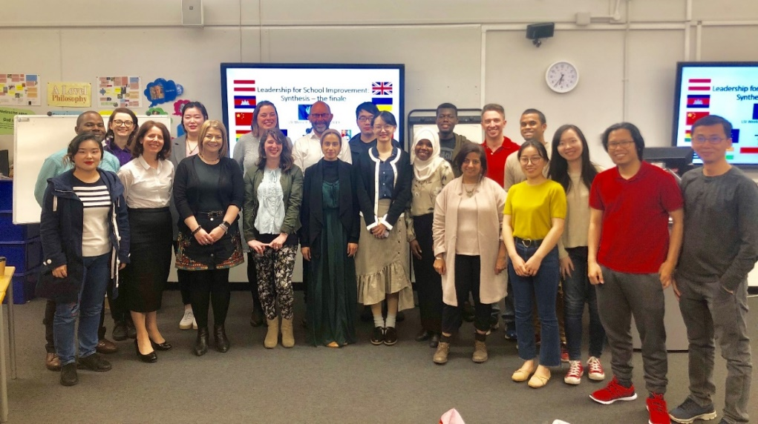
What do we do?
We teach today’s and tomorrow’s leaders from around the world - based in Birmingham and Dubai
Our programmes are co-designed, co-constructed and co-delivered between academics and education leaders
We combine the best research with the best contemporary leadership practice
Developing plans to introduce an MBA Education Leadership DA programme
Rolling out the Seminar Programme led by England’s top educationalists

Slide 6
Next seminar: Steve Munby Imperfect Leadership 4th February 2020

Slide 7
The standards you walk past are the standards you accept
The standards you walk past are the standards you accept
Sir David Carter, Executive Director of System Leadership, Ambition Institute

Slide 8
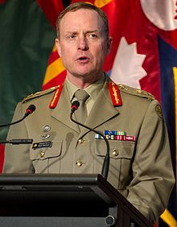
Lieutenant General David Morrison
Lieutenant General David Morrison
Published on 13 June 2013
Message from the Chief of Army, Lieutenant General David Morrison, AO, to the Australian Army following the announcement on Thursday, 13 June 2013 of civilian police and Defence investigations into allegations of unacceptable behaviour by Army members.

Slide 9
David Morrison – Video Clip
▶ 3:07
https://www.youtube.com/watch?v=QaqpoeVgr8U

Slide 10
How do you remain loyal to your values but deliver the right messages at the same time?
How do you remain loyal to your values but deliver the right messages at the same time?”
This is the challenge that all leaders have to be capable of meeting

Slide 11
The Leadership Landscape today
The leadership landscape today
What we need our leaders to be good at:
Ethical Leadership in a Collaborative Context
How leaders build culture through multiple intelligences
Multiple School Leadership and its challenges and opportunities
Leading Collaboration
How we lead and govern school Improvement
Leadership Legacy and preparing our leaders of tomorrow

Slide 12
My Career
My career (not the Dalek!)
1983 – 2019
Teacher of Music and PE
Head of Creative Arts
Dorset LA Music Advisor
Senior Teacher Boys Achievement
Deputy Head
Principal
Executive Head
CEO of a large MAT
RSC for the South West
National Schools Commissioner
Executive Director of System Leadership at Ambition Institute

Slide 13
The multiple intelligences that enable leaders to be effective
The multiple intelligences that enable leaders to be effective
OPERATIONAL INTELLIGENCE
EMOTIONAL INTELLIGENCE
How my leadership impacts on change
How my leadership impacts on other people
TRANSACTIONAL LEADERSHIP

Slide 14
Leaders should show leadership through these virtues
Leaders should show leadership through these virtues
Trust-leaders are trustworthy and reliable
Wisdom-leaders use experience, knowledge and insight
Kindness-leaders show respect, generosity of spirit, understanding and good temper
Justice-leaders are fair
Service-leaders are conscientious & dutiful
Courage-leaders work courageously in the best interests of young people
Optimism-leaders are positive and encouraging

Slide 15
Leaders create a culture that creates impact
Leaders create a culture that creates impact
Workforce
Where the Leader Influences
Where the Leader builds Confidence
Children
Where the Leader builds Engagement
Where the Leader Delivers Impact
Parents & Carers
Community

Slide 16
How do we frame this in leadership schools?
How do we frame this in the leadership of schools?
What are the values that underpin the standards we don’t accept?
What should we never be willing to walk past?
How do we enact and become the embodiment of our values?
How do you help others to model ethical leadership?
Who models it for you?
How does your leadership raise the expectations in the communities you serve?

Slide 17
What are the standards we should expect to see when we lead others?
What are the standards we should expect to see when we lead others?
Behaviours-Reacting to what we observe
The way adults behave towards children
The way adults behave towards other adults
The way children behave towards other children
The way in which we build relationships with parents
Inclusion-Building fairness and equity
The fairness of keeping an open mind and listening to every person who experiences our leadership
The refusal to give up on any child or adult no matter how demanding their behaviours might be
Entitlements-Building equality
The entitlement of all children to quality teaching
The entitlement of adults to being developed professionally
The entitlement of adults to wellbeing in the workplace
Supporting our Educational Community
The belief that leaders in schools within their community are educating all children not just those in their building

Slide 18
How do we enact our vales as we improve our schools?
How do we enact our values as we improve our schools?
We describe them to staff, students and parents
We celebrate examples of when we see them being displayed
We place praise ahead of sanction
Question? What is the risk of our values being obscured from those we lead?
Our actions also make explicit our values when we are…
Appointing & Promoting Staff
Performance managing staff
“Managing our mates” & “Managing more experienced staff”
Praising and Sanctioning children
Responding to upset or the challenging behaviour of visitors to the school
Creating our strategic plans

Slide 19
How do we help others to model ethical leadership?
How do we help others to model ethical leadership?
What does it mean to be a role model?
A good leadership role model sets high standards of accountability for themselves and their behaviours
How close to reality is the behaviour you want to model compared with that which others see?

Slide 20
How do we help others to model ethical leadership?
How do we help others to model ethical leadership?
The role of coaching/mentoring in creating great role models – the 6 questions I use more than any others with leaders I coach
What are your current developmental goals and how far have you come in the last 12 months
How challenging of your own performance do you want to be?
How close is the alignment between your personal leadership competencies and the behaviours you show most frequently
How do you know that you embody your own motivations and values?
What habits and insecurities hold you back?
Do you behave differently when you are being observed in public as opposed to a more private setting?

Slide 21
How does our leadership raise the expectations in the communities we serve?
How does our leadership raise the expectations in the communities we serve?
By raising our expectations of the standards we would be happy to accept we…
Play the short and long term game
We develop people to become great citizens
We paint the picture of what is possible
We transform communities through hope and optimism
We step up when another school is in trouble
We create legacy that leaves a school in a better position than we found it in

Slide 22
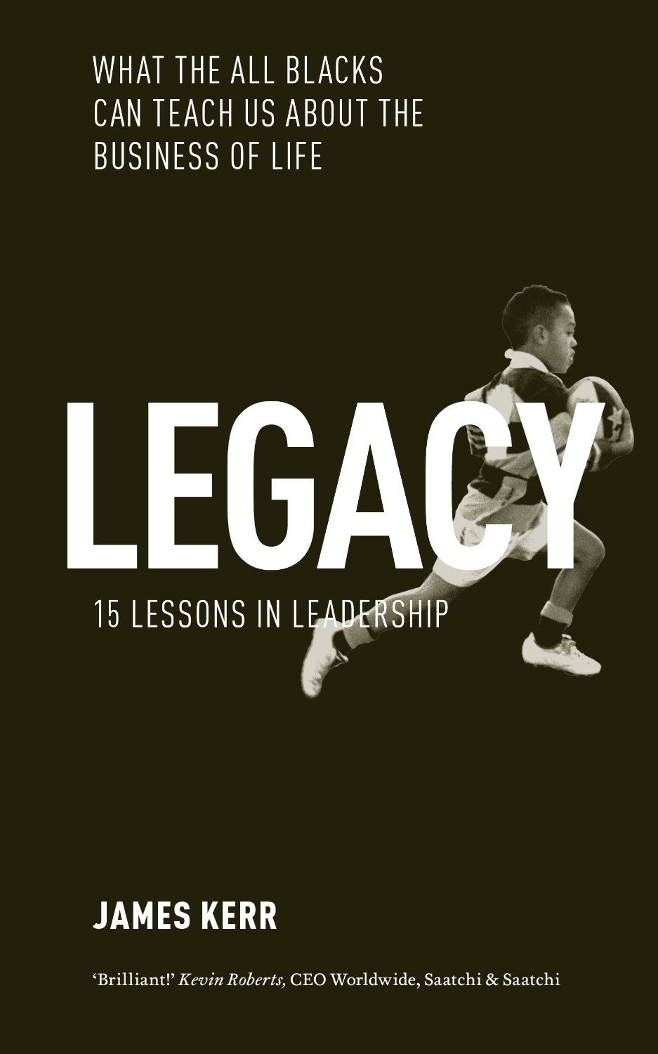
Our generation of leaders must play an even bigger role in increasing Social Mobility
Our next generation of leaders must play an even bigger role in increasing Social Mobility
What does this mean for the young people that you are responsible for?
Fairer access to Skills and Qualifications
Focusing upon reading and vocabulary to close the literacy gap
More resilient learners able to overcome challenges when they arise
Creates exposure for learners to broader experiences in the Arts, Sport, & Film, for example
Makes the route map to HE and the workplace easier to follow
Builds confidence and personal capacity, and drives social responsibility
It is the Legacy Challenge and how we leave our schools in better shape than when we took them on

Slide 23
“The standards you walk past are the standards you accept”
“The standards you walk past are the standards you accept”
What happens when we see the standards we want?
School Improvement is sequential and progressive
Teacher Development is incremental and dynamic
Children’s learning becomes enriched and embedded
Curriculum becomes relevant and challenging
Enrichment promotes deeper learning
Relationships become more respectful
Differences are celebrated
Inclusion means people are included and welcomed
Disagreements are resolved
Communities are more hopeful and sustainable

Slide 24
Two questions the best leaders have to be able to answer
Two questions the best leaders have to be able to answer
What are the standards that you would never walk past if…
…accepting them meant your team had to choose between you and their own personal values?
…accepting them meant children remained disadvantaged?

Slide 25
How do we make this a reality?
How do we make this a reality?
We do it by developing a system of leaders who make ethical and values driven decisions in a culture of collaboration and collegiality

Slide 26
The 5 tests for purpose driven collaboration to pass
The 5 tests for purpose driven collaboration to pass
When there is a clear set of agreed goals about the intended outcome of the collaboration-PURPOSE
When there is recognition that giving and receiving is expected of all partners-MUTUALITY
When there is an understanding that practice might need to change even if it is not a performance issue (yet)-CHANGE
When there is a clear timescale for the collaboration to deliver its objectives-PACE
That there is an opportunity cost in terms of finance, resources and time-PRIORITISATION

Slide 27
The three contributions to collaboration
The three contributions to collaboration
Leading - The school provides the leadership for a new collaborative experience that others sign up to
Participating - The school takes part in the collaboration but does not lead it-adds capacity through activity and commits to doing what is needed
Endorsing - The school neither leads nor participates but talks positively about it and encourages others to engage; takes part later in more appropriate collaborations
Collaboration

Slide 28
The call to arms
The Call to arms
What Experiences should we be giving to our future leaders in our schools today?
Our Future Leaders need access to…..
A Great Coach
The Chance to become a Coach
The chance to mentor a new teacher
Taking an assembly or experiencing talking to large audiences
Lead a training development experience for colleagues
Visit 5 different schools in the next 12 months
Become a governor in a school other than your own
Publish a blog or write a research project
Participate in and create new enrichment opportunities for children

Slide 29
My 5 personal leadership lessons from the past 20 years
My 5 personal leadership lessons from the past 20 years
It is OK to change your mind but it is not OK to compromise your values and beliefs
People forget what you said, what you did but never how you made them feel (Maya Angelou)
Improvement is not a quick fix-find the right strategy and steer the course even if it takes time for the results to catch up
Aggressive behaviour whilst difficult and challenging is more often than not a cry for help than a desire to inflict damage
Legacy matters-build teams, develop people and leave your school in a better state for your successor than it was in when you arrived

Slide 30
Thank you

Slide 31
Next seminar: Steve Munby Imperfect Leadership 4th February 2020

