Slide 1
Education Leadership Academy
Welcome
Please note this event is being recorded.

Slide 2
Before we start….
Please keep your microphones muted, unless invited to speak by the Chair.
Please utilise the chat function to ask questions or comments as we go through.
If you encounter technical issues, stop video and switch to audio only as a first measure to resolve.
We will share the slides and event recording following the session.

Slide 3
ELA Seminar - number 3 Leadership during CV-19 June 2020
#Blacklivesmatter

Slide 4
Educational Leadership MEd Level 7

Slide 5
Education Leadership Academy
Ava Sturridge-Packer CBE

Slide 6
Leading in lockdown
15th June 2020

Slide 7
From Still I Rise Maya Angelou
You may write me down in history
With your bitter, twisted lies,
You may trod me in the very dirt
But still, like dust, I'll rise…
Just like moons and like suns,
With the certainty of tides,
Just like hopes springing high,
Still I'll rise.
Leaving behind nights of terror and fear
I rise
Into a daybreak that’s wondrously clear
I rise…

Slide 8
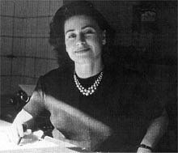
A gift from holocaust survivor Zdenka Fantlova:
‘Never envy, never slander, never despair,
Wish well to all, work hard and hope.’
Arnost Fantyl, 1928

Slide 9
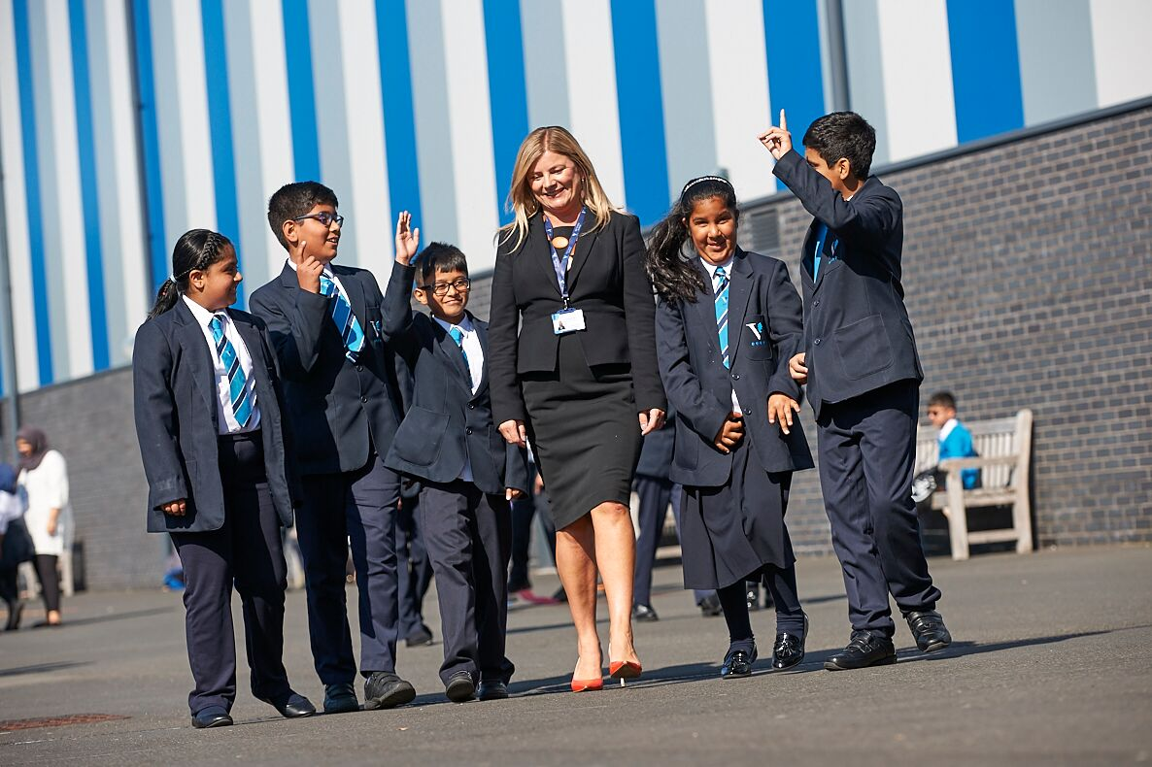
Leading is a privilege, honour (and really hard at times)
‘Good actions give strength to ourselves and inspire good actions in others.’
Plato

Slide 10
Core questions to help decision making
Equity: is what we are providing equitable to all?
Accessibility: can everyone access?
Reasonable: is what I am asking reasonable given…?
Practical: is what we are trying to do practical?
Care: have I considered my staff and students and their families sufficiently? Have I shown and given enough care?
Making a positive difference: is what we are proposing going to have the right kind of impact? Will it matter?

Slide 11
Great Teachers make Great Schools
‘a school that does not prioritise professional learning and managing staff workload – which as a consequence, will help improve staff well-being – is disadvantaging its own students.’
(John Tomsett and Jonny Uttley, Putting Staff First, 2020):

Slide 12
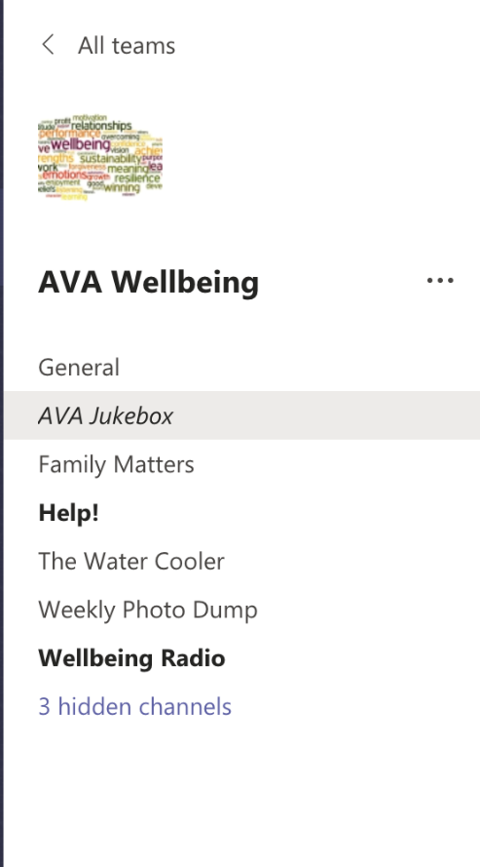
Tip #1 Prioritise staff well-being
Well-being committee and platform
‘Pub’ quizzes
Staff band on the ‘juke box’
Shout outs
Clinics
Face to face time with Principal
External support – Ed Psych Managing Stress and Anxiety workshop, yoga, pilates etc

Slide 13
Everyone Learns
‘We know that the best school leaders develop other leaders and build positive cultures where the professional talent, capability and knowledge of all educators can be fully expressed, enhanced and extended.’
(Leithwood, Harris and Hopkins, 2020).

Slide 14
Tip #2 Keep the learning going for staff
Focus groups
Online courses
Virtual training
Reading groups
Mini ResearchEd INSET
Curriculum discussion
Thinking meetings

Slide 15
Communication, communication, communication
Leading others at a distance requires establishing clear protocols of engagement around online communication and collaboration to ensure the experience is positive for all participants. This includes creating boundaries around online communication with colleagues and scheduling dedicated time slots for discussion. These boundaries need to be respected to give work colleagues the time and space to do other things and to meet other needs – family, friends, etc.
(Professor Alma Harris, Deputy Head, School of Education, University of Swansea, UK, Leading a School during Lockdown, Impact Journal, CCT, 2020)

Slide 16
Tip #3 Communicate often and with care
Think carefully about the meetings you need
Spend more time on creating agendas
Script meetings and briefings
Regular virtual briefings keeps everyone connected: emails, via MS Teams
Newsletters, shout outs, virtual assemblies to students
Pastoral calls – key!
Collaborative documents, platforms
Sharing newsletters and letters to parents with all staff
Re-iterate and repeat core messages
Don’t forget parents: virtual coffee mornings

Slide 17
Tip #4 Be realistic about your provision (remote or in-school) and don’t forget access for all
We have tried not to make assumptions
Our students’ home and financial situation has impacted on our remote learning leadership (and aspiration): we have made needed to make sure all work is 'accessible' and context specific
Quality over quantity
Phone calls/talking very useful way of checking engagement/access
Revisit vulnerable pupils
Resources are finite
Check it is manageable with staff
We cannot replicate school currently
We cannot do it all – we are part of a community – and have leant on and used local services - resilience funding etc.
‘In it together’

Slide 18
Tip #5 Keep your vision and strategic thinking alive
Remember your vision: the way to achieving this may look different but we all need reminding
Easy to be forced into operational issues and reacting rather than being proactive
Easy to think these are not your decisions to make: but YOU know your school and context better than anyone
Your leadership team need time to be strategic and to think too – how can you build this in?
Sharing your vision and strategy with the wider staff team will remind them of their core purpose and may help them navigate difficult waters

Slide 19
Finally
‘Showing kindness and generosity means demonstrating genuine concern for others’ happiness and well-being…When we act in accordance with this aspect of character and ethics, we not only strengthen our interpersonal relationships and make others feel good but we also increase the amount of joy that we feel on a daily basis, so it’s a total win-win situation.’
(Danielle Harlan, The New Alpha, 2017)

Slide 20
Tip #6 Be kind (to yourself too)
Always be kind in interactions – we just don’t know how this is affecting each individual
Be open and honest
Allow flexibility
Demonstrate compassion
Celebrate
Email, meeting, call black-out for all
On site reduced hours (look after site and admin teams)
don’t forget birthdays and special occasions
You also need time off/out otherwise how do you do that all-important thinking and taking stock?

Slide 21
Thank you for listening! Any questions?
Happy to share and learn: e.mcsorley@arkvictoria.org

Slide 22
The Thinking School – Developing a Dynamic Learning Community. Moral and Ethical leadership in a Post Covid World. Dr Kulvarn Atwal June 2020 @Thinkingschool2
Notes:
Focus for the day: 1. Theories of workplace learning and how to maximise teacher learning in schools to impact upon pupil outcomes. Discuss why workplace learning is more encompassing than CPD 2. Distributed leadership and how to develop learning leaders in schools. My aim is to illustrate how we can build a structure within a school that underpins teacher learning, to enable pupil learning. Give background to my research. Have focused on teacher learning throughout my career, both in terms of theory and practice. My doctoral work took me into the realms of workplace learning literature, and the value of informal learning in schools. EXPANSIVE/RESTRICTIVE and INDIVIDUAL DISPOSITIONS.
One of the bullet points for this session was about who is accountable for CPD. My research works on a single premise. The biggest factor that influences the quality of children’s learning is the quality of teaching, and the biggest factor that influences the quality of teacher learning is the quality of teacher learning. A Head Teacher (my title is Head Learning Leader) should be responsible for the learning of their staff in the same way as a teacher is responsible and accountable for the learning of their children.
I believe that it is an irony that in the very institutions where ‘learning’ is the core business, the quality of adult learning is relatively poor. Discuss how expansive we can make our learning environment to maximise teacher learning.

Slide 23
Learning For Today . . .
Setting a positive culture for learning focused leadership
The power of staff professional learning
A dynamic learning community . . . ?

Slide 24
Prompt Questions
How would you currently describe the learning environment for teachers in your school?
What opportunities do teachers have to engage in collaborative learning activities?
What aspects of teacher professional learning would you like to develop?

Slide 25
My message . . .
The value of collaboration and combined wisdom is crucial to continual improvement. We are all doing well and can all do better.
A culture of continued enhancement, improvement and growth.

Slide 26
Values Matter
“Leading organisations use their values and principles (core beliefs) as a strategic guidance system.”
Kanter 2010
…… which is also consistent with
“Be the change you want to see in the world.”
Gandhi
….. individually and collectively we make a difference
Notes:
Relate to wider attainment and achievement in their school. What do they believe that the children in their schools can achieve? Expectations.
We can’t start without considering our values. Values are important because we have to demonstrate that we value adult learning and that we invest in it. Highest performing school systems value teacher learning and they invest in it. If we really believe that teacher learning is the driver for pupil outcomes, it will be our priority. We are creating a learning organisation.

Slide 27
Key concerns
The quality of teacher learning experiences
Opportunities for teachers to engage in research
How to retain teachers to the profession
Quality of teacher wellbeing in schools
How to develop learning-focused leadership?

Slide 28
School Context – September 2012
June 2012 – Ofsted Rating 3
2011 – 60% of children achieved Level 4 in English and Maths
Established leadership team, established practices
90%+ EAL
High mobility
Notes:
Explain context – explain why great teaching is great for all children, regardless of language needs.
I want to demonstrate the practice reflects the theory. The ‘so what’ of teacher learning.
That I cannot directly influence the learning of the children at the school – I can influence the teachers through developing their understanding of best practice. To enable them to continually learn.

Slide 29
Learning Focused Leadership
You are constantly curious and restless about your practice, reflecting on your own planning and decision-making in light of relevant findings and research. Hungry to continually gain new knowledge to be the best teacher, leader, teaching assistant.
Focused on the learning outcomes of their children. That means every decision is analysed in terms of an impact upon children’s learning.

Slide 30
Emotionally Literate Leaders
Kindness: Leaders show respect, generosity of spirit, understanding and consistency.
Justice: Leaders have a sense of fairness and their actions reflect their values and beliefs.
Service: Leaders are conscientious and have a sense of duty and moral purpose.
Courage: Leaders are courageous in their decision making in the best interests of children.
Optimism: Leaders are positive and cheer others on.
Inclusive: Leaders believe in the learning and development of all children and adults.

Slide 31
What factors affect teacher learning?
The need for learning to be relevant and contextualised to individuals and children
Selecting own focus for learning
Collaboration is key
Support from school leaders
Perceived negative influence of Ofsted
Notes:
Talk through

Slide 32
Dynamic Learning Community
Research based practice
Teacher choice in learning and contextualised to children
Collaborative planning and Collaborative CPL
Coaching for all
Quality of Peer Learning/Lesson study
Team teaching
Non-judgemental lesson observations
Time made available for learning during the school day
Learning focused leaders
Intellectually challenging learning activities
Notes:
These are the activities that we can implement in schools to enable the structures and cultures in place to underpin formal and informal learning. Consider them in relation to the aims of the day. Head Learner leads, they all include learning over time, and relatively cost effective.
Masters engagement
Professional dialogue
We need to be co-constructing in the same way that we want children to learn dialogically.
Describe peer learning and lesson study.
We have to give time.

Slide 33
So what?
In each of the past seven years, the school has been placed at least in the top 10% of schools nationally for pupil progress. (2018: top 2% in RWM).
In 2018, 87% of children achieved the expected standard in Reading, Writing and Maths at Key Stage 2.
10 teachers at the school have completed their Masters in Education, and a further 15 are in the process of doing so.
The school has been awarded the Mayor of London’s Schools for Success Award for three consecutive years.
The recruitment, retention and advertising budget in the past 7 years has been £28.

Slide 34
thank you for listening! Any Questions?

Slide 35
Q&A SESSION

Slide 36
Next Seminar: Alison Kriel Date TBC
Thank you for attending – see you next time – stay safe and well

