Slide 1
Imperfect Leadership
University of Birmingham
February 2020
Steve Munby
Munby Education

Slide 2
Imperfect Leadership: Book

Slide 3
Lyrics from “Imperfect Leadership”
“Many’s the time I’ve been mistaken and many times confused” Paul Simon. American Tune
“You need me, need you, need him, need everyone” Lindisfarne January song.
“You’ve got to wake up every morning with a smile on your face” Carol King Beautiful
“It’s not dark yet, but it’s getting there” Bob Dylan. Not dark yet.
“When all the parts of the puzzle start to look like they fit” Van Morrison. Days like this.

Slide 4
Imperfect Leadership
Imperfect leaders are self-aware – they know their own strengths and weaknesses

Slide 5
The iceberg model
Knowledge
My reservoir of knowledge and experience
Skills
What I can do
Social role
How I see myself in society
Self-image
What I value in myself
Traits
My non-conscious patterns of behaviour
Motives
What excites me and matters most to me
Source: Adapted from The Iceberg Model by M. Goodman, 2002

Slide 6
The iceberg model
What knowledge, experience and skills do I have that make me an effective leader/ What are the gaps?
What do I think others want and expect from me as a leader? How do I know? Am I happy with that?
How do my traits work for or against me as a leader? What are my default modes? Why do I sometimes end up behaving in a way that I regret afterwards? How might I adapt or change my default modes to make me even more effective?
What motivates me about leadership? What are my drivers and how does that effect my behaviour and how I feel about myself? Making a difference? Achievement? Ambition? Status and power? Income for my family? Not being a failure? Being liked?

Slide 7
Leadership Style
“Leaders need to develop their own leadership style based on their beliefs and values, their expertise and skills and their personality. But context matters so our leadership style has to change as our context changes.”
Steve Munby Imperfect Leadership.

Slide 8
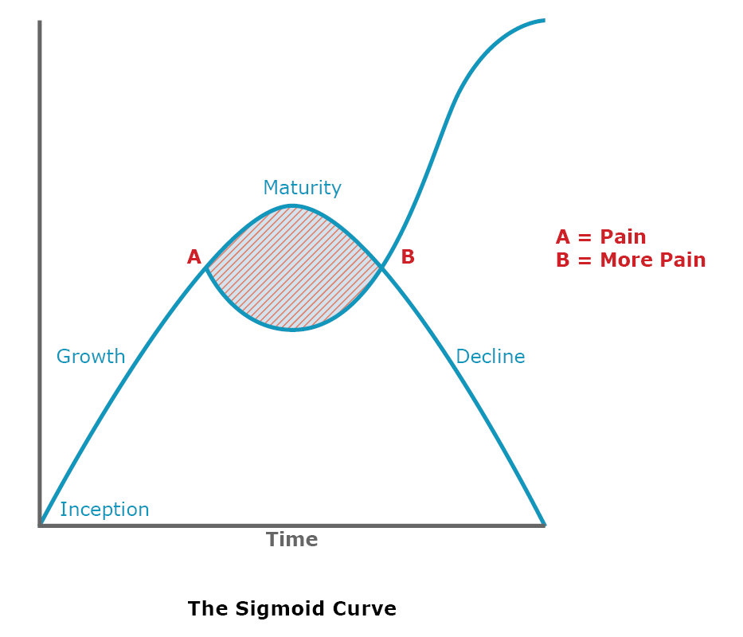
Sigmoid Curve - Understanding the inflection point
Activity
The inflection point
Time
Source: The Age of Unreason, Charles Handy

Slide 9
Using leadership styles to manage colleagues
Good Behaviour and Values
Saints
Stars
Sloths
Sinners
Coach and support
Recognise and stretch
Coaching Pace-setting
Affiliative.
Democratic
Ineffective
Highly Effective
Remove or neutralise
Feedback and sanctions
Commanding. Coaching.
Commanding
Pendleton and Furnham 2012
Poor behaviour and questionable values

Slide 10
Imperfect Leadership
2. Imperfect leaders know their weaknesses so they try to appoint people who are noticeably better at things than they are. They try to ensure that the team has the balance of skills and expertise that no single person can possibly have.

Slide 11
Imperfect Leadership
3. Imperfect leaders understand that it is not all about them (why should it be?), and that it is better to be right at the end of a process than to be seen to be right at the beginning. They empower their team and distribute the leadership.

Slide 12
When teams go wrong
Reason number 1.
The CEO keeps too much control. He or she delegates tasks rather than responsibility. Team members are neither empowered nor supported/coached in their key areas of work. The team just waits for the CEO to make all the decisions.

Slide 13
Why teams go wrong
Reason number 2
People are there because of their role rather than their expertise on the issues being addressed. At any given time, the person in the organisation with the most expertise on the issue being discussed may not even be in the room!

Slide 14
Why teams go wrong
Reason number 3
Trust between team members can be lacking. Lack of reciprocity and generosity within and outside the meeting can lead to tensions. The team does not address this or even discuss it.

Slide 15
The 5 Dysfunctions Of A Team
Patrick Lencioni
Inattention to
RESULTS
Ego - Attention on me/my team
Avoidance of
ACCOUNTABILITY
Low standards
Lack of
COMMITMENT
Ambiguity & Vagueness
Fear of
CONFLICT
Artificial Harmony
Absence of
TRUST
Lack of Openness

Slide 16
Members of trusting teams…
Admit weaknesses and mistakes
Ask for help
Accept questions and input about their areas of responsibility
Take risks in offering feedback and assistance
Appreciate and tap into one another’s skills and experience
Offer and accept apologies without hesitation
Patrick Lencioni

Slide 17
The Circle of Trust
B
A
C
D
E

Slide 18
Imperfect Leadership
4. Imperfect leaders are invitational. They ask for help and are prepared to admit that they need it

Slide 19
Why Invitational leadership/asking for help is so effective
It builds collective ownership and is more likely to change behaviours

Slide 20
Santorini in the mist

Slide 21
Why Invitational leadership/asking for help is so effective
2. It leads to better and cleverer strategies

Slide 22
Knowsley Education Office.

Slide 23
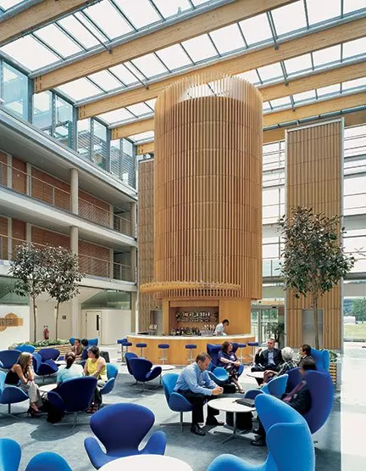
The National College for School Leadership

Slide 24
Imperfect Leadership
Imperfect leaders acknowledge their mistakes. They are not afraid of being seen to be imperfect. They avoid narcissism and manage their ego.

Slide 25
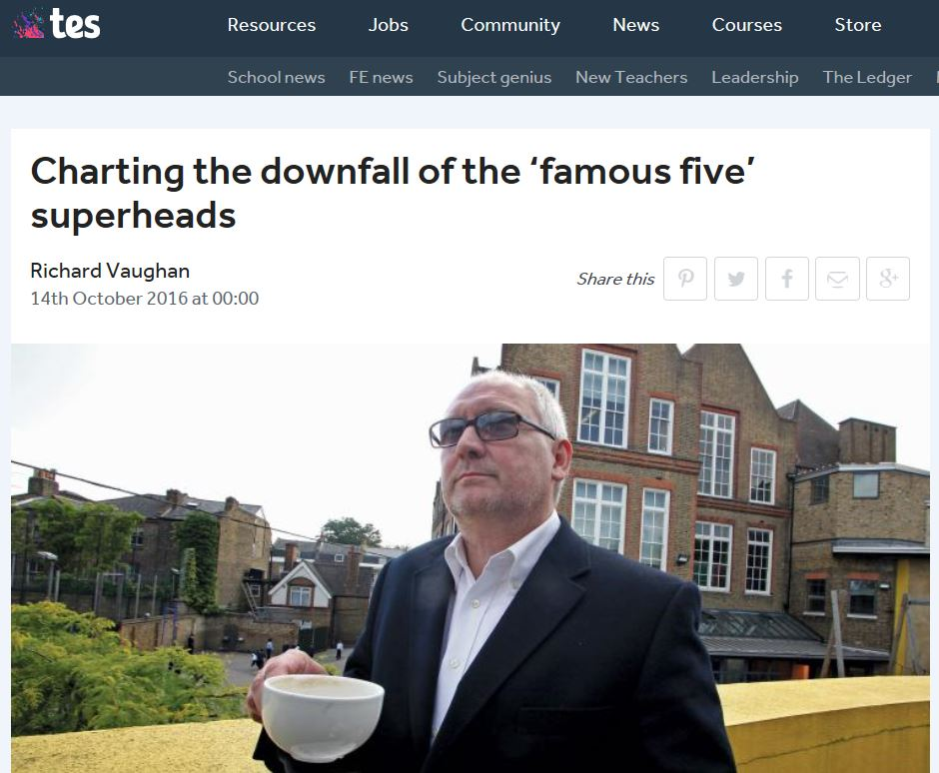
Charting the downfall of the ‘famous five’ superheads

Slide 26
Quote by Dr Ben Laker
“Success requires a moderate fear of failure because it is the balance of such fear with the desire to excel that leads to great leadership”……
those who lack this fear of failure “break rules, take risks and sense no boundaries; they are a law unto themselves”.
Dr Ben Laker

Slide 27
Imperfect Leadership
6. Imperfect leaders make public promises because they are acutely aware of their own weaknesses and they know that, without making public promises, they might fail to deliver on something that is really important

Slide 28
Imperfect Leadership
7. Imperfect leaders are learners. If they mess up – and they often do – imperfect leaders learn from their mistakes and try to do it better next time. They worry about having got it wrong today (sometimes they worry too much), but they are even more concerned about getting it right tomorrow

Slide 29
Being at our best more often
“We all make mistakes, and it is important that we give ourselves permission to have those down times. But the best leaders are able to be at their best more often because they reflect on it, then they apply what they are learning in a more consistent way. Reducing variation within our own leadership– that is a great skill. Outstanding leaders aren’t necessarily better leaders than the rest of us, they just operate at their best more often”
Steve Munby Imperfect Leadership

Slide 30
Imperfect Leadership
8. Imperfect leaders encourage others to step up to leadership rather than putting them off. There is a deep understanding in the organisation that you don’t have to be “the finished product” in order to become a leader.

Slide 31
Imperfect Leadership
9. Imperfect leaders are authentic

Slide 32
Imperfect Leadership
“People will forgive leaders who make mistakes and admit to them, but they hate a cover-up or a blame culture. It takes confidence to admit to being a learner and to being vulnerable, and those who do so are probably more self-confident than those who give the impression that they know all the answers”
Steve Munby
Imperfect Leadership

Slide 33
Dark Nights of the Soul
“It’s not dark yet, but it’s getting there” Bob Dylan. Not dark yet

Slide 34
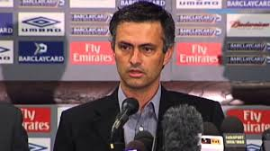
Quote by Jose Mourinho, July 2004
“Please don’t say I’m arrogant, because what I say is true. I am European champion, so I’m not…one of…of the bottle. I’m a…I think I’m a special one.”
Jose Mourinho, July 2004

Slide 35
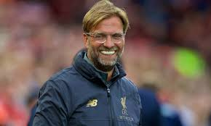
Jurgen Klopp – An Imperfect Leader
“I know that I am good at a couple of things, really good at a few things and that’s enough………
My confidence is big enough that I can really let people grow next to me…..
I need experts around me…that’s what leadership is….have strong people around you with better knowledge in different departments than yourself…don’t act like you know everything, be ready to admit that..
It’s not a real philosophy, it’s just my way of life.”

Slide 36
Why Imperfect Leadership is so important
‘If we want sustainable, well-led schools, if we want long-term and effective education systems, if we want to attract the next generation into leadership, then we should ditch all the striving towards perfection, focus on doing what is right for the students, genuinely ask for help from others and celebrate the fact that we are imperfect leaders’.
Steve Munby Imperfect Leadership

Slide 37
Masai Traditional Greeting
“Kasserian Ingera”
“How goes it
with our children?”
Masai traditional greeting

Slide 38
Email: steve@munbyeducation.co.uk
Twitter: @steve_munby

