Slide 1
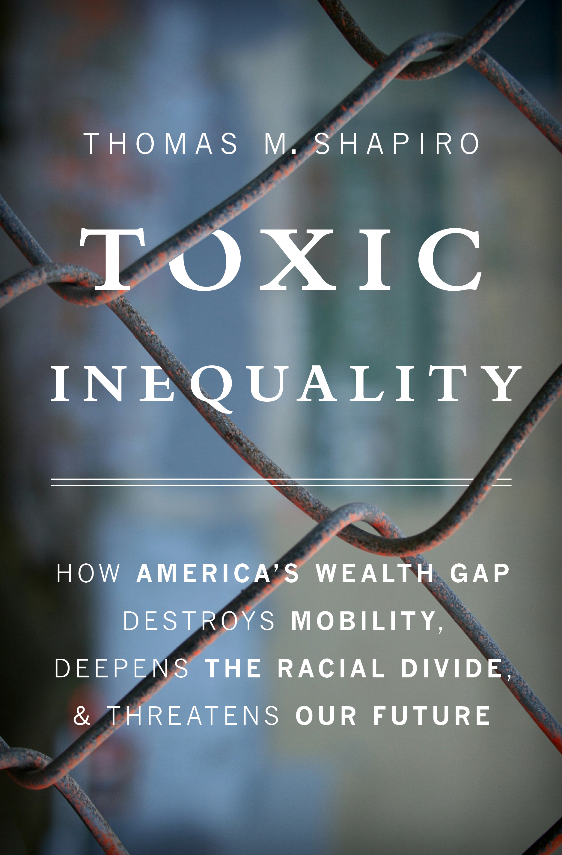

Slide 2
Toxic Inequality in the United States: Economic Inequality and Racial Injustice Driving Ugly Politics
University of Birmingham
January 19, 2018
@tmshapiro
@IASP_Heller
#ToxicInequality
#RacialWealthGap
Director, IASP. Prokross Professor of Law and Social Policy Heller School for Social Policy and Management,
Brandeis University

Slide 3
What is Toxic Inequality?
Convergence, Not Your Ordinary Inequality
Historic Income and Wealth Inequality
Stalled Mobility/Stagnated Living Standards
Widening Racial Wealth Gap
Demographic Changes
Pandering to Racial Anxieties

Slide 4
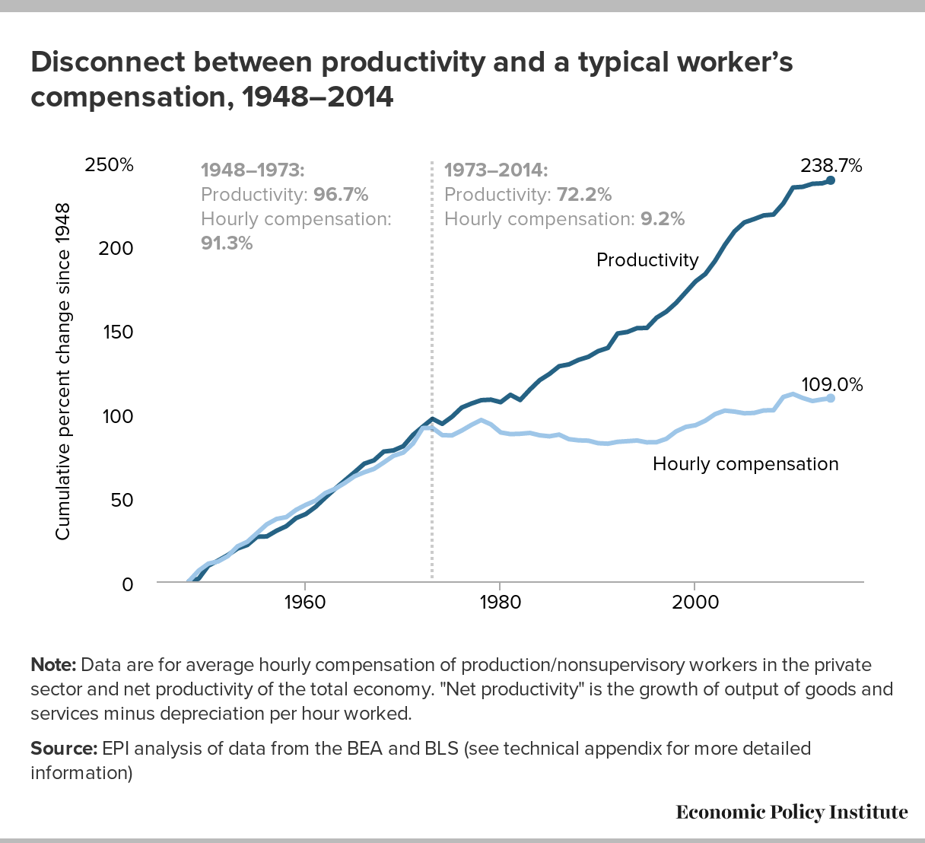

Slide 5
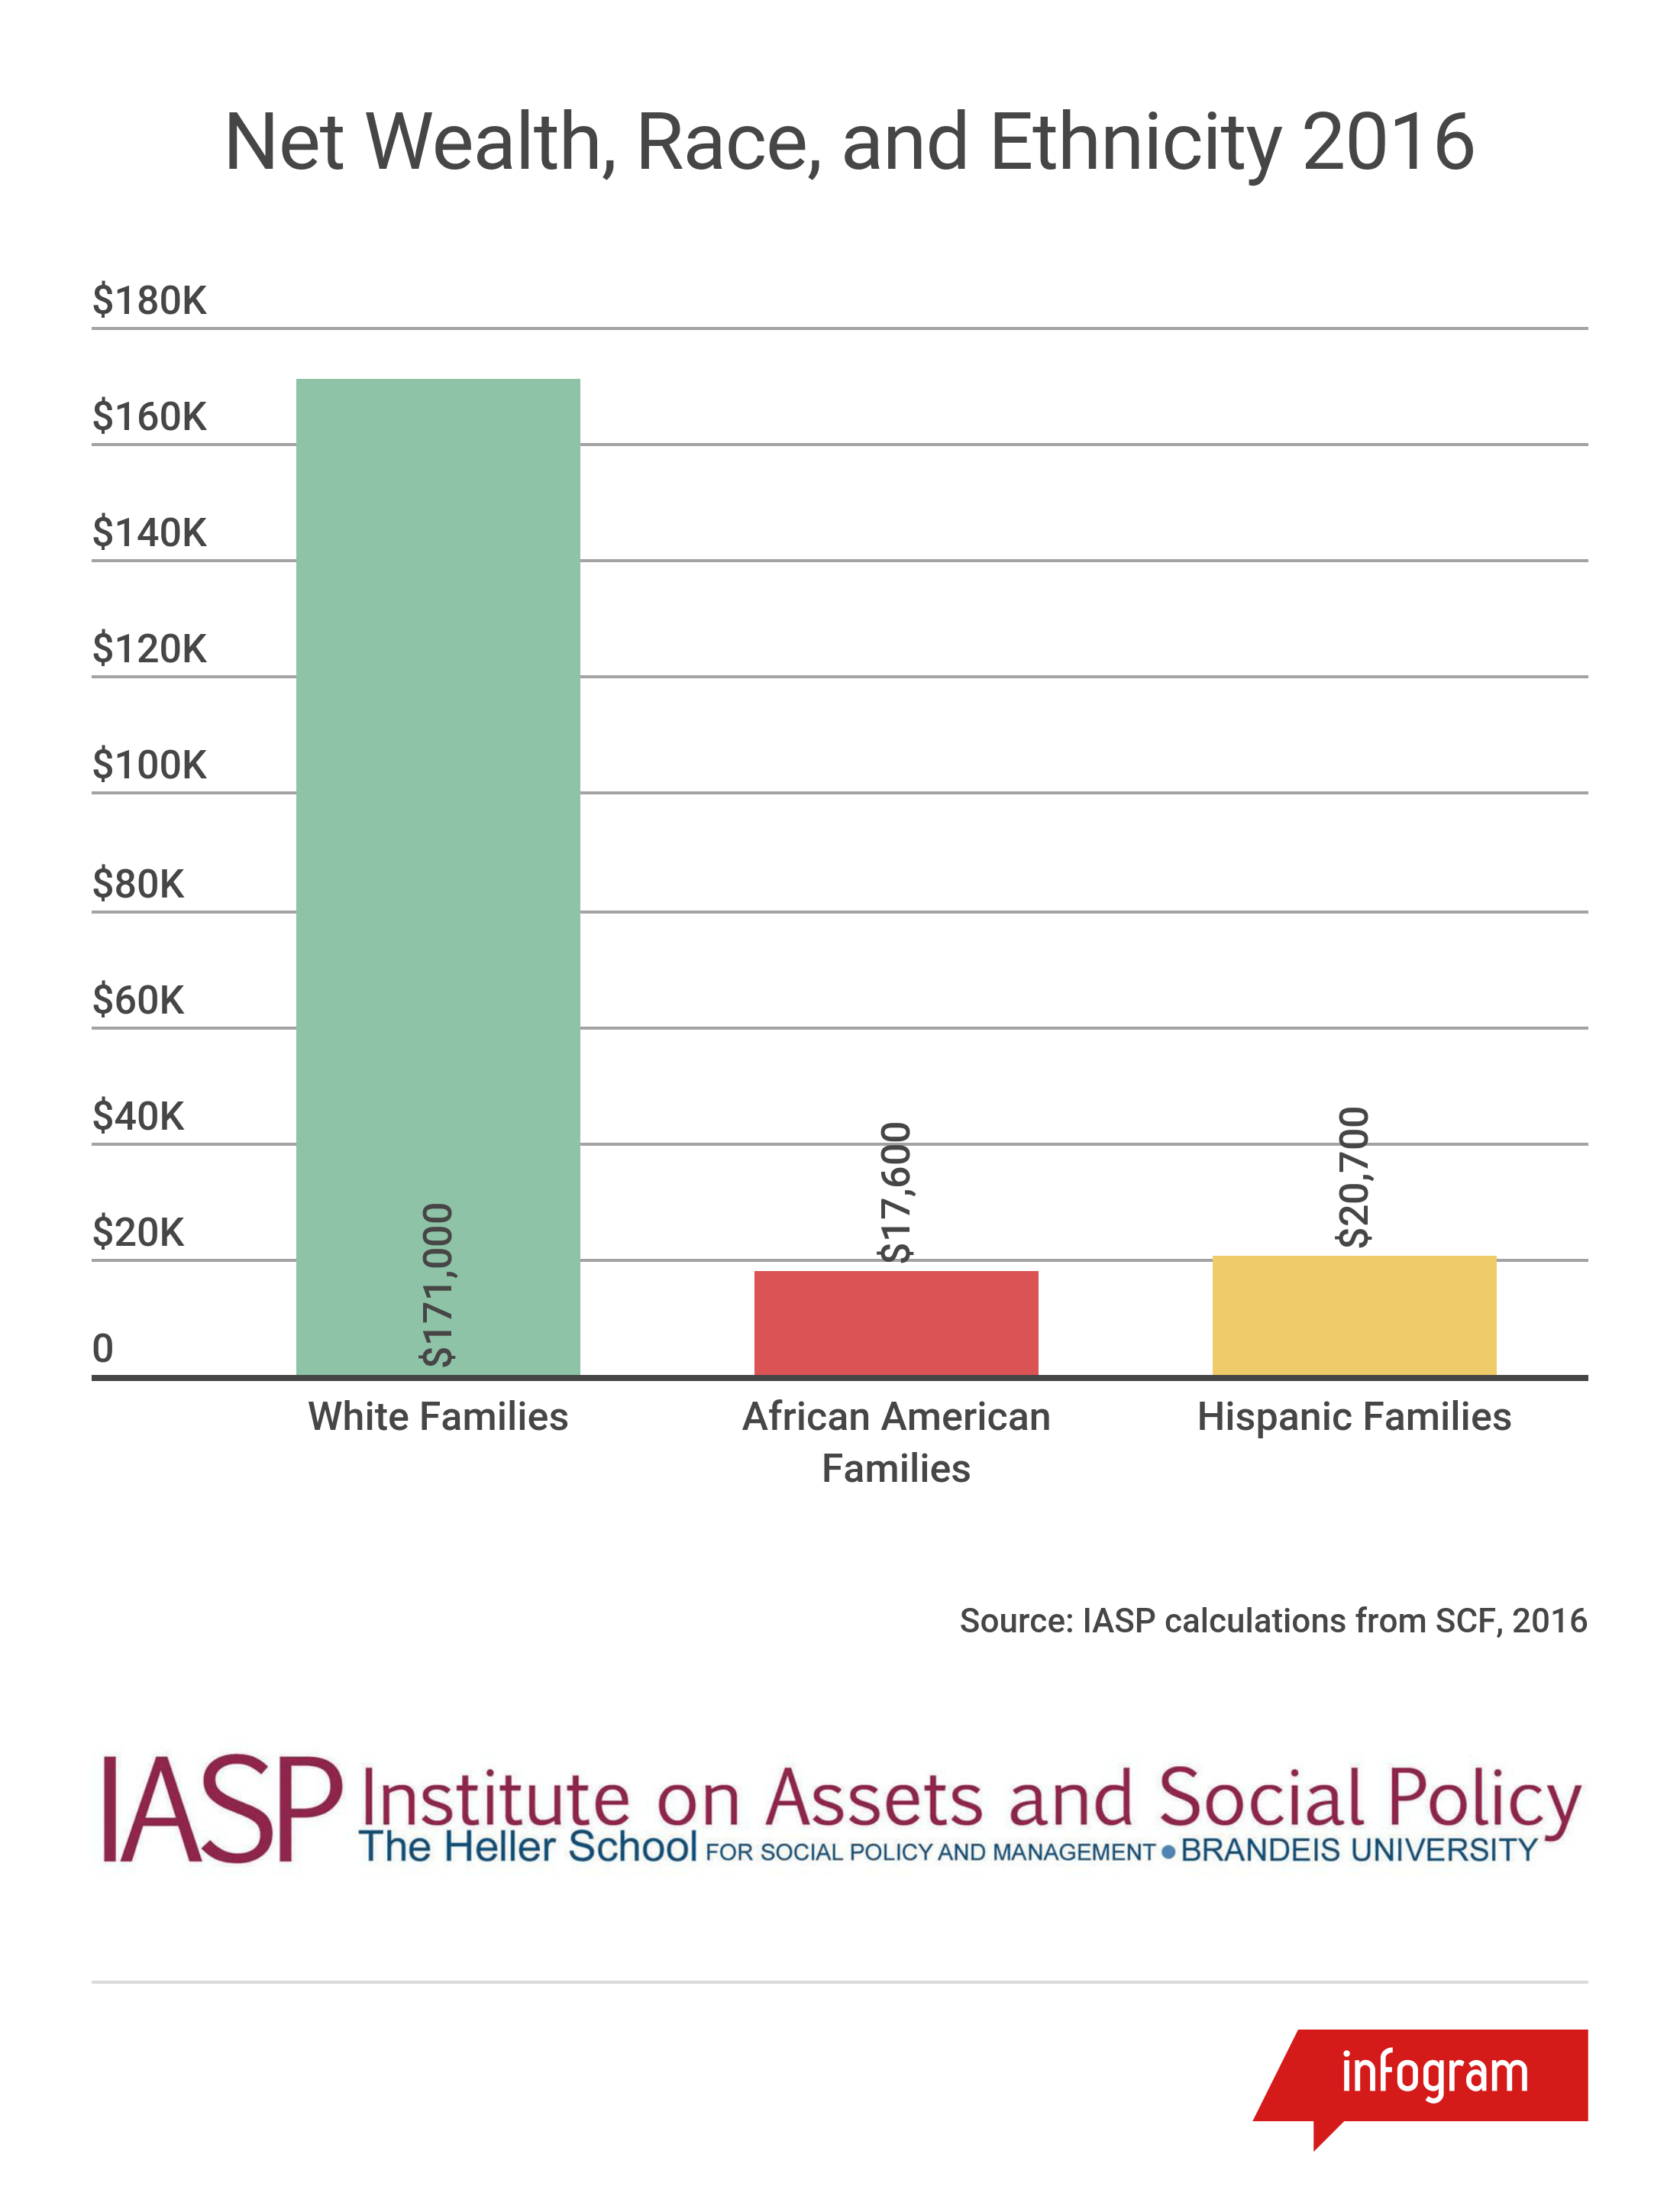

Slide 6
What Happens to Wealth… Once Incomes are Similar?
Income Band | White, Non-Hispanic Net Wealth | Black Net Wealth | Black-to-White Ratio | Latino-to-White Ratio
<25th Percentile (<$25k) | $13,400 | $210 | .15 | .10
40th-60th Percentile ($40-66k) | $97,500 | $21,000 | .22 | .18
>75th Percentile (>$95k) | $398,500 | $172,000 | .43 | .37
PSID, 2014 Panel
IASP Calculations

Slide 7
Meet Patricia Arroya
Single Mom, welfare-to-work policy transition
South Central, Watts
FSS
Inland Empire, KB Homes, Foreclosure Crisis,
KB, Full Service Operation, Linked loan to Countrywide!
One of 187 Families interview, 1998-1999 and followed up 2010-2011

Slide 8
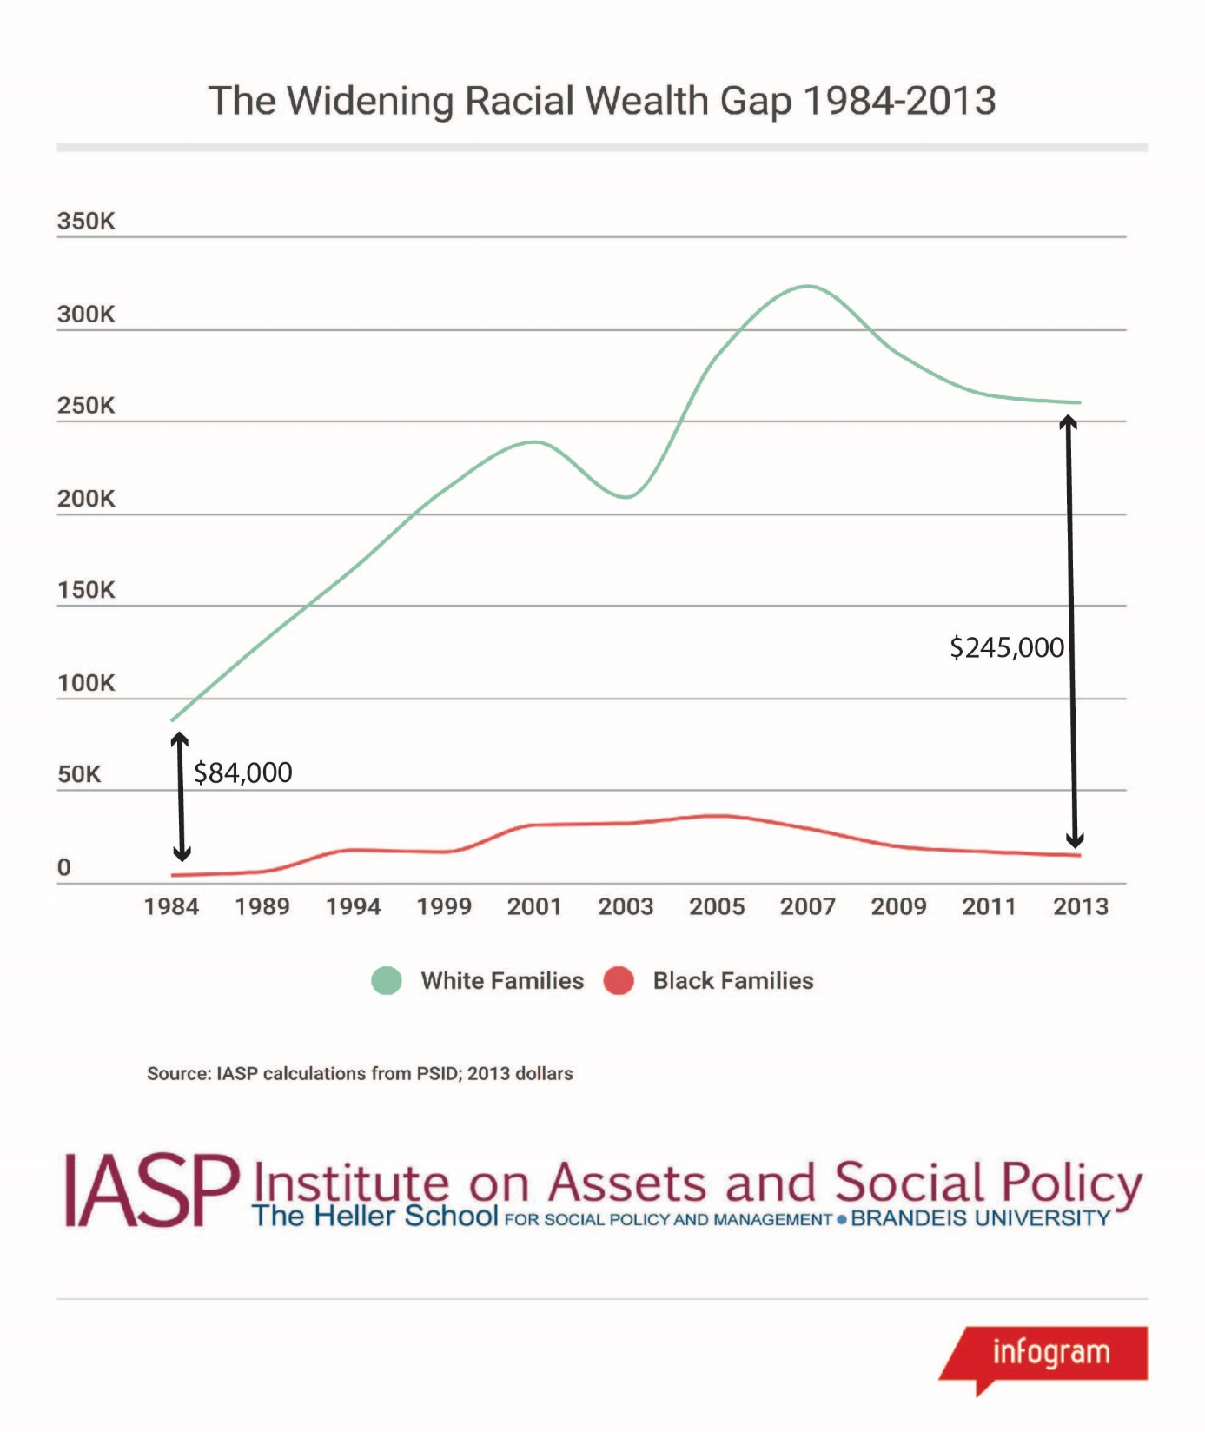

Slide 9
Inequality Preserved by Policy
Tax Policy Actively Redistributes to the top, widens racial wealth gap
Disincentives to Savings
Mortgage Interest Deduction (MID)
Estate Tax

Slide 10
Mortgage Interest Deduction [3rd Rail?]
What is Housing Policy of U.S?
About $40B spent on means-tested programs
Contrast, $205.6B (2015) invested in Home Ownership Subsidies
To 10% Amass 86% of MID Subsidy

Slide 11
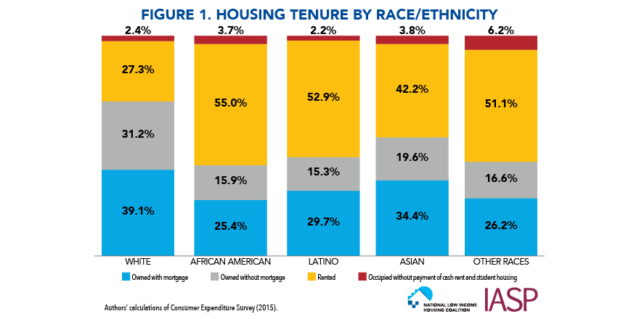
Notes:
On my very first day in the US, I was in downtown Los Angeles waiting for the bus to take me to a friend’s house, I was approached by 2 homeless people who were probably around 30 years old who asked me for money and told me that they did not have a home. Up to that point in time, I had only seen homeless people on my extended travels to a number of poor Asian countries such as India and Bangladesh but had never seen them in any of the European countries I had been to and definitely did not expect to find homeless people in the US. Why would there be homeless people in the US? We all know that the US is the richest country in the world, so why would there be homeless people here? Needless to say, I was very puzzled but in my first weeks in the US I heard the word homeless over and over again, and it was then I got interested in learning more about it. And so I have been involved in research on homelessness for more than 20 years.

Slide 12
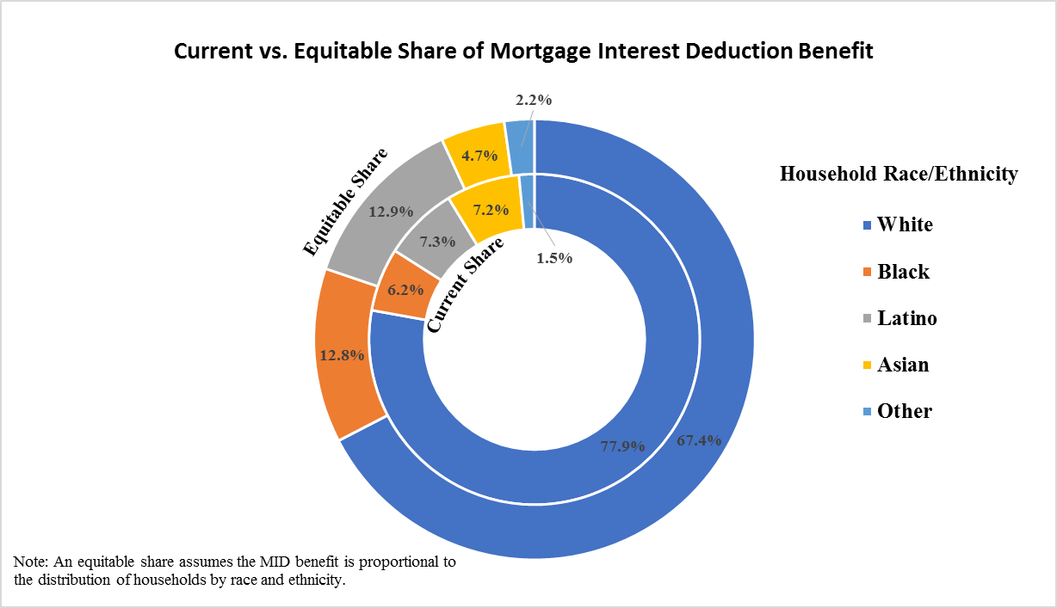
What If Equity?

Slide 13
MID Re-Distributes Wealth
Mortgage Interest Deduction promotes both racial and economic inequality by distributing the lion’s share of tax benefit towards wealthy, white households.
New evidence-- black and Latino households access just 6 and 7 percent of total benefits from the mortgage interest deduction respectively, despite the fact that black and Latino households each make up about 13 percent of the U.S. population.
This amounts to an estimated $4.8 billion in lost housing investments for black families and $4.1 billion dollars directed away from Latino families, relative to a more equitable distribution of benefits.

Slide 14
Way(s) Forward
Racial Justice Filter, Plus, for Policy
Multi-Sector Approaches
Wait, Wait, No Talk of Economic Security, Mobility Unless Wealth Key Part of Analysis
Re-Connect Work and Wealth—retirement savings, paid sick leave, health insurance

Slide 15
the conversation continues…
Tshapiro@brandeis.edu
For more information,
Agulliksen@brandeis.edu
@tmshapiro
@IASP_Heller
#ToxicInequality
#RacialWealthGap
IASP.brandeis.edu

Slide 17
Racialwealthaudit.org

