Slide 1
ASSURE: Understanding the impact of CQC assurance on local authorities Summary findings from Phase 1 - national interviews
Catherine Needham and Emily Burn
University of Birmingham

Slide 2
Disclaimer
This presentation is informed by independent research funded by the National Institute for Health and Care Research’s School for Social Care Research. The views expressed are those of the authors and not necessarily those of NIHR SSCR, the NIHR or the Department of Health and Social Care

Slide 3
About the project
Explores whether assurance is the right process to assess local authorities’ performance of Care Act duties.
Develops understanding of the impact of CQC assurance on local authorities and local care systems.
Two stage fieldwork:
National fieldwork – Interviewing stakeholders to discuss the rationale and implementation of assurance.
Local fieldwork – Working in four local case sites to consider the impact of CQC assurance of local authorities and how the assurance process has embedded lived experience of drawing on services.

Slide 4
Methods for literature review and national interviews
Literature review
Aims to understand impact of regulation on health and social care services. Searches conducted on academic and practice databases. Inclusion / exclusion criteria developed (45 items included in the review).
National interviews
20 online interviews. These have been transcribed using Teams and analysed to identify common themes. We interviewed people from DHSC, CQC, ADASS, LGA, TLAP and care provider representatives.
We will also be analysing policy documents.

Slide 5
Background
CQC assurance was introduced in the Health and Care Act 2022 after a 12 year gap in national oversight of local authority social care teams
Sector-led improvement by LGA/ADASS in the 2010s had worked well in some localities but was patchy and could mask weaknesses: ‘it didn’t have sufficient level of challenge’ (INT13)
DHSC didn’t have the overview of LA performance and the explanation of variance that it wanted – particularly during Covid-19. The minister wanted ‘a much clearer line of sight’ (INT12)
The return of assurance was welcomed by many in local govt as a way to raise the profile of adult social care vis a vis children's services
Some doubted the extent to which Part 1 of the Care Act was specific enough to be used as the basis for assurance.
CQC took a consultative approach to developing the baselining phase. Its use of the I/we statements was widely welcomed.

Slide 6
Baselining 1
CQC visiting every higher tier local authority in England from 2024-25 in benchmarking phase
Every local authority gets a one-word assessment as well as scored on four themes. Reports will be publicly available (about half have been published to date).
All interviewees reported that time pressures have been a key limiting factor – two years perceived to be a very ambitious timeline to recruit and train staff and do baselining to the standard that everyone would have preferred (and in a context of wider organisational turbulence at CQC).
Local govt sector interviewees generally felt that site visits had gone well, although some expressed concern about whether the team at the site visit had the right skills and/or been briefed from the pre-inspection paperwork. There were also some concerns that involvement of people with lived experience during the visit had been poorly handled.
The main local govt sector criticisms related to the reports:
lack of transparency in the calibration and the algorithm
delays and high levels of factual errors in the reports
over-reliance on the perspectives of a small number of people with lived experience in the reports
reports not being sufficiently improvement focused
lack of clarity on when/how Requires Improvement will be lifted

Slide 7
Baselining 2
Interviewees representing providers and people with lived experience expressed concern about:
Lack of effective inclusion in the assurance process.
Lack of consequences for LAs following an ‘Inadequate’ or ‘Requires Improvement’ rating.
Lack of a level playing field – CQC treating LAs and providers in different ways.
Other concerns
Some interviewees from all sectors noted that a preponderance of ‘Good’ ratings will be used by the government to justify lack of investment in the sector (perception that the sector is doing well despite pressures).

Slide 8
What’s changed as a result of assurance?
Self-assessment has helped some LAs to collect and analyse data more effectively, get to know their populations and services.
LAs and CQC are reporting anticipatory effects in addressing local weaknesses.
Waiting times for assessment and review have reduced (as noted in ADASS, Spring survey 2025).
Over the two years, CQC have noted increased LA attention to unpaid carers, more awareness of EDI issues and more efforts to do proper co-production.

Slide 9
What comes after baselining?
CQC will make a recommendation to Sec of State. Consultation is ongoing
Local authorities and CQC both want a more relational approach. As noted by one CQC interviewee:
‘[Currently] we go in, we assess and we run off. Whereas what we want to do is have an ongoing relationship, because an ongoing relationship is where you're going to get the most improvement and really understand the sector.’ [INT11]
In future, likely to be annual self-assessment and annual engagement. Potentially there could be a more thematic approach, e.g. focus on commissioning.
CQC trialling a new approach to case sampling.
LAs want clarity on what the improvement offer will be going forward and who will lead on that.
Future model will need to be responsive to local government reorganisation.

Slide 10
Locating findings in a theoretical framework
High
Rules
The level of structured rules in place. How are behaviour and actions constrained or facilitated by these rules? How do these rules affect the quality of relationships?
Low
High
Relationships
The extent people feel bound alongside others. What level of expectation is there from the wider group? How close are the relationships?
This theory offers us a way to explore the interplay between rules and relationships
Adapted from Douglas, M. (1970) as used in Needham et al. (2023)
Low

Slide 11
Mapping LA oversight onto the framework
 | Distant relationships | Close relationships
Strong rules | Inspection A distant relationship between regulator and LA. Local authorities feel ‘done to’ | Assurance A more relational approach to support continuous improvement
Weak rules | No quality assurance/inspection | Sector-led improvement/peer review

Slide 12
Mapping our findings onto the framework
 | Distant relationships | Close relationships
Strong rules | Inspection A distant relationship between regulator and LAs. Local authorities feel ‘done to’ Where CQC assurance is now | Assurance A more relational approach to support continuous improvement Where interviewees want CQC to get to
Weak rules | No quality assurance/inspection Some LAs/regions in the 2010s | Sector-led improvement/peer review Most LAs/regions in the 2010s

Slide 13
Future risks 1
 | Distant relationships | Close relationships
Strong rules | Inspection Where CQC assurance is now WE GET STUCK HERE – adversarial relationships, compliance oriented | Assurance Where interviewees want CQC to get to
Weak rules | No quality assurance/inspection | Sector-led improvement/peer review

Slide 14
Future risks 2
 | Distant relationships | Close relationships
Strong rules | Inspection | Assurance
Weak rules | No quality assurance/inspection | Sector-led improvement/peer review Too much happens here. Other stakeholders don’t feel there is proper accountability

Slide 15
Future risks 3
 | Distant relationships | Close relationships
Strong rules | Inspection Provider relationships with CQC stay stuck here. Perception of unfairness disrupts local relationships | Assurance LA relationships with CQC moves to this space
Weak rules | No quality assurance/inspection | Sector-led improvement/peer review

Slide 16
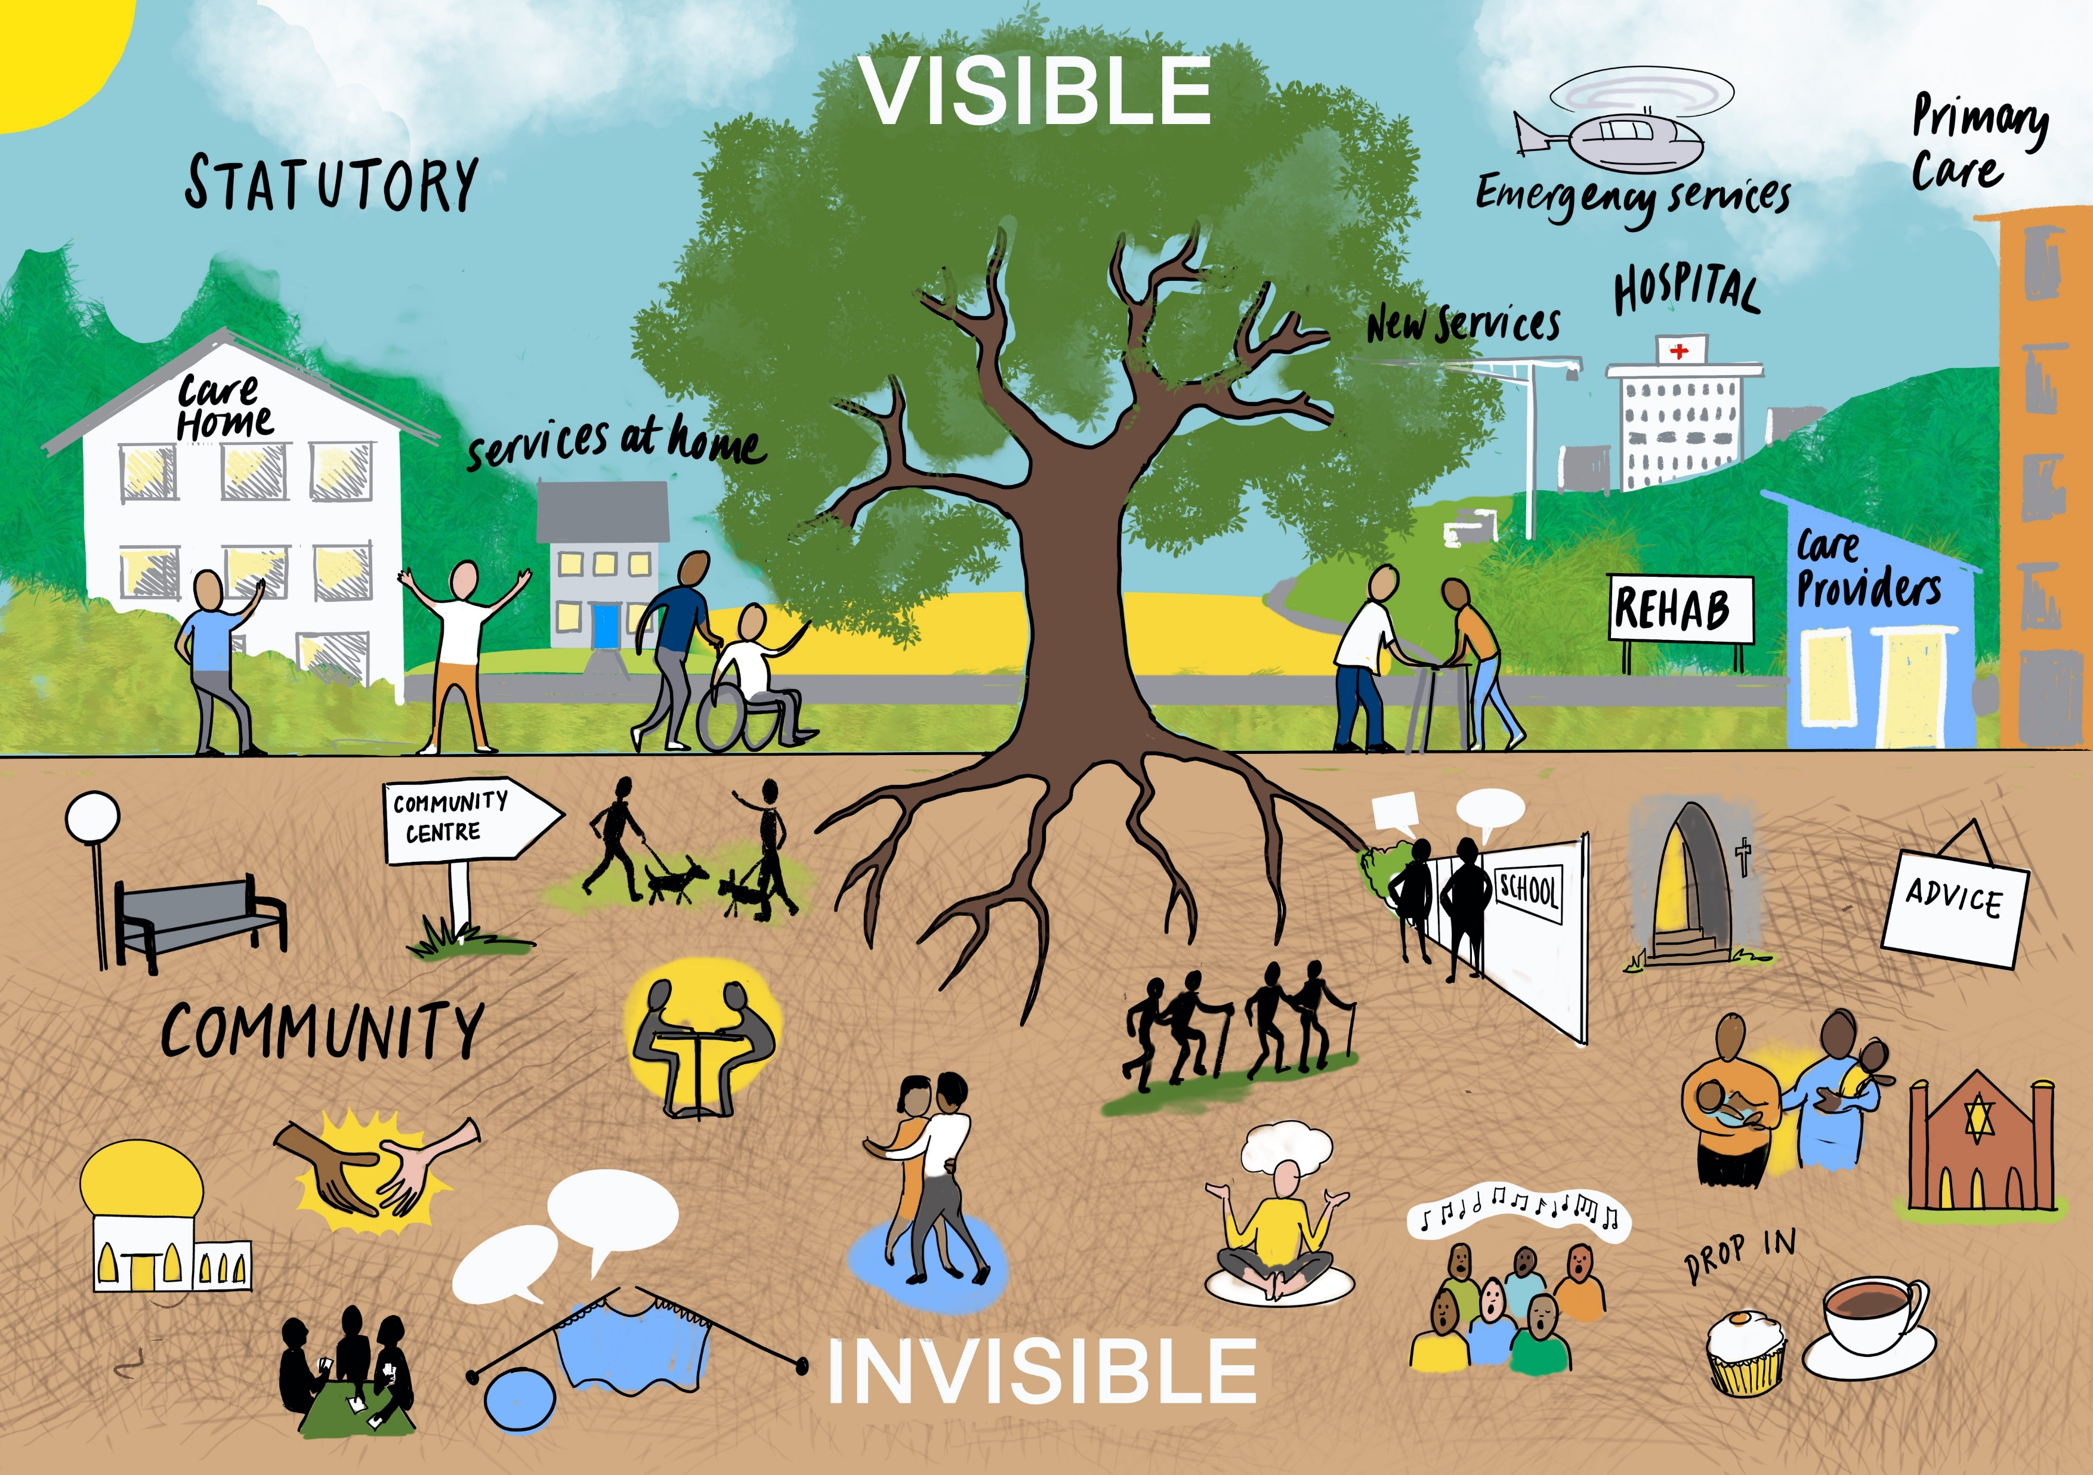
Future risks 4
Whichever quadrant it is in, CQC assurance becomes an overly narrow process which isn’t sufficiently connected to the broader social care ecosystem, locally or nationally
 | Distant relationships | Close relationships
Strong rules | Inspection | Assurance
Weak rules | No quality assurance/inspection | Sector-led improvement/ peer review
Image by Laura Brodrick, Think Big Picture

Slide 17
Next steps
We will be working in four local case sites to explore local authorities’ experience of assurance and the impact it has had on local care ecosystems.
We’ll be talking to people with lived experience in those sites to understand their involvement in local CQC processes.
Further updates will be available on our project webpage: ASSURE - University of Birmingham

Slide 18
References
Association of Directors of Adult Social Services (2025) 2025 Spring Survey. Available https://www.adass.org.uk/wp-content/uploads/2025/07/ADASS-Spring-Survey-Final-15-July-2025.pdf (accessed: 18/11/2025)
Douglas, M. (1970) Natural Symbols. London: Barrie & Rockliff / the Cresset Press
Needham, C., Allen, K., Burn, E., Hall, K., Mangan, C., Al-Janabi, H., Tahir, W., Carr, S., Glasby, J., Henwood, M. and Mckay, S., 2023. How do you shape a market? Explaining local state practices in adult social care. Journal of Social Policy, 52(3), pp.640-660.

