Slide 1
Biophilic Cities
Tim Beatley, UVA Urban and Environ Planning

Slide 2
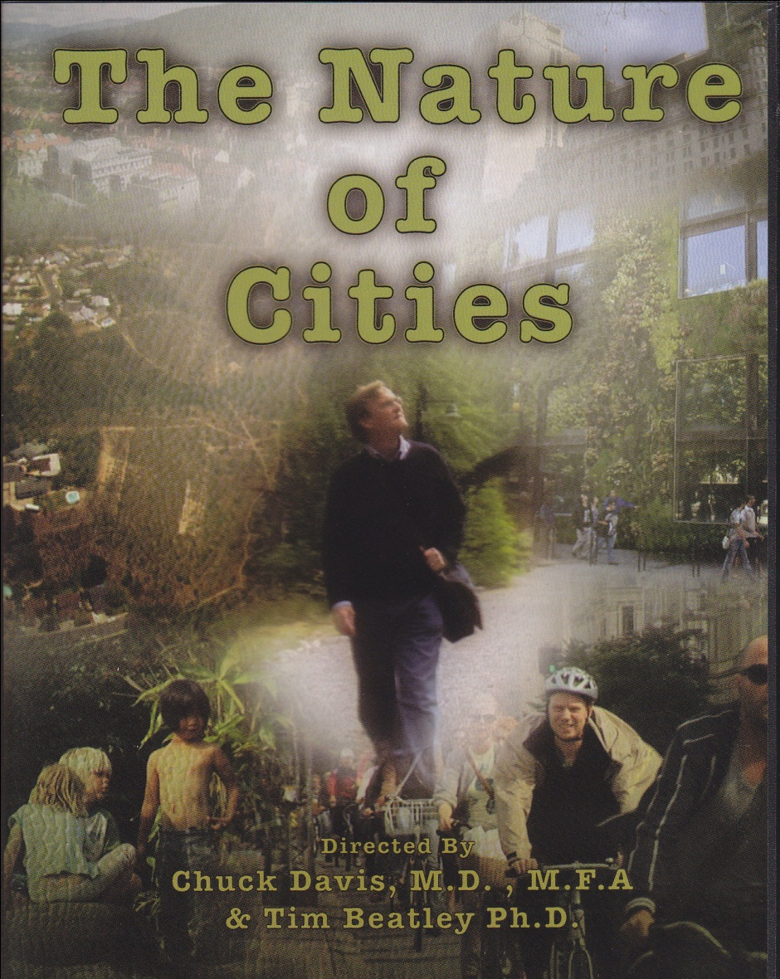

Slide 3
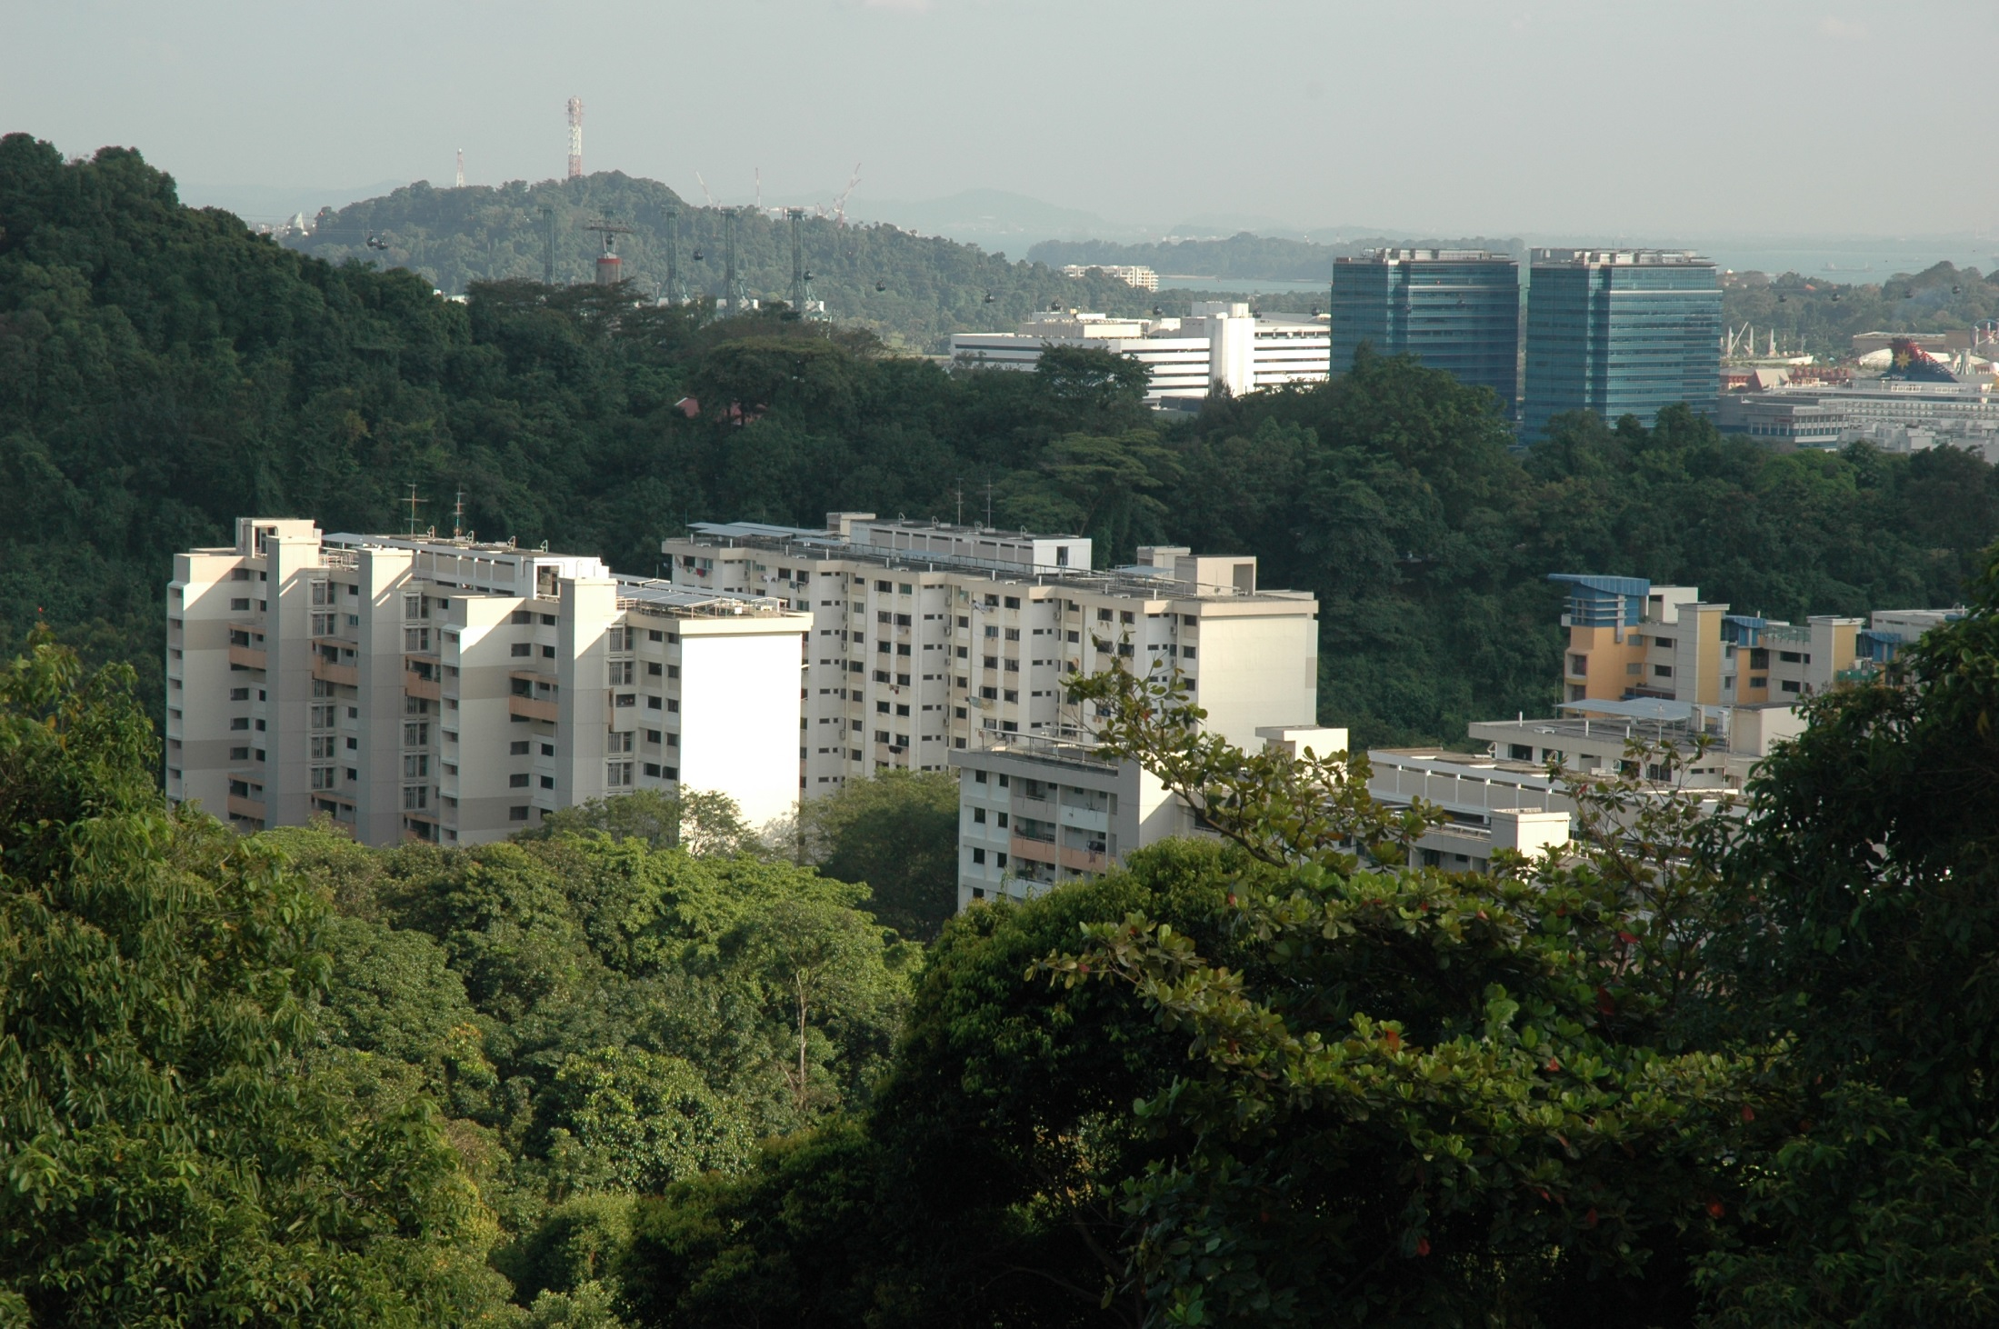
Cities + Nature?

Slide 4
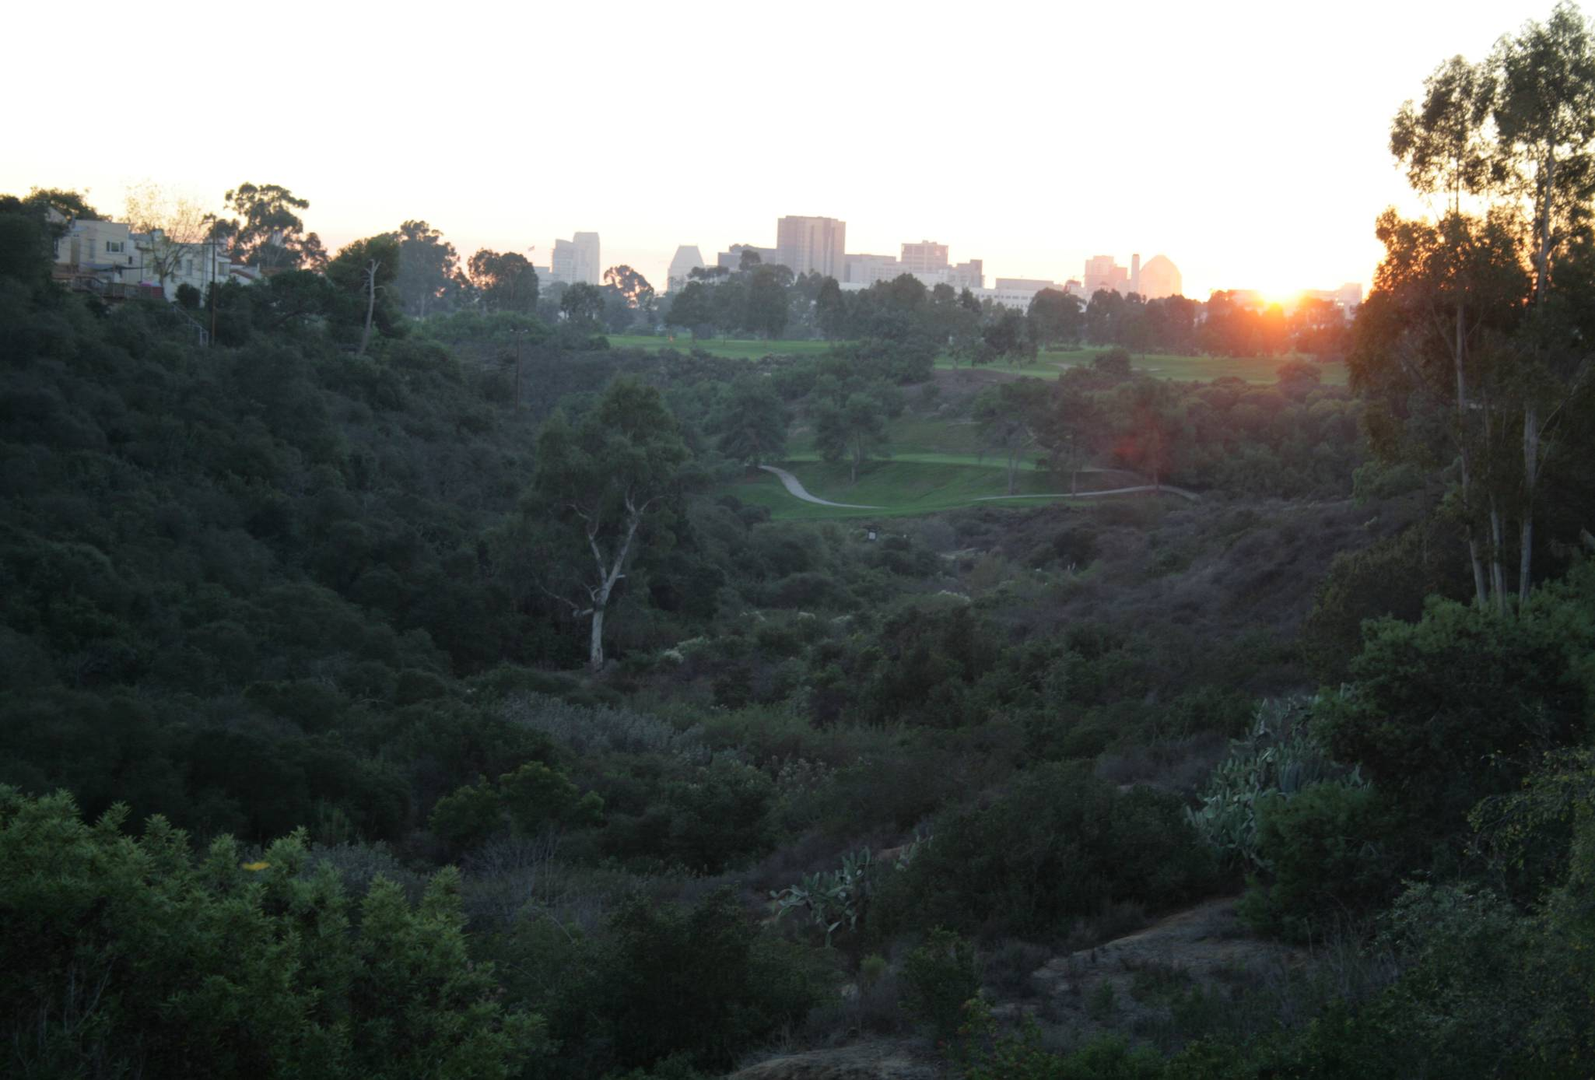
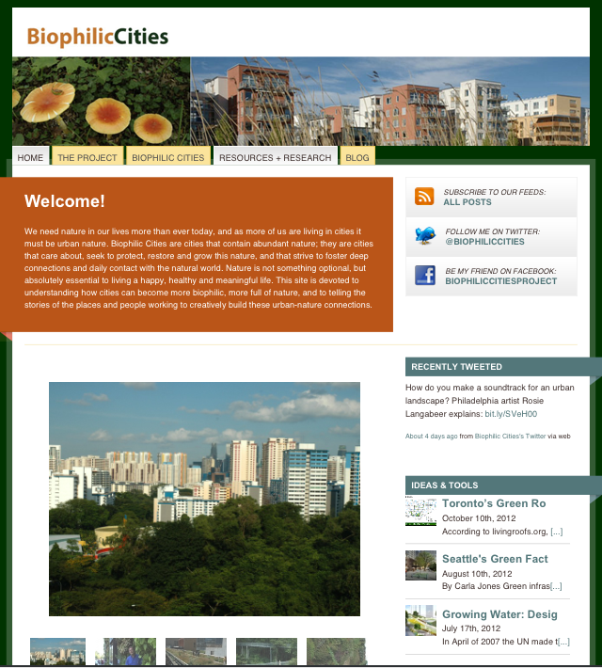

Slide 5
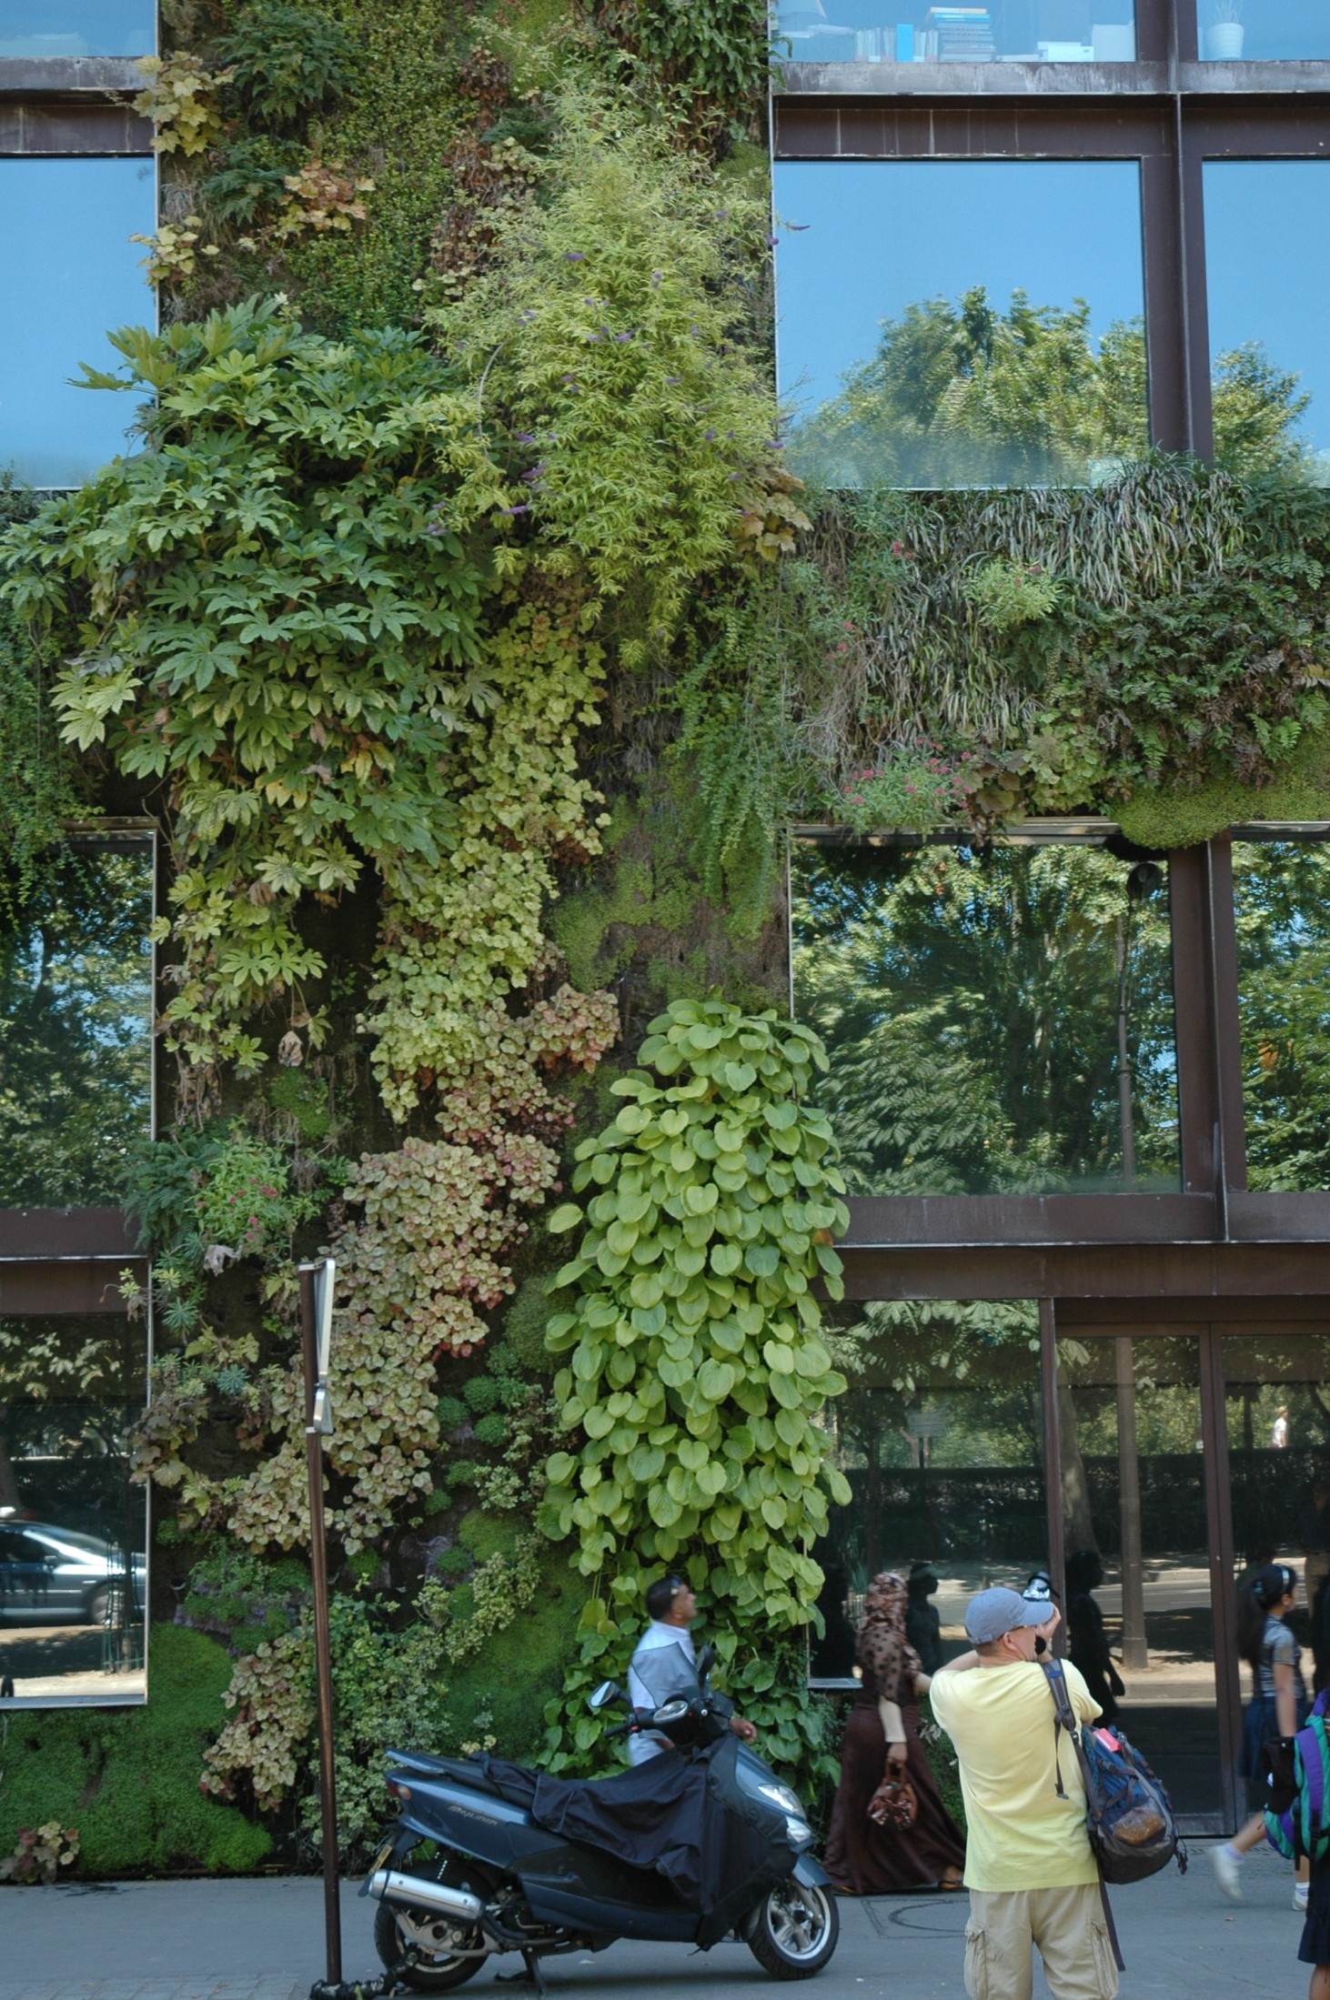
Biophilic Cities Project
Biophilia: “…the innately emotional affiliation of human beings to other living organisms. Innate means hereditary and hence part of ultimate human nature.” --E.O. Wilson

Slide 7
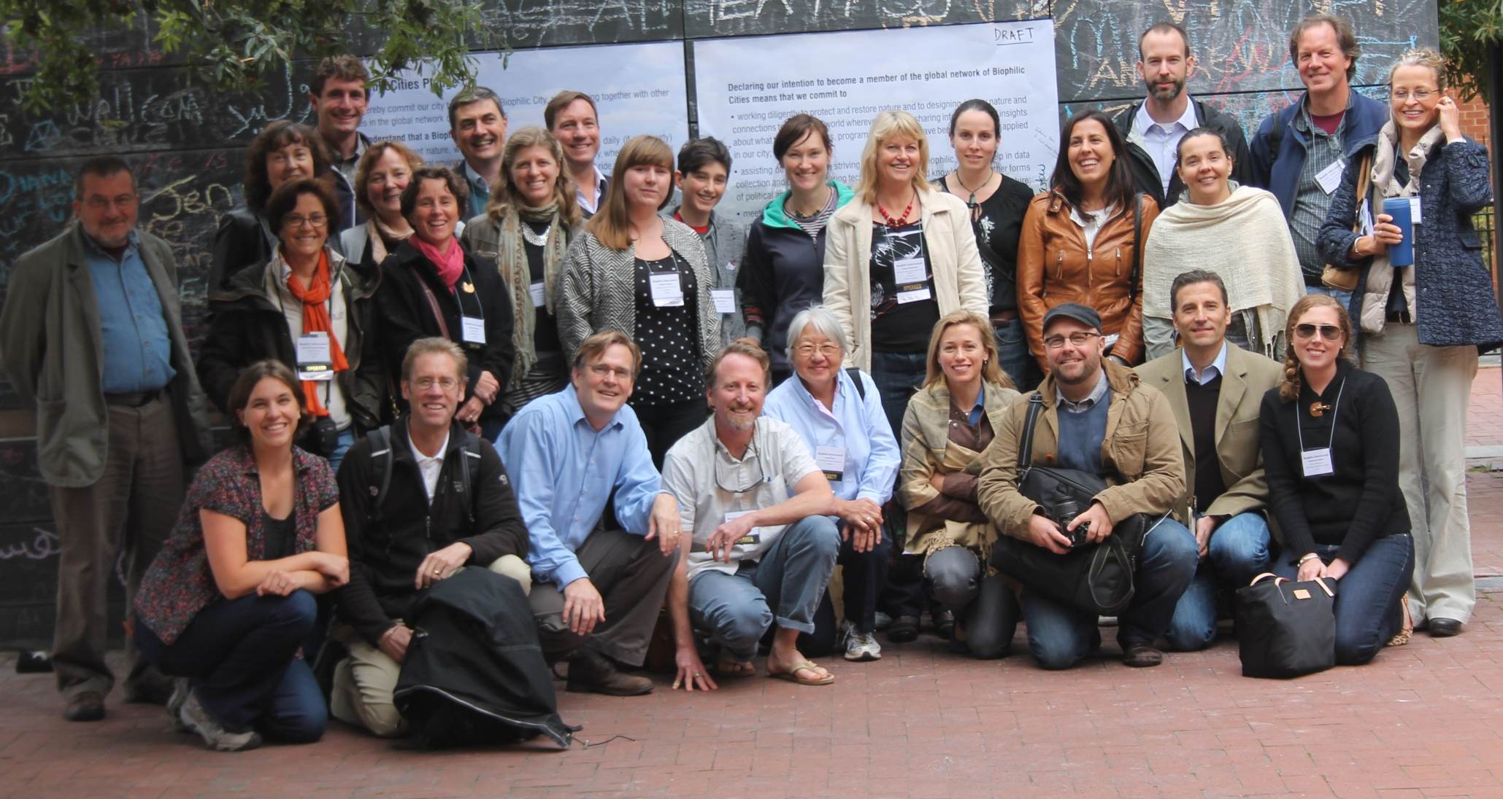
Launching a new Global Network of Biophilic Cities

