Slide 1
A Who’s Who
In the Late ROMAN REPUBLIC

Slide 2
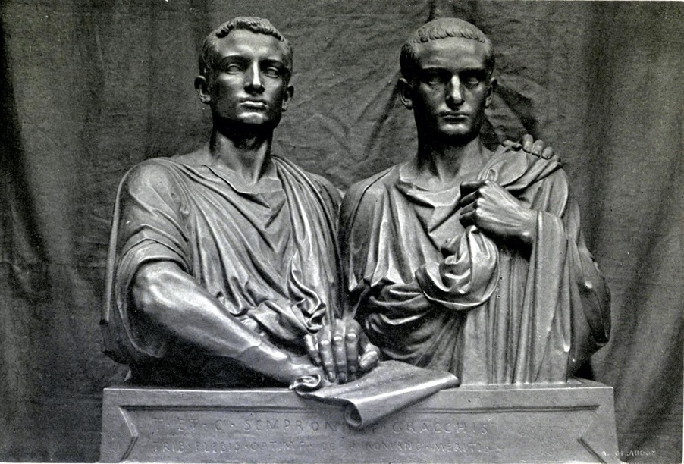
Tiberius Sempronius Gracchus (169? – 133 BC)
Tribune of the Plebs in 133 BC
Proposal to distribute land to the landless poor (lex sempronia agraria).
Passes law through popular assembly instead of the senate
Proposal (before popular assembly) to use the revenues from the newly acquired province of Asia to finance the settlements
Attempt to gain 2nd tribunate for 132 BC
Assassinated by members of the Senate, led by the Pontifex Maximus (Chief Priest), Publicus Cornelius Scipio Nasica.
Gaius Sempronius Gracchus (154 – 121 BC)
133 BC, on the board of three of Tiberius’ land commission
Tribune of the Plebs in 123 BC, passing numerous laws, including:
no Roman citizen should be put to death without an appeal to the people, and rendering magistrates who transgressed this law liable to prosecution
Grain law establishing the monthly distribution of corn at a fixed, subsidized price.
Law establishing tax farming in Asia (taken over by Rome in 132) through contracts leased in Rome by censors. This became the biggest and most lucrative tax contract available.
Tribune of the Plebs in 122 BC, further laws:
Taking law courts away from the control of the senate, creating Equestrian juries.
Attempt to give citizenship to allies (failed)
121 BC, senate passed a decree that the consuls should do whatever was necessary to save the state from harm – under this decree Gaius and 3,000 supporters were killed.

Slide 3
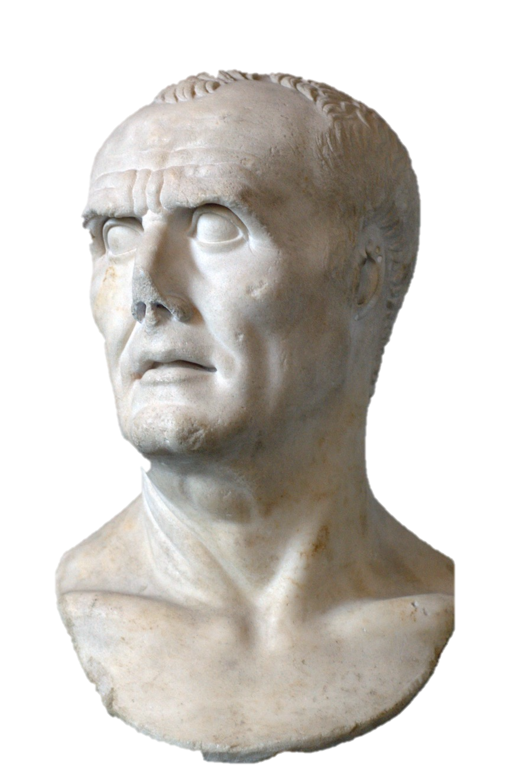
Gaius Marius (157-86 BC)
Novus homo
Plebeian
Consul (I) 107 BC
Given command in the war against Jugurtha
Consul (II) 104 BC
Given command in the war against the Cimbri and Teutones
Consul (III) 103 BC
Consul (IV) 102 BC
Consul (V) 101 BC
Consul (VI) 100 BC
Received the command against Mithridates in 88 BC, via the popular assembly (comitium plebis), although Sulla already had the command by lot
Consul (VII) 86 BC
Dies 86 BC

Slide 4
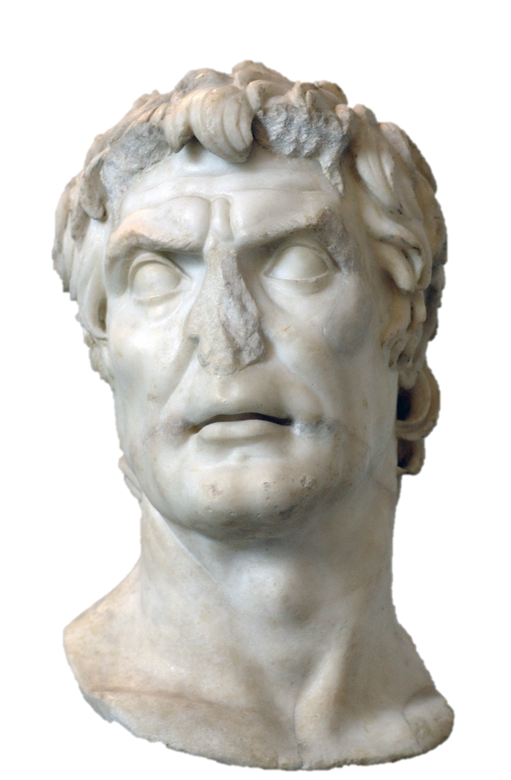
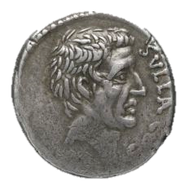
Lucius Cornelius Sulla (138 – 78 BC)
Patrician and a noble
107-6 BC quaestor under Marius in the Jugurthine War
Responsibility for the capture of Jugurtha
104 BC campaigned under Marius against the Cimbri and Teutones
96 BC propraetor governor of Asia Minor
91- 88 BC commander in the Social War
88 BC Consul (1)
Assigned command against Mithridates
Marches on Rome with army (after Marius takes command from him)
Declares opponents enemies of the state
83 BC 2nd march on Rome
81 BC - dictator (for the making of laws and the restoration of the state)
Introduced proscriptions
80 BC resigns dictatorship and holds consulship (II)
79 BC Retired from politics
78 BC Dies

Slide 5
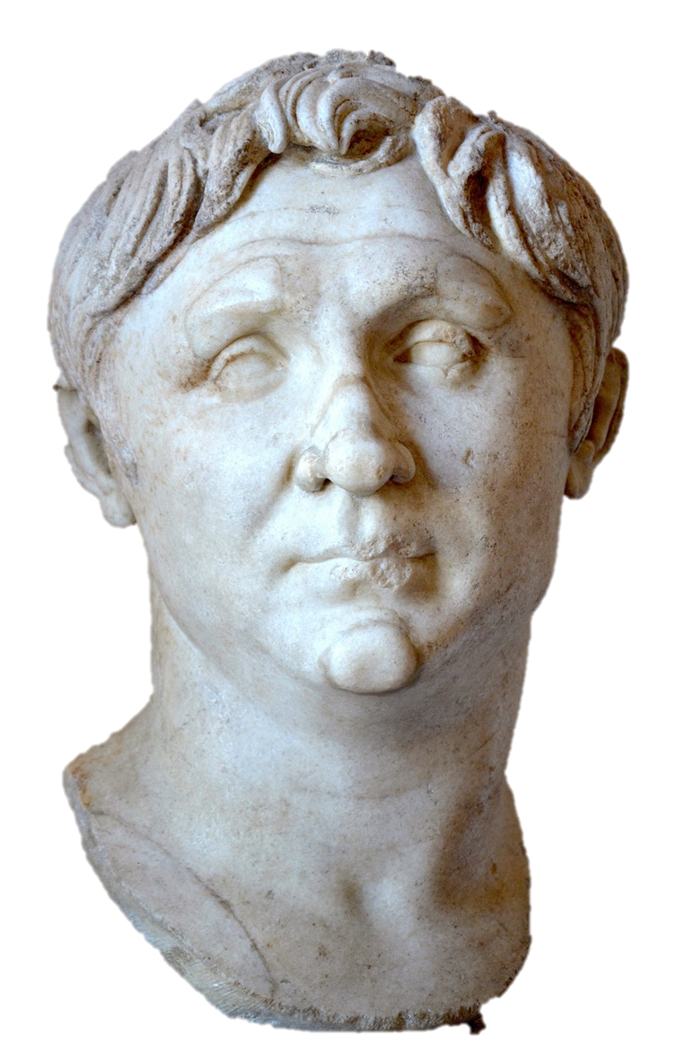
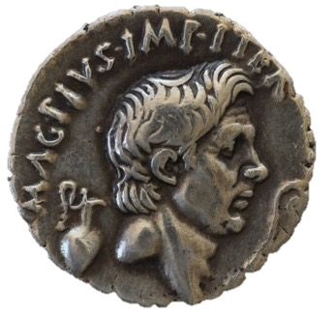
Gnaeus Pompeius Magnus (106 – 48 BC)
Plebeian and a noble (son of a consul)
84 BC levies 3 (private) legions
83-81 BC propraetor command against Sulla’s opponents in Sicily and Africa
79 BC Triumph over Africa
77 BC command against Lepidus (uprising in Italy)
76-71 BC command against Sertorius (rogue Roman commander in Spain)
71 BC Triumph over Spain and Consulship (I)
67 BC command against piracy in the Mediterranean (lex Gabinia)
66 BC command against Mithridates (lex Manilia)
61 BC Triumph over the East
60 BC formed informal alliance with Caesar and Crassus
57 BC command over the grain supply (5 yrs)
55 BC Consul (II)
52 BC SOLE consul (III)
48 BC killed by agents of Ptolemy XIII

Slide 6
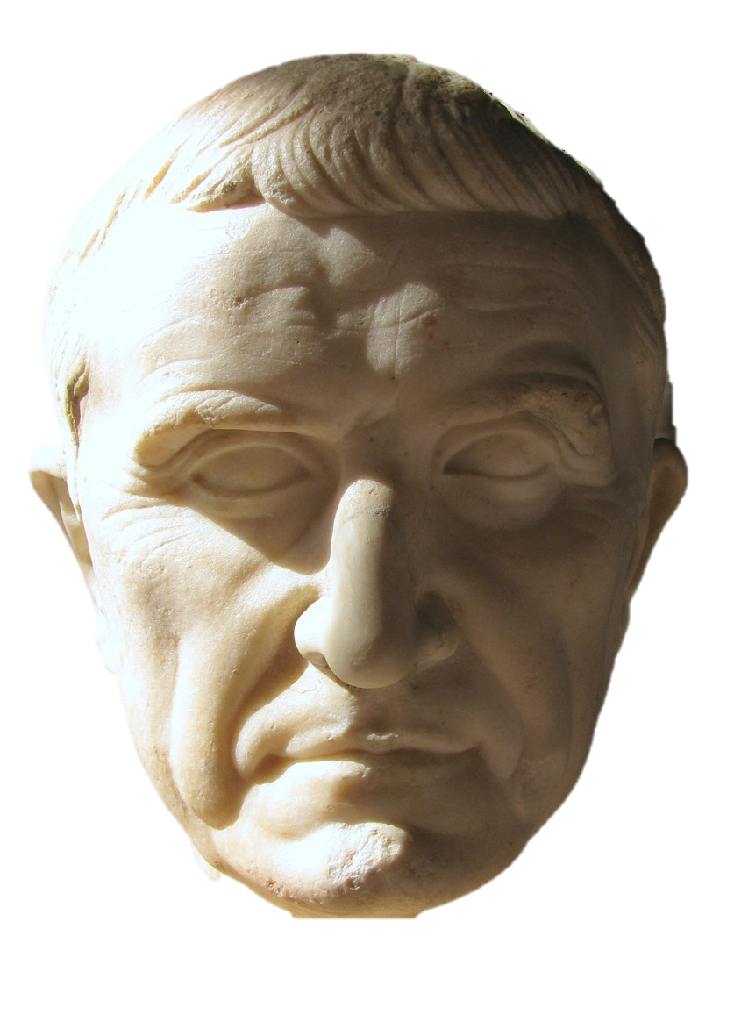
Marcus Licinus Crassus (144 – 53 BC)
Extremely wealthy Plebeian – Plutarch, Live of Crassus 2 tells us his property was valued at 7,100 talents = £100,000,000.00
73 BC – Praetor and commander in the war against Spartacus (73-71 BC)
Ovation (minor triumph)
70 BC – consul (with Pompey)
65 BC – censor
60 BC – joined an informal alliance with Pompey and Caesar
56 BC – renewal of alliance
55 BC – 2nd consulship with Pompey
54 BC – command against the Parthian Empire
53 BC – defeated and killed by the Parthians
According to Cassius Dio (40.27), the Parthians poured molten gold into his corpse’s mouth to symbolise his greed
According to Plutarch (Crassus 33), a Parthian king had Crassus’ head used as a prop in a production of Euripides’ Bacchae

Slide 7
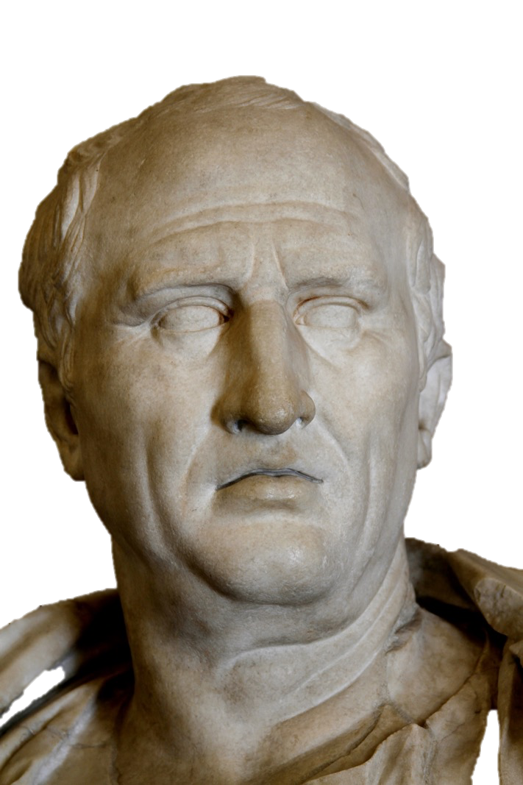
Marcus Tullius Cicero (106 – 43 BC)
novus homo (‘new man’ in politics) – first in his family to hold constitutional office.
One of our main contemporary sources for Roman history.
Establish career as an orator and advocate in court
Prosecuted the Roman governor of Sicily, Verres, in 70 BC
Consul in 63 BC
Claimed to have saved the state from a conspiracy led by a political rival, Lucius Sergius Catilina (and patrician noble).
Attacked by the Tribune of the Plebs, Clodius, in 58 BC for killing Roman citizens without trial before the Roman People.
Went into exile
Recalled by the consul of 57 BC, Lentulus Spinther
Governor of Cilicia in 51-50 BC
In the civil war of 49 BC, initially undecided who to side with, but joined Pompey
Opposed Mark Antony after the death of Caesar (Cicero’s Philippic speeches)
Helped Octavian rise of power in early 43 BC
Proscribed and killed under the Triumvirate of Mark Antony, Lepidus and Octavian in 43 BC

Slide 8
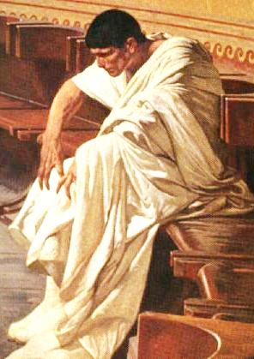
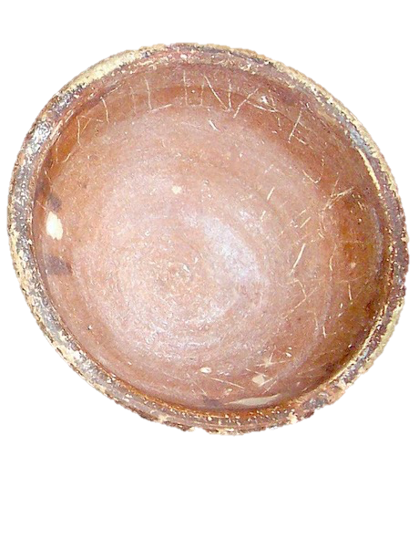
Lucius Sergius Catiline (108 – 62 BC)
Patrician noble
Served during the Social War (91-89 BC)
Supported Sulla in the civil war, 84- 81 BC
73 BC brought to trial for incest with a Vestal virgin;
Catulus, the leading Optimate, testified on his behalf
acquitted
Praetor in 68 BC
Propraetor governor of Africa in 67-66 BC
Accused of extortion in Africa, 65 BC
Supported by members of the elite and acquitted
Attempted to run for consul in 64 BC; defended by Cicero
Attempted to run for consul in 63 BC; later accused by Cicero in November of attempting to conspire against the state:
Cicero, Against Catiline 1 & 2
Catiline declared an enemy of the state
Defeated and killed in battle in early 62 BC
Catilina ‘propaganda’ cup for political election to the consulate. These cups, filled with food or drinks, were distributed to the electors to support the candidates.

Slide 9
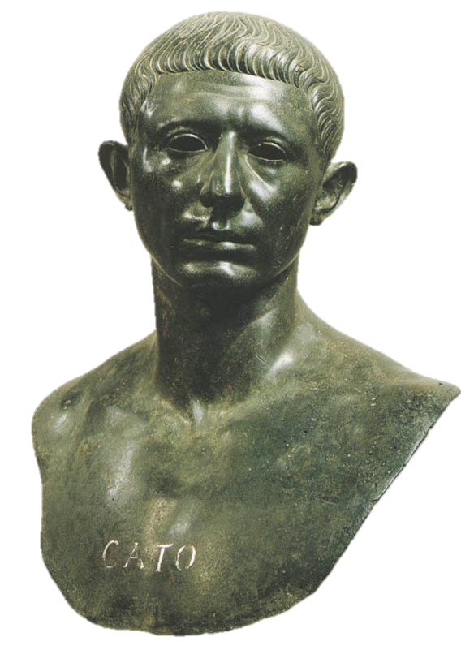
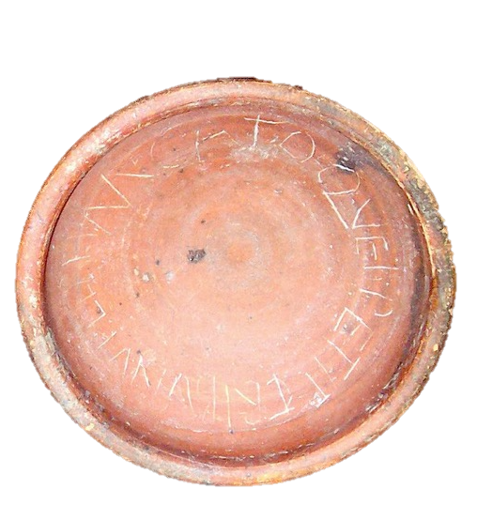
Marcus Porcius Cato (95 – 46 BC)
Roman politician and stoic philosopher
Known for his strict adherence to discipline
65 BC – quaestor
63 BC – elected Tribune of the Plebs for 62 BC and argued for the deaths of the ‘conspirators’ in December 63 BC (against Caesar, see Sallust Catilinarian War 51-52).
Opposed the activities of the alliance of Pompey, Crassus and Caesar
58-56 BC - governor of Cyprus
54 BC – praetor
52 BC – tried and failed to run for Consul
49 BC - Opposed Caesar during the Civil War
47-46 BC – Led Republican resistance to Caesar in North Africa
46 BC – committed suicide at Utica, as a rejection of Caesar’s pardon
Cato’s ‘propaganda’ cup for political election to the tribunate of the Plebs. These cups, filled with food or drinks, were distributed to the electors to support the candidates.

Slide 10
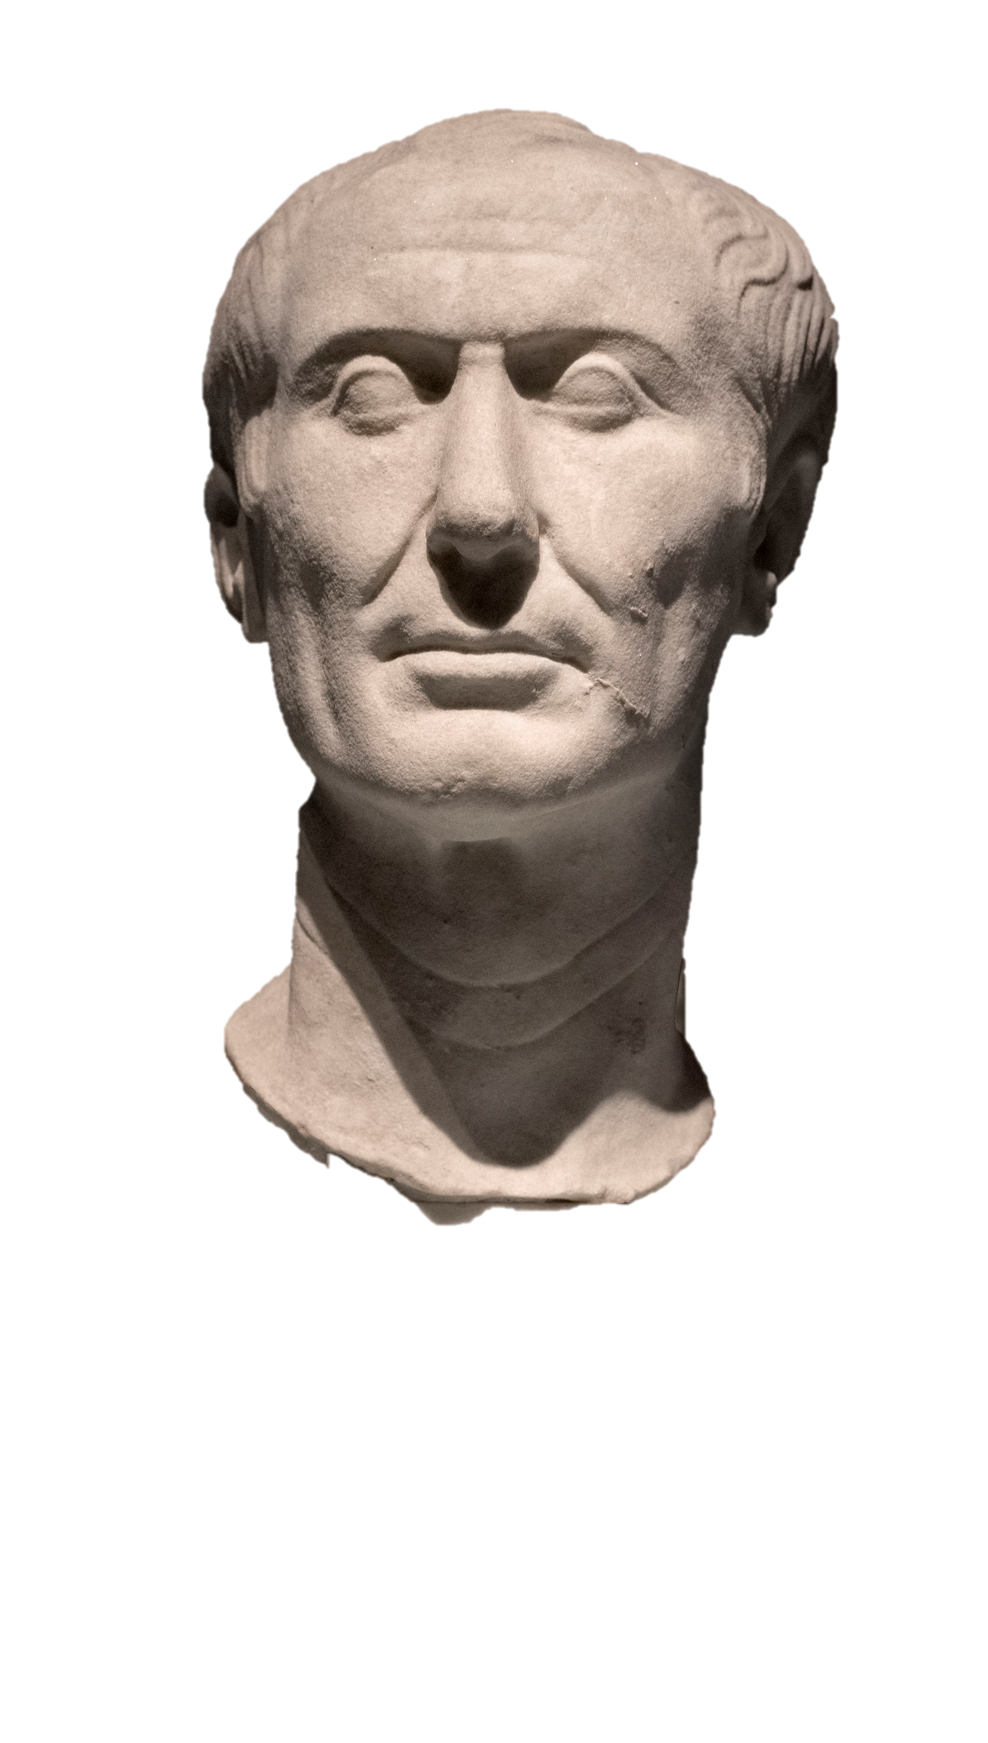
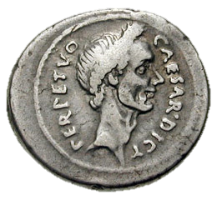
Gaius Iulius Caesar (100 – 44 BC)
Patrician noble
Marius’ nephew and married to Cinna’s daughter Cornelia; later married Sulla’s grand-daughter, Pompeia.
63 BC – praetor elect and Pontifex Maximus
60 BC – formed informal alliance with Pompey and Crassus
59 BC – consul
58 BC – command in Gaul
56 BC – command in Gaul extended for 5 years
50 BC – senate command Caesar to disband army
Refuses and marches into Italy, Jan 49 BC
49-48 BC, Civil War against Pompey
49 BC – 1st Dictatorship (for 11 days, to oversee elections)
48 BC - Consul II
47 BC - 2nd Dictatorship (for the purpose of accomplishing things in absentia; fighting foreign opponent – Pontic king at Zela)
46 BC - 3rd Dictatorship (for the purpose of accomplishing things against Numidian allies of the republicans) and consul III
45 BC - 4th Dictatorship for 10 years, consul IV
44 BC - 5th Dictatorship (perpetuo = continuously), consul V
Assassinated on 15th March 44 BC

Slide 11
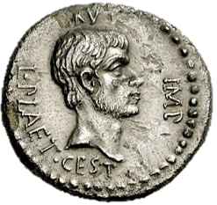
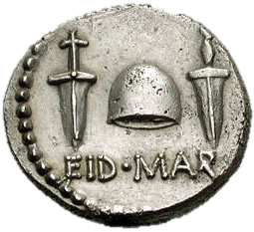
Marcus Junius Brutus (85 – 42 BC)
Nephew of Cato the Younger (Marcus Porcius Cato)
Served under him in Cyprus (58- 56 BC)
Supported Pompey in the civil war against Caesar, 49 BC
Surrendered to Caesar and was pardoned, 48 BC
Appointed Governor of Gaul during civil wars of 47- 46 BC
Nominated by Caesar for the Urban Praetorship in 45 BC
44 BC – Urban Praetor
15th March – assassination of Julius Caesar
17th March – Negotiation with Mark Antony and Lepidus
Left Rome for the East in summer 44 BC
November 43 BC - lex Pedia sought to punish those who had killed Caesar
3 October 42 BC – defeated Octavian at Philippi
23 October 42 BC – defeated and committed suicide

Slide 12
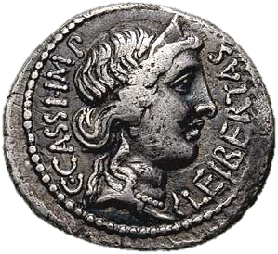
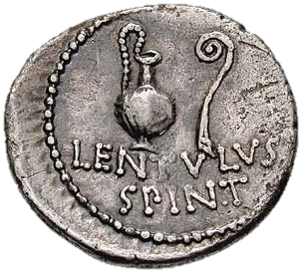
Gaius Cassius Longinus (c. 85 – 42 BC)
Campaigned with Crassus in Parthia (54 BC)
50 BC – returned to Rome
49 BC – elected Tribune of the Plebs; opposed Caesar
Fought with Pompey and had command of part of the fleet
48 BC – naval successes against Caesar, but after defeat of Pompey, surrendered.
44 BC – Praetor Peregrinus (in charge of foreign concerns)
15th March – assassination of Caesar
Cassius had wanted to kill Antony as well
Left Rome in summer 44 BC and went east
3 Oct 42 BC - defeated by Antony at Philippi; suicide

Slide 13
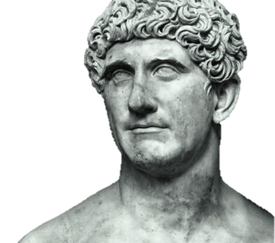
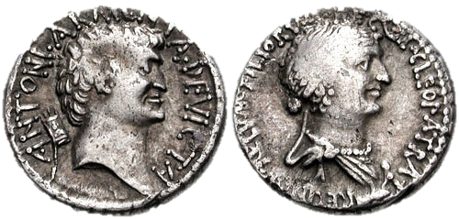
Marcus Antonius (83 – 30 BC)
49 BC – tribune of the Plebs, supported Caesar against the Pompeian and senatorial factions (fled Rome, 7 January 49 BC).
44 BC – Consul with Caesar
15th March – assassination of Caesar; 17th March – organised an amnesty with the assassins
Summer 44 BC – conflict with Augustus
September 44 BC - April 43 BC – attacked by Cicero (Philippic speeches)
43 BC – governor of Cisalpine Gaul; besieged Decimus Brutus at Mutina
November 43 BC – alliance with Lepidus and Augustus to found the Triumvirate for the restoration of the state.
3 October 42 BC – defeats Cassius at Philippi
42 BC – alliance with Cleopatra
41- 36 BC – campaigning against Parthia
40 BC – Marriage of Antony to Octavia (Octavian’s sister):
Treaty of Brundisium
37 BC – Treaty of Tarentum (renewal of the Triumvirate)
33 BC – triumviral powers expire
32 BC – Octavian declares war of Cleopatra
2 Sept 31 BC – Battle of Actium
August 30 BC – suicide in Alexandria

Slide 14
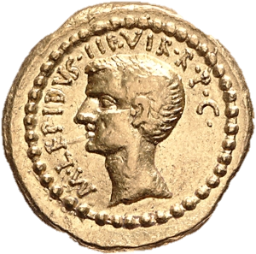
Marcus Aemilius Lepidus (89/88 – 13/12 BC)
Ally of Julius Caesar
Praetor in 49 BC
Had Caesar appointed to the Dictatorship
46 BC – Consul & Caesar’s Master of Horse (2nd in command to Dictator)
44 BC – Master of Horse II
15th March – assassination of Caesar
Lepidus has self appointed Pontifex Maximus
Allied with Antony in the aftermath of Caesar’s death and Antony’s defeat
at Mutina in April 43 BC
Formed the Triumvirate with Mark Antony and Octavian in November 43 BC
Command over Africa after 40 BC
Triumvirate renewed in 37 BC (treaty of Tarentum)
36 BC Defeat of Sextus Pompeius in Sicily; Lepidus makes a failed grab for power in Sicily and is defeated by Octavian
22 September 36 BC – stripped of power apart from Pontifex Maximus and exiled
12 BC – dies (Augustus becomes Pontifex Maximus)

Slide 15
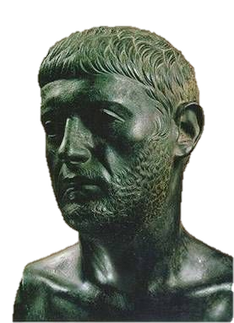
Sextus Pompeius (67 – 35 BC)
Younger son of Pompey the Great
47-45 BC – along with his older brother Gnaeus Pompeius, fought against Caesar in Spain.
Defeated in 45 BC at Munda; Gnaeus was killed.
43 BC – during the proscriptions of the Triumvirs, Sextus welcomed Republicans in Spain
42 BC appointed commander of the Fleet (praefectus classis et orae maritimae)
39 BC – Treaty of Misenum - an agreement to end hostilities in the west (Sextus had control on the grain supply), whilst war was being fought against Parthia in the east.
37-36 BC – conflict for control of the west continued between Sextus and Octavian
Defeated by Agrippa in Sicily in 36 BC
Fled to the east but executed on the orders of Antony in 35 BC

Slide 16
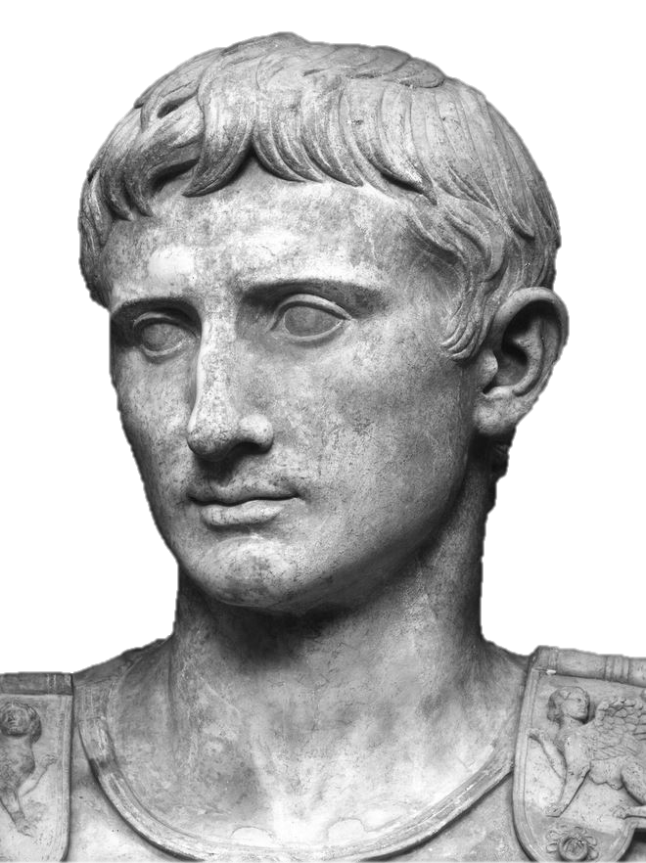
Gaius Octavius = Gaius Julius Caesar = Augustus (63 BC – AD 14)
45 BC Joined Caesar on campaign in Spain (aged 16)
44 BC is adopted in Caesar’s will
43 BC is granted propraetorian imperium (aged 19!) to join fight against Antony at Mutina
43 BC – appointed consul after the deaths of both Pansa and Hirtius
November 43 BC – forms Triumvirate with Mark Antony and Lepidus
41/40 BC – battle of Perusia against Mark Antony’s brother and wife
40 BC – treaty of Brundisium and marriage of Antony to Octavia
39 BC – Treaty of Misenum with Sextus Pompeius
37 BC – Treaty of Tarentum and renewal of Triumviral powers
36 BC – defeat of Sextus Pompeius and Lepidus
32 BC – war with Cleopatra and Antony
30 BC – sole commander of all of Rome’s armies
28/27 BC – ‘restores the state’ and awarded the new name:
Augustus

