Slide 1
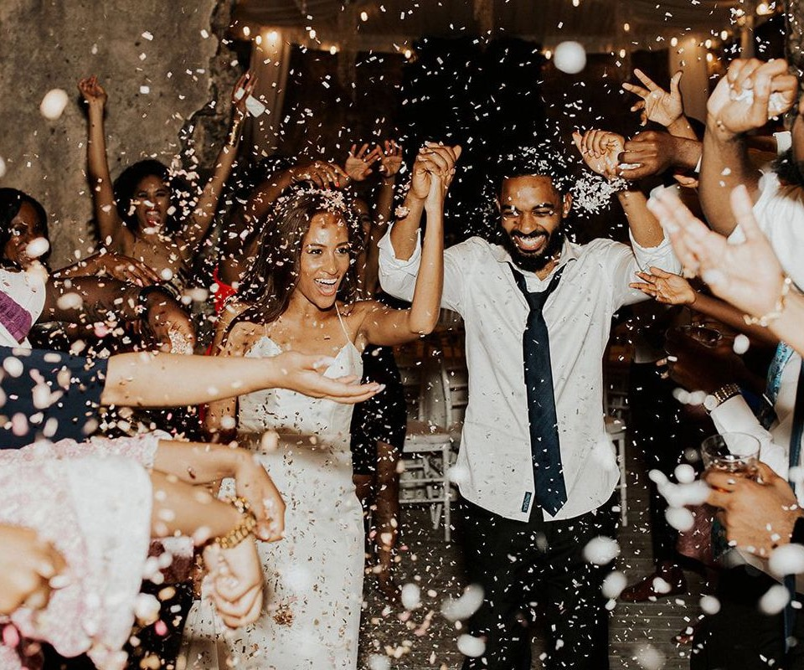
Weddings Reform and Religious-only Marriages
Dr Rajnaara Akhtar
Prof Rebecca Probert

Slide 2

Overview
Investigating a wide range of non-legally binding wedding ceremonies in various communities
  Nature of ceremonies
  Beliefs, practices and desires of those involved – couples and celebrants
  Impact of Law Commission reform proposals
Investigating both religious and non-religious marriage practices
Overall aims: find out who is opting for non-legally binding ceremonies, reasons for doing so, the role of those who perform them, and potential impact of different proposals for reform.
Focus: couples who had a non-legally binding ceremony only or first

Slide 3
Non-Legally binding (NLB) ceremony first
12 participants had a NLB ceremony over a month before a legal wedding
16 couples were in religious-only marriages at the time of the interview
14 nikah ceremonies
1 Sikh wedding
1 interfaith ceremony
10 nikah ceremonies
1 Hindu
1 Wiccan

Slide 4
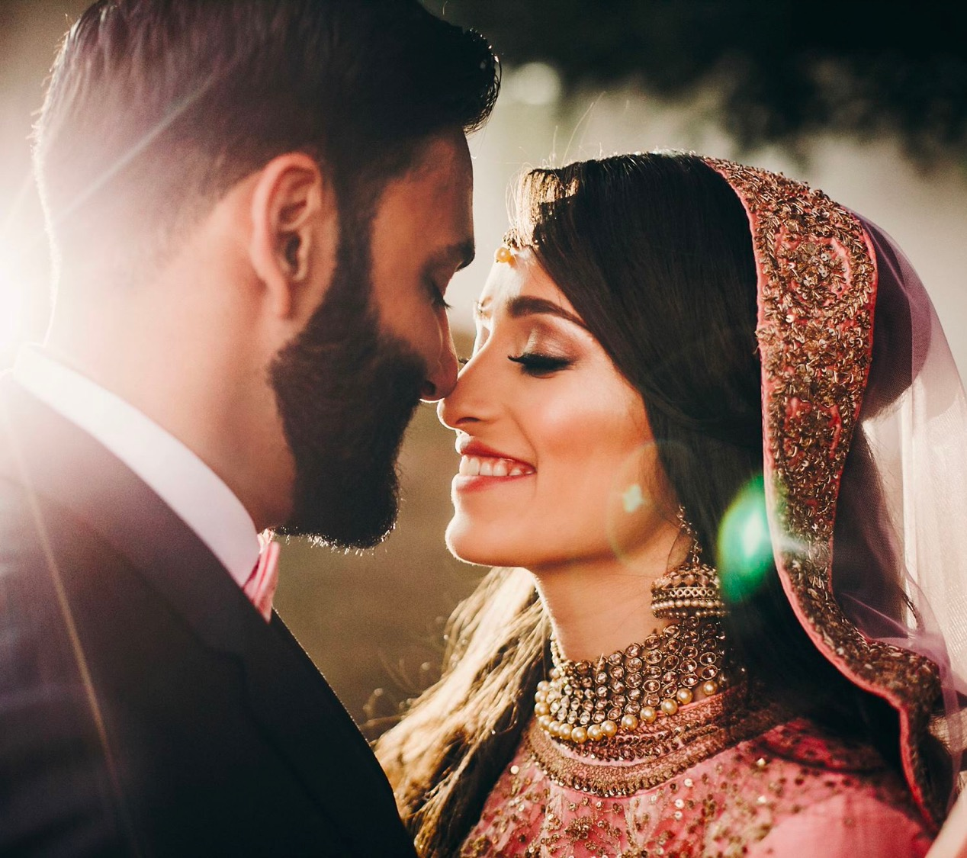
Why Muslim couples have NLB (nikah) ceremonies
More important than legal wedding
‘It’s the only valid form of ceremony in terms of my religion’
‘I could have had a civil ceremony but that doesn’t mean I’m married in our terms, as a Muslim. You’re only married once you’ve had the nikah..’
Necessary to enable relationship
‘no intimate relationship. Only through marriage.’
‘we’ve known each other a long time so we were extremely close in terms of the emotional aspect of things but physical intimacy, yeah, it would have had to have been marriage before.’

Slide 5
Why imams conduct NLB
Performing a religious role
‘As we believe that the nikah and the marriage is part of the religion, it is not only worldly matter, it is part of our faith, part of our religion, and so the imam and the Islamic centre has to facilitate it for the Muslim community.’
Barriers to Certified Places of Worship becoming registered for wedding
‘We applied for registration of the centre last year and …. we’re still here now in November, 12 months later, with no paperwork and continuous headaches from them … I don’t know whether it’s Covid or just the inability to be able to deal with an application, I don’t understand what’s going on between them… so, we did actually apply for being registered.’

Slide 6
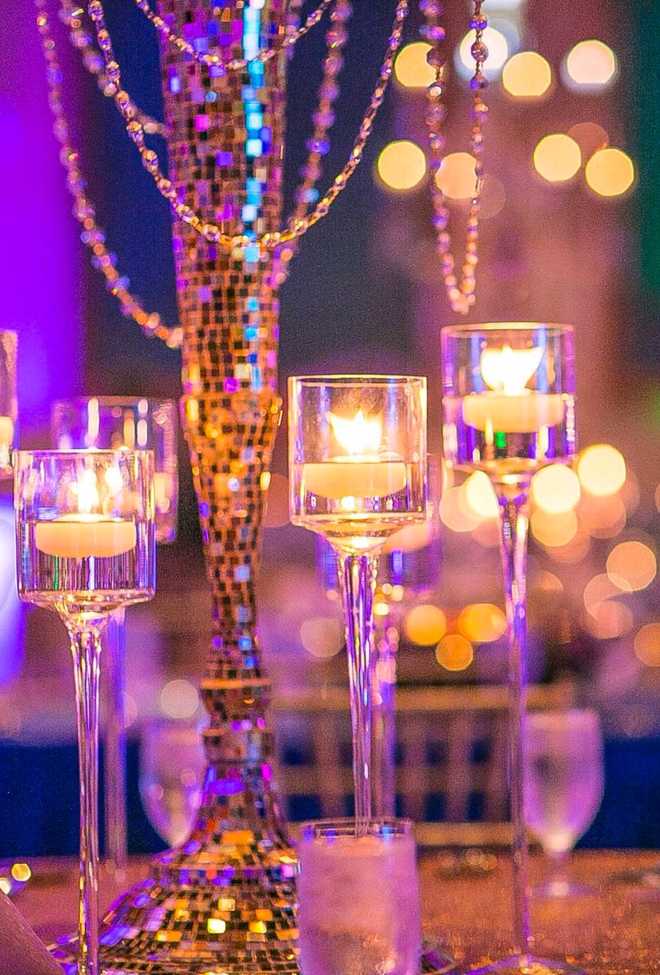
Reason for delaying or omitting a legal wedding
Delay
Legal or administrative barrier
Delay in getting round to it, ‘life’ getting in the way
Deliberate delay – to test the relationship
Omit
Financial considerations
Unable to access legal wedding
No desire to legally marry

Slide 7

Misunderstandings?
Most interviewees knew that their religious ceremony was not legally recognised at the time they entered into it.
One had not been aware but suspected that her husband had been: ‘ I think he absolutely knew all of this which is why, you know, he was always going to be in a more powerful position, because he was aware of this and I wasn’t.’
Little evidence of the common-law marriage myth influencing behaviour

Slide 8

Knowledge
Differing views as to levels of awareness across Muslim communities about the status of the nikah
‘so much awareness about it’
‘Even educated women… Their families told them, “This is all you need to do.” And then, you know, ten, 15, 20 years down the line, they find themselves in a very difficult position

Slide 9

Implications
Cohabitation reform would benefit couples in NLB marriages
Need to consider whether the same threshold conditions should apply and what account should be taken of the fact that the couple have gone through a ceremony
Law Commission's recommendations would encourage at least some couples to have dual ceremonies
Need for weddings law reform

