Slide 1
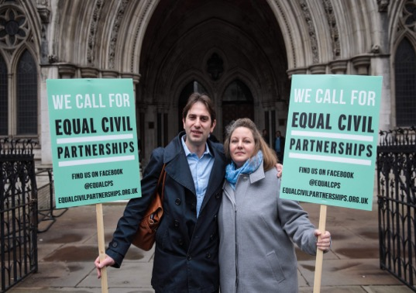

Equal Civil Partnerships and Cohabitation Reform
Dr Andy Hayward
Durham Law School
a.p.hayward@durham.ac.uk
@DrAndyHayward
27th January 2023

Slide 2
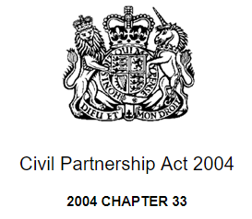
Research Questions
  What is the relationship between civil partnerships and cohabitation reform?
  What are the early indications as to public receptivity towards mixed-civil partnerships?
  Do mixed-sex civil partnerships possess transformative potential vis-à-vis the legal regulation, and conceptualization, of adult interpersonal relationships? How might they assist cohabitants?

Slide 3
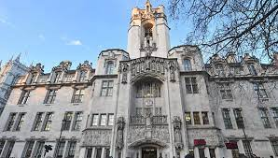

Evolution of Civil Partnerships in England and Wales
  Civil Partnership Act 2004, Part II =>
  Marriage (Same Sex Couples) Act 2013 =>
  Steinfeld and Keidan [2018] UKSC 32 =>
  Civil Partnerships, Marriages and Deaths (Registration etc) Act 2019, section 2 =>
  Civil Partnership (Opposite-sex Couples) Regulations 2019 =>
  …first mixed-sex civil partnership registrations took place 31st December 2019.

Slide 4

Evolution of Civil Partnerships in England and Wales - II
  Reactionary, unprincipled, ‘top down’ reform.
  Limited insight provided by Supreme Court in Steinfeld and Keidan [2018].
  Equal Civil Partnerships organization no longer ‘active’ in terms of campaign element but performing advice/profile-raising role.
  Statutory framework created exhibits internal inconsistency.
  Amending process involved retrospective rationalization and revisionism, especially as to civil partner ‘intimacy’.
  Further legal amendments still needed regarding conversion rules.

Slide 5

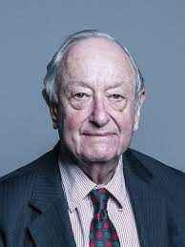
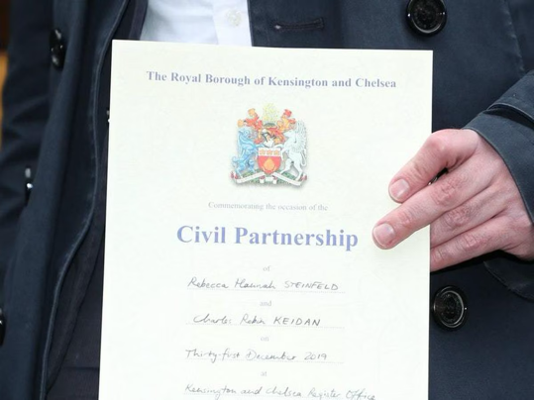
The Relationship between Civil Partnerships and Cohabitation
  Cohabitation featured in the early civil partnership debates.
  Natural connection between the two, as seen in comparative family law (especially France, Belgium).
  More recently, misconceptions identifiable:
    Lighter commitment;
    Capable of personalization;
    Cheaper;
    Fully secular;
    Pathway to marriage
    Cohabitants as Beneficiaries of the Reform

Slide 6
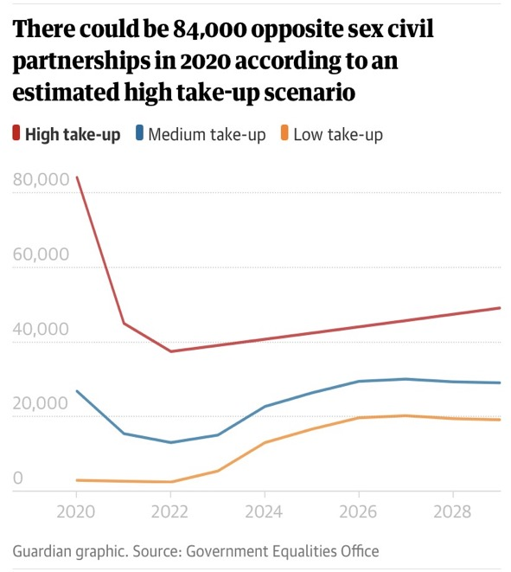
Impact Assessment
  167 mixed-sex CPs registered on 31st December 2019
  Government Equalities Office, Civil Partnerships - Impact Assessment (9th July 2019):

Slide 7



Public Engagement
  Impact of Covid-19 pandemic:
    reducing ceremony size;
    postponement of registrations.
  Media discourse on registrations that did take place:
    Smaller ceremonies;
    Informal;
    Egalitarian;
    Choice/autonomy-enhancing.
  No decided case law yet.

Slide 8
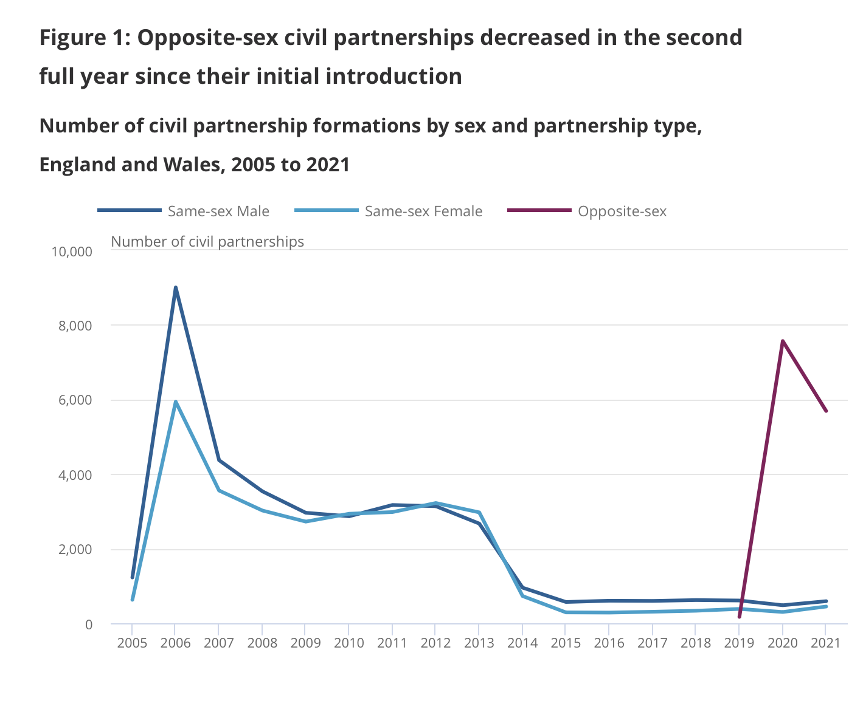
Recent Statistics
  1

Slide 9

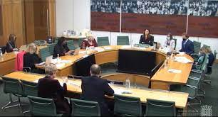
The Women and Equalities Committee Inquiry
  Inquiry Report stated civil partnerships would be suitable for a ‘statistical minority’ of couples (e.g. the Ideologue couples)
  but…
  In oral evidence, civil partnerships:
    ‘resolve quite a lot of the challenges in this space’ (Tom Pursglove MP),
    ‘are a good thing’,
    are ‘a significant step’ (Neal Barcoe)
    are ‘low-cost option’.

Slide 10

The Women and Equalities Committee Inquiry - II
  Caroline Nokes MP (Chair):
  ‘Do you not see that there is a bit of a challenge around this? Twice you have said there is a low-cost option to sort this; it is civil partnership. Mr Barcoe said civil partnership is the way to sort this. Many couples end up cohabiting without a definite start date—it sort of evolves—and the solution of, “Well, enter into a civil partnership,” might not come along at a convenient moment in time.

Slide 11


Next steps for Cohabitation Reform
  Need to break the connection between cohabitation reform and the availability of equal civil partnership.
  Empirical, longitudinal study needed on mixed- and same-sex couple perceptions, experiences, and dissolution data.
  Appreciate civil partnership innovation is constrained by legal framework.
  Analyse the shift from campaign or ‘champion’ cohort to a selecting cohort.

