Slide 1
Schedule 1 – fit for modern society?
Joshua Viney – 1 hare court

Slide 2
History of Schedule 1
The creation of Schedule 1 and its predecessor the Family Law Reform Act 1987 was born out of a noble goal. It was designed for to remove the legal distinction between children born to married and unmarried parents (often former cohabitants) and it was part of a wider move to eradicate discrimination based on birth status.

Slide 3
Younger but already out of date?
Perhaps because of its goal and its relative infancy it is easy to fall into the trap of believing that Schedule 1 of the Children Act is more ‘modern’ than, for example, the Matrimonial Causes Act 1973 which is now in its sixth decade.
But remember Schedule 1 was drafted long before same sex couples could adopt (2005, per the the Adoption and Children Act 2002) and before both the HFEA 1990 and 2008.

Slide 4
Over 30 years on and Schedule 1 is by no means perfect…
Macro: the use mainly by the extremely wealthy (think footballers and oligarchs) to the exclusion of most former cohabitants / parents, the consequentially disconnected case law and the interplay with the Child Support Act 1991.
Micro: the costs rules and recent case law with respect to provision for adult children (Siddiqui v Siddiqui [2021]; UD v DN [2021]).
Today I’m going to consider whether Schedule 1 itself is discriminatory, specifically considering former cohabitants and how the statute can perversely prioritise individuals because of their marital status.

Slide 5
Who can actually make a claim?
The ‘applicant’ is drafted very widely by both Schedule 1 and FPR r 9.10:
  (a) a parent, guardian or special guardian of any child of the family;
  (b) any person who is named in a child arrangements order as a person with whom a child of the family is to live, and any applicant for such an order;
  (c) any other person who is entitled to apply for a child arrangements order which names that person as a person with whom a child is to live;
  (d) a local authority, where an order has been made under section 31(1)(a) of the 1989 Act placing a child in its care;
  (e) the Official Solicitor, if appointed the children's guardian of a child of the family under rule 16.24; and
  (f) subject to paragraph (1A), a child of the family who has been given permission to apply for a financial remedy.
For the purposes of Schedule 1, the child must be living with the applicant either by virtue of a lives with order or, where there is no order, the child is living with the applicant or there is a shared care arrangement.

Slide 6
Who can be a respondent?
This is where things get less coherent.
The respondent can only be a ‘parent’ (Paragraph 1(2)).
There is no statutory definition of ‘parent’. Paragraph 16 does not define what ‘parent’ as a word means but it does specify that parent includes:
  (a) any party to a marriage (whether or not subsisting) in relation to whom the child concerned is a child of the family, and
  (b) any civil partner in a civil partnership (whether or not subsisting) in relation to whom the child concerned is a child of the family.

Slide 7
7
Whilst there is no statutory definition of a ‘parent’, case law (see Moylan J in T v B [2010] EWHC 1444) has provided a definition as follows:
a legal parent:
  biological parents; and
  parents who have become a parent by operation of law such as by adoption, under the HFEA 1990 or under the HFEA 2008.
As set out above and at paragraph 16, parties to either a marriage or civil partnership where the child is treated as a ‘child of the family’.
The judge was clear that having parental responsibility did not make a party a ‘parent’.

Slide 8
Child of the family
For completeness, a ‘child of the family’ means by virtue of section 105 of the Children Act:
  (a) a child of both of them; and
  (b) any other child, other than a child placed with them as foster parents, who is treated by both of them as a child of their family.

Slide 9

9

Slide 10


Prince Harry and the Multiverse of Madness
We are now going to explore a family law multiverse – where the relationships in the royal family, fortunate or otherwise, take some interesting turns, hopefully displaying for you how bizarre Schedule 1 can be.

Slide 11
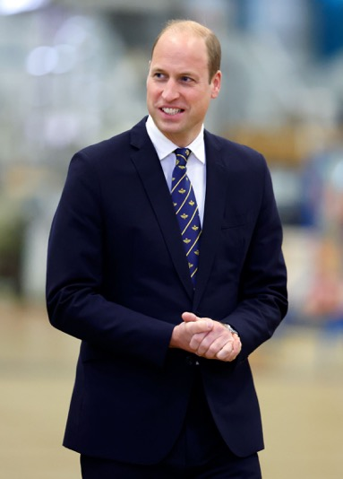
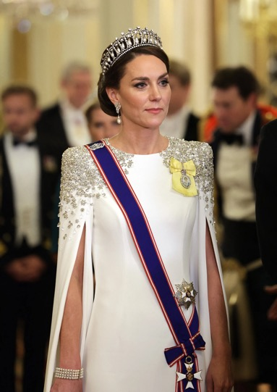
11
Cohabiting

Slide 12
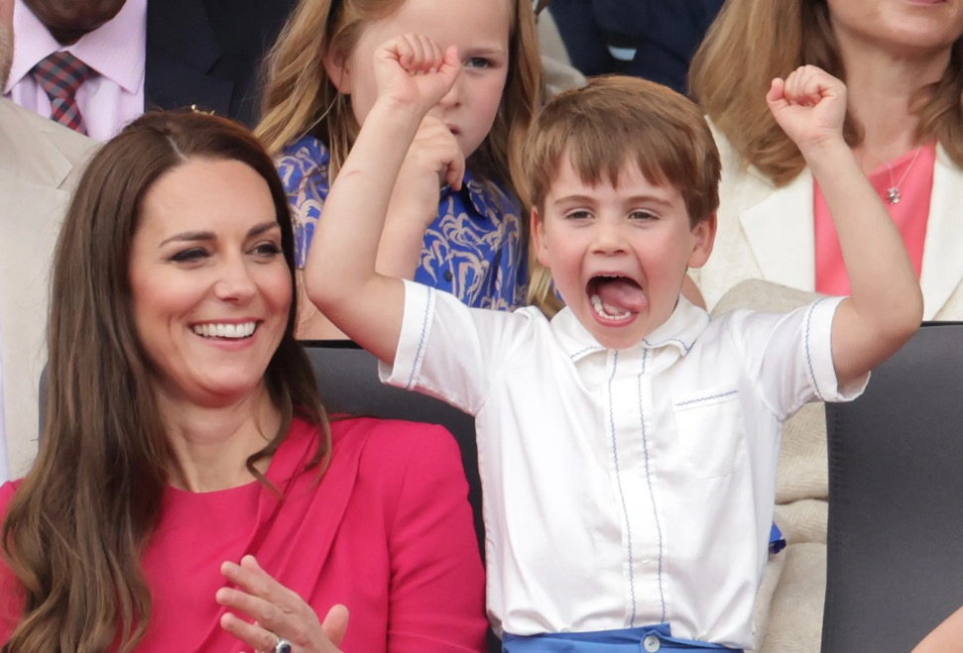
12

Slide 13

13

Slide 14

14

Slide 15
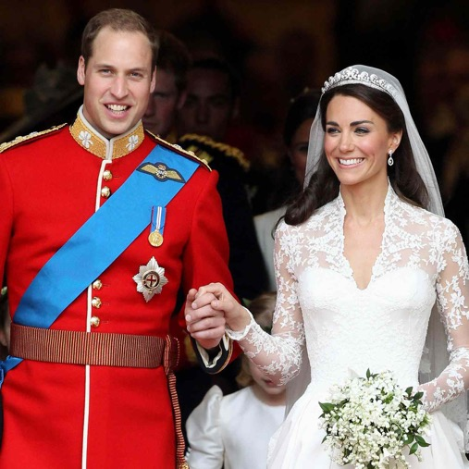

15

Slide 16




16
Lives with
Lives with
Prince Louis

Slide 17


17
Applicant
Respondent

Slide 18
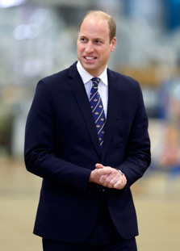
18
Respondent
Applicant
  Paragraph 16 – ‘Parent’ includes:
  (a) any party to a marriage (whether or not subsisting) in relation to whom the child concerned is a child of the family.

Slide 19
Important discretionary side note – paragraph 4(2)
In deciding whether to exercise its powers under paragraph 1 against a person who is not the mother or father of the child, and if so in what manner, the court shall in addition have regard to—
(a) whether that person had assumed responsibility for the maintenance of the child and, if so, the extent to which and basis on which he assumed that responsibility and the length of the period during which he met that responsibility;
(b) whether he did so knowing that the child was not his child;
(c) the liability of any other person to maintain the child.

Slide 20
Let’s make George Clooney’s connection more remote …
Remember paragraph 16:
  (a) any party to a marriage (whether or not subsisting) in relation to whom the child concerned is a child of the family.

Slide 21



21

Slide 22


22
Lives with
Lives with

Slide 23

23
Respondent
Applicant
  Paragraph 16 – ‘Parent’ includes:
  (a) any party to a marriage (whether or not subsisting) in relation to whom the child concerned is a child of the family.

Slide 24

24
Cohabiting

Slide 25

25

Slide 26
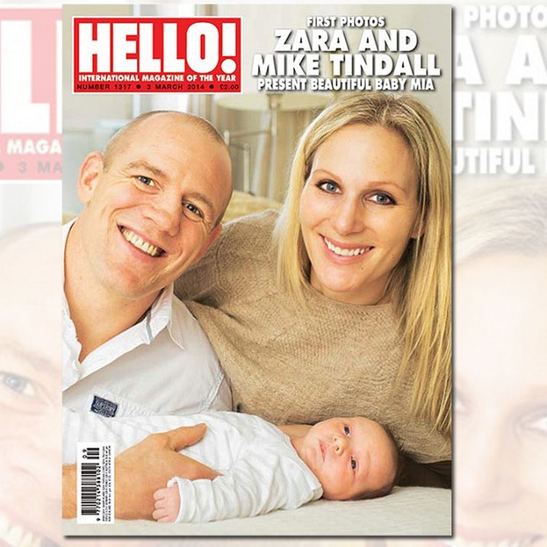
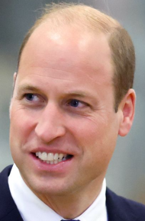
26

Slide 27



27
Mike Tindall elects not to adopt Baby Timothy
Prince William is the
biological father
Baby Timothy

Slide 28
28

Slide 29



29
Mike Tindall obtains PR and a lives with order
Lives with
Baby Timothy

Slide 30
Where does that leave us?
Baby Timothy views Mike Tindall as his father and Mike Tindall views Baby Timothy as his child;
Mike Tindall raised baby Timothy for 5 years whilst cohabiting with Prince William;
Mike Tindall supported baby Timothy financially for 5 years whilst cohabiting with Prince William; and
Mike Tindall has PR and a lives with order for Timothy to live with him.

Slide 31
However, Prince William cannot make a claim against Mike Tindall under Schedule 1 because, per T v B:
    Mike Tindall is not a biological parent;
    Mike Tindall did not adopt Baby Timothy;
    Mike Tindall is not a parent by operation of HFEA 1990 or HFEA 2008 (the Act expressly forbids it); and
    Mike Tindall is not married to Prince William and they are not civil partners.
So, we can have the bizarre situation where Prince William (in another life) can hypothetically claim against George Clooney (who he has never met) and who has no biological link to Prince Louis and who has no lives with order but, in this analogous scenario, Prince William cannot claim against Mike Tindall for Baby Timothy.

Slide 32
32
Cohabiting

Slide 33
33

Slide 34

34

Slide 35
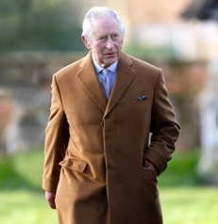


35
King Charles obtains
PR and a lives with order
Lives with

Slide 36
Again, a rather bizarre situation where:
  King Charles has PR and a lives with order;
  King Charles is supporting Prince Louis day to day and meeting his school fees;
  King Charles is biologically related to Prince Louis;
  But there is no route for the Princess of Wales to claim under Schedule 1 because, just as with Mike Tindall in the earlier example, King Charles is not a parent.

Slide 37
Practically what to do with clients?
The scenarios I’ve given you are likely to be of the rarer variety but here are some key points to keep in mind:
  It is important that where a client is looking to adopt a non-biological child they should be warned of the legal consequences to them of doing so, particularly where currently they would almost certainly be able to obtain PR and a lives with order without any financial exposure if they chose not to adopt. Conversely, when advising a client who is the biological parent, they may wish to encourage the other party to take steps to formalise their legal status as a parent.
  If a client is seeking advice on the risks of a second marriage or marrying somebody with children, they should be advised of the risks they are taking on under Schedule 1 and ways to mitigate those risks.
  Always be aware of who a respondent could be.

Slide 38
Where did the Act (or interpretation of the Act) go wrong?
Plainly the drafters did not intend that the respondent to a claim would have to be biologically related to the child – otherwise provision for parties such as George Clooney would not exist. Ignoring the definition within paragraph 16, George Clooney is at best, on a traditional view, a ‘step-parent’. Further, hypothetically, George Clooney could even be separated from the Princess of Wales and have limited contact (if any) with the child and still (hypothetically) be on the receiving end of an application.
Equally, the drafters were content, with regards to parties such as George Clooney, for the court to have a discretion before making an order – paragraph 4(2) reading:
  In deciding whether to exercise its powers under paragraph 1 against a person who is not the mother or father of the child, and if so in what manner, the court shall in addition have regard to—
  (a) whether that person had assumed responsibility for the maintenance of the child and, if so, the extent to which and basis on which he assumed that responsibility and the length of the period during which he met that responsibility;
  (b) whether he did so knowing that the child was not his child;
  (c) the liability of any other person to maintain the child.

Slide 39
So where did the Act (or interpretation of the Act) go wrong?
Moylan J (as he then was) considered this issue in T v B. He was only briefly given submissions on Article 8 of the ECHR. It would be interesting to see how a court would react to a case pursued under Article 14 (discrimination) where there is prima facie case that homosexual couples (particularly male homosexual couples) face discrimination in certain circumstances (the Prince William and Mike Tindall scenario).
The Act appears to look for some change in legal status which provides a straitjacket for the courts:
  being a biological parent;
  adoption;
  through HFEA 1990 or under the HFEA 2008; and
  marriage or civil partnership.

Slide 40
A possible solution
Plainly there needs to be a reconsideration of who a ‘respondent’ is. This could be achieved either through the court interpreting ‘parent’ in a more expansive way or through statutory reform.
The interpretation could be through a statutory interpretation given the act does not define the meaning of ‘parent’. Moylan J declined to do so which was a conservative reading of ‘parent’.
Or the court could read in wider language through section 3 of the Human Rights Act following a finding that there was a breach of a parties Article rights (likely through Article 1 Protocol 1 (enjoyment of property), Article 8 (family life), Article 14 (discrimination). For example, the court could read in that those with parental responsibility are ‘parents’ but that they would need to get through the discretionary test in paragraph 4(2). Moylan J considered that having PR was plainly not intended to make someone a legal parent – he is right but surely someone with PR is no different from a party who is a ‘parent’ by virtue of treating the child as a child of the family.

