Slide 1
Complementary Food Hygiene in The Gambia
Photos of Tools Used

Slide 2
Cover of story booklet
Notes:
1

Slide 3
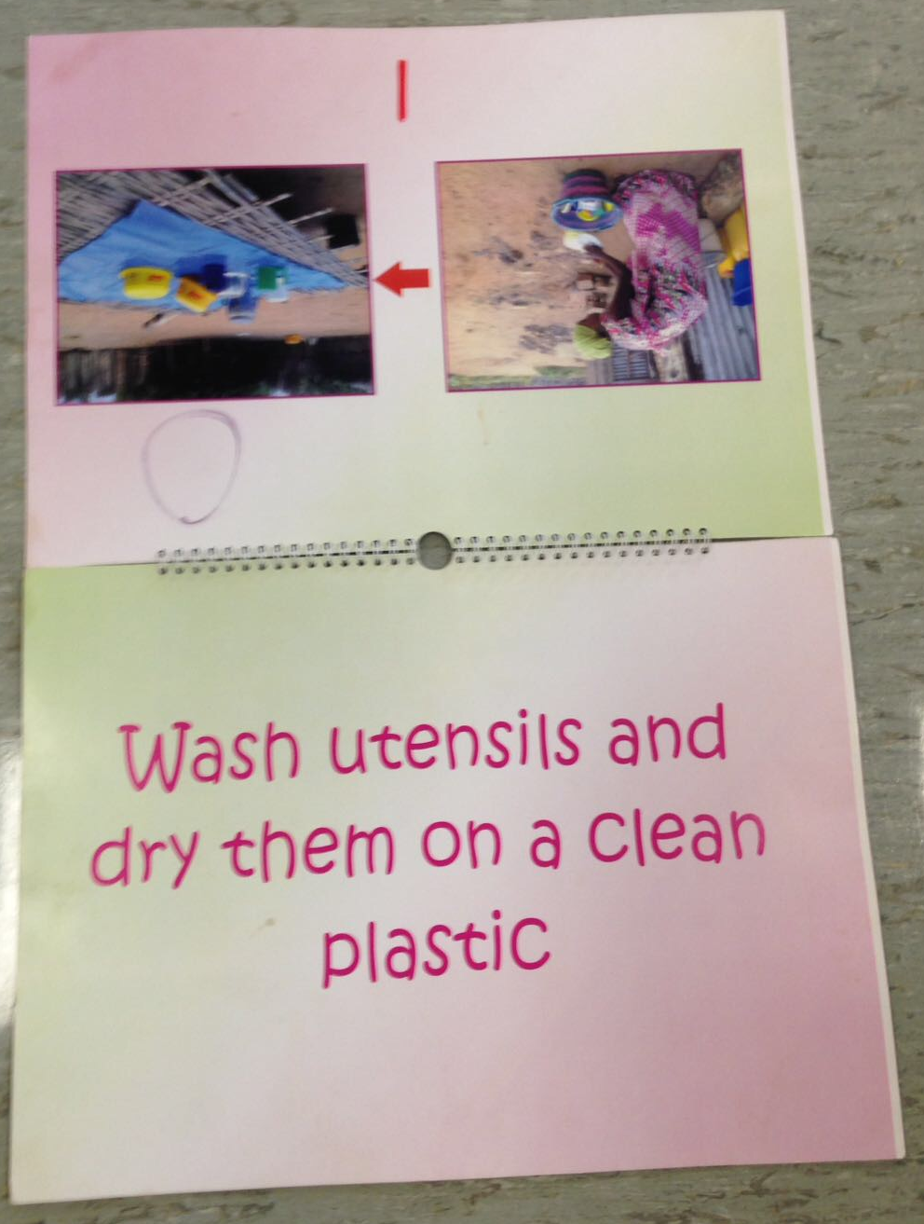
Instructional booklet
Notes:
2a

Slide 4
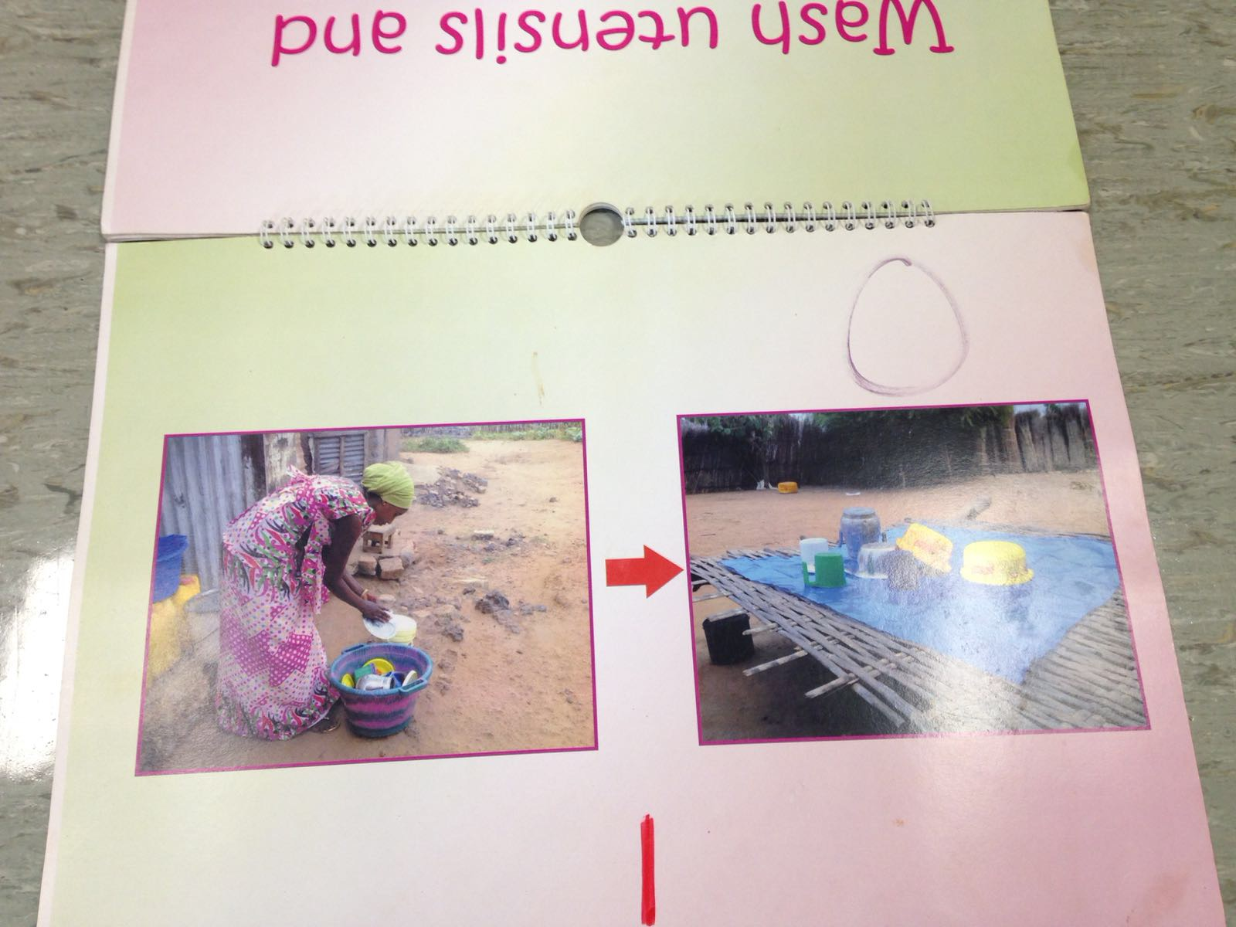
Photographic instructions in booklet
Notes:
2b

Slide 5
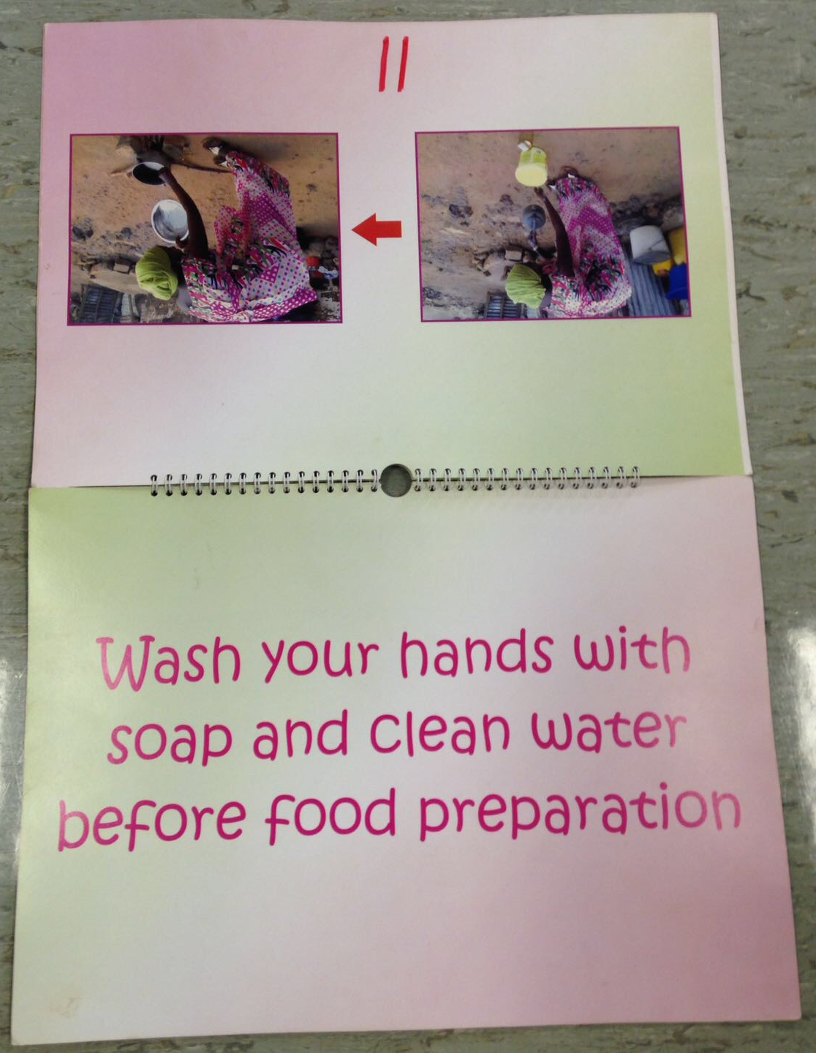
Inside of booklet
Notes:
3a

Slide 6
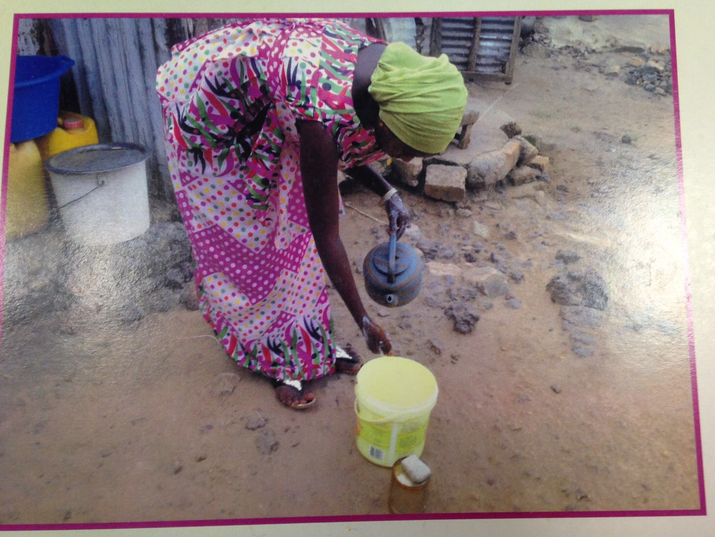
Photograph used in booklet
Notes:
3c

Slide 7
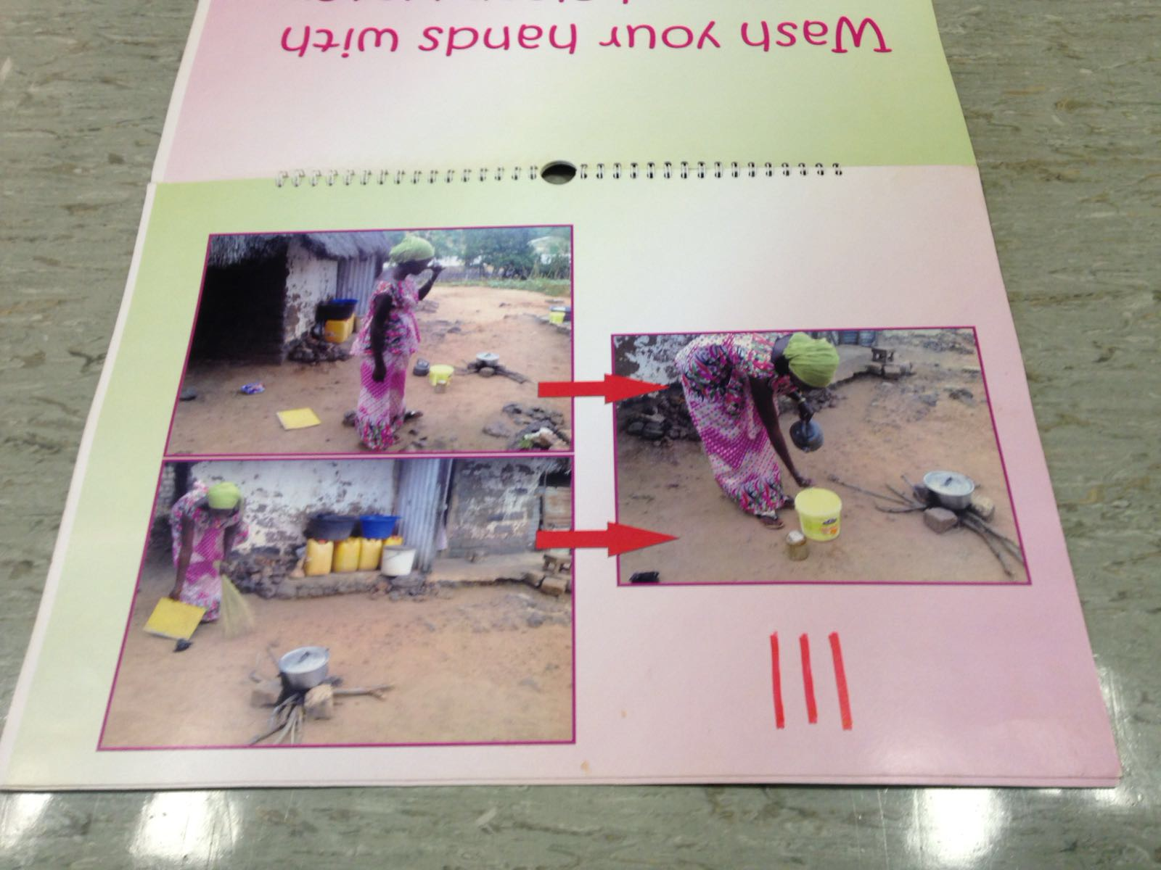
Step-by-step instructions
Notes:
4b

Slide 8
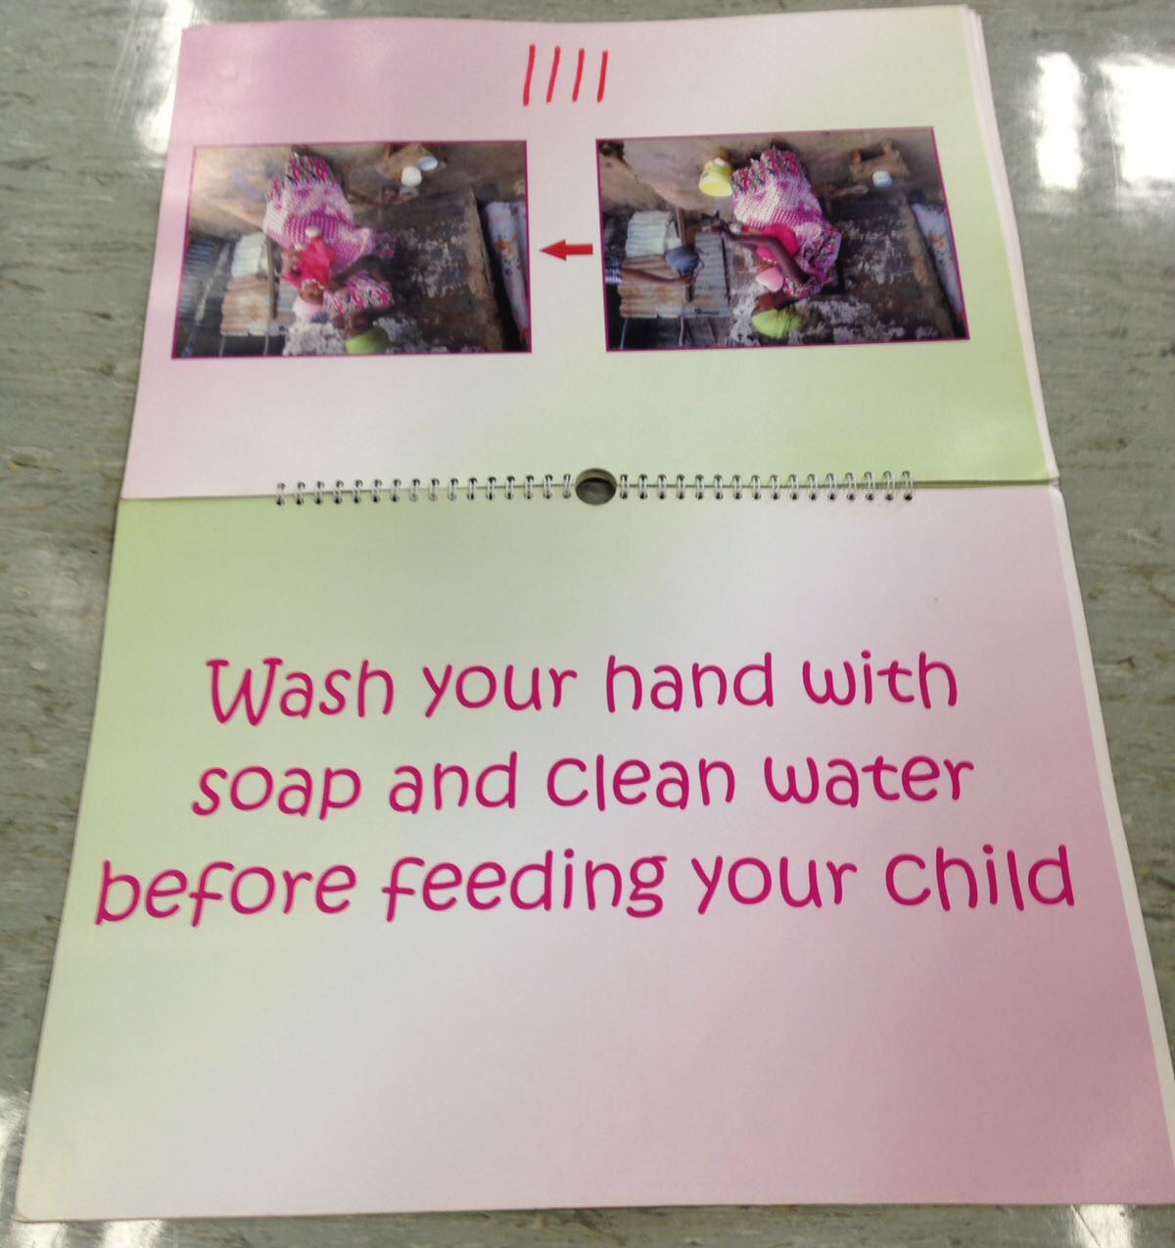
Different scenarios in the booklet
Notes:
5a

Slide 9
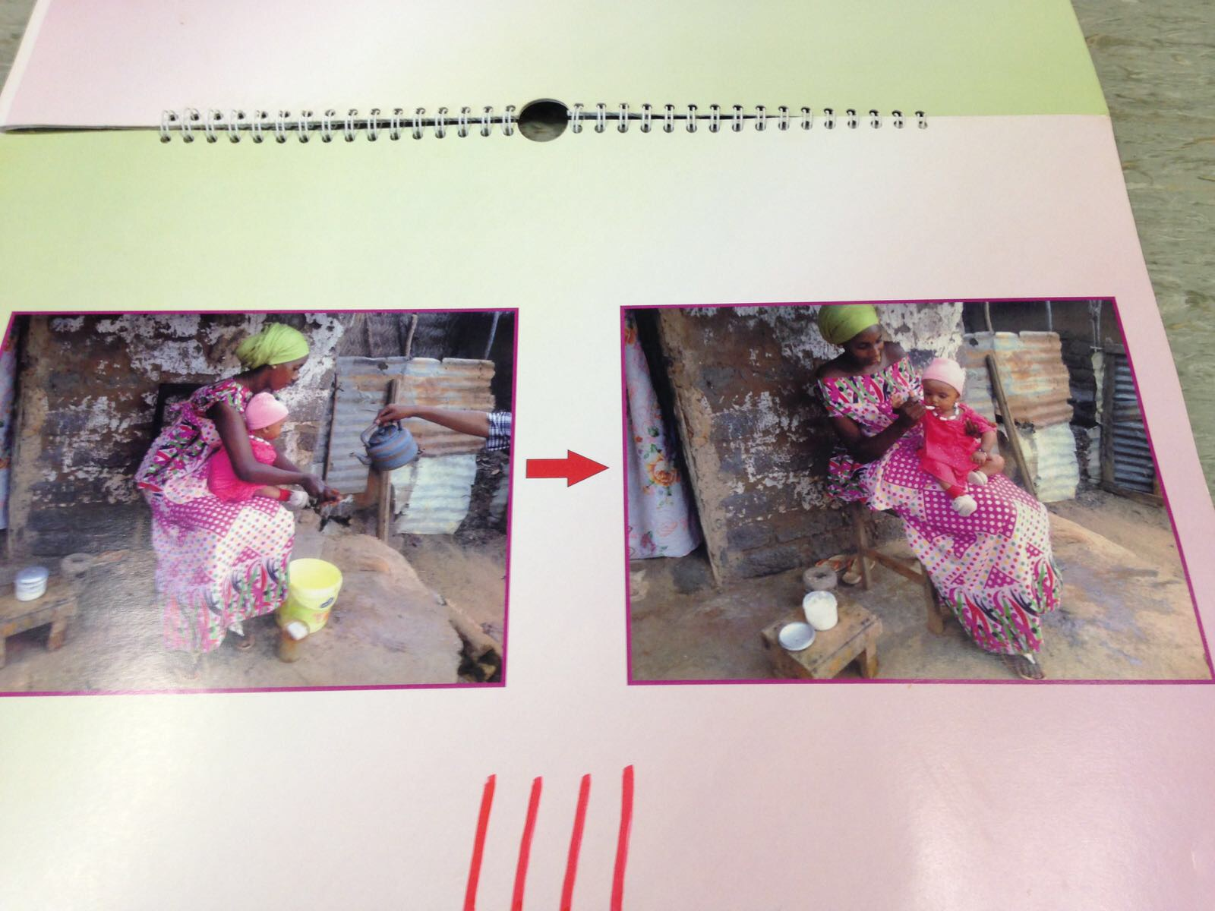
Photographs used
Notes:
5b

Slide 10
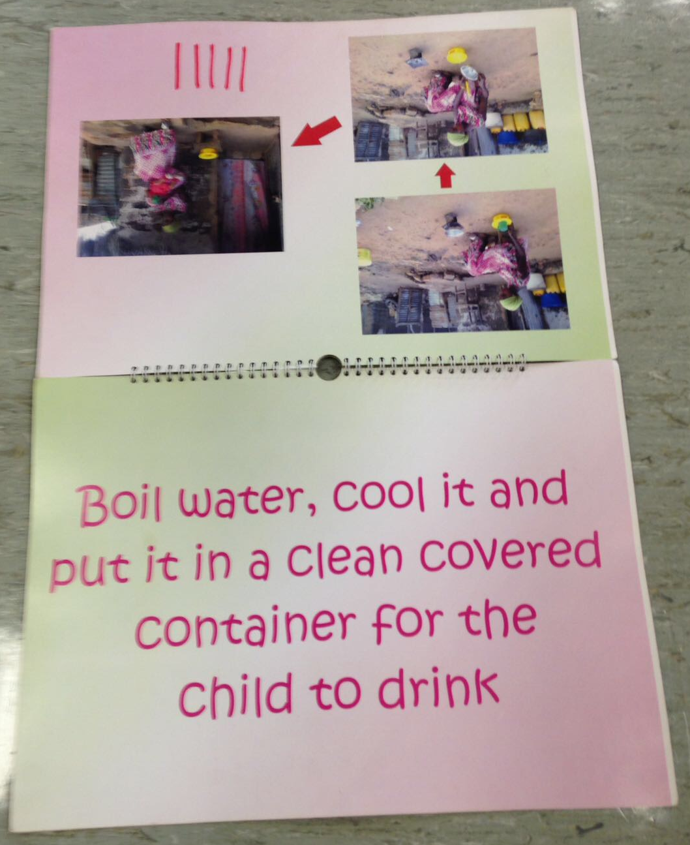
Boil water, cool it and put it in a clean covered container for the child to drink
Notes:
Boil water, cool it and put it in a clean covered container for the child to drink

Slide 11
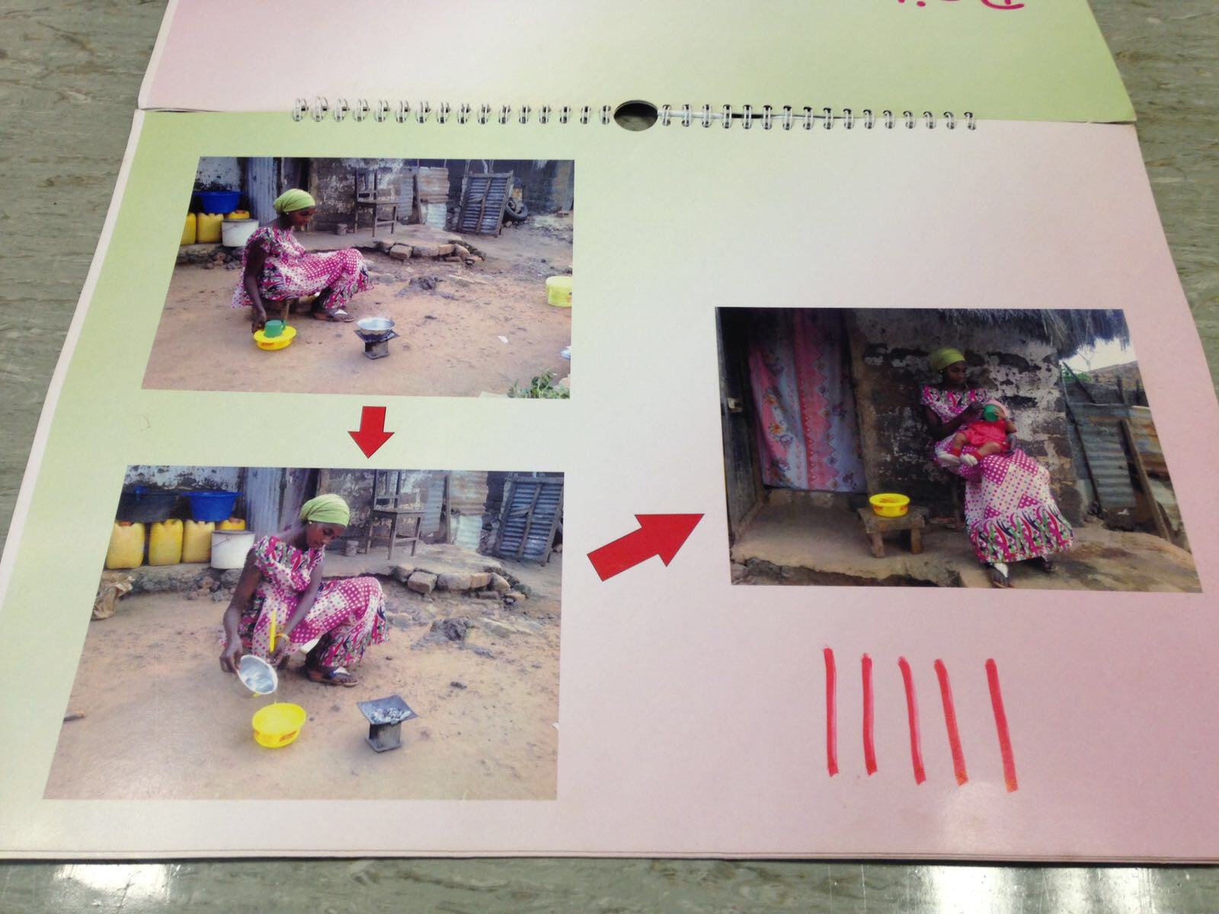
Images of using hot water to reheat food and feed baby
Notes:
Images of using hot water to reheat food and feed baby

Slide 12
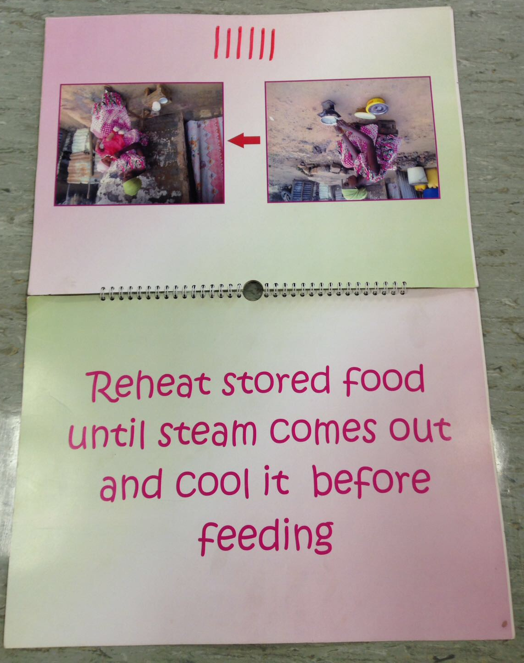
Reheat stored food until steam comes out and cool it before feeding
Notes:
Reheat stored food until steam comes out and cool it before feeding

Slide 13
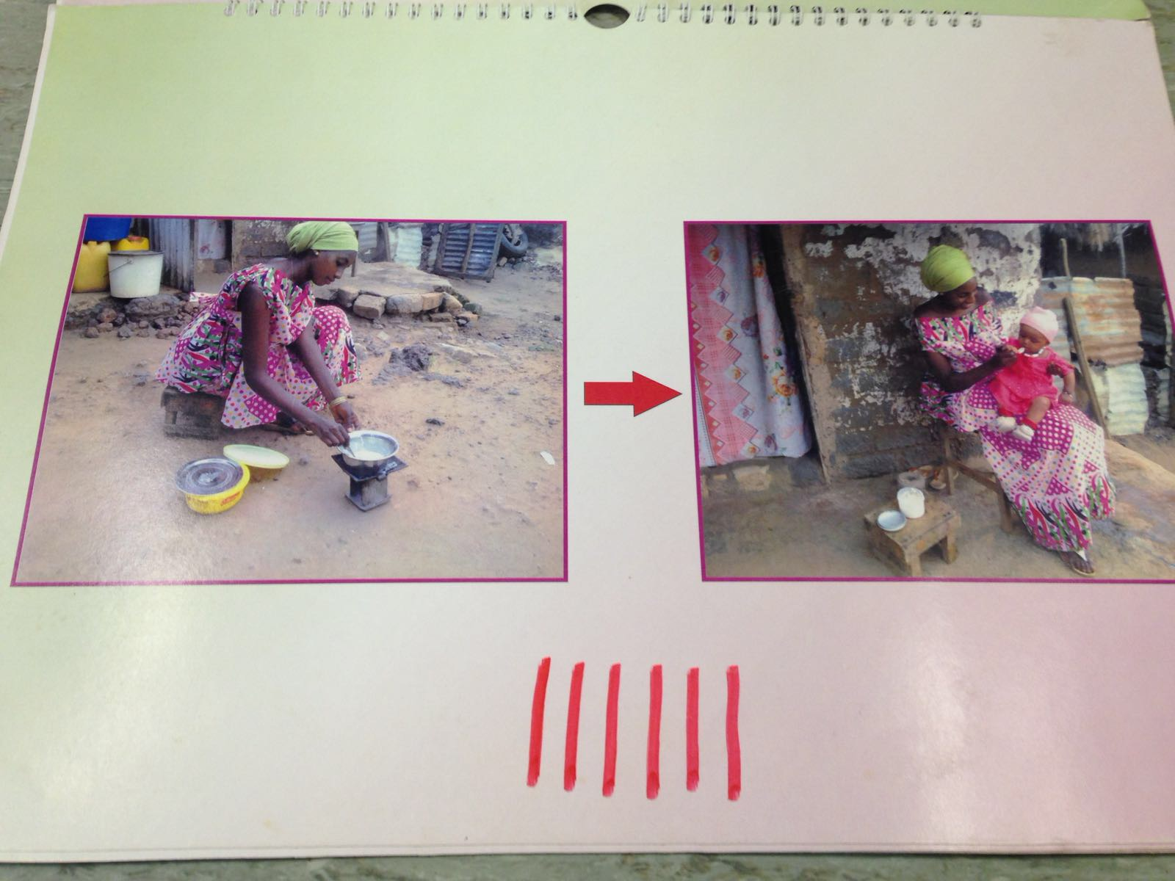
Heating baby food, feeding baby
Notes:
Heating baby food, feeding baby

Slide 14
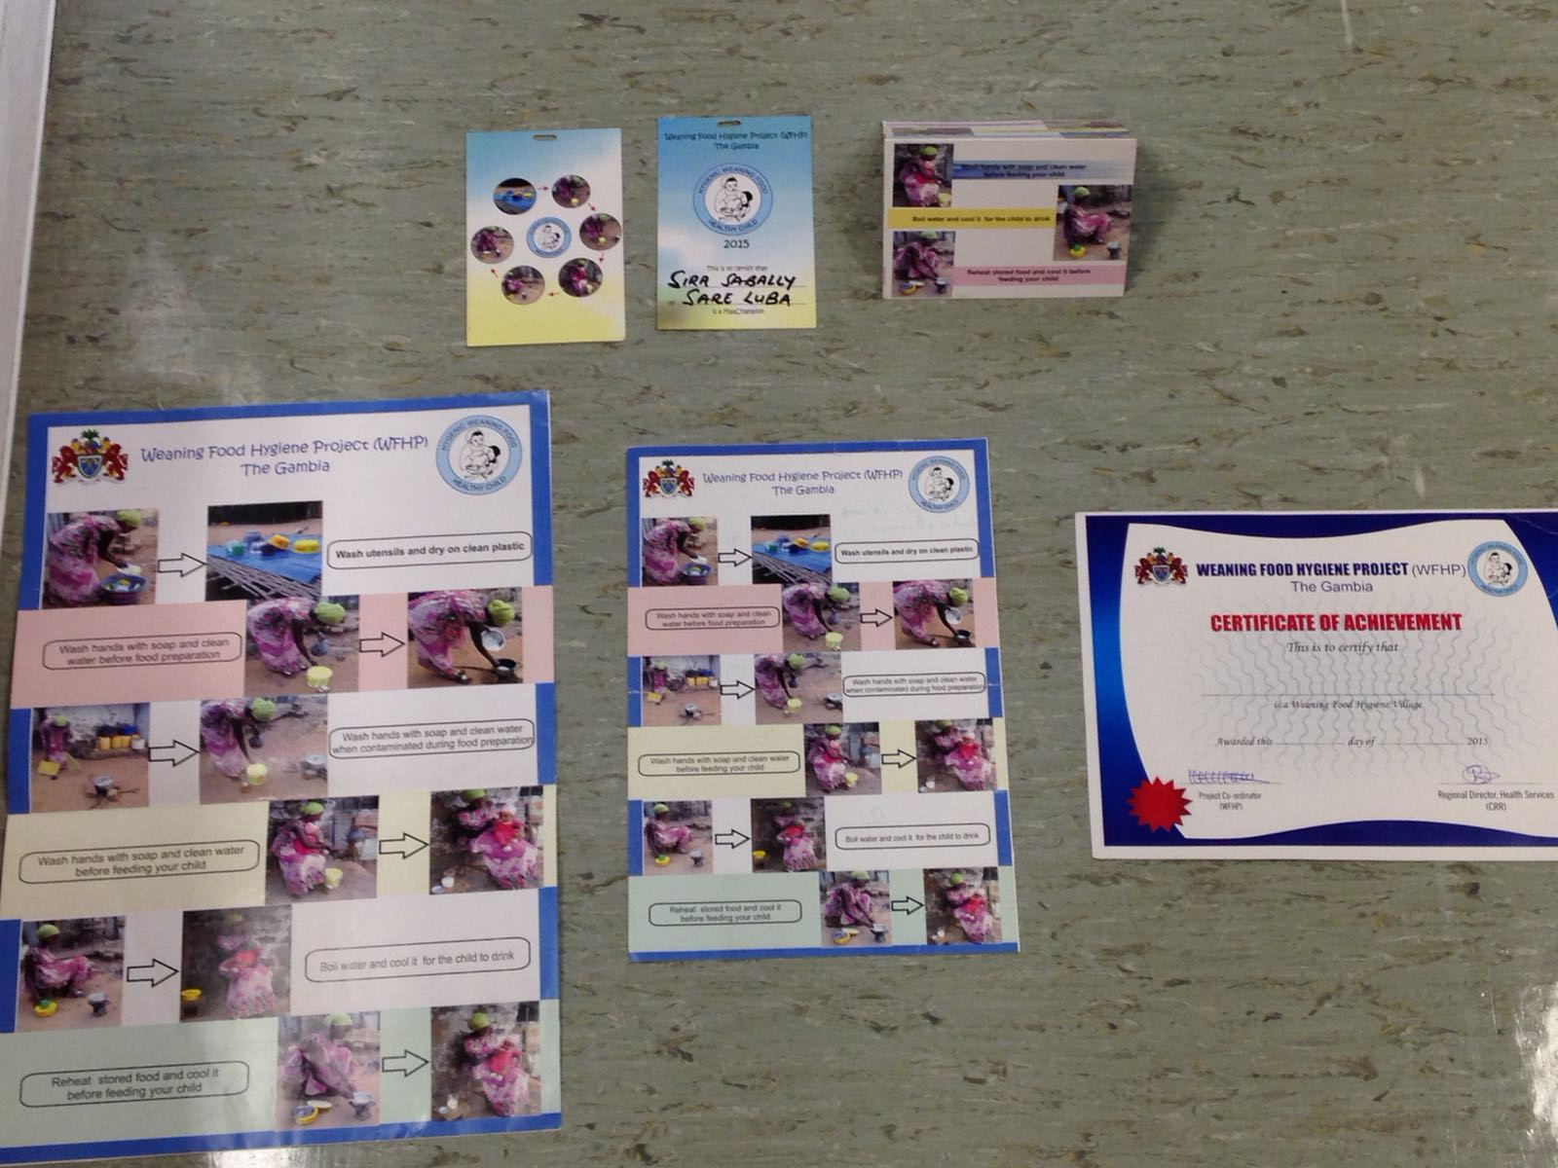
Different materials used: certificates, medals, instructions

Slide 15
Signage
Notes:
9a

Slide 16
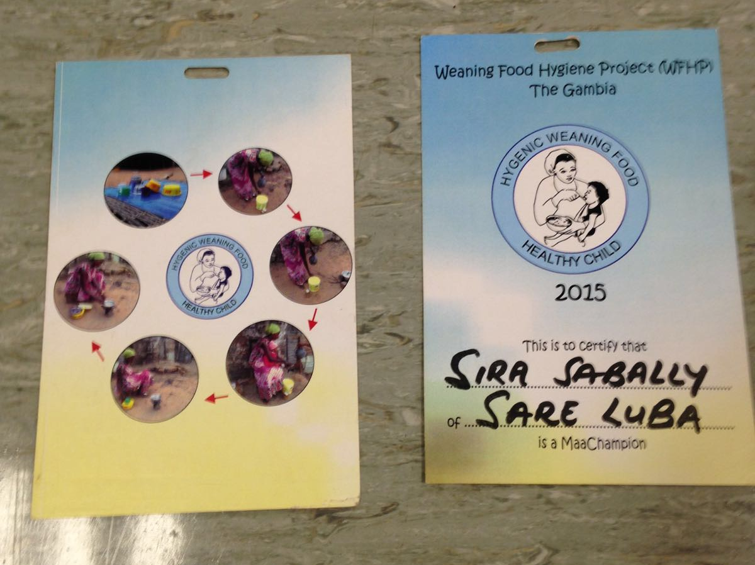
Medal example

Slide 17
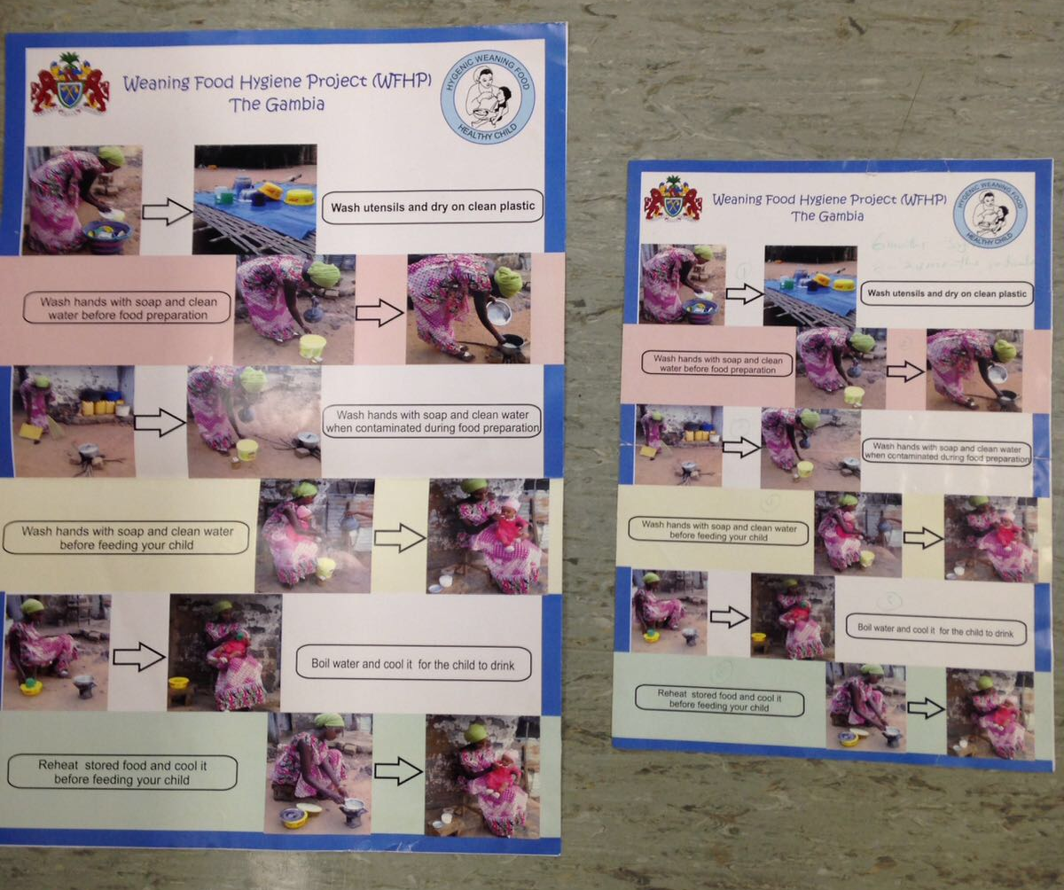
Poster of six corrective behaviours

Slide 18
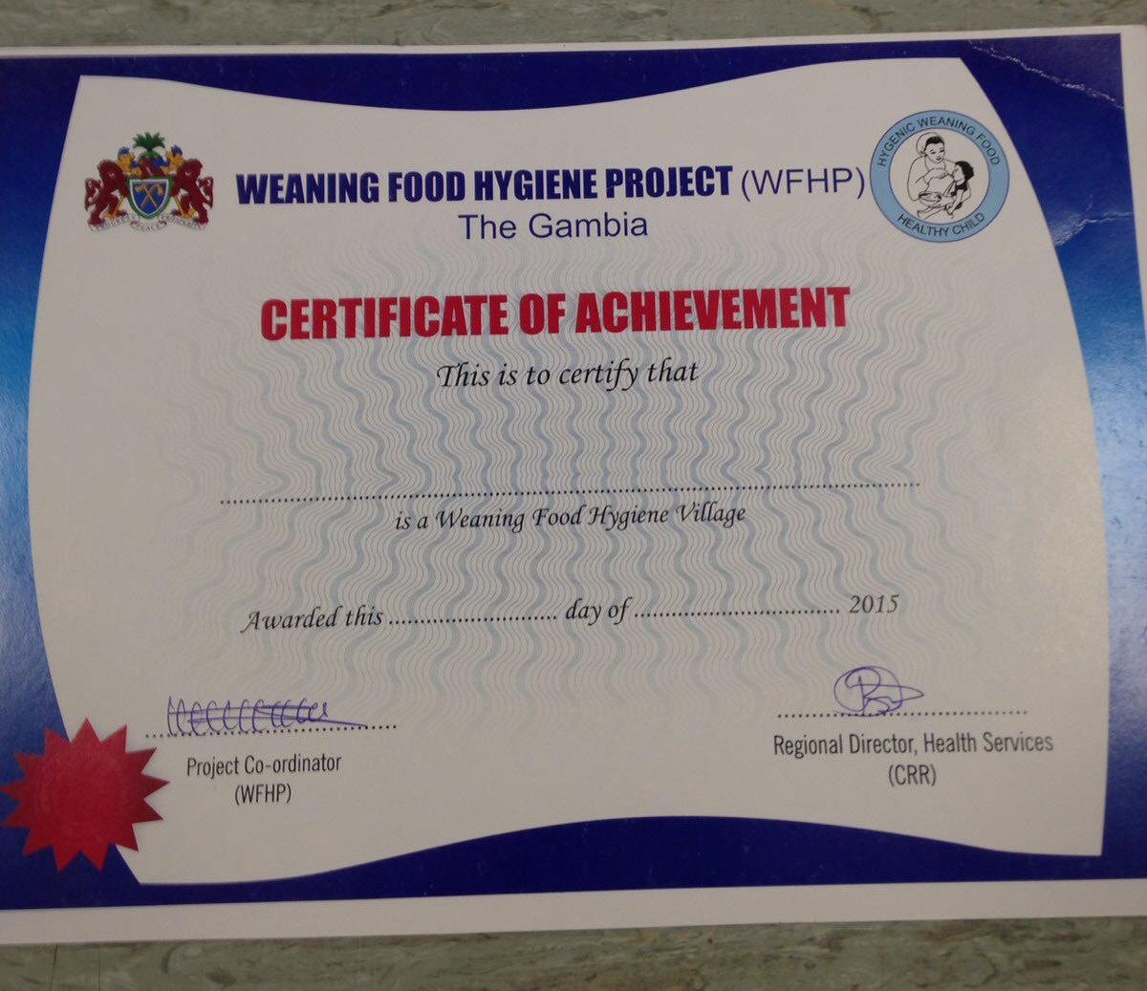
Certificate of Achievement

