Slide 1

Assistive Technology and Employment
Policy Landscape and Commission Updates

Slide 2




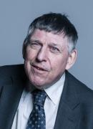



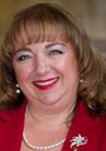
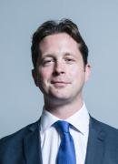
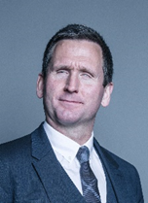


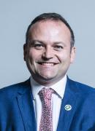
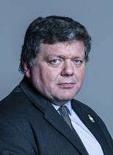

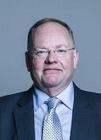
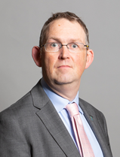
Parliamentary members of the APPGAT
Co-Chairs:
Lord Shinkwin
Lilian Greenwood MP

Slide 3
Policy Landscape – Disability and Employment
Health & Disability Green Paper
National Strategy for Disabled People
Centralised Employer Information Hub
Regional Stakeholder Network
Disability Confident (find a job)

Slide 4
Policy Landscape – Skills and further education
Skills and Post-16 Education Bill
Local Enterprise Partnership Review
Tech & Diversity – AI
APPG for Skills, Careers & Employment; Higher Education Commission; Skills Commission

Slide 5
AT and Transitions into Employment Commission
Impetus- Cliff edges and battles
‘Digital no longer optional’
Opportunity for cross-government buy-in
Education, unemployment, on-boarding

Slide 6
AT and Transitions into Employment Commission
Launch early July
Findings & Recommendations
Education-based work placements & AT
Careers Information Advice & Guidance
DSA to Access to Work
Unemployment, JCP, and the Work & Health Programme
Access to Work (experience) & Disability Confident
Government, Employers, and Education Providers
Impact work

Slide 7
Get involved & stay in touch
Regional Stakeholder Network
Policy Connect
Newsletter signups: policyconnect.org/get-involved
APPGAT Twitter: @AT_APPG
Skills & FE Twitter: @EduSkillsPC
Geena.Vabulas@policyconnect.org.uk

Slide 8

Supporters

