Slide 1

Lost in Transition? The post-school experiences of young people with vision impairment
Rachel Hewett and Graeme Douglas, VICTAR, University of Birmingham
Notes:
Final report can be accessed at: https://www.birmingham.ac.uk/Documents/college-social-sciences/education/victar/lost-in-transition.pdf

Slide 2
Vision Impairment Centre for Teaching and Research (VICTAR)
Department of Disability Inclusion and Special Needs (DISN), School of Education, University of Birmingham
Two research & teaching centres
VICTAR
ACER (Autism Centre for Education and Research)
Largest UK provider of Mandatory Qualification for Teachers of Children with Vision Impairment
Masters/PhD students

Slide 3
Overview
Current context and where we are coming from
Longitudinal Transitions Study: what does the evidence say?
What can we do about it?

Slide 4
1. Current context, and where we are coming from

Slide 5
Starting point
10+ year project
We wanted to know about young people’s transitions experiences from their adolescent years onwards. [linked to concerns in the literature].
Principles from the beginning: believing in a fair access to education, and education that prepares young people for life. [linked to principles and evidence in the ‘Vision Impairment Education’ literature]
In legislation these principles are captured in, e.g.:
Equality Act
DfE context (England): CoP and ‘Preparing for Adulthood’

Slide 6
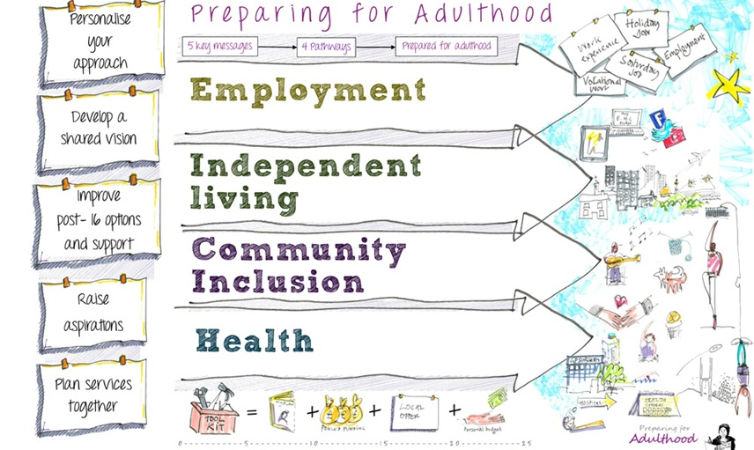

Preparing for Adulthood
Notes:
The DfE preparing for adulthood – focussing upon employment, independent living, having connections with one’s community, and understanding one’s health and health services
e.g. DfE resource on 19-25 EHC plan eligibility: https://www.gov.uk/government/publications/send-19-to-25-year-olds-entitlement-to-ehc-plans
During this time, the SEND Code of Practice (England), and parallel research in other countries, made increased reference to ‘independence’ as a critical outcome.
e.g. SEN Code of Practice (2001) --> SEND Code of Practice (2015) mention of key terms:
“Independence” as an educational outcome (3) --> (54)
“Outcome (for the young person) (17) --> (221)
BUT: “Curriculum/curricular (125) --> (25)

Slide 7
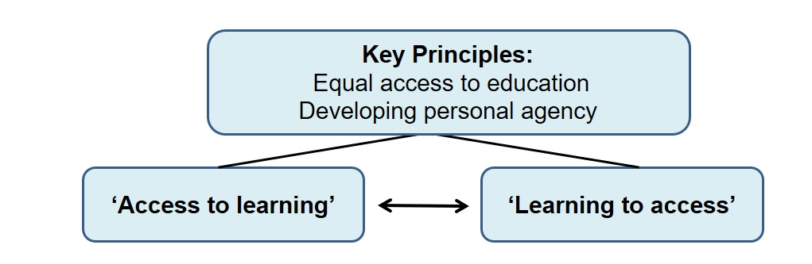
VI Education: ‘Dual access model’
Source: Welsh Government ‘rapid evidence assessment’ and ‘guide’
Douglas, G. and McLinden, M. (2019). Support for children and young people with vision impairment in educational settings. Cardiff: Welsh Government. Available here
Douglas, G., McLinden, M., Ellis, E., Hewett, R., Wooten, A., Ware, J., & Williams, L. (2019). A Rapid Evidence Assessment of the effectiveness of edcational interventions to support children and young people with vision impairment. Cardiff: Welsh Government, GSR report number 39/2019. Available here.
Notes:
Source: Welsh Government ‘rapid evidence assessment’ and ‘guide’
Douglas, G. and McLinden, M. (2019). Support for children and young people with vision impairment in educational settings. Cardiff: Welsh Government. Available at: https://gov.wales/sites/default/files/publications/2019-12/191209-support-for-children-and-young-people-with-vision-impairment-in-educational-settings.pdf
Douglas, G., McLinden, M., Ellis, E., Hewett, R., Wooten, A., Ware, J., & Williams, L. (2019). A Rapid Evidence Assessment of the effectiveness of educational interventions to support children and young people with vision impairment. Cardiff: Welsh Government, GSR report number 39/2019. Available at: https://gov.wales/sites/default/files/statistics-and-research/2019-09/effectiveness-educational-interventions-support-children-young-people-vision-impairment.pdf

Slide 8

Dual access model
Access to learning
Universal or ’inclusive’ teaching (accessible and modified materials, environmental audits and adjustments, peer and staff awareness training)
Learning to access
Concepts of independence and ‘specialist’ teaching (mobility, living skills, technology), additional curricula
And this defines how to conceptualise:
advice, intervention, school and service policy, university provision, employment strategies.
recommendations for IEP, EHCP, statement, etc.; or reasonable adjustment plan, APR, etc.
Helps us define what inclusion looks like.
Helps us define ‘what matters’

Slide 9
Access to Learning-Learning to Access
Child’s age / developmental level (Time)
Providing
‘Access to Learning’
Teaching
‘Learning to Access’
Increased development of independence
Notes:
Source:
McLinden, M., Douglas, G., Cobb, R., Hewett, R. and Ravenscroft, J. (2016). Access to learning’ and ‘learning to access’: Analysing the distinctive role of specialist teachers of children and young people with vision impairments in facilitating curriculum access through an ecological systems theory. British Journal of Visual Impairment, 34(2) 179–197.

Slide 10
Access to learning – Learning to access
Key Principles:
Equal access to education
Developing personal agency
‘Access to learning’
‘Learning to access’
Education intervention procedures include:
inclusive practice (e.g. peer training, environmental audits)
access strategies (e.g. accommodations, large print, models)
targeted curriculum interventions (e.g. literacy, cognitive skills, communication)
teaching support
Education intervention procedures include:
mobility
independent living skills
access technology
low vision training
social emotional functioning / self-advocacy
braille (linked also to literacy)
Source: Welsh Government ‘rapid evidence assessment’ and ‘guide’
Notes:
Source: Welsh Government ‘rapid evidence assessment’ and ‘guide’
Douglas, G. and McLinden, M. (2019). Support for children and young people with vision impairment in educational settings. Cardiff: Welsh Government. Available at: https://gov.wales/sites/default/files/publications/2019-12/191209-support-for-children-and-young-people-with-vision-impairment-in-educational-settings.pdf
Douglas, G., McLinden, M., Ellis, E., Hewett, R., Wooten, A., Ware, J., & Williams, L. (2019). A Rapid Evidence Assessment of the effectiveness of educational interventions to support children and young people with vision impairment. Cardiff: Welsh Government, GSR report number 39/2019. Available at: https://gov.wales/sites/default/files/statistics-and-research/2019-09/effectiveness-educational-interventions-support-children-young-people-vision-impairment.pdf

Slide 11
The challenge for the research:
Allman & Lewis (2014) sum up our educational goals neatly:
“Beginning with the end in mind”
“Focussing on the potential adult”
Gather evidence of how young people have experienced and made this transition from 14-16 to 24-26
How the systems have given them access to learning?
How the systems have taught them learn to access?
And how these have been balanced?
Notes:
Allman, C. B. & Lewis, S. (2014). ECC essentials: teaching the expanded core curriculum to students with visual impairments. AFB Press.

Slide 12
2. What does the evidence say?
Post-school transition journeys of young people with vision impairment, as captured through the Longitudinal Transitions Study

Slide 13
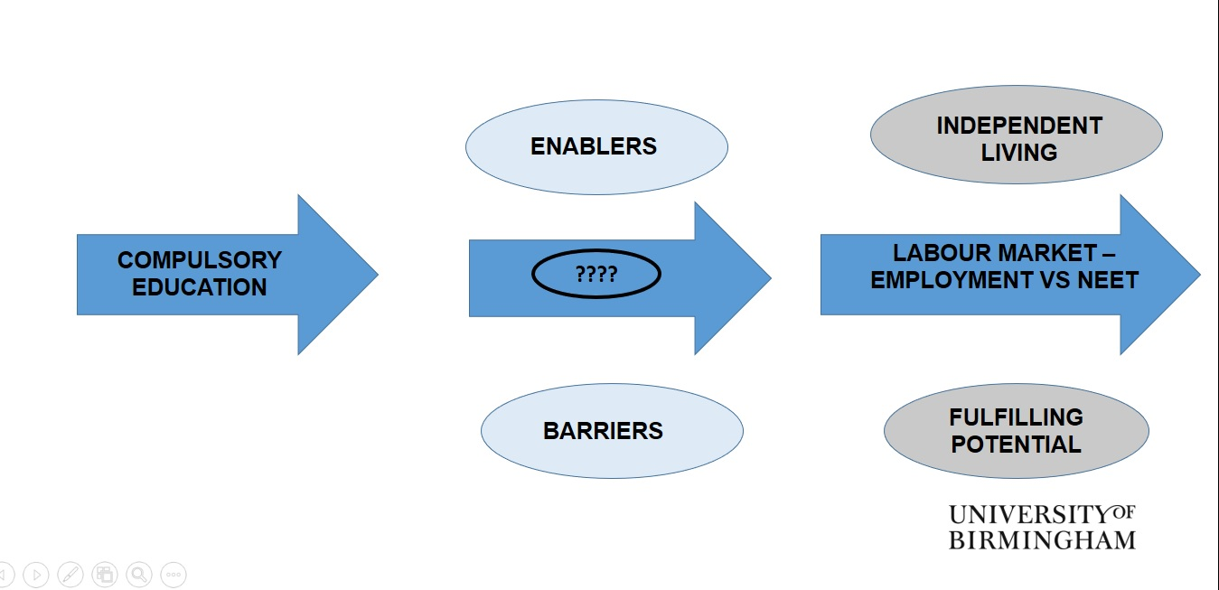
Aims of the Longitudinal Transitions Study

Slide 14

Introduction to the participants
In 2010 we recruited 82 young people:
aged 14-16 years
supported by service for their vision impairment
‘independently complete a questionnaire’
broadly representation of the overall population
supportive families

Slide 15

Research design
Longitudinal qualitative study
Participants interviewed 1-2 times a year
Tracked transition journey
Explored various themes, informed by literature
Telephone interviews, recorded, transcribed verbatim

Slide 16
Destinations after GCSEs
Sixth form/FE college
Apprenticeships
Higher Education
Labour market
School

Slide 17
Destinations after GCSEs
Where do young people with VI go after compulsory education?
Well educated (higher than national average) and optimistic
Many remained in education – sixth form, FE
Some into employment and apprenticeships
But increasingly:
Churning
Uncertainty about what to do next
Difficulties in identifying opportunities
Barriers in accessing support in FE

Slide 18
Higher Education
Sixth form/FE college
Apprenticeships
Higher Education
Labour market
School

Slide 19
Studying in Higher Education: “Jamie”
Notes:
Video can be accessed at: https://www.veed.io/download/635283b2-0afa-4e15-b1eb-3bd2d84f9e6e

Slide 20

Higher Education
Disabled Students’ Allowance
Extremely valuable scheme
Barriers to access
Lack of inclusion in HE
General inaccessibility
Limited understanding of VI
Lack of anticipatory adjustments
Exams
Outcomes
Majority successfully graduated, however…
Repeated years/modules
Restricted participation in other activities
Disabled Students’ Allowance
Extremely valuable scheme
Barriers to access
Lack of inclusion in HE
General inaccessibility
Limited understanding of VI
Lack of anticipatory adjustments
Exams
Outcomes
Majority successfully graduated, however…
Repeated years/modules
Restricted participation in other activities

Slide 21
Entering the labour market
Sixth form/FE college
Apprenticeships
Higher Education
Labour market
School

Slide 22
Searching for employment: “May”
Notes:
Video can be accessed at: https://www.veed.io/download/539814fd-57d2-4ade-93e6-851f442f1a03

Slide 23
Experiences of searching for jobs
Inaccessible application processes
Lack of understanding of VI from employers
Highlighted importance of self-advocacy skills
Limited skills for searching for jobs
Lack of knowledge of Access to Work/reluctance to use
Some reluctance to disclose VI

Slide 24
Becoming long-term NEET: “Eva”
Notes:
Video can be accessed at https://www.veed.io/download/b1de0451-9d37-4cab-9a2d-dcd415137634

Slide 25
Accessing support once NEET
Limited support available to help move closer to the labour market
Low aspirations from JobCentre Plus staff
Mixed experiences when accessing specialist services
Limited knowledge for supporting individuals with VI
Lack of support for developing specialist skills
Leaves young people with VI vulnerable to becoming long-term NEET

Slide 26
What helps improve transition outcomes?
Inclusive environments
Being able to draw on previous experiences
Broad range of skills for accessing information
Confidence in getting around independently in new areas
Self-advocacy skills

Slide 27
Advocating: “Stephen”
Notes:
Video can be accessed at: https://www.veed.io/download/c8f355b8-748f-4f44-9ac8-22021ba890ff

Slide 28
3. What can we do about it?

Slide 29

‘Lost in Transition’ report
See: Factors contributing to positive outcomes for young people with vision impairment
9 recommendations:
Some focus upon the (specialist) education services: protecting and defining; work experience opportunities
Some on developing target policies (existing and emerging): DSA, Access to Work; Job Centre Plus
Notes:
Source:
Hewett, Douglas, McLinden, Chattaway, Keil (2021). Lost in Transition? The post-school experiences of young people with vision impairment. University of Birmingham.
https://www.birmingham.ac.uk/Documents/college-social-sciences/education/victar/lost-in-transition.pdf

Slide 30
Challenges faced
Real material challenges faced by stakeholders, including specialist VI education services
Funding challenges
Policy challenges – emphasis of policies which demand schools being held to account for narrow attainment vs. preparation for – and the challenges “given the time constraints of the school day” (Wolffe and Kelly, 2011, p. 341)
Policy challenges – disconnection between EHC plans (England), DSA, Access to Work, and Job Centre Plus
Some of these are big and profound challenges – and subject to further campaigning
But there is more that can be done within the current systems
Notes:
Source:
Wolffe, K., & Kelly, S. (2011). Instruction in areas of the expanded core curriculum linked to transition outcomes for students with visual impairments. Journal of Visual Impairment & Blindness, 105, 340–349.

Slide 31

Resources
Access a range of resources on our impact page.
Work experience
HE
Transitions planning
Notes:
Source: https://www.birmingham.ac.uk/research/victar/research/longitudinal-transitions-study/impact.aspx

Slide 32
Resources
The biggest resource is what we already have – the sector, the young people, the parents, the services…
If we can coordinate that effort at the formal and informal:
Ensuring we have access to learning and learning to access
Ensuring we have the right progressive balance between the two
This is reflected in day-to-day inclusive practice
This is reflected in formal processes – e.g. IEP content
One powerful way of doing this is by making the service position clear – the ‘offer’
NATSIP have done some great work on this (e.g. the Learner Outcome Framework)
Ongoing development Specialist VI Curriculum Framework
Notes:
Sources:
NATSIP learner outcomes framework for VI children and young people - https://www.natsip.org.uk/doc-library-login/supporting-the-si-workforce/learner-outcomes-framework-for-vi-children-and-young-people/1070-report-learner-outcomes-framework-for-vi-children-and-young-people
Specialist VI Curriculum Framework –
https://viewweb.org.uk/specialistvicurriculum/

Slide 33
Education often works – and when it does… it’s transformative:
“The dignity of risk is one of the most important gifts we can give a child” Baroness Jane Campbell
“I can’t really emphasise how helpful she has been, to be honest. Because she has been consistent since when I was 14 all the way to now, she has always been a support through uni and everything, when I was at [college], finding me these work placements that I did, thinking about when I graduate, she was on the ball… She would help me with my job search and finding somewhere to live…” (Young person, LTP, sharing their experience of working with a Transitions Officer)
“I have been blind since I was 5, and I’m bloody good at being blind! It’s something that I do every day!” (Young person, LTP)
Notes:
Source:
Meet the 'Vulnerables': Baroness Jane Campbell. BBC mini-series, Meet The ‘Vulnerables’, 15 May 2020. Online:
https://www.bbc.co.uk/news/av/disability-52677134

Slide 34

Contact details
Rachel Hewett: R.G.Hewett@bham.ac.uk
@RachelHewettUoB
Graeme Douglas: G.G.A.Douglas@bham.ac.uk
VICTAR website: www.birmingham.ac.uk/victar

Slide 35

Acknowledgements
Our participants!
Funders: Thomas Pocklington Trust, Nuffield Foundation, RNIB
Sue Keil and Tara Chattaway
Steering group members
UCAN productions
Supporting Local Authorities and schools

