Slide 1
Vertical integration of GP practices with acute hospitals in England and Wales: rapid evaluation
Jon Sussex and Manbinder Sidhu
NIHR BRACE Rapid Evaluation Centre

Slide 2
Acknowledgement and disclaimer
This project was funded by the National Institute for Health Research, Health Services and Delivery Research programme (HSDR 16/138/31 – Birmingham, RAND and Cambridge Evaluation Centre).
BRACE, including this evaluation, is funded by the NIHR Health Services and Delivery Research (HS&DR) programme (HSDR16/138/31). The views expressed are those of the authors and not necessarily those of the NIHR or the Department of Health and Social Care.

Slide 3
Outline of presentation
Background
Methods
Findings
Discussion
Potential follow up impact evaluation

Slide 4
Background and scope
The evaluation reported here is of where organisations running acute hospitals have also taken on the responsibility for fulfilling multiple GP contracts. This has been happening in several locations in England and Wales, but it is not yet widespread practice.
This is an example of ‘vertical integration’ (VI): integration between organisations operating at different stages along the patient pathway.
Our rapid evaluation sought to understand the rationale and process of implementation of VI in England and Wales.

Slide 5
Evaluation aims
Aim 1: to understand the early impacts of vertical integration: its objectives; how it is being implemented; whether and how vertical integration can underpin and drive the redesigning of care pathways; whether and how services offered in primary care settings change as a result; and the impact on the general practice and hospital workforces.
Aim 2: to develop a theory of change (ToC) for vertical integration. Thus, identifying what outcomes this model of vertical integration is expected to achieve in the short, medium and long terms, and under what circumstances.

Slide 6
What is vertical integration?
An acute hospital taking responsibility for GP contracts
Integration between organisations operating at different stages along the patient pathway
So, why vertically integrate?
Redesign services
Improve governance
Reduce transaction costs
Efficient clinical pathways
Improve continuity of care for patients
Sustain primary care

Slide 7
Examples of vertical integration
Examples
Southwark and Lambeth Integrated Care (SLIC)
Northumbria Primary Care
The Alzira model
The Kaiser Permanente Community Health Initiative

Slide 8
Types of (vertical) integration
Organisational integration: organisations are brought together by mergers and/or structural change, or virtually through contracts between separate organisations
Functional integration: where non-clinical support and back office functions are integrated
Service integration: where different clinical services provided are integrated at the organisational level
Clinical integration: patient care is integrated in a single process both within and across professions, for example by use of shared guidelines
Normative integration: shared values in coordinating work and securing collaboration in delivering health care
Systemic integration: coherence of rules and policies at all organisational levels

Slide 9
Literature review: evidence base about vertical integration is thin
Findings of a 2009 study in the UK:
Some evidence of strengthened partnerships [between the integrating organisations] …
Some reports of improved capacity, for example personnel
Improved focus on governance and adherence to guidelines
Little evidence of impact on health outcomes
Limited evidence of impact on cost
Ramsay A, Fulop N, Edwards N. The evidence base for vertical integration in health care. J Integrated Care 2009;17:3–12.

Slide 10
Methods for the evaluation
Work Package 1
Rapid review of literature
Telephone scoping interviews
Work Package 2
Interviews (N=52)
Non-participant observations (N=4)
Work Package 3
Analysis and synthesis: case specific
Analysis and synthesis: overall
Design workshop
Document review

Slide 11
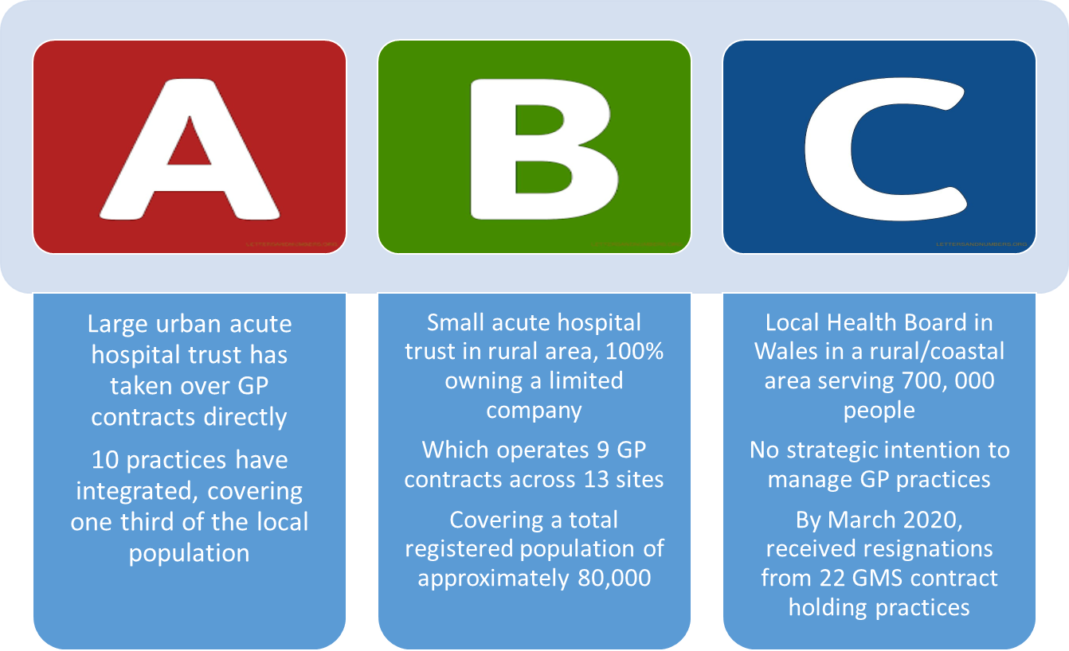
Sites

Slide 12
Discussion
Vertical integration as a concept (both theoretically and in relation to health policy)
Vertical integration in the context of the NHS and general practice

Slide 13
Overall study findings
The main rationale across the three case studies is to sustain primary care by supporting local GP practices that are in financial and recruitment difficulties, and thereby manage demand effectively and efficiently across primary, secondary, and community care
Early implementation centred on achieving functional integration, as distinct from clinical integration
Closer integration was attributed to previous good relationships between primary and secondary care locally, and to historical planning and preparation towards integrated working across the local health economy
VI may have a role as a route to better integration of patient care, at least in some areas
The inevitable corollary of salaried GPs replacing independent GP contractors is a loss of autonomy for GPs
Transitioning to VI imposed a significant requirement on acute trust/LHB staff, who are used to operating in large organisations focused on secondary care, to learn about and understand the practicalities and the culture of running primary care
Improving care pathways, and the efficiency of the local health economy, for patients who are high users of emergency secondary care and/or living with complex or multiple morbidities, was a particular focus at 2/3 sites

Slide 14
Understanding the need for and purpose of acute hospital integration with primary care
“it was quite apparent there was several practices that would fold, because – well, as you’ve heard a million times before – so elderly GPs having to retire, no one to take over the practice, or no desire to move it forward. Expensive locums to fill people, long-term vacancies.” (B14)
“I think there’s always been a concern about the big monster, which is the trust, so it’s about being engulfed into an organisation and losing to some degree your autonomy. So the one advantage of being a partner and being a GP is it’s your business; you’re autonomous.” (A15)

Slide 15
Developing an integration model and implementation strategy
“So within one of the normal teams, there’s – depending on the hours that they work – sort of perhaps one and a half full-time equivalent GPs. We have nurse practitioners, possibly some ANPs [advanced nurse practitioners] involvement, there’s an occupational therapist linked to that, a pharmacist and then we also have a team coordinator, who tries to manage the team’s work” (C09)
“the practices that had joined seemed to be those that have had difficulty recruiting staff and therefore were struggling generally; they’ve had problems with their estates maybe and felt that the hospital could help them with that, and that seems to have been the main driver for people moving. The practices that are quite stable, are happy running their own businesses, seem to be making money, having no staff problems, don't seem to be that interested.” (A12)
“they’re looking at the PCN holding the GMS [contract] for all of our practices, so they’re looking at one GMS contract for the PCN, which is all the VI practices.” (A17)

Slide 16
Transitioning: from GMS to sub-contracted providers of primary care
“The way it [the new contractual arrangement] was actually created was a bit kind of Byzantine …” (B15)
“For example, health and safety, I know that provided a lot of challenges. A lot of the estate is not up to scratch. Now the health board’s taken liability for that and not the GMS partners.” (C03)
“They didn’t really understand primary care … they're jumping to something, but they didn’t really know how to run it.” (A03)

Slide 17
Impact on patient management: changes to primary care and secondary care delivery
“They (patients) don't always have to see a doctor, but some people have got it in their head they’ve got a problem, they need to see a doctor. So it’s educating, trying to educate the patients as well.” (C08)
“It’s like a dashboard, so it tells us what patients have been admitted overnight, what procedures they’ve had done, and we get a copy of that each day and the GPs look at it and think, ‘Oh, Mrs so-and-so was in there last night; I might give her a call and see if she’s OK.’ So it links the care up better.” (A02)
“No, I think … it feels like a – I won't say a missed opportunity – it feels like an opportunity we haven't yet grasped.” (B15)

Slide 18
Measuring success and identifying unintended impacts
“We’ve recruited something approaching 40 GPs in the last two and a half years, but not one single one of them is full time.” (B03)
“So, personally, primary care has probably been underfunded. If we had to put in a certain amount of money into a practice, lose a bit of money on the practice, but it makes it a better practice that supports people that are frail, that diverts patients from A&E, all those good things, if we spend a bit of money on that, that’s great. So that probably is value for money.” (A13)
“And one of the huge differences is the onus on the GPs working within the practice to take on clinical leadership, such as they would do were they partners, and not just turn up and see the patients, as they would do under a salaried GP contract. So I think the big – for me, one of the huge – differences is that establishing clinical leadership within the practices.” (C03)

Slide 19
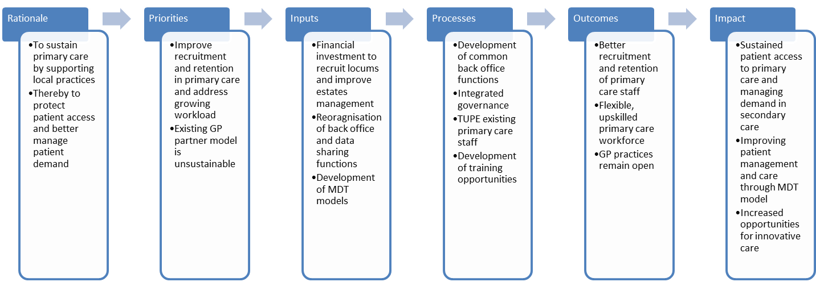
Overall VI ‘theory of change

Slide 20
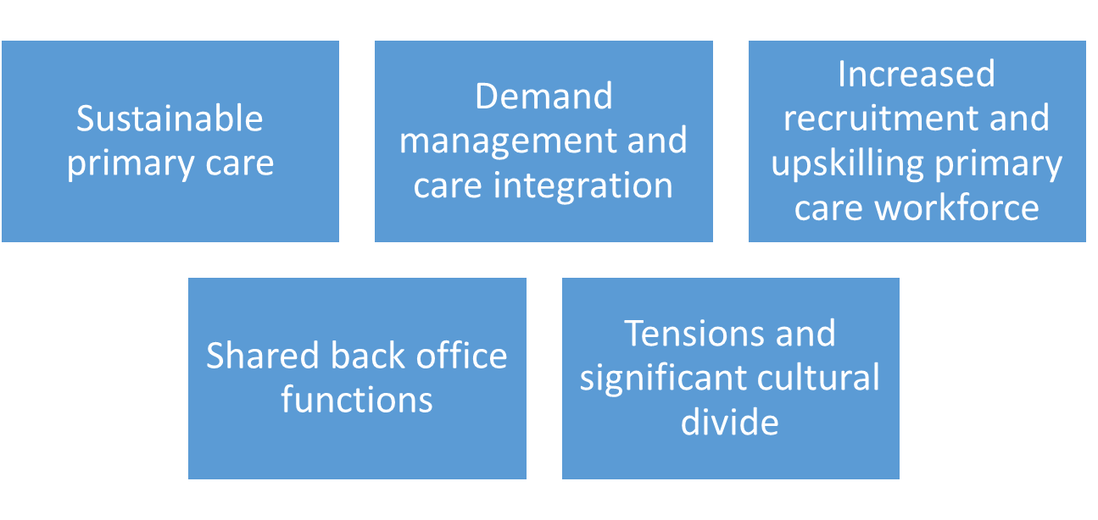
Overall conclusions

Slide 21
Possible further evaluation from mid-2021
The VI sites are pioneers and are being approached by others to learn about such models
Net impact of VI on health system costs is argued by local stakeholders to be beneficial but that remains to be demonstrated robustly
We propose a follow-up evaluation across ≈3 sites, quantitative and qualitative, potentially to address:
Is VI improving recruitment and retention of primary care staff?
To what extent has there been service redesign as a result of the VI arrangement, as distinct from horizontal integration via PCNs?
What are the views of patients in relation to their experience of accessing primary care services?
Are these views different for patients with multiple morbidities?
What impact is VI having on secondary care service utilisation (A&E admissions, re-admissions, length of stay in bed-days) and patient access (GP and practice nurse appointments) to primary care?
Is this impact different for patients with multiple morbidities?
Are there economies of scale in provision of back-office functions?

Slide 22
Thank you
For any questions relating to this presentation please email:
jsussex@randeurope.org or m.s.sidhu@bham.ac.uk
More information about BRACE can be found at: https://www.birmingham.ac.uk/research/brace/index.aspx

