Slide 1
Citizen Power and Housing Some reflections on community action and housing renewal in Birmingham in the 70s and 80s
November 2017
Jon Stevens and Colleagues

Slide 2
Prelude
In 2013, an event held to celebrate 40th anniversary of Community Forum
Forum was a network of community groups that helped to shape Birmingham’s ground-breaking Urban Renewal programme
‘Residents Renewing Their City’ is an account of those years

Slide 3
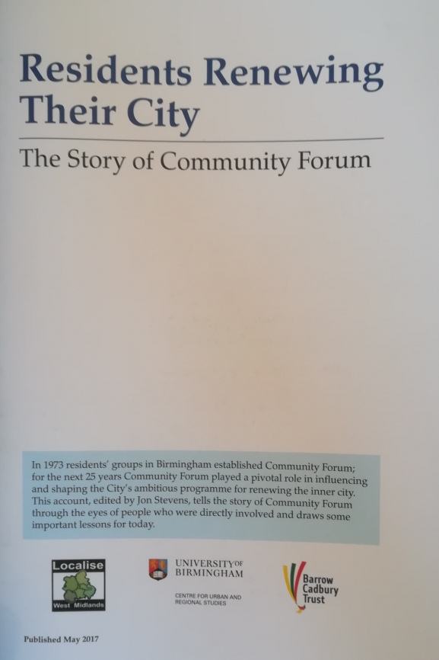

Slide 4
Disengagement and neglect
Inevitably the event raised questions about the complete retreat of government from intervention in areas of older housing
It also led to a number of spin-offs which looked at how community-led renewal might happen today
Grenfell Tower highlights the peril of disengagement and neglect

Slide 5
Contents
The post-war housing settlement
The rise of radical planning and community action in Birmingham
A comprehensive approach to market intervention: Urban Renewal
The role of Community Forum
The retreat from intervention: the inner-city abandoned?
Ways forward: discussion points

Slide 6
The post-war housing settlement
Tackling the post-war housing crisis
Successive Governments invested in major programmes of Council house building from the 1940s until 1980s
Further support for low-income owner-occupation from the 1960s
Plus a regulated and controlled PRS
Housing viewed as a national asset

Slide 7
Limits of state-led approaches
Controlling the onward march of the ‘bulldozer’: redevelopment vs improvement
The limitations of technocratic and managerial housing solutions
The social costs: the break-up of communities and the need to tackle the roots of poverty

Slide 8
Some faultlines
The Maudsley, Poulson and T Dan Smith scandals - the politics of mass housing exposed
The collapse of Ronan Point - echoes of Grenfell Tower
‘Cathy Come Home’ and the birth of Shelter - people as pawns

Slide 9
An emerging analysis
The statist/corporate nature of the planning system and of ‘enforced modernism’
The flaws of the political system and weaknesses of representative democracy
The limitations of traditional forms of working class resistance

Slide 10
The rise of community action
A grass-roots urban political movement from the late 1960’s
Centered on ad-hoc local action groups/projects
Based on new coalitions of local interests ref. community organising
Often supported by radical professionals ref. advocacy planning

Slide 11
Some Government responses
Incremental housing renewal; combined redevelopment and improvement
Public participation in service planning/delivery?
Targeted resources for deprived areas
New housing models and agencies

Slide 12
Stirrings in Birmingham
Around 1970, a group of radical planners formed Community Planning Associates
Aimed to take planning to the people via local campaigns/projects + a regional network via ‘West Midlands Grass Roots’
With others, inc. CURS, they developed new strategic approaches and methods of practice

Slide 13
This created a new platform
For debate and engagement with the ‘local state’
With a focus on housing policy and on participative approaches to urban regeneration
That helped to shape a major rethink on housing strategy in the early 1970s

Slide 14
Developing a new strategy
CPA participated in Birmingham’s 1972 Urban Renewal Conference
Made the case for real community involvement and for integrated and responsive service delivery
Strengthened links between local politicians and leading community activists
A progressive coalition

Slide 15
The Urban Renewal Programme
A comprehensive redevelopment/ improvement strategy covering the whole inner-city for next 25 years
Public launch in 1973; followed by an extensive promotion/consultation process
Commitment made to area-based, locally accountable forms of delivery

Slide 16
Establishing a community forum
The strategy proposed a ‘community forum’ to bring together groups from across the city to influence and shape the policy
CPA worked with the Council to establish the forum
Importantly they secured independent (and long-term) funding

Slide 17
The importance of Project Teams
Central plan (with a dedicated UR committee/central team) to be delivered by 8 Project Teams
Each had a degree of local decision-making + devolved budgets
Each developed a local basis for engagement/participation
Each worked with local resource agencies and emerging community-based housing associations

Slide 18
An holistic approach to delivery
Multi-skilled inter-departmental teams; including EHO’s, architects, planners, housing officers, ethnic liaison workers etc.
Range of services/functions from grant administration to large-scale improvement programmes to neighbourhood planning…
Support for community-led initiatives and projects eg. area caretakers

Slide 19
A city-wide residents’ network
In 1974, Community Forum was launched as a city-wide network of residents’ groups and local agencies
The network grew rapidly with strong leaders/committee and dedicated worker/s
Secured formal liaison arrangements; giving Forum input into strategy making and reviews of progress

Slide 20
Campaigning
Liaison had its limits
Forum launched a succession of campaigns on:
Tackling cowboy builders
Enhancing Enveloping
Addressing the needs of Council tenants
As time went by, participation became more embedded in the process

Slide 21
Diversifying
As Government policy/resources shifted in the 1980’s Forum changed its ways of working
National connections and international forays
Community-led research/action: meeting the challenge of clearance
New ways of organising; Birmingham for People

Slide 22
The demise of Urban Renewal
From late 1980’s with the ascendancy of neo-liberalism, the Government retreated from housing market intervention and regulation
Under pressure, the Council abandoned many of the principles/ practices that underpinned Urban Renewal
Whilst civic leaders embraced ‘entrepreneurialism’ and neglected service delivery

Slide 23
A decline in city-wide activism
Without a programme and with reduced Council support, community groups and networks lost impetus
This eroded Forum’s base and led to reduced activity
The Council returned to historic strategies of incorporation/tokenism and/or divide and rule

Slide 24
Urban Renewal 40 Years On
Following 25+ years of market intervention, the inner-city is once again in decline
The private rented sector has returned (with a vengeance)
The local authority has been in retreat and housing associations have largely moved on
Social polarisation and fragmentation is on the increase

Slide 25
Some ways forward
Post-Grenfell, the case needs to be forcefully made for a national housing strategy that embraces housing renewal ref. the work of the APPG
Meanwhile, the Council should develop a new kind of housing renewal strategy: one that is localised, collaborative and which mobilises all possible resources

Slide 26
Some ways forward
The Council urgently needs to tackle abuses in the PRS sector; using all of the means at its disposal (inc. a city-wide self-funded licensing scheme)
Local delivery partnerships should be formed; with a sustained commitment from housing associations to re-engage and to support community-based housing initiatives

Slide 27
Some ways forward…
Above all, we need to create new forms of community organising and engagement & new models of local control with secure sources of funding
A tall order perhaps, but ‘citizen
engagement’ is beginning to gain
greater traction

