Slide 1


Slide 2

Conference Exhibitors

Slide 3
Do you want to communicate with others on campus about teaching and learning? Subscribe to ‘HEFi-OPEN’, a JiscMail mailing list service:
https://tinyurl.com/y3wczmyh
Use it to:
share teaching ideas and resources, look for collaborators
find out about development opportunities related to teaching and learning
ask questions about how others teach and support learning
build and strengthen links within the teaching community

Slide 4
Parallel session 4A: Employer Led Learning
4.1 The equality challenge for employer-based learning Lesley Batty, GEES, University of Birmingham
4.2 Pathways for Reflexivity: Designing a Blended Level 7 Executive Apprenticeship in Public Management and Leadership Karin Bottom, Stephen Jeffares, Catherine Mangan and Louise Reardon, Institute of Local Government Studies, University of Birmingham
4.3 Future Work and Creativity: A study of employers’ interpretation of creativity in the workplace and the implications for student learning Employer-led learning Elaine Clarke and Chris Wilson, Aston Business School, Centre for Learning Innovation and Professional Practice, Aston University
4.4 Transforming learning through commercial challenge-led projects Jess Power, School of Creative Arts and Engineering, Staffordshire University

Slide 5
The Equality Challenge for Employer Based Learning
Lesley Batty, School of Geography Earth and Environmental Sciences

Slide 6


Work based learning
Work placements (including sandwich years)
Internships
Volunteering
Fieldwork
Job shadowing
The relationship between academic performance and placement experience is confounded by the tendency for more capable students opting to complete placements (Bullock et al 2009)

Slide 7

What are the barriers to students engaging with work based learning?
International students-confidence, visa requirements, language
Students with disabilities (declared and undeclared)
Students with caring responsibilities
Students with little financial support
Students who are less confident (this can be related to a number of factors)
Students who have experienced extenuating circumstances
Students who are not achieving high grades
First generation
THERE IS VERY LITTLE (IF ANY) LITERATURE ON THIS
…insufficient attention to matters of equity and access to WIL (Australian Learning and Teaching Council 2011)

Slide 8

Not just students…
Charities
Small companies
New organisations/companies
Local organisations

Slide 9
Year 3 Professional Placement Module
20 credits
Semester 1-preparation
Semester 2-placement
Placements organised by module lead or student
All based in and around Birmingham
Assessed by a report and reflective piece

Slide 10

How have we addressed equality/equity?
Integrated placements into the curriculum
Removed any grade requirement for signing up to the module
Run workshops on CV writing and interview techniques
Run interviews with staff from within GEES
Ensured that each student has an academic supervisor
Provided funding for travel

Slide 11
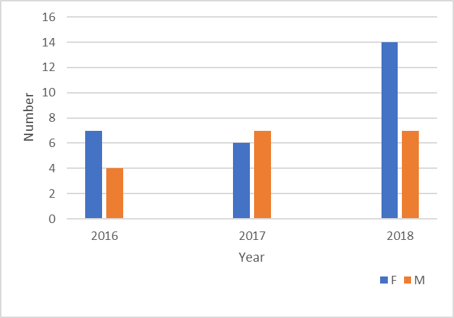
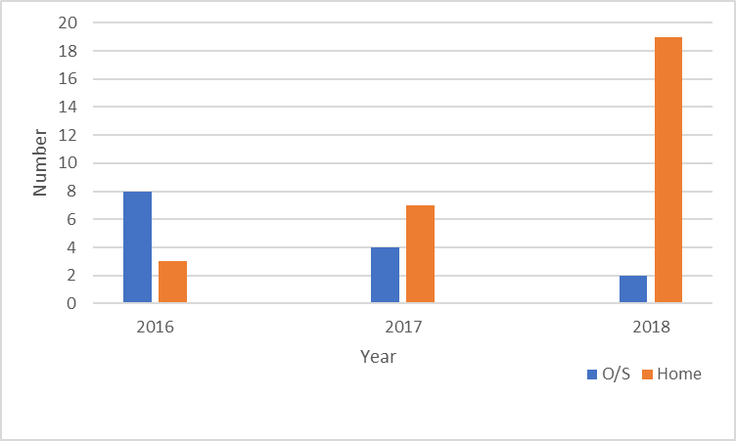
Students
Last 3 years:

Slide 12
Feedback
‘being able to network with the support of x’
‘ I liked having to write a mock cover letter and interview…helped for application after graduation’
‘I learnt a lot about UK politics, government and professional working environment, which is utterly different from my home country’
‘scope and versatility to suit a range of students, helping them to achieve their individual goals’
‘the placement improved me a lot’
The two placements I had were fantastic..have really helped me kick start some things here
I will be utilising his project work as part of writing a Short Statement as part of PHE’s responses’

Slide 13
Where next?
Using technology to support placements
Pebble pad
Discussion boards
Introduction of Group tutorials
How to be more proactive in attracting all students
Working with Leonard Cheshire

Slide 14
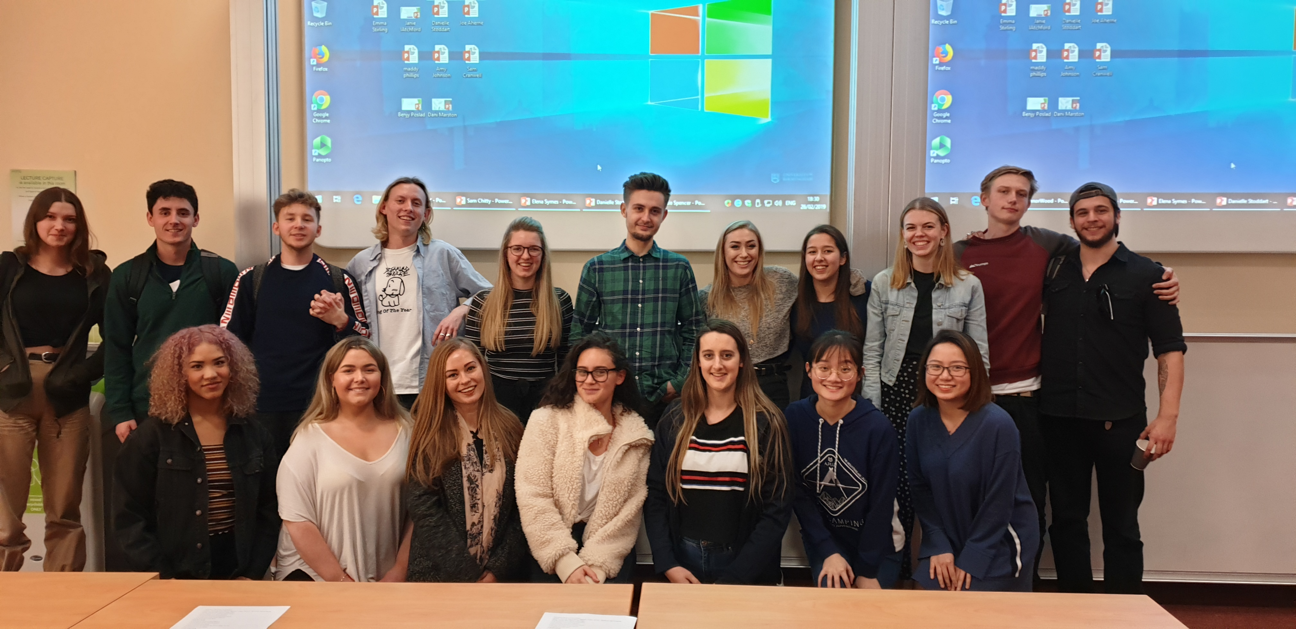
Thankyou!

Slide 15
Do you want to communicate with others on campus about teaching and learning? Subscribe to ‘HEFi-OPEN’, a JiscMail mailing list service:
https://tinyurl.com/y3wczmyh
Use it to:
share teaching ideas and resources, look for collaborators
find out about development opportunities related to teaching and learning
ask questions about how others teach and support learning
build and strengthen links within the teaching community

Slide 16
Parallel session 4B: Addressing Inequality
4.5 The Interdisciplinary Birmingham Engineer: Integrated Design Projects that embed sustainability concepts to inspire and motivate students while improving their employability Withdrawn
4.6 Challenging Teaching Practice: considerations about HE education development programmes Erika Corradini, Centre for Higher Education Practice, Faculty of Social Sciences, University of Southampton
4.7 Embedding Entrepreneurial Skills and Employability into the Academic Curriculum Mircea Scrob and Matt Edwards, Liberal Arts and Natural Sciences, University of Birmingham
4.8 Development Skills for the Future: Mentoring in Schools on the Curriculum at Cass Business School to Drive Social Mobility Rob Compton and Paul Palmer, School of Management, Cass Business School, University of London
4.9 Interdisciplinary collaborative network to support innovation and increased diversity in energy teaching Grant Wilson and Claudia Favero, School of Chemical Engineering, University of Birmingham

