Slide 1


Slide 2

Conference Exhibitors

Slide 3
Welcome
Professor Kathleen Armour
Pro-Vice-Chancellor (Education)
University of Birmingham

Slide 4

WiFi:
Network: uobevents
Password: uniofbham
App: Convene app – scroll down to HEFi2019
Twitter: #HEFi19

Slide 5
Keynote Speaker:
Addressing Economic Inequalities
Professor Karen Rowlingson
Professor of Social Policy
University of Birmingham

Slide 6
Parallel session 3A: Addressing Inequality
3.1 Using Pebblepad as a tool for portfolio based assessment Sarah-Jane Fenton, Paul Dyson and Dr Marios Hadjianastasis, Institute for Mental Health, School of Social Policy, University of Birmingham
3.2 Inclusive Curriculum Development Lucy Atkins and Richard Hall, Freedom to Achieve, De Montfort University
3.3 Transition into University for students with BETC and ‘non traditional’ qualifications Dan Herbert and Rob Fleming, Birmingham Business School, University of Birmingham; Rebecca Morris, School of Education, University of Warwick; Rebecca Morris and Helen Mackenzie, School of Education, Loughborough University
3.4 Finding the expert within: teaching in more inclusive ways Els Van Geyte, Higher Education Futures Institute; Rina De Vries, Birmingham International Academy, University of Birmingham

Slide 7
Using PebblePad as a tool for portfolio based assessment
Sarah-Jane Fenton*, Paul Dyson, Marios Hadjianastasis
Notes:
Title that belies my real interest in student mental health and inclusive assessment practices.

Slide 8
Overview of presentation
Why assess differently?
What did I do differently?
What were the results – what was the feedback from students?
Overall conclusions
Ethical approval received by the University of Birmingham Humanities and Social Sciences Ethical Review Committee – For study: Researching secondary data: student assignments and module feedback – to look at innovation in HE teaching practice (ERN_19-0622)

Slide 9
Why assess differently?
We know that mental health is an increasing concern within Higher Education settings^{1,2}. There is currently no research exploring how to design assessment methods to better support students.
Portfolio-based learning is not in and of itself new, nor is reflective practice⁴. However, student led portfolio development with reflection built in is more common in applied programmes such as social work or nursing^{5–7}. Although e-portfolios are being developed, these are not commonly used within existing Higher Education teaching for assessment^{8.}
We know assessment is a key trigger point for stress in students³. Some students find assessment disproportionately stressful. Students reported to me that even where they could take papers away to complete, the requirement to perform in a certain time frame was unsuitable for those students experiencing a period mental ill health.
Notes:
E-portfolio assessment challenges the dominant monolithic structures (predicated on things such as being well enough to sit exams), which potentially disadvantage particular groups of students. This paper considers the benefits of e-portfolio assessment in relation to addressing inequalities (mental health and wellbeing) through enabling students to manage their own work and deadlines around their needs.
Examinations were found to be the biggest concern for students. An overwhelming 90% of students reported this caused them more stress than expected. Less than 2% reported exams and assessments did not cause them stress at all.

Slide 10
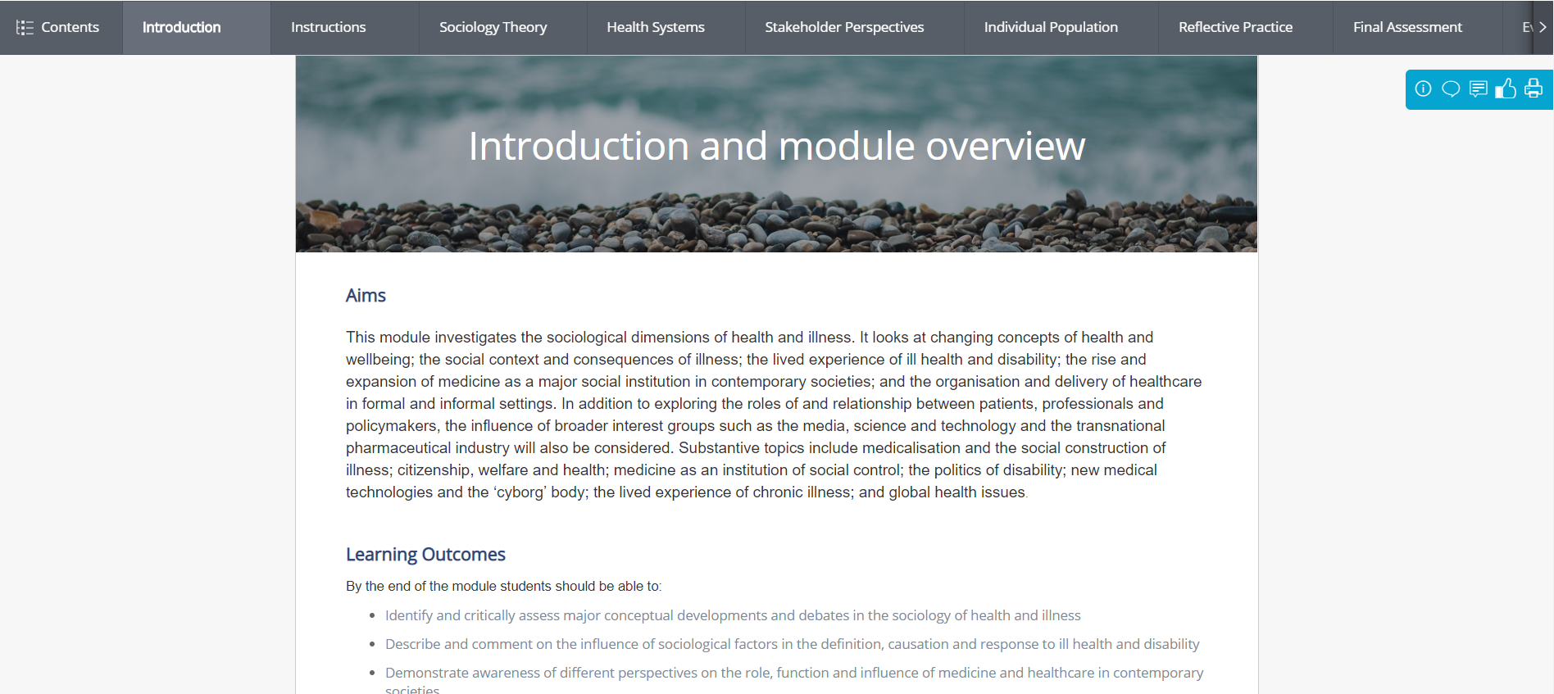
Using PebblePad as a tool for portfolio-based assessment
Reflective practice task
Ribbons

Slide 11
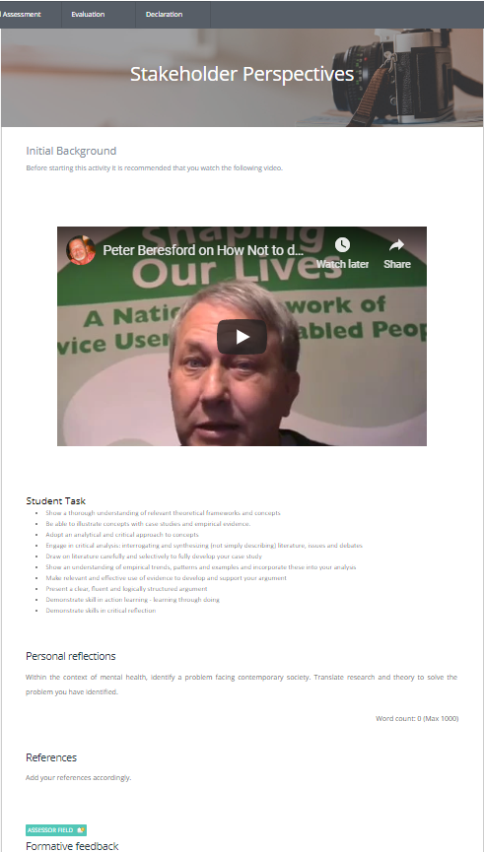
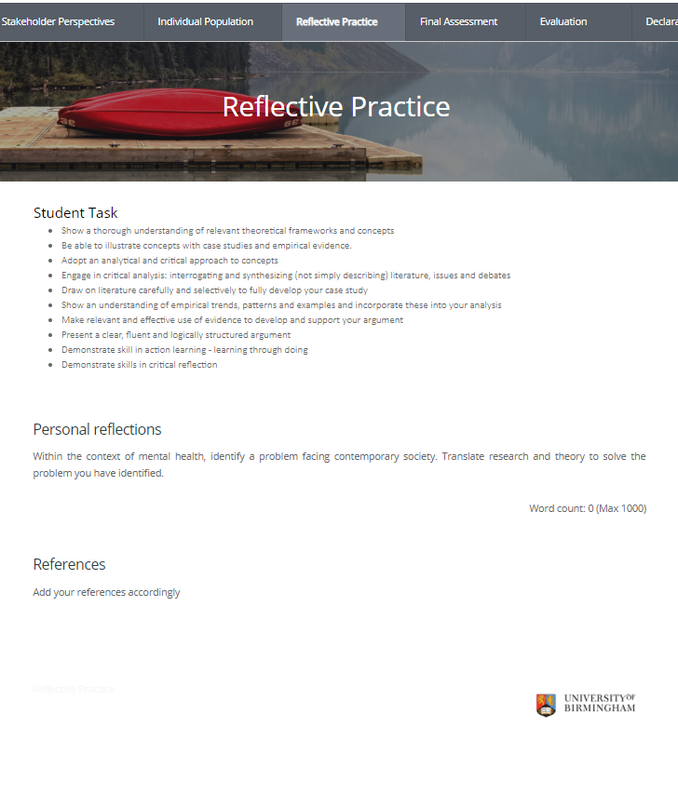
Patchwork assessment model
The case study will have five components that map onto the module outline:
Sociology Theory - 1000 words (with formative feedback)
Health Systems - 1000 words (with formative feedback)
Stakeholder Perspective - 1000 words (with formative feedback)
Individual Populations - 1000 words
Reflective Practice - 1000 word
The first three components have the opportunity for formative assessment to be submitted.
The approximate total word count for all components will be 5000 words.
Your final submission will be processed through Turnitin.

Slide 12
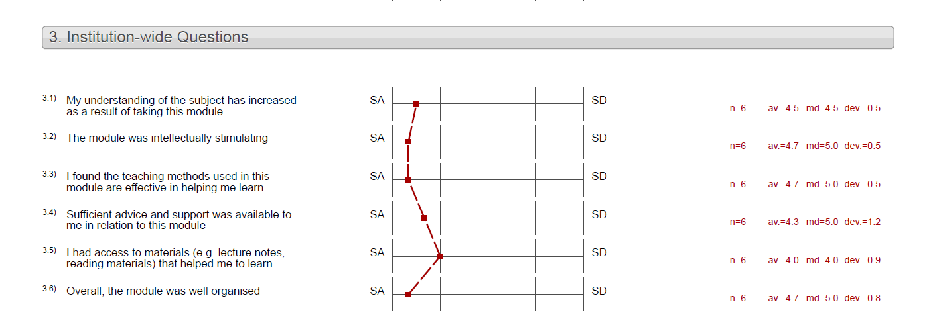
Feedback from students
Formal feedback
Informal feedback
The student feedback at regular intervals during the course helped indicate where things needed tweaking in relation to understanding how to complete the formative assignments etc.

Slide 13



Positive outcomes from the change in assessment
Majority of student feedback was positive
Other benefits/positive outcomes:
The quality of the work produced was generally good and marks were broadly consistent with previous years
The formative pieces gave me as a lecturer a real sense of where material was clearly understood and where things were unclear, and helped me engage with the students
Notes:
Other benefits:
1) Headed trouble off at the pass

Slide 14
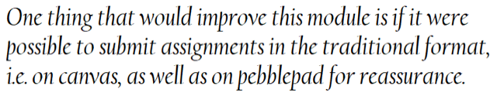
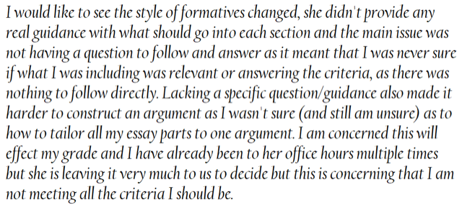
Critiques of the change in approach to assessment
Student critique: adapting to new technologies or approaches to learning
Student critique: Independent critical enquiry through case versus traditional essay/exam based assessment techniques
Colleague critique: raised concerns about the intensive formative approach
This would not necessarily be suitable where you are the sole module lead responsible for marking with large cohorts – but it is not impossible!

Slide 15
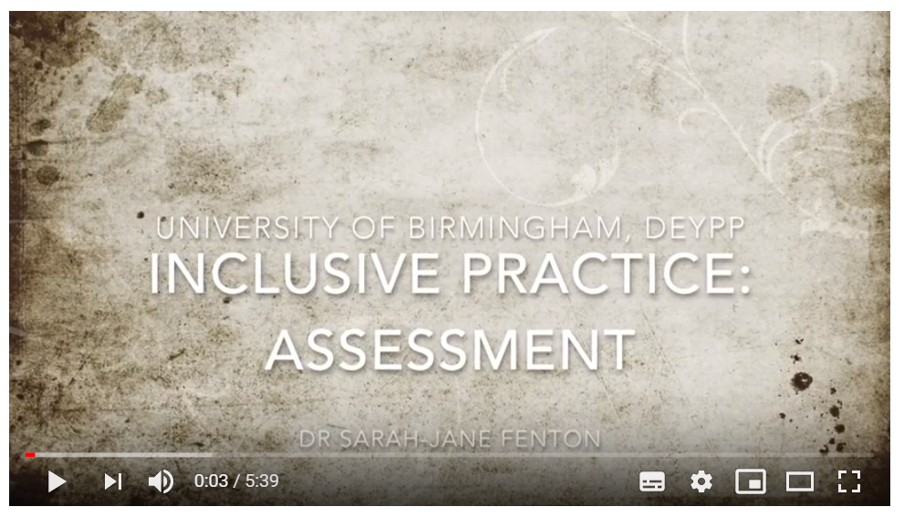
Overall conclusion:
Inclusive assessment is possible – we need to be designing assessments that offer all our students the opportunity to showcase their skills and learning within our programmes
Find out more:
https://youtu.be/3p6ABYLQVoM
s.h.fenton@bham.ac.uk

Slide 16
References
Universities UK. Student mental wellbeing in higher education: good practice guide. 2015.
Universities UK. #stepchange. Universities UK. 2017. URL: https://www.universitiesuk.ac.uk/stepchange (Accessed 4 February 2019).
NUS Scotland. Silently Stressed: A survey into student wellbeing. 2010.
Schön DA. The reflective practitioner: how professionals think in action. New York: Basic Books; 1983.
Bogg D, Challis M. Evidencing CPD: a guide to building your social work portfolio. 2nd edition. Northwich: Critical Publishing; 2016.
Howatson-Jones L. Reflective practice in nursing. 2016.
Doel M. Teaching Social Work Practice: A Programme of Exercises and Activities Towards the Practice Teaching Award. 1st ed. Routledge; 2017.
Utanto Y, Widhanarto GP, Maretta YA. A Web-Based Portfolio Model as the Students’ Final Assignment: Dealing with the Development of Higher Education Trend. Presented at the ENGINEERING INTERNATIONAL CONFERENCE (EIC) 2016: Proceedings of the 5th International Conference on Education, Concept, and Application of Green Technology, Semarang, Indonesia

Slide 17


Informing inclusive curriculum development through co-creation
Dr Lucy Ansley

Slide 18

The Attainment Gap
Better expressed as differential degree awarding (Singh 2019)
13% difference, nationally, in likelihood of white students and students of colour getting a good honours degree (UUK & NUS 2019)
8.9% difference at DMU
Students of colour make up approximately 56% of student body at DMU

Slide 19
DMU Freedom to Achieve
Institutional response
Partnering with other institutions through OfS funding, led by Kingston University
Working with 40 pilot programmes across our 4 faculties
Co-creation and student voice at the heart of our project work
Notes:
Initiating cultural conversations
Focused on four themes
Relationships
Community
Development
Teaching and Learning

Slide 20
Prominent themes
Student Integration
Placements
Personal tutoring
Role Models
Careers and employability
Campus space
Notes:
Feedback
Curriculum content
Assessments
Societies
Awareness of support
Communications (email, etc.)
Representation

Slide 21
Outcomes
Findings fed back at programme level
Aggregated summary report in development
Report to be shared with DSU, Careers & Employability, Library and Learning Services, etc. to support institutional decision making
Findings used to inform future project activity

Slide 22








Transforming Transitions
HEFCE/OfS Catalyst Grant Funded Project

Slide 23
Outline
The problem
The project
An intervention in detail – maths support
Key findings

Slide 24
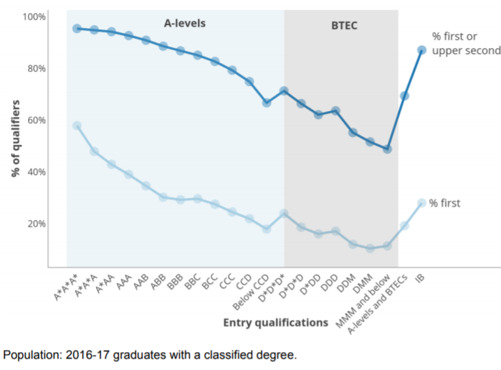
Outcomes Differ
Source: HEFCE (2018) Differences in Student Outcomes

Slide 25
1st year can be transformational

Slide 26
The Research Problem
Recent research highlights differential outcomes for BTEC students
A level students are more likely to achieve a first than vocational students;
BTEC students are more likely to drop out of university when compared with those on a traditional academic pathway, even when accounting for prior attainment.
BTEC students in Russell Group universities are less likely to complete than those elsewhere;
the salary gap between BTEC students and other students is significant and at its largest in Russell Groups universities.
Notes:
UCAS data indicates that selecting universities are less likely to recruit BTEC students than those with traditional qualifications.

Slide 27
Introducing the Transforming Transitions project
This project set out to better understand and reduce the differential educational outcomes of BTEC students at selecting universities by:
Phase 1: conducting investigative interventions to explore BTEC students’ educational experiences across the FE/HE transition; (look out for our book!)
Phase 2: designing, implementing and evaluating evidence-based interventions to address identified issues of transition.

Slide 28
The Interventions
Designed
to be evidence-based - findings from Phase 1 of the project
to include cross-institutional collaboration
with scalability in mind
for roll-out in two phases
Four Interventions
Academic Tutoring
Online pre-entry module
Mathematics Support
Academic Writing

Slide 29
Mathematics Support
Intervention - Different model in each institution
Drop-in, computer-based, help-desks, workshops, lecture capture
Resources used:
Human contact
Paper-based
Lecture capture
Online resources
Notes:
Different model of maths supports in each institution
Assessment of the current mathematics and statistics support provision
Identifying particular areas that students find difficult
Developing a particular model of mathematics support relevant to the situation
Publicising and encouraging uptake

Slide 30
Mathematics Support
Implementation and Impact
Notes:
Different model of maths supports in each institution
Assessment of the current mathematics and statistics support provision
Identifying particular areas that students find difficult
Developing a particular model of mathematics support relevant to the situation
Publicising and encouraging uptake

Slide 31
Issues and Barriers
There is considerable variation in the way data is collected and shared across institutions
Addressing fairer access and educational outcomes requires culture change, not just interventions
Effective partnership working across multiple boundaries, is fundamental to achieve sustainable and scalable change
Notes:
DATA
There is considerable variation in the way institutions collect data at institutional level, but also at programme/module level
Various legal, institutional and cultural barriers exist to using data and these need to be removed
There is a widespread lack of knowledge and understanding on the part of staff of public bodies of the circumstances in which information may be disclosed, to whom and for what purposes
CULTURE
Need to change deficit discourses and stereotyping: less about what disadvantaged students can’t do, and more about inclusive discourses which recognise the strengths of diversity and difference;
Need for organisational change: - different cultures and admissions policies different departments at the same university; different kinds of encouragement in FE for accessing top universities; different opinions about student needs/academic responses among various learning units in both FE and HE;
Need to foster genuinely inclusive pedagogies and curricula: academics can be resistant to adapting to meet diverse learner needs because of traditional/conservative outlooks on educational standards and practice or because of pressures of assessment regimes.

Slide 32
Integrated transition
Pre-Entry
School/College
Transition
University
Post-Entry
University
Pre-Entry
School/College with University
Transition
University with School/College
Post-Entry
University

Slide 33
Dan Herbert d.herbert@bham.ac.uk
Rob Fleming r.fleming@bham.ac.uk
Helen MacKenzie h.e.mackenzie@lboro.ac.uk

Slide 34


Finding the expert within:
teaching in more inclusive ways
Rina F. de Vries Els Van Geyte
EAP programmes coordinator & tutor Educational Developer
Notes:
ELS

Slide 35
From our abstract…
Using examples from teaching international students as starting points, this session focusses on… inclusive teaching practices by questioning the conformist or ‘deficit model’ (Carroll and Ryan, 2005), seeking a more inclusive perspective... and using a critical reflection tool (Brookfield’s four lenses, 2017) to evaluate and build on existing teaching practices, encouraging the audience to find the expert within and reflect on how inclusivity in teaching and course design can be promoted.
Notes:
ELS
Quick reminder here that we will be focusing on tools for reflection / in 10 minutes all we can do is give some examples from our practice and give some tools for further reflection after the session.

Slide 36
Inclusive teaching
participate and have their contributions valued
= enabling every student to…
learn to the best of their ability
feel that they belong
feel safe and respected
be supported by staff and other students
Notes:
ELS
We’ve done some work at the university, working with HEFi Fellows and Scholars to develop an initial working definition on what inclusive teaching is. It is about individuals – every single student feeling included – and here are the aspects that were identified. Depending on our teaching context, e.g. whether we teach small or large groups, whether we teach in labs or online, we will have some idea of whether we achieve this. But how can we make sure that we are right about this?

Slide 37
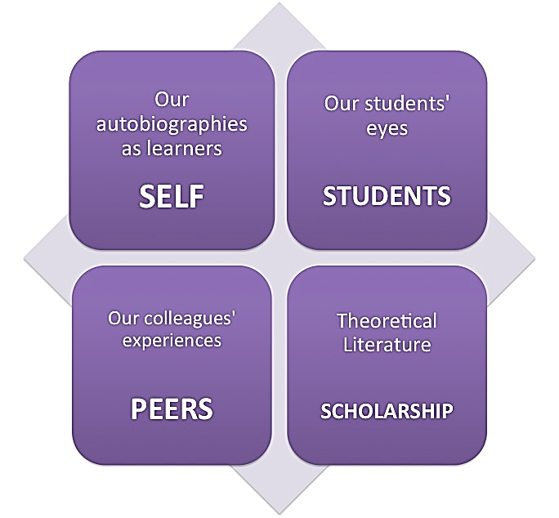
Brookfield’s (2002, 2017) four lenses (for a critically reflective teacher)
Self
Peers
Students
Literature
Using these lenses to develop more inclusive teaching practices: examples and suggestions
Notes:
RINA
Brookfield’s identification of four lenses through which to critically reflect on our teaching can be used particularly to find out if our teaching is inclusive. We will look at some examples from our practice.

Slide 38
SELF
- our autobiographies as teachers
- what we have learnt from our experiences
- working with what we know / who we are
Example: teaching international students
Notes:
RINA
We have both worked with international students for many years. When we concentrate on the first lens, our selves, and what we know, here are some of the things we’ve learned:
Some of the things we learned in terms of classroom technique:
Body language, use visuals but keep them simple / don’t overload slides with words, time to prepare beforehand, letting students use phones (to look words up), recap what was done previously/ not starting with the most important information but giving time to adjust, write down/have a hand-out for the most important information, speak clearly and at a reasonable pace/ repeat regularly and in different ways what is important, plan in short breaks, give students regular chances to check what they have understood/ clarify what they have not, use ice breakers and small group work to reduce anxiety about participating
BUT ALSO – very importantly- value their contributions. Don’t look at them as ‘missing’ something (e.g. perfect English) – the deficit model. Seek the international perspective and their individual perspectives on the topics that are being taught, acknowledge that they speak more than one language rather than having a view that one of their languages, English, is perhaps not at native speaker level.

Slide 39
2. PEERS
2.1 Our colleagues’ experiences: questioning / reflecting on what others do
Example: journal articles
On the next page, you’ll see a table taken from a journal article. When you read what’s in the column on the left, what is your reaction?
Notes:
ELS
One way of getting information from our peers, is to question or reflect on what they do.

Slide 40
Barrier | UDL Checkpoint | Practice
Students are confused as to how to get help, or loose track of tasks | Heighten salience of goals and objectives | Weekly email detailing upcoming tasks, and where to get help
Learners lose track of important course goals | Highlight patterns, critical features, big ideas, and relationships | Surveys provided to students so they can self report progress on course goals
Instructor becomes bord reading the same assignments | Vary the methods for response and navigation | Dance your PhD video shown to class. Invite students to demonstrate knowledge in unusual way. Grade on creativity.
Notes:
ELS
Invite to focus on column on the left – you have found this table in a journal. What is your reaction/ feeling/ attitude?

Slide 41
Barrier | UDL Checkpoint | Practice
Students are confused as to how to get help, or loose track of tasks | Heighten salience of goals and objectives | Weekly email detailing upcoming tasks, and where to get help
Learners lose track of important course goals | Highlight patterns, critical features, big ideas, and relationships | Surveys provided to students so they can self report progress on course goals
Instructor becomes bord reading the same assignments | Vary the methods for response and navigation | Dance your PhD video shown to class. Invite students to demonstrate knowledge in unusual way. Grade on creativity.
Notes:
ELS
Invite to focus on column on the left – you have found this table in a journal. What is your reaction/ feeling/ attitude?

Slide 42
More language examples from same article
Universities serve a more diverse group of students then ever before, including students with learning disabilities.
As these scholars access university systems there is an awareness that these learners bring unique experiences that challenge long held believes about what university students should know and understand about the college experience.
Notes:
ELS
Some more examples from the same article

Slide 43
Universal Design for Learning and Digital Environments: The Education Superpower Coy, K., California State University, Fresno
The Journal of Inclusive Practice in Further and Higher Education Issue 10.1 Winter 2018
I am also dyslexic. This is another strength that I used to perceive as a weakness. Although I have been dyslexic brain since birth, I was not diagnosed until I was in graduate school getting my teaching degree. This is where I learned what dyslexia was (Høien and Lundberg, 2000), and it was a comfort knowing that it was not that I was not trying hard enough to spell word correctly or to read new material, but that my brain was just wired a bit differently.
Notes:
ELS
Then I read this … – does that make a difference? This made me realise that my standards are the normative view / protection of the ‘canon’ , what we perceive to be of the highest quality. Journals as gatekeepers …. Letting only people through who can conform. It is an ablist attitude.

Slide 44
Example from another journal’s submission guidelines:
“Authors should follow the De Gruyter Mouton style sheet but with one change:
While the standard style sheet stipulates, under 'Special attention', that authors should have their "contribution carefully checked by a native speaker", the editors of JELF simply expect authors to submit manuscripts written in an English which is intelligible to a wide international academic audience, but it need not conform to native English norms.”
Notes:
ELS
So do we need to be so protective? Here is an example of a peer reviewed journal that explicitly rejects the notion that “native English” language standards should be the norm. [although, as the next slide points out – there is a particular reason for this, we suggests that other journals should not necessarily follow suit]

Slide 45
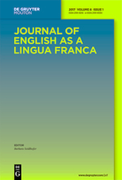
Aims and Scope
The Journal of English as a Lingua Franca (JELF) is the first journal to be devoted to the rapidly-growing phenomenon of English as a Lingua Franca. The articles and other features explore this global phenomenon from a wide number of perspectives (…) in a diverse range of settings where English is the common language of choice.
Notes:
ELS
The journal is about English sociolinguistics . The concept of ‘English as a lingua franca’ acknowledges that English is a common means of communication for speakers of different first languages. For example when English is spoken at work e.g. an Italian person is communicating with someone in Japan, or when people from different languages network at a conference, they are speaking in a way which may not be deemed correct if views by native speaker norms, e.g. they might make grammatical mistakes, but their communication is not impeded. In classrooms, time spent getting people to pronounce sounds in exactly the same way as native speakers do, is a waste of time. It is unlikely to work, and is totally unnecessary – whether I say thing or ting is not going to stop me from being intelligible. The fact that this journal therefore does not need authors to conform to native English norms is not that strange.

Slide 46
2. PEERS
2.2 Open Classroom:
starting dialogues with others
“The idea is very simple – open up your classroom for others to come and learn from your practice and use the opportunity to visit other classrooms across campus and find out what is going on.”
https://www.birmingham.ac.uk/university/hefi/staff-development/Open-Classroom-initiative.aspx
Notes:
ELS

Slide 47
3. STUDENTS
3.1 observing students: their response
3.2 asking students: their view
3.3 being approachable: welcome their contributions
Notes:
RINA
These are some ways that we can get information about our students about whether we teach inclusively

Slide 48
How do we know if we are an inclusive teacher?
Do we know if a student feels
- safe and respected
- supported by staff and other students
- that they belong
- that their contributions are valued
- and that they are learning to the best of their ability?
observing students | asking students (how?) | through course design, e.g. methods of delivery and assessment | other ?
Notes:
RINA
Going back to the definition from the start …
If time, invite some answers e.g. how do you ensure and check if a student feels safe in a teaching space?
Encourage audience to try and categorise – more than one category possible. May lead to debate on university structures and policy having to be in place / possible other ‘other’ too.
If no time, present this as a tool for reflection – a way to start identifying what we as lecturers do not know, and to start thinking about what we can do about that.

Slide 49
4. LITERATURE: engage with different theories
Brookfield, S.D., 2017. Becoming a critically reflective teacher. John Wiley & Sons. (First edition 1995)
Carroll, J. and J. Ryan (2005). Canaries in the coalmine: International students in Western universities. In J. Carroll and J. Ryan (eds), Teaching international Students: Improving Learning for All. London: Routledge.
Chong, Chia Suan (2019). What does inclusion mean to me? In: English Teaching Professional, accessed 13/06/2019 via https://www.etprofessional.com/what-does-inclusion-mean-to-me
Coy, K. (2018). Universal Design for Learning and Digital Environments: The Education Superpower. In The Journal of Inclusive Practice in Further and Higher Education, 10 (1) (pp.12-135). Available at https://nadp-uk.org/resources/publications/published-journals/ Accessed 24 January 2019.
Equiip (2017). Strategies and Recommendations for the International Classroom [Online]. Available at: https://equiip.eu/2017/08/18/new-videos-by-ubordeaux Accessed 8 January 2019.
Florian, L. and H. Linklater (2010). Preparing teachers for inclusive education: using inclusive pedagogy to enhance teaching and learning for all. In Cambridge Journal of Education, Vol. 40 (2010), Issue 4, 369-386. Available at: https://www.tandfonline.com/doi/full/10.1080/0305764X.2010.526588?scroll=top&needAccess=true Accessed 11 February 2019
University of Nebraska (2018). Inclusive teaching. In: Graduate Connections Newsletter, accessed 13/06/2019 via https://tomprof.stanford.edu/posting/1684
Leask, B. and J. Carroll (2013). A Quick Guide to Developing English Language Skills. Melbourne: IEAA. Available at: https://www.ieaa.org.au/documents/item/128 Accessed 09 January 2019
Leask, B. (2015). Internationalizing the Curriculum. London, New York: Routledge.
Thomas, L., 2016. Developing inclusive learning to improve the engagement, belonging, retention, and success of students from diverse groups. In Widening Higher Education Participation (pp. 135-159). Chandos Publishing.
Notes:
RINA

Slide 50
To sum up: finding the expert within
Acknowledge our existing expertise, question /evaluate our and our peers’ practices, and build further skills:
1. Audit of our expertise Effective teaching is also inclusive teaching. What have we learnt through teaching certain groups of students that we can extend to other students?
2. Questioning our (implicit) standards: are they Eurocentric, ablist, outdated…?
3. Engaging with peers: observing teaching, starting dialogues…
4.Observing and checking with students; thinking about inclusivity during course design
5. Reading up and keeping informed on matters related to inclusivity
Notes:
RINA

Slide 51
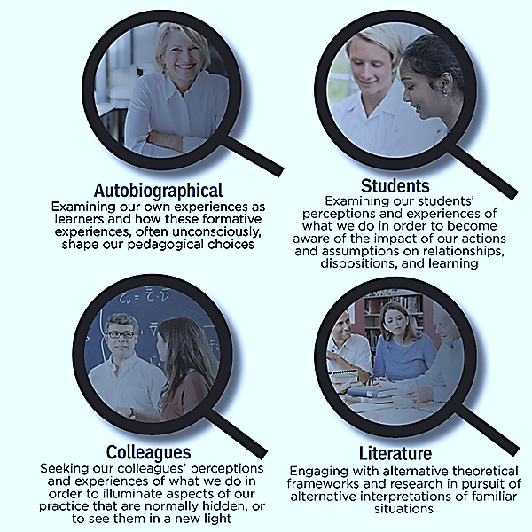

Slide 52
Parallel session 3B: Addressing Inequality
3.5 How can teachers avoid reinforcing international educational inequality? Eleanor Chowns, International Development Department, University of Birmingham
3.6 Students’ perceptions of institute reputation; fostering a genuine culture of belonging and inclusion in Higher Education Sandhya Duggal, Department of Social Work and Social Care, School of Social Policy, University of Birmingham
3.7 Exploring 8 Situational Lenses in Curriculum Design Danielle Hinton, Higher Education, University of Birmingham
3.8 Models of higher education provision for refugees within UK and European universities Gabi Witthaus, College of Arts and Law, Digital Education Team, University of Birmingham
3.9 Queer pedagogies and transnational education for disruptive practice Holly Foss, Birmingham Centre for Railway Research and Education, University of Birmingham

Slide 53
Students’ perceptions of institute reputation; fostering a genuine culture of belonging and inclusion in Higher Education
Dr Sandhya Duggal
s.duggal@bham.ac.uk
Department of Social Work and Social Care, School of Social Policy

Slide 54

Recent teaching experience
Assessing first year undergraduate student assignments
Reflective piece about experience of admissions process to UoB
Typical experiences described
Another theme also emerged…

Slide 55

“it was my back up choice because I never thought I’d be good enough to get into Birmingham”
“I had some doubts if it was the right place for me”
“I was shocked when I got in, but then I was worried I wouldn't fit in…”

Slide 56

Reputation - the world HE lives in
Annual rankings
International league tables
Local groupings
But it’s also important for students…

Slide 57
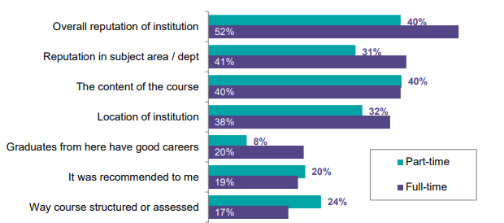
Why do students choose a course? (PTES 2018)

Slide 58
Importance of belonging
Belonging is aligned with the concept of student (academic and social) engagement (Thomas, 2012)
Belonging and inclusion impact on student progress and success
“Students as travellers crossing borders” (Mann, 2001)

Slide 59
What the research tells us (Kandiko and Mawer, 2013)
Students incoming experiences of HE come from family, friends, secondary schooling and FE and general media
Importance of ‘feeling in the loop’
Students expectations rarely matched their subsequent experiences of HE
Students felt lost, unsure of what was expected of them and where to go for assistance

Slide 60
How can we bridge the gap?
Formally recognise pre-arrival students being in a transitional period
Offer sufficient transitional support
Direct interventions in students transitional experiences
peer mentoring
pre-entry induction
community engagement days

Slide 61
Conclusion
Genuine commitment to inclusion and belonging
Students as stakeholders
Creation of confident and successful HE learners

Slide 62
References
Kandiko, C. B. & Mawer, M. (2013). Student Expectations and Perceptions of Higher Education. London: King’s Learning Institute.
Mann, S.J. (2001) ‘Alternative perspectives on the student experience: alienation and engagement.’ Studies in Higher Education, 26(1), 7-19.
Thomas, L. (2012) Building student engagement and belonging in Higher Education at a time of change: a summary of findings and recommendations from the What Works? Student Retention and Success programme. London: Paul Hamlyn Foundation

Slide 63
Keynote Employer Led Panel:
Employer-led learning
John Curnow (Chair), Direction of Education, College of Medical and Dental Sciences
Tim Jones, Chief Innovation Officer, University Hospitals Birmingham NHS Foundation Trust
Christina Jackson, Technical Director, Ground Engineering, Jacobs
Simon Astill, Chief Executive, 3PB Barristers
Charles Hardy, Education Engagement Leader, LinkedIn
Alison Sharp, Assistant Director – Innovation, Careers Network, University of Birmingham

Slide 64
Plenary Session and Panel Discussion:
What does this mean for the
next generation university?
Professor Kathleen Armour
Pro-Vice-Chancellor (Education)
University of Birmingham

