Slide 1


Slide 2

Conference Exhibitors

Slide 3
Welcome
Professor Kathleen Armour
Pro-Vice-Chancellor (Education)
University of Birmingham

Slide 4

WiFi:
Network: uobevents
Password: uniofbham
App: Convene app – scroll down to HEFi2019
Twitter: #HEFi19

Slide 5
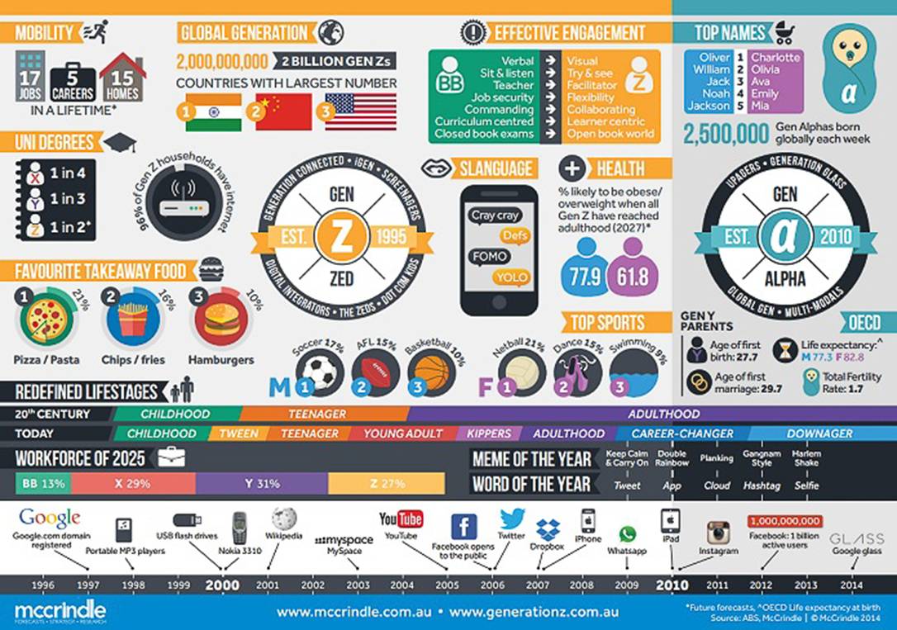

Slide 6
• How should research-intensive universities respond to these changes?
• What do we need to do differently to ensure we maintain our position in a changing market for education?
• How will learning and teaching need to evolve to ensure our graduates are ready for THEIR futures?

Slide 7
Keynote Speaker:
The Next Generation University
Zac Ashkanasey
Principal
Nous

Slide 8
Digitised Futures?
How do we prepare?
Professor Linda Price
University of Bedfordshire

Slide 9
The changing world
By 2050 there will be 9 billion people to feed, clothe, transport, employ and educate
Current population is 7.5 billion: the estimate for 2019 was 7.2 billion
5 billion, 2/3 of the world's population, are connected by mobile devices, (GSMA)
By 2020, almost 75% of the global population will be connected by mobile devices
Notes:
2/3

Slide 10
Challenges
Limitless consumption for things
Warming the climate
Overspending financial resources
Requiring more fresh water
Increasing income inequality
Diminishing other species
Billions are at the “bottom” of the economy
Rampant youth underemployment in many countries
The forecast is for billions to remain stuck for their whole lives.
Dan Abelow, Imagine A New Future: Creating Greatness for All,

Slide 11
4th Industrial Revolution
https://commons.wikimedia.org/wiki/File:Industry_4.0.png

Slide 12
What will the fourth industrial revolution bring?
artificial intelligence
genome editing
virtual reality
robotics
3-D printing
rapidly changing the way humans create, exchange, and distribute value
will profoundly transform institutions, industries, and individuals.
It will be guided by the choices that people make today
It will be shaped by how we invest in and deploy these powerful new technologies.
Notes:
digital, physical and biological systems in a way never seen before.

Slide 13
Artificial Intelligence
Google: every time you search, google is storing your preferences
Process automation, predicting buyer preferences, chatbots, medical diagnostics
Siri or Alexa don’t understand language – they just match keywords with actions (Weak AI)
Computer Games – self teach and learn better and faster actions (Strong AI)
Self-Driving cars (general AI)
Risks:
AI is programmed to do something devastating
AI is programmed to do something beneficial, but it develops a destructive methods
Notes:
They are systems that function intelligently and independently – they are not humans.
How well self-driving cars and

Slide 14

Genome Editing
Used to precisely and efficiently modify DNA within a cell
Can be used to modify human blood cells that are then put back into the body to treat conditions including leukaemia and AIDS.
Has potential to be used to treat other infections (such as MRSA) and simple genetic conditions (such as muscular dystrophy and haemophilia).
CRISPR-Cas9 is a widely used genome editing method.
Specific sequences can be produced relatively easily in a laboratory, or obtained in the form of commercially available kits that can be purchased online.

Slide 15
Virtual Reality
Using VR to walk patients through cancer treatments (Winnipeg)
Surgical residents can use VR to practice skills
GP Trainees can practice difficult conversations around child abuse issues (UCL)
Pharmacists practicing difficult conversations in VR environments (Umeå, Sweden)
https://pixabay.com/photos/clouds-virtual-reality-game-ar-1845517/
Notes:
VR activity (Winnipeg) which is allowing breast cancer patients to have a very personalised experience of simulated radiotherapy in advance of the real radiotherapy. And they’ve found that this has a really beneficial effect in terms of patient wellbeing, patient… you know, it’s very anxiety reducing. Patient recovery is linked to anxiety – so less anxious patients recover better.
And that’s something that you can’t easily do in the real world, without using very expensive resources.
at surgical residents can do, where they can practice techniques not on real patients, that’s a real opportunity, a real benefit.
UCL - used VR simulation where GP trainees can interact with VR avatars - . They explore some of the very delicate conversations you might have with parents and children around child protection, and child abuse issues, - very difficult to do in the real world, even with actors and role play but actually within a VR environment offer some real advantages and opportunities to advance the pedagogy.
However, there is not that much skill in universities at the moment re thinking how to to use the technologies to advance the pedagogy. T
here’s a lot of interest, but there is a big overhead in investing in the equipment, investing in the staff development. And it’s really early days for the meaningful use of these technologies..

Slide 16
3D Printing
A variety of processes where material is joined or solidified under computer control to create a three-dimensional object
Notes:
Low volume manufacturing
Moving across to 3D printing will make it possible for businesses to consider short-run part production, where focused product teams can launch new products more frequently. They will be able to work beyond the realms of their imagination and certainly beyond the restraints that come with traditional methods. It delivers an agile development process for physical parts and has the ability to accelerate the production and the time it takes to get to market.
There is no doubt that 3D printing is way ahead of conventional methods when it comes to manufacturing the first several hundred parts. But is 3D printing also suitable for manufacturing on large scale?
High volume manufacturing
3D printing is a technology that is developing and growing faster than most other technologies due to the way it can influence manufacturing processes and help businesses perform to a higher level. A production line that is set up for 3D printing is easier to alter than that of a production line for traditional manufacturing, making 3D printing a feasible option for many reasons.
The whole production line can be adjusted and adapted with the speed of the printing production line. Therefore, improvements to machinery, adjustments to the print speed or even a change of product can be made almost instantly. When you consider this against older methods, it can take several weeks or months to make the changes and then begin producing again.
It is inevitable that the capabilities that come with 3D printing and the way in which technology is evolving will enable businesses to adopt this new way of producing products or parts and it is likely that this adoption is going to grow well in the future.
1. Reduction in costs
Traditional manufacturing methods are notoriously expensive, whereas the 3D printing process makes the creation of parts products cheaper and more accessible. Unlike traditional manufacturing where many different people may be required to operate a number of machines or a production line is required to piece together the product, 3D printing removes this. Each 3D printer will require an operator to start the machine before it begins an automated process of creating the uploaded design. Therefore, when using 3D printing for manufacturing, the labour costs are significantly lower as there is no need for skilled machinists or operators to form part of the process.
2. Reduction of risks
When businesses have the ability to confirm a design before committing it to production, it can help to remove the risk of errors, wasted materials and money. Creating products with 3D printing can help to increase confidence, especially when you consider that a 3D prototype is easier to redesign and alter than anything that has been created using a traditional method.
When it comes to setup costs, manufacturers won’t have to produce so much of a product in order to justify the setup costs. The traditional methods of production often relies on the efficiencies of mass production and requires a large number of assembly workers, whereas, 3D printing requires the filament material and not a lot more to fulfil an order.
3. Failure is cheaper and faster
3D printers will not need to be retooled between production runs. The speed at which a 3D printer can assemble could be deemed to be slower than that of a traditional assembly line. However, when you factor in machinery problems that can stop production and human error, there is more that can go wrong with traditional manufacturing.
4. Time to market
3D printing makes it possible to develop ideas at a faster pace. In some instances, it could be possible for 3D concepts to be designed and printed on the same day but in terms of large-scale manufacturing, it is certainly faster than conventional methods. This can help companies to reduce manufacturing time from months to days while ensuring that they remain ahead of their competitors.

Slide 17
Robotics
the design, construction, operation, and use of robots, as well as computer systems for their control, sensory feedback, and information processing.

Slide 18
Changes that are upon us…
Notes:
Uber – gaining investment for a taxi business where you don’t own an assets
AirBnB – gaining investment for a hotel business where you don’t have the assets
Procuring software
Can only gain capital funding for assets – but software is more frequently being ‘sold’ as Software as a Service

Slide 19
Are we ready?
Are our students ready?

Slide 20
Fear of Technology…..
“We have always had a fear of new technology, even as far back as the industrial revolution, but those fears have been largely unfounded, so why is it different now?
Well, it’s the speed in which technology has come to the fore. The risk factor we are dealing with is on a grand economic; political and social level.”
Dr Reuben Abraham, CEO of Think-Tank the IDFC Institute, speaking at Global Education and Skills Forum (GESF) in Dubai, 2018
Notes:
IDFC Institute has been set up as an independent, economic development-focused think/do tank to investigate the political, economic and spatial dimensions of India's ongoing transition from a low-income, state-led country to a prosperous market-based economy. We provide in-depth, actionable research and recommendations that are grounded in a contextual understanding of the political economy of execution.
Our approach to public policy issues rests on a solid foundation of evidence-based research. We use this to parse symptom from the disease, to get to the “what” of diagnosing problems correctly and developing appropriate solutions. Yet a common concern from government is how to get things done. A critical part of our work is therefore liaising with relevant stakeholders to understand “how” to get solutions implemented and institutionalised.

Slide 21
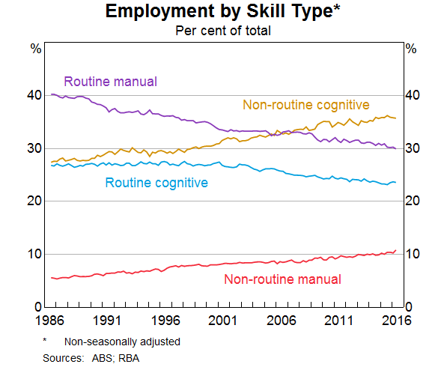

Slide 22
What is it we need to transform?
Employers top-rated skills…
Literacy and numeracy
Time management and organisation
Oral and written communication
Teamwork
Creative problem-solving
Initiative and enterprise
Critical and analytical thinking
Ability to apply discipline, knowledge and concepts
Information gathering, evaluation and synthesis
Emotional intelligence and interpersonal skills
Adaptability

Slide 23

Can Teaching and Learning with Technology help?
Lack of a well-established body of evidence of transformational HE
Concerns about the quality and validity of some research and evaluation studies in TEL (Price and Kirkwood, 2014)
‘“Notoriously sloppy” and “brimming over with lazily executed ‘investigations’ and standalone case studies, while also tolerating some highly questionable thinking” (Selwyn, 2012, p. 213).
…technologies have often been used ‘regardless of whether or not they are pedagogically effective’ (Beetham & Sharpe, 2007, p. 3), (Johnson, Adams Becker, Estrada, & Freeman, 2014)
https://www.flickr.com/photos/usfwsnortheast/28273604424

Slide 24
Ubiquitous Technologies
How students perceive the value of u-technology and how students use u-technology in their learning.
Explored the preferences and usage of u-technologies with pre-service teachers in a German university.
It investigated the purpose of the usage and whether it was academic in orientation or leisure-oriented.
Cohort were pre-service teachers
Their experiences were considered relevant in offering insight into how they, as future educators, would view and use technology in their teaching.
(Daunert and Price, 2019)

Slide 25
Influences
Teaching models we experience often influence how we teach as teachers (Cheek & Castle, 1981; Chicoine, 2004; Frank, 1990; Goodlad, 1982; Herrington, Sparrow, & Herrington, 1999; Hornbach, 2004; Knowles, 1988; Pringle, 2006).
Teacher’s beliefs and approaches to teaching also affect how they use technology Englund, Olofsson and Price (2017)
Examining pre-service teachers perceptions and use of technology can provide valuable insights into their development and the development of those that teach them

Slide 26
The sample
A total of 331 respondents participated in the survey.
65% were female
76% of the sample were in their 3rd semester
76% were within the age range of 20 to 22.

Slide 27
Some results
Preferred technological devices
  laptops (58.3%)
  smartphones (25.4%)
Preferred web-based tools and applications
  Social networking (54.1%).

Slide 28
So how are they social networking?
51.2% claim to use social-networking tools for academic purposes for up to 2 hours per day
22.3% up to 4 hours,
3.3% up to 6 hours
17.6% claim to use blogs for academic purposes up to 2 hours
4.5% up to 4 hours per day
Notes:
BLOGS Overall, this is a small percentage of the sample of preservice teachers who report usage for educational purposes. This is contrary to other higher education settings in which blogs are reputed to play an important role in students’ learning activities especially in the education discipline.
Don’t seem that effective

Slide 29
How are they using Uni Systems
36.7% claimed to use the VLE for up to 2 hours
8.8% up to 4 hours
1.8% up to 6 hours per day.
Although the students can use their university VLE for exchanging ideas or discussion, they mostly use Facebook, Skype, WhatsApp, and email.

Slide 30
Statements | Mean
1. I can do most of my learning activities in the university easier and quicker with technical devices than without. | 4.17
2. If I use a technological device as a working tool, I often work faster and more effectively. | 3.50
3. My laptop/PC with internet connection is a great a big part of my learning because I do not necessarily have to go to the library. | 4.23
4. I find information on the internet very helpful because it makes studying easier and more accessible. | 4.26
5. I use links and other web-based tools/applications very often because they support the learning process. | 3.12
6. I write my notes/documents only with my laptop/netbook/tablet. | 2.04
7. Communication with instructors or colleagues using e-mail/chat/forum is a great advantage because it is a very convenient way to reach someone. | 4.30
8. I use blogs, wikis, or other web-based collaborative applications/tools support the learning process. | 3.45
9. I cannot imagine myself studying/learning without a technical device and without an internet connection. | 4.19
10. I mainly use web-based applications or tools for my courses at the university. | 3.02

Slide 31
Student’s use of U-technologies
Students have creatively adapted the functionalities of the web-based tools into their everyday learning activities.
Students want to be able to integrate and take advantage of the tools that they use and are familiar with.
Tinto’s model (1997, 1998) of academic and social integration purports that students who are adapted socially as well as academically into the academy are more likely to succeed.
Use of u-technologies indicates how students are enacting Tinto’s model in a digitally-mediated world
Making learning and leisure work together seamlessly

Slide 32
Digital Disruption
- what is being disrupted?
Disruption
Communicate
Act
Know
Collaborate
What
How
Why
Speed

Slide 33
Critical areas for development
Collaboration & teamwork
Creativity & imagination
Critical thinking
Problem solving
Flexibility & adaptability
Global & cultural awareness
Information literacy
Leadership
Other skills for success
Civic literacy & citizenship
Oral & written communication skills
Social responsibility & ethics
Technology literacy
Initiative

Slide 34

‘The quickest way to change student learning is to change the assessment system’ (Elton & Laurillard, 1979)
“Despite the good intentions of staff, assessment tasks are set which encourage a narrow, instrumental approach to learning that emphasizes the reproduction of what is presented at the expense of critical thinking, deep understanding and independent activity” (Boud, 1995, p. 104).
A paradigm shift is required (Nightingale, 2000, p. 118)

Slide 35
The Significance of Assessment
Assessment is the de facto curriculum: students pay close attention to assessment
Assessment is one of the most powerful teaching tools for directing student learning
If technology use is not integrated with the assessment, is it often unused and undervalued
(Kirkwood and Price, 2008)

Slide 36
Authentic assessment…
Mirrors priorities and challenges found in real life
Assesses whether students can craft polished, thorough and justifiable answers, performances or products
Tasks involve activities that help students rehearse for the complexity and ambiguity of adult and professional life

Slide 37
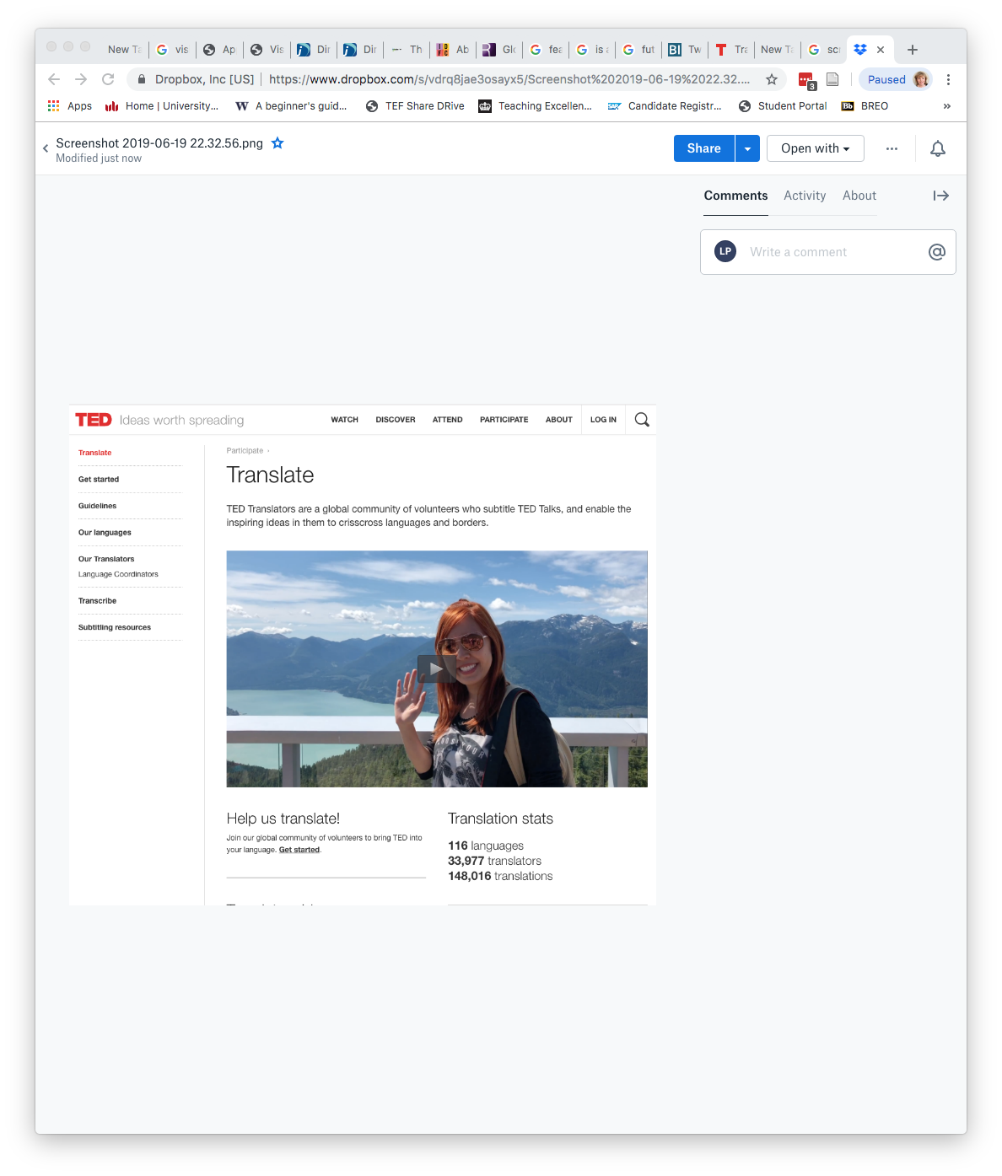

Slide 38

Moving Forward
Use of the u-technologies for academic purposes needs to reflect ‘everyday things’
We should recoil from a focus on which technology we think students should use and enable them to use technologies of their choice
….provided they can use them effectively or justify their use.
We need to construct assessment that enables development of key skills needed for the future.

Slide 39
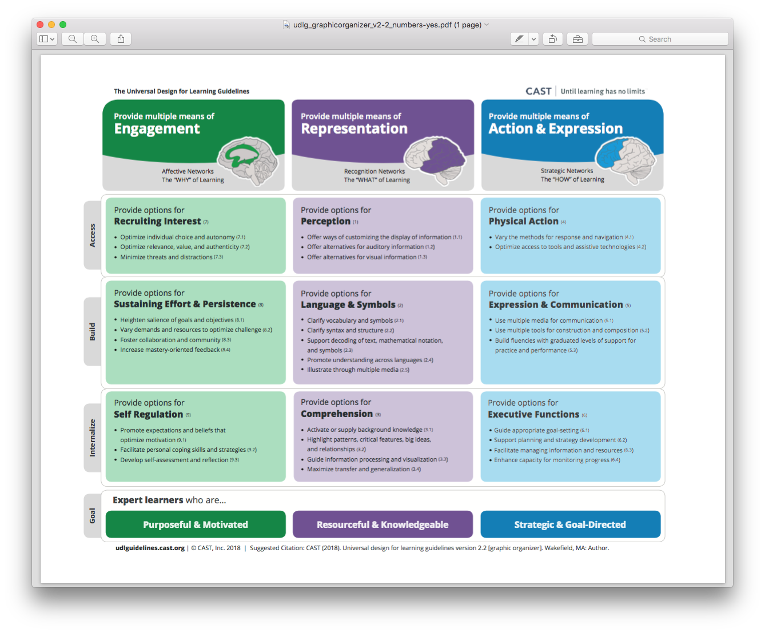

Slide 40
Preparing for the future…
Design learning that enables student to develop key skills for the future.…
Challenge conventional thinking about ‘how’ to create learning environments – fit for the future
Enable assessments that allow students to be creative in their solutions
More staff development to develop our teaching skills
Change the political discourse about the value of higher education!

Slide 41

Thank you for listening
Questions?
Professor Linda Price
Director of Academic and Organisational Development
University of Bedfordshire
F308, Park Square, Luton, Bedfordshire LU1 3JU
e: Linda.Price@beds.ac.uk
t: +44 (0)1234 400 400 ext 9229
s: mlindaprice

Slide 42
Do you want to communicate with others on campus about teaching and learning?
Subscribe to ‘HEFi-OPEN’, a JiscMail mailing list service:
https://tinyurl.com/y3wczmyh
Use it to:
share teaching ideas and resources, look for collaborators
find out about development opportunities related to teaching and learning
ask questions about how others teach and support learning
build and strengthen links within the teaching community

Slide 43
Parallel session 1A: Lifelong Learning
1.1 Simulate and stimulate – gamification for HR learning and development
Lisa Clark, Newcastle University Business School
1.2 Teaching future-ready graduates equipped for the 4th industrial revolution
Susan Geertshuis, Innovative Learning and Teaching, University of Auckland
1.3 Cognitive un-load: using online design to optimise the conditions for learning
David Rowson, Director of Academic Services, Wiley Education Services
1.4 Establishing Lifelong Learning from Day 1 - a flexible learning framework
Simon C Riley and Gavin McCabe, Institute for Academic Development and Employability Consultancy, University of Edinburgh

Slide 44
Do you want to communicate with others on campus about teaching and learning?
Subscribe to ‘HEFi-OPEN’, a JiscMail mailing list service:
https://tinyurl.com/y3wczmyh
Use it to:
share teaching ideas and resources, look for collaborators
find out about development opportunities related to teaching and learning
ask questions about how others teach and support learning
build and strengthen links within the teaching community

Slide 45
Parallel session 1B: Lifelong Learning
1.5 Academics as lifelong learners: connecting future-facing curriculum design and research-based education at UCL EAST
Anne Preston, UCL EAST, University College London
1.6 Student perception on feedback practices – an informed study from Engineering
Panagiota Axelithioti, Lewis Parry, Daniel Donaldston, Mohamed Samra, Carl Anthony, Daniel Espino and Aziza Mahomed, School of Engineering and School of Education, University of Birmingham
1.7 Who is student work for, in the twenty-first century university?
Nick Grindle, Arena Centre for Research-based Education, University College London
1.8 Throwing the cat among the pigeons: research-intensive learning at Birmingham and beyond Marios Hadjianastasis, HEFI Educational Development, University of Birmingham
1.9 Student-centred learning: a case study
Simon Scott, Liberal Arts and Natural Sciences, University of Birmingham

Slide 46


Throwing the cat among the pigeons: research-intensive learning at Birmingham and beyond
Marios Hadjianastasis
PGCHE Programme Lead
Higher Education Futures Institute
University of Birmingham
Jorge Ravagli-Cardona
PhD student
Theology and Religion
@mariosbham
Notes:
Background/Birmingham context
Movements in sector/literature and practice: research-intensive learning as a powerful alternative to the divide
Application at Birmingham: project aims and
Showcasing results from Geography, Biosciences and Business School
The future

Slide 47
Outline
Background
The sector and its evolution
Application at Birmingham: the RILT project
The future

Slide 48

Boyer and the rest
“on far too many campuses, teaching is not well rewarded”
“faculty who spend too much time counseling and advising students may diminish their prospects for tenure and promotion.”
“Research and publication have become the primary means by which most professors achieve academic status”
Boyer (1990), xii.
@mariosbham
Notes:
Inevitably perhaps, we must fast-forward to 1990, and the publication of Ernest Boyer’s seminal work, Scholarship Reconsidered. Boyer’s work was a stinging critique of something which is no doubt familiar to us, almost 30 years later: the understanding of academic success purely as research, and the consequent neglect of teaching. Boyer highlighted the contrast between universities as businesses which market the university experience to prospective students, “aggressively” recruiting them using “glossy brochures” (xi), but not delivering on the high quality teaching they advertise as a result of the prioritisation of research. For Boyer, teaching was an activity that should be mutually beneficial and critical in our journey of discovery, echoing the ideals of Humboldt and Newman.
Boyer’s more holistic view of higher education, where research and teaching are not to be seen in an oppositional framework, had great resonance. The publication in 1998 of the findings of the Boyer Commission, three years after Boyer’s death in 1995, called for a rethinking of curricula towards a more enquiry- and research-based model which spans across higher education from the beginning to the end.
Boyer’s work, and the work of the commission, inspired the work of others, such as Healey & Jenkins, and Angela Brew for example.

Slide 49

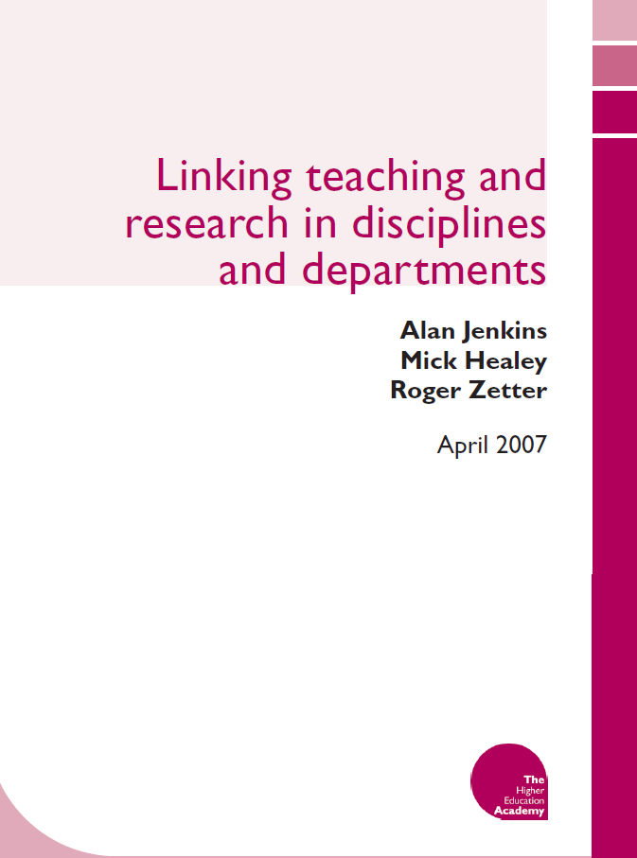
Healey & Jenkins, Brew and Barnett
Notes:
Mick Healey and Alan Jenkins took the mantle in the UK, who along with many other colleagues produced numerous publications on the benefits or an integrated, research-based model in higher education. They went on to write up numerous case studies in order to promote such a model, and in the previous decade you will remember the drive for enquiry-based learning, along the now long gone Centre for Excellence in EBL in Manchester. Angela Brew’s work is also pivotal here. In Research and Teaching: Beyond the Divide she acknowledges that teaching and research were pitched in competition against each other, and proposes ways of mitigating the effects of such a divisive understanding of the functions of higher education. Ron Barnett also sought to offer a broader philosophical framework which often deals with concerns on what is expressed as a conflict between the ‘original’ function of universities, and universities today. And finally, many others weighed into this debate with valuable observations and research into practice in disciplines, such as Malcolm Tight and Helen Walkington for example.

Slide 50

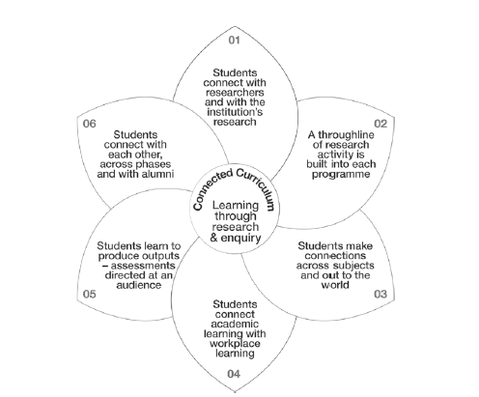
Connected Curriculum
Source: Fung, D. (2017), 5
Notes:
I will end this mini literature review with a mention of Dilly Fung’s Connected Curriculum. Much like its predecessors, Fung’s work at UCL proposes a 6-point framework which seeks to propose a way out of the divide into a more integrated approach which also mirrors Boyer’s work. The Connected Curriculum, published a couple of years ago, has made a mark across UK institutions. But has it really made a difference? And in fact, has anything made a difference?

Slide 51
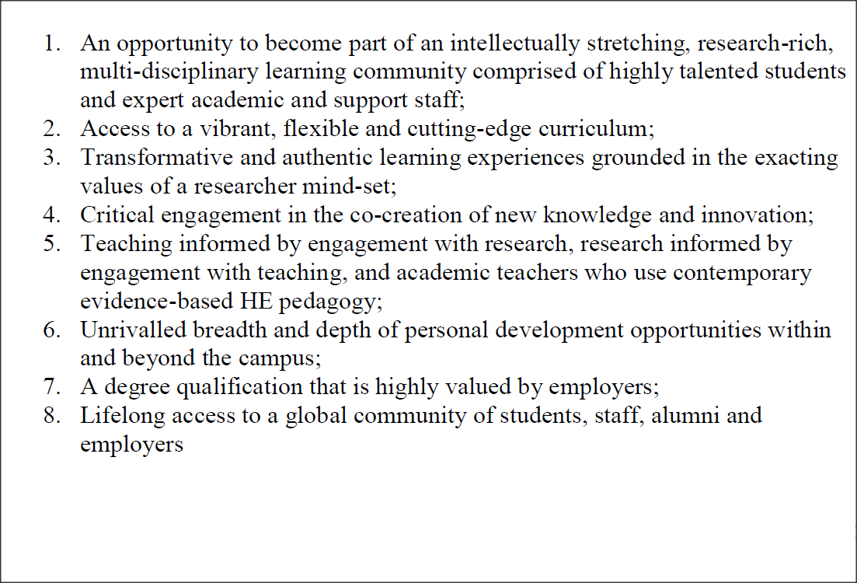
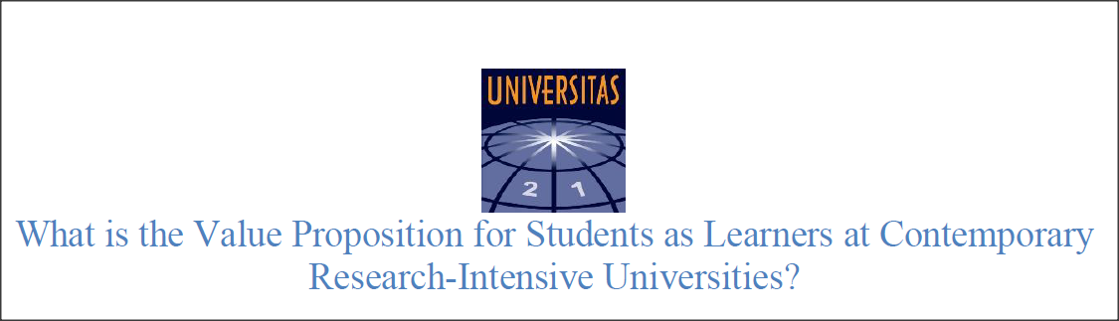
The Birmingham context:
2016: renewed “commitment to the findings of the Boyer Commission report” (U21, 2017, 1)
Notes:
At Birmingham I dare say we followed the trend of RIUs until very recently. It was generally assumed that as long as we had excellent research, excellent teaching would surely follow. A former Pro-Vice Chancellor at Birmingham told our new cohort of PGCert participants that “you are all excellent researchers, therefore your teaching is research-informed”. Thankfully those days are long gone. Our current PVC-Education, Kathy Armour follows a strict, Boyer-inspired approach to raising the profile and standards of teaching and learning. Her work promotes and champions teaching, and has created a framework for reward and recognition of teaching-focused staff, something which in the Russell Group has been a long time coming.
In 2016 we hosted a 3-day U21 conference which discussed and reiterated its commitment to the findings of the Boyer Commission Report, with a position statement issued in 2017.

Slide 52
The project
Evidence-base: literature review
Showcasing
Challenging
Offering examples and CPD
@mariosbham
Notes:
From ‘-informed’ to ‘-intensive…
At Birmingham we decided to slightly change the term we use for what we traditionally knew as research-informed teaching, to ‘research-intensive learning and teaching’. Although in my book there is little difference between the different ideas expressed since the Boyer days, the term research-informed is often misunderstood and requires further explanation: I am sure we have all had the conversations where research-informed teaching is described as “I tell my students about my research” or “I have research papers in my reading list”.
So, to the project I’ve been running. I decided to identify and showcase instances where a deliberate attempt was made to organise learning in a research-intensive manner (or –based, or indeed –informed in the true sense). The project aimed at bringing to the surface such instances of great practice which often went unnoticed outside the disciplinary context. This would serve as a bit of showing off, while at the same time throw down the gauntlet to other areas of our institution where such practice is still considered to happen by osmosis and by association with research excellence.
Finally, having concrete examples from our own institution coming from diverse disciplines could really help in my role as educational developer. Having such examples and evidence to showcase somehow makes conversations much more powerful than using cases from the Healey & Jenkins publications or other published scholarship. I hope to develop material we can use in our PGCert, but also in support for curriculum redesign in departments which we are often asked to support.
The response has been overwhelming. Although I had a limited budget for a postgraduate student to support me with a literature review, and only aimed at gathering five cases in total, I have at least 13 cases in the pipeline, all to be completed by July of this year! Below I showcase three of these.

Slide 53
Literature review
From the analysis of teaching to the comprehension of learning.
From research-informed teaching, via research-led teaching, to teaching-informed research?
Reaction: from more attention to teaching, to the renovation of teaching and research.

Slide 54
School of Geography, Earth and Environmental Sciences (GEES): Lloyd Jenkins
“a pedagogic vision for the teaching of geography: to create a curriculum that produces high quality, research active, independent and critical thinkers”
Redesign of core Y1 and Y2 curriculum with focus on development of research methods and skills
Introduction of research-based components in year 1, combining field work and research methods
Y1 field course in Rotterdam
‘Junior researchers’

Slide 55
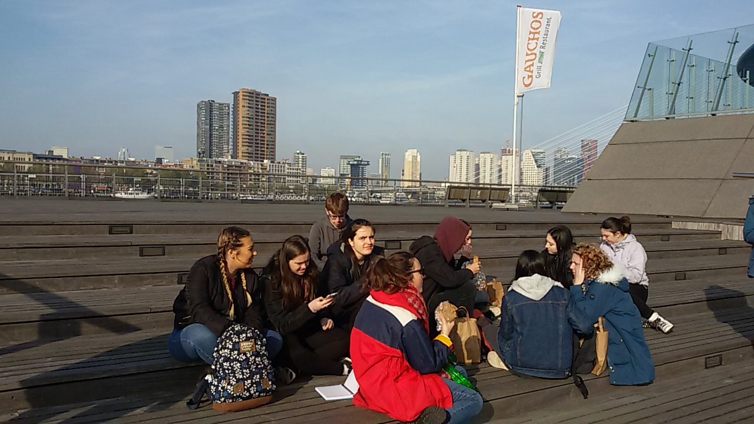

Slide 56
Political Science and International Studies: George Kyris
“my pedagogy considers students as both audience and participants to my research”
Students supported with development of research skills
Research-based formative/summative assessment co-created with students
Focus on publication of student work and co-publication with module lead

Slide 57
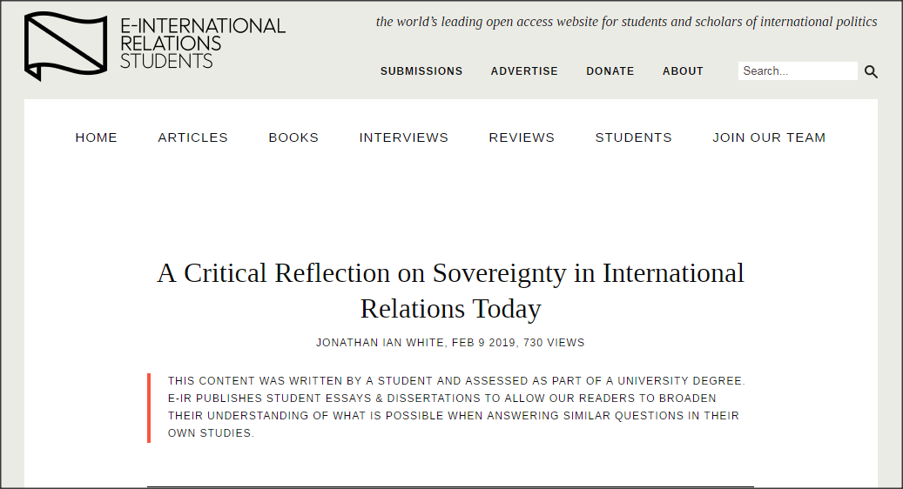
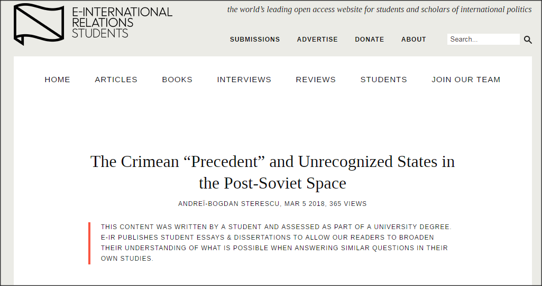
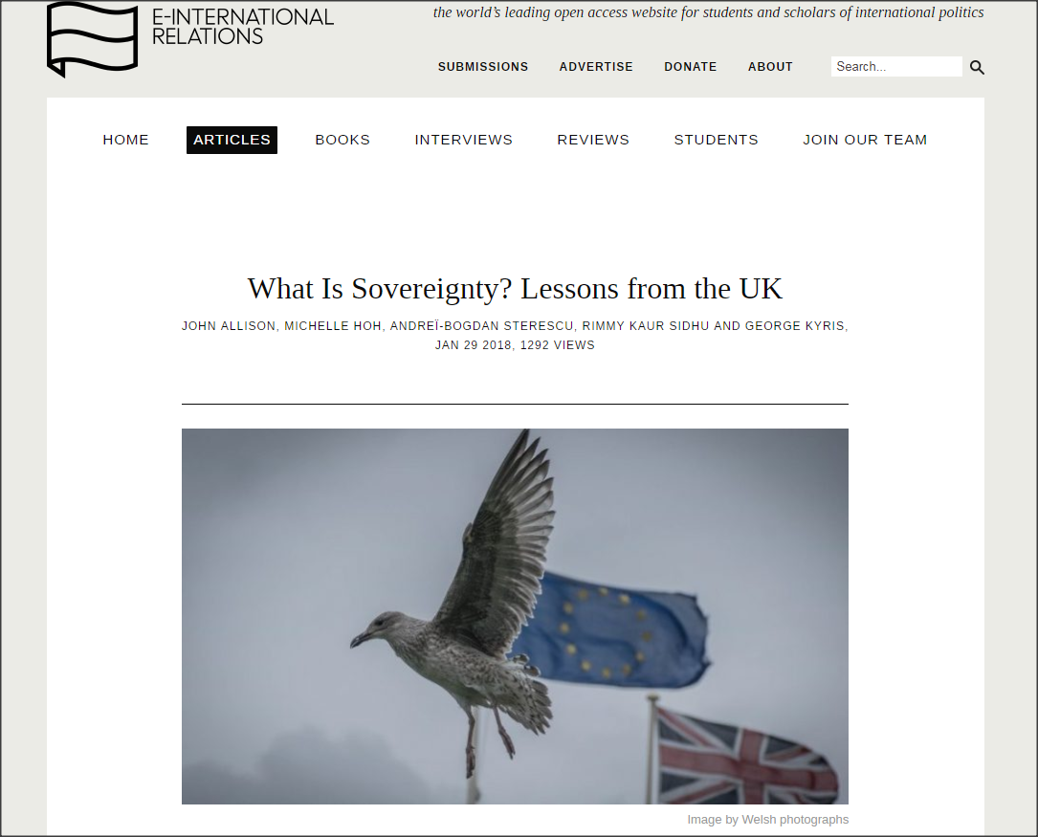

Slide 58
Biosciences
(Mary Blanchard, Debbie Cunningham,
Julia Lodge, Roisin Madigan)
Creation of an UG/MSc programme which engages UG students in research-based learning throughout the programme
Collaborative outputs such as grant applications, projects and publications
Students in collaboration with research-active staff

Slide 59
Law
Examples of research-based modules (Julian Lonbay)
Final-year module Global Legal Services
Group research project (formative) and presentation (summative) assessments
Teams select their project topic and pursue independently with guidance from module lead

Slide 60
Liberal Arts and Natural Sciences
Research-based curriculum (Julia Myatt & Simon Scott)
Learning through tasks
Embedding of research skills
Interdisciplinarity
Links to employability

Slide 61
Chemical Engineering
RILT embedded in numerous modules (Sophie Cox)
Product Design Exercise (PDE)
Evidence-based design of product for the market
Utilisation of research and employability skills

Slide 62
Next steps
Website to host resources
Workshop to be delivered within the PGCHE and to programme teams on request
Further research with College-based colleagues and publication
@mariosbham

Slide 63
References…
Allison, J., Hoh, M., Sterescu, A., Kaur Sidhu, R. & Kyris, G. (2018). What Is Sovereignty? Lessons from the UK. E-International Relations Students, 29 Jan 2018. https://www.e-ir.info/2018/01/29/what-is-sovereignty-lessons-from-the-uk/ (accessed 7 April 2019).
Boyer, E. L. Scholarship Reconsidered. Priorities of the Professoriate. NY: The Carnegie Foundation for the Advancement of Teaching.
Boyer, E.L. (1996) The scholarship of engagement. Journal of Public Service & Outreach.
Boyer Commission on Educating Undergraduates in the Research University (1998). Reinventing Undergraduate Education: A Blueprint for America's Research Universities. Carnegie Foundation for the Advancement of Teaching, Princeton, NJ.
Brew, A. (2006). Research and Teaching: Beyond the Divide. NY: Palgrave Macmillian.
Centre for Excellence in Enquiry-Based Learning (CEEBL): http://www.ceebl.manchester.ac.uk/.
Fung, D. (2017). A Connected Curriculum for Higher Education. London: UCL Press.
Grove, J. (2019). Academics fight Birmingham’s plan to cut time for research. Times Higher Education, 19 Mar 2019. https://www.timeshighereducation.com/news/academics-fight-birminghams-plan-cut-time-research (accessed 7 April 2019).
Hattie, J. & Marsh, H.W. (1996). The Relationship Between Research and Teaching: A Meta-Analysis, 66 (4) (Winter 1996), 507-542.
McGrath, F. (1951). Newman’s University: Idea and Reality. (Longmans).
Morgan, K. (2011). Where is von Humboldt’s University now? Research in Higher Education. Daigaku Ronshu 42, 325– 344. http://ir.lib.hiroshima-u.ac.jp/files/public/3/31450/20141016181556308145/DaigakuRonshu_42_325.pdf (Accessed 1 April 2019).
Newman, John Henry (1852). The Idea of a University. Project Gutenberg and Archive.org, https://archive.org/details/theideaofauniver24526gut/page/n1. (Accessed 25 March 2019).

Slide 64
…References
Pells, R. (2019). Universities urged to rule out submitting redundant staff to REF. Times Higher Education, 5 Feb 2019. https://www.timeshighereducation.com/news/universities-urged-rule-out-submitting-redundant-staff-ref (accessed 7 April 2019).
Petrova P. & Hadjianastasis , M. (2015). Understanding the varying investments in researcher and teacher development and enhancement: implications for academic developers, International Journal for Academic Development 20 (3), 295-299.
Shils, E. (1970). University Reform in Germany. Minerva 8 (2), 242-267.
Shrimpton, P. (2014). The ‘Making of Men’: the idea and reality of Newman’s university in Oxford and Dublin. Leominster, Gracewing.
Shrimpton, P. and Humphreys, J. (2014) . Unthinkable: Has Cardinal John Henry Newman’s vision for universities died?. The Irish Times. 2 December 2014. https://www.irishtimes.com/culture/unthinkable-has-cardinal-john-henry-newman-s-vision-for-universities-died-1.2017424 (accessed 5 April 2019).
Sterescu, A., The Crimean “Precedent” and Unrecognized States in the Post-Soviet Space. E-International Relations Students, 5 Mar 2018. https://www.e-ir.info/2018/03/05/the-crimean-precedent-and-unrecognized-states-in-the-post-soviet-space/ (accessed 7 April 2019).
U21 (2016). What is the Value Proposition for Students as Learners at Contemporary Research-Intensive Universities? U21 Educational Innovation Cluster Position Statement: April 2017. https://universitas21.com/sites/default/files/2018-06/EI%20Value%20Proposition%20for%20Students.pdf (Accessed 7 April 2019).
Von Humboldt, W. (1810). Über die innere und äussere Organisation der höheren wissenschaftlichen Anstalten zu Berlin. Gesammelte Schriften (Herausgegeben von der Königlich Preussischen Akademie der Wissenschaften) (Berlin: B. Behr's Verlag, 1903), 250-26. (On the spirit and the organisational framework of intellectual institutions in Berlin). Full text on the Humboldt University website, accessed 1 April 2019: https://edoc.hu-berlin.de/bitstream/handle/18452/5305/229.pdf?sequence=1&isAllowed=y .
Wertz, M. (1996). Education and Character: the Classical Curriculum of Wilhelm Von Humboldt. Fidelio, 5 (2), 29-39.
White, J.I., A Critical Reflection on Sovereignty in International Relations Today. E-International Relations Students, 9 Feb 2019. https://www.e-ir.info/2019/02/09/a-critical-reflection-on-sovereignty-in-international-relations-today/ (accessed 7 April 2019).
Yorke, H. (2017). Universities must prioritise students over their research interests, new regulator says. The Telegraph, 9 October 2017. https://www.telegraph.co.uk/education/2017/10/09/universities-must-prioritise-students-research-interests-says/ (accessed 7 April 2019).

Slide 65
Keynote Speaker:
Charting the journey of lifelong education and adult learning at the National University of Singapore
Professor Teck-Hua Ho
Senior Deputy President and Provost
National University of Singapore

Slide 66
Plenary Session and Panel Discussion:
What does this mean for the
next generation university?
Student session with Modest Lungociu, Harvey Jones, Keziah Watson, Wakaya Islam and Adam Goldstone

