Slide 1
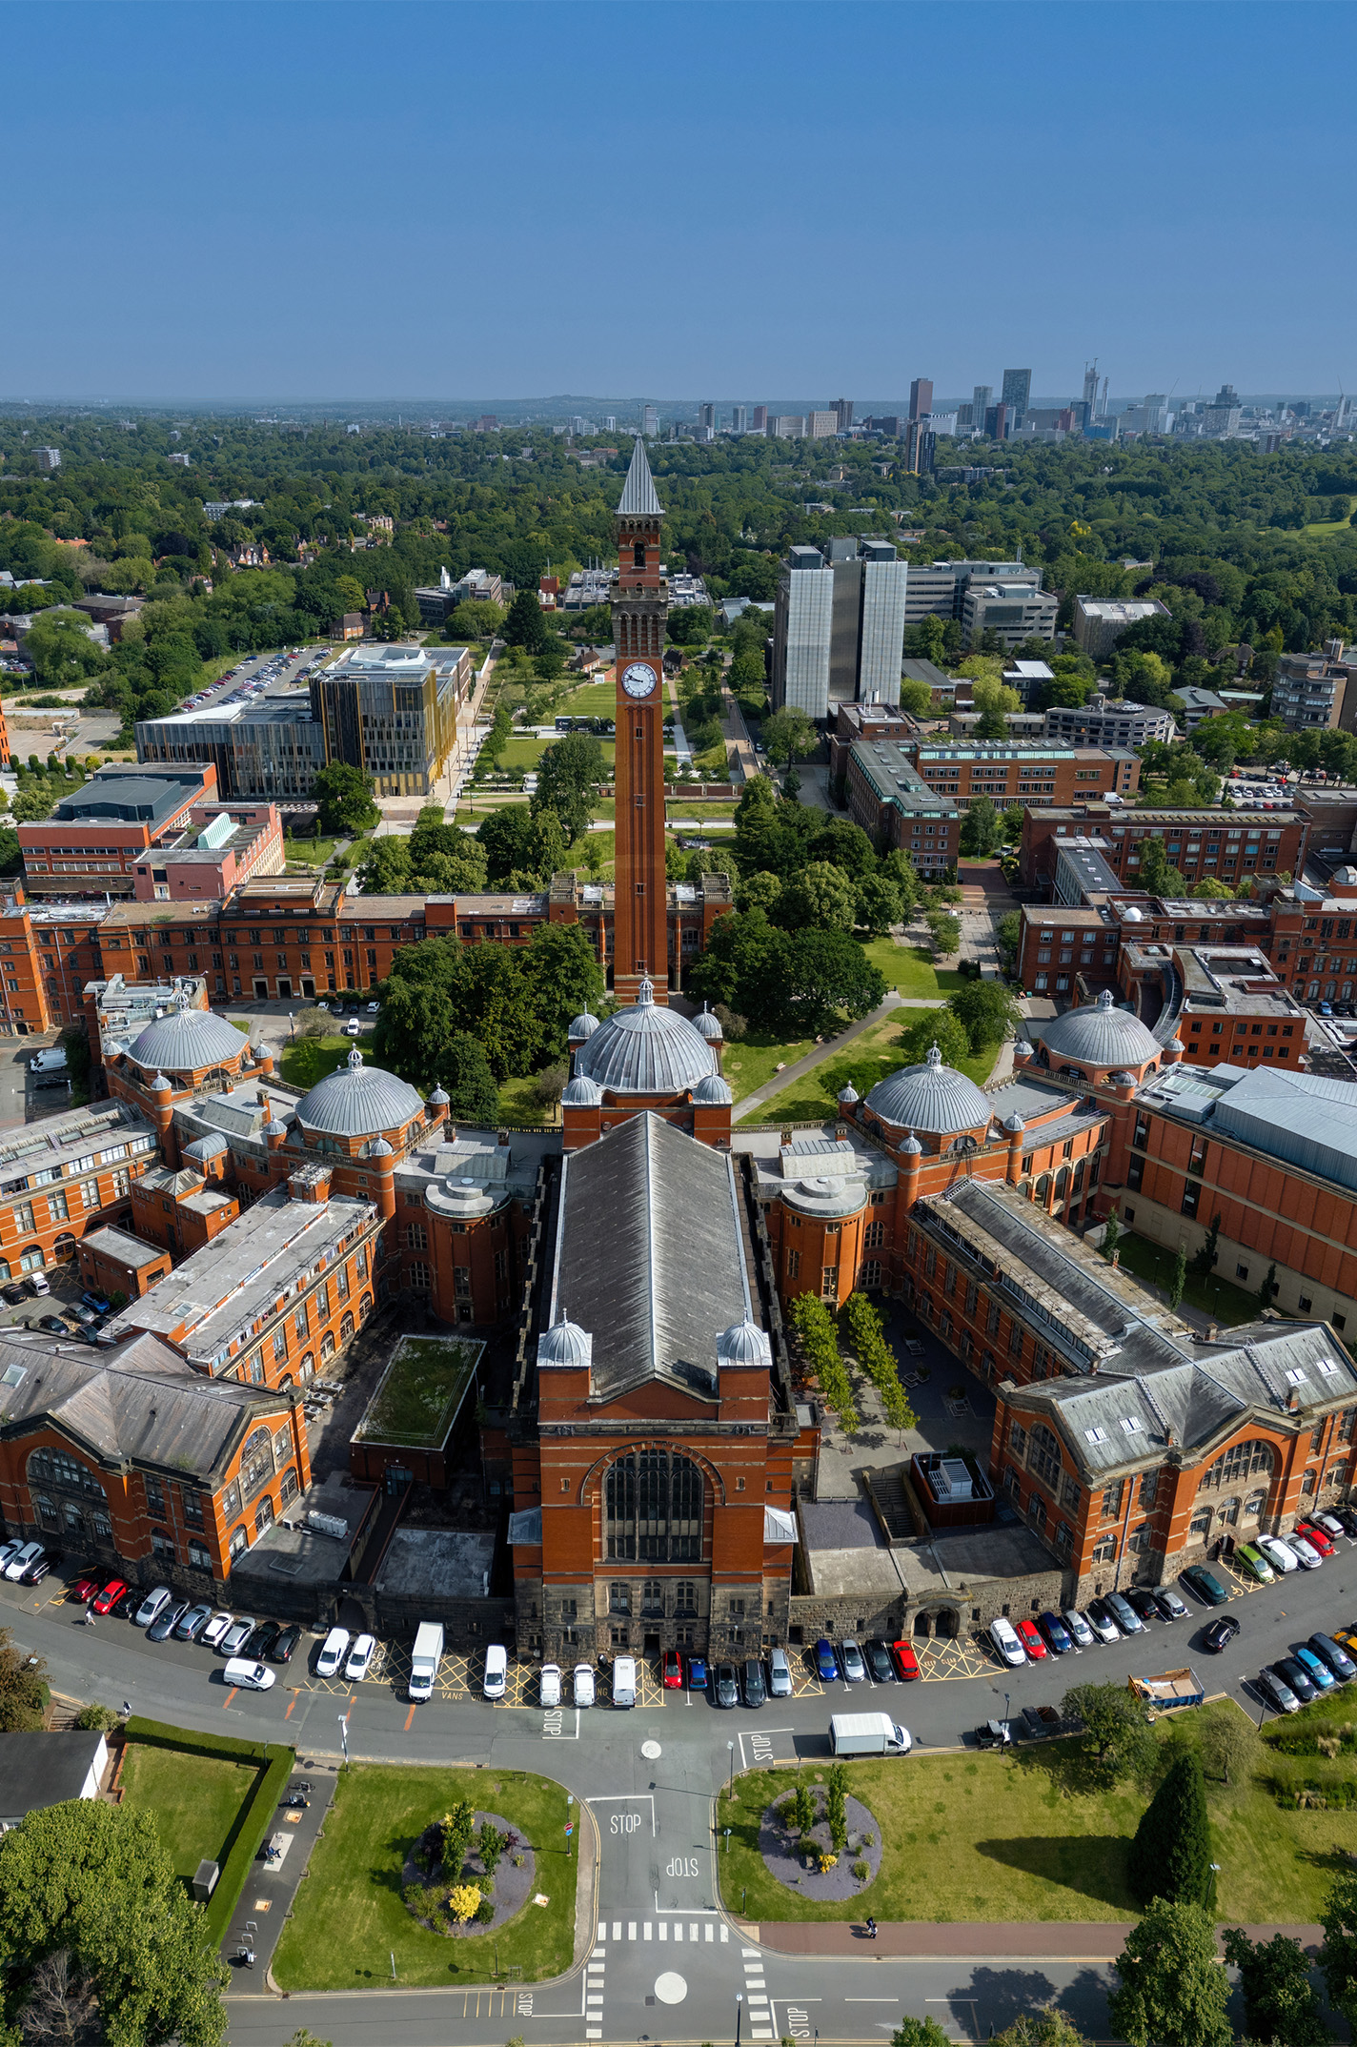
Carbon Accounting
Measuring, tracking, and reporting our Carbon Footprint
2023/24

Slide 2
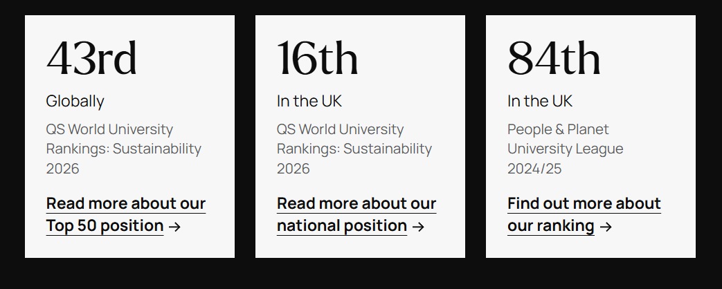
Our Approach to Sustainability at University of Birmingham
The University of Birmingham was England's first civic university, founded on social responsibility. Now, 125 years later, we see no greater responsibility than ensuring our planet thrives to support future generations. We have embodied our commitment to sustainability within our Birmingham 2030 Strategic Framework, outlining our approach to delivering positive change, not only through our research, education, operations and partnerships, but through the behaviour and actions of our students and staff, and our engagement with our local communities.
How it's going: our progress
Sustainability in Focus 2024/25
Read more about our Top 50 position
Read more about our national position
Find out more about our ranking

Slide 3
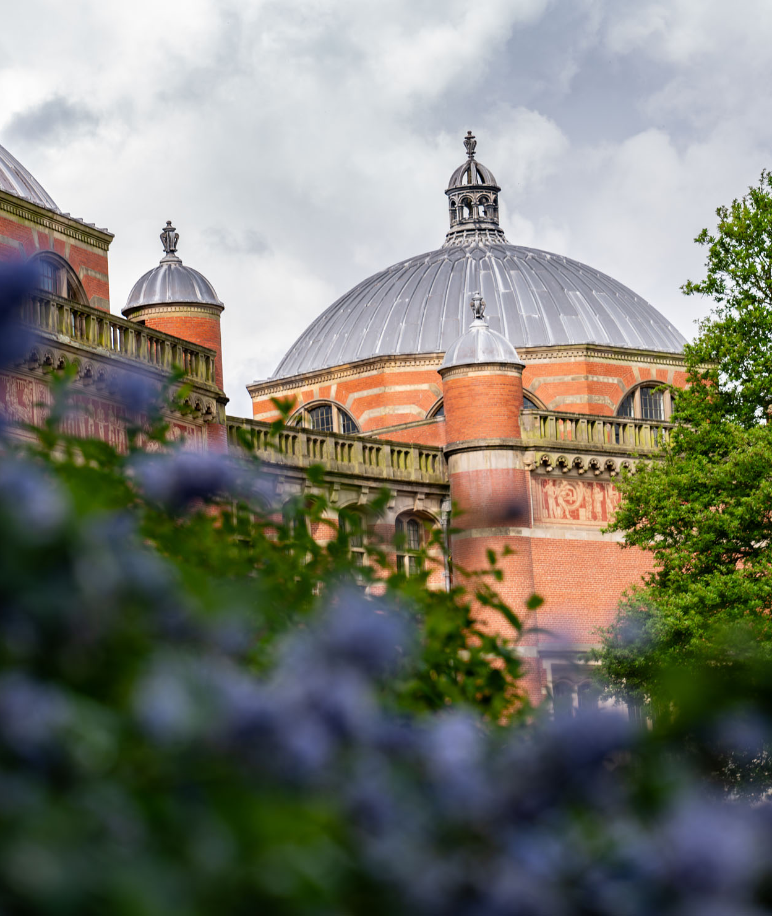
Carbon Targets
Our journey towards net zero

Slide 4
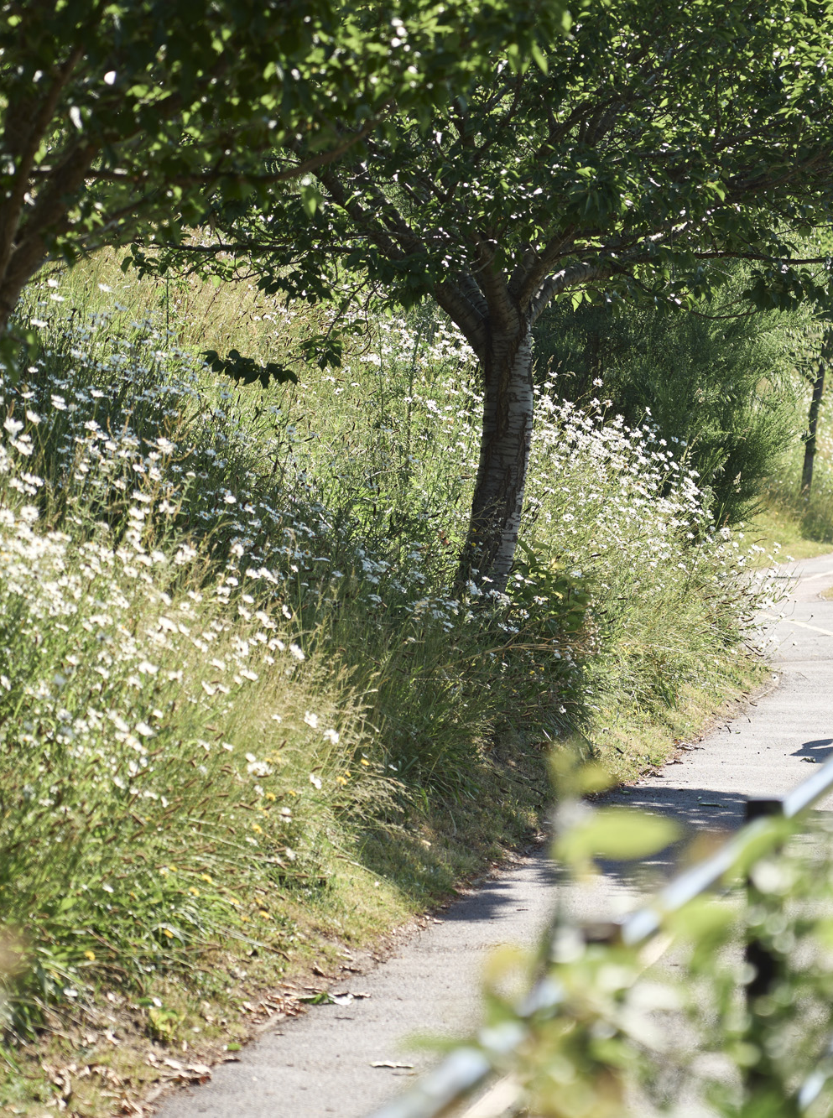
Our net zero goals
Our Strategy: We will make annual gains in reducing our carbon footprint, aiming to achieve net zero carbon for scope 1 and 2 by 2035 and overall by 2045
To track our progress to net zero, we have set interim ‘stepping stone’ targets to December 2030; these will measure our performance in the short term to ensure that we remain on the right trajectory towards achieving our net zero goals by 2045.
We aim to meet our ‘stepping stone’ reduction targets for Scopes 1 and 2 by investing in building maintenance and targeted capital improvements; we anticipate achieving our most significant reduction in Scope 1 and 2 emissions between 2030 and 2035, through the decarbonisation of our on-site energy centre and the ongoing decarbonisation of the national grid. We aim to reduce our Scope 3 supply-chain emissions by a third by 2030, adapting our internal frameworks and practices and working with suppliers who mirror our sustainability goals and values.
18% reduction in Scopes 1 & 2
20% reduction in Scopes
1 & 2;
36% reduction
in procurement
Base year
Net zero in Scopes 1 & 2
Net zero in Scope 3
2020/21
2025/26
2030/31
2035/36
2040/41
2045/46

Slide 5
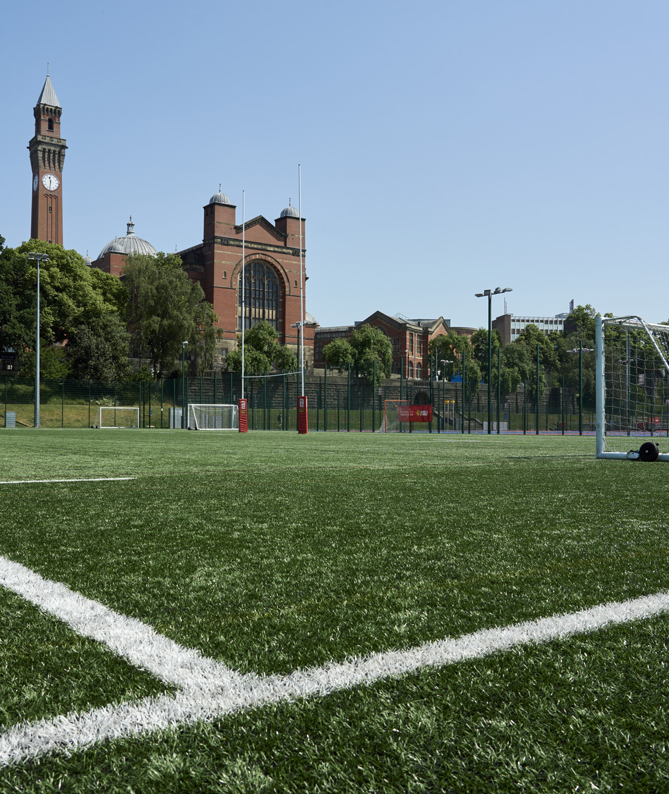
Our Progress
Performance against our baseline, and current carbon-reduction actions

Slide 6
Our overall performance 2023/24

Slide 7
Our Carbon Footprint by Scope 2023/24
Scope 1
Scope 1
Scope 1
Scope 1
Scope 2
Emissions (tCO₂e) | Emissions category
1,672 | Leased buildings (downstream)
62,587 | Student commuting and home visits
6,179 | Staff commuting and working from home
19,534 | Business travel
25 | Waste
263 | Water and wastewater
8,136 | Fuel and energy procurement emissions
165,533 | Procurement emissions
75 | Heat and steam
6,883 | Purchased electricity
42 | Other fuels
345 | Refrigerants
124 | Fleet fuel
36,122 | Natural gas
316,240
315,645
307,522
298,748
Indirect emissions that occur because of University activity, from sources we don’t own e.g., purchased goods and services, travel, disposal of waste
Scope 3
Indirect emissions that result from the generation of purchased energy that we consume, e.g., national grid electricity.
Scope 2
Emissions that come from sources that we directly own and control, e.g., combustion of fuel in boilers, furnaces, laboratory infrastructure, and university-owned vehicles.
Scope 1

Slide 8







What are we doing to reduce our Carbon Footprint?
Staff commuting and working from home
We are improving facilities and services to support staff to choose more sustainable travel, including supporting the redevelopment of University station and providing a low-emission-vehicle scheme. We have installed new electric-vehicle charging points on campus, and we provide cycling classes, an on-site cycle-repair shop, and new, secure bike stores.
Business travel
We have updated our travel guidance encouraging staff to use the most sustainable travel options available for essential travel; work is underway to create detailed travel reports to enable senior leaders to monitor travel in their area.
Waste
We have improved waste segregation across campus (including food waste) aligning with Simpler Recycling legislation. A Sustainability Manager (Circular Economy) has been appointed to implement a new Waste & Circular Economy Strategy and governance.
Water and wastewater
A programme of water audits is underway across campus to identify water efficiencies; a working group is actively looking at water efficiency opportunities in our student accommodation.
Procurement emissions
We have updated our Sustainable Procurement Policy and tender processes and worked to support and encourage more sustainable purchasing. We are working with suppliers to improve the accuracy of our supply-chain carbon reporting and offer them support to reduce their own Carbon Footprint.
Purchased electricity
We are upgrading lighting and controls across our estate; almost two thirds of our buildings have energy-efficient LED lighting installed with three additional projects to be delivered by summer 2026.
Natural gas
We are installing a heat pump to replace fossil-fuel heating and cooling at our Institute for Biomedical Research, due to complete in summer 2026. Work is underway to develop energy performance dashboards for priority buildings to help identify opportunities for improvement. Work is underway to replace outdated building energy management systems to ensure efficient control of heating, ventilation and air conditioning and minimise energy waste.

Slide 9

Our Data
A closer look at our carbon performance:
what has changed since our baseline and why?

Slide 10
Carbon performance: baseline to 2023/24
Scope | Emission category | Emissions (tCO₂e)
 |  | 2020/21 | 2021/22 | 2022/23 | 2023/24
1 | Natural gas | 42,923 | 35,208 | 35,150 | 36,122
 | Fleet fuel | 75 | 340 | 154 | 124
 | Refrigerants | 225 | 500* | 111 | 345
 | Other fuels | 192 | 17 | 23 | 42
2 | Purchased electricity | 4,652 | 6,833 | 6,426 | 6,883
 | Heat and steam | 24 | 85 | 93 | 75
3 | Procurement emissions | 191,866 | 202,948 | 163,336 | 165,533
 | Fuel and energy procurement emissions | 9,145 | 8,516* | 7,974 | 8,136
 | Water and wastewater | 185 | 168 | 210 | 263
 | Waste | 628 | 57 | 75 | 25
 | Business travel | 9,767 | 6,555 | 18,975 | 19,534
 | Staff commuting and working from home | 6,962 | 4,204* | 4,434 | 6,179
 | Student commuting (term-time and home visits) | 48,565 | 49,532* | 60,854 | 62,587
 | Leased buildings (downstream) | 1,031 | 680 | 933 | 1,672
 | Total | 316,240 | 315,645 | 298,748 | 307,522
* We have discovered errors in four of the categories in our 2021/22 carbon accounting report. These figures have been corrected here. The change amounts to a reduction of 15,347 tCO₂e from the previously published total.

Slide 11
Changes over time
The reduction in calculated procurement emissions since the base year is encouraging. While this improvement is largely driven by improvements to our methodology and data accuracy, it provides a more reliable foundation to measure and report progress. We are actively working to reduce emissions by spending less, where viable, and spending with suppliers who share our sustainability and climate commitments.
Travel emissions have increased since our baseline year, partly due to the Covid-19 pandemic, when travel restrictions significantly reduced our activity. Travel remains essential to teaching, research, and developing partnerships and our priority is to ensure that essential staff and student travel is undertaken using the most sustainable options available. Travel is one of the more challenging areas in which to reduce environmental impact; we are continuing to explore solutions that enable essential activity whilst lowering emissions over time.
7 of the 14 emissions
categories account for
99%
of our emissions

Slide 12
Our energy mix
We anticipate that purchased electricity will make up an increasing proportion of our energy mix over time, as we move away from fossil-fuel heating across campus. Between 2030 and 2035, we propose to decarbonise our energy supply by moving away from natural gas in favour of clean power, provided by the national grid.
10%
16%
15%
16%
90%
84%
85%
84%

Slide 13
Carbon intensity
Carbon intensity is a measure of our carbon efficiency. Our carbon performance in absolute terms is outlined on slide 10; this slide shows another way of analysing our performance: environmental efficiency. For this we can look at carbon emissions per person and per square metre of our campus buildings. The smaller the number the better – a lower carbon intensity indicates a greater environmental efficiency and smaller climate impact per person or per square metre of our campus buildings.
Our environmental efficiency per person is unchanged – our carbon emissions per person have stayed relatively constant
We have improved our environmental efficiency comparative to the size of our estate (buildings), emitting less carbon per square metre despite expanding the campus

Slide 14

Key changes 2022/23
The carbon intensity of flying increased in 2023, with the Government’s emissions factors for:
Short-Haul Economy
up 21%
Long-Haul Economy
up 35%
+23%
Our student body grew by 10%, and we adopted a new tool for estimating student home- travel emissions more accurately.
+189%
-20%
Business travel increased
following the Covid-19 pandemic, returning towards previous, ‘normal’ levels.
A more accurate, supplier-specific carbon calculation method was applied, to more of our procurement spend in 2022/23 than previously carried out (15%).

Slide 15
Key changes 2023/24
+3%
We are getting more mature in our understanding and reporting of student travel.
The same improvements
raised calculated staff commuting emissions by 39%.
+3%
Business travel emissions rose by another 3%, due to actual increases in travel.
+1%
This year we spent less with the suppliers for which we use a supplier-specific method (only 5% of our total expenditure).
Our overall spend went down by 11%, so it is likely that our real emissions decreased (as opposed to reductions derived from data accuracy)

